Slide 1
POC
Jira → GitLab
Sync Service
Automated replication of Jira Stories, Bugs & Tasks
to GitLab milestones using a .NET 8 Windows Service
.NET 8 · Windows Service · Jira REST API v3 · GitLab REST API v4

Slide 2
Problem Statement
Three challenges driving the need for this sync service
Limited Jira Access — Entire Team Cannot See Work Items
1
Stories and Bugs are created and managed in Jira, but only a few team members have Jira licences. Developers, QA, and other contributors who work in GitLab daily have no visibility into planned work items, sprint scope, or ticket details — creating a blind spot across the team.
Disconnected Tools — Code in GitLab, Work Tracking in Jira
2
All code repositories live in GitLab which every team member can access, but sprint planning, stories, and bugs remain siloed in Jira. Developers must context-switch between two systems to understand what to build, making it difficult to track sprint progress or link commits to work items.
Manual Work Tracking — Team Managing Tasks & Status in Excel
3
Without access to Jira or a shared system, team members resort to maintaining tasks, assignments, and work status in Excel spreadsheets. This leads to version conflicts, stale data, no sprint-wise progress tracking, and zero traceability between work items and the actual code being delivered.
Jira → GitLab Sync Service | POC

Slide 3
Solution Benefits
What the team gains by syncing Jira to GitLab
👥
Whole Team Visibility
🗂️
Single Source of Truth
📅
Sprint-wise Progress Tracking
Every team member — developer, QA, designer — can view sprint stories, bugs and tasks directly in GitLab without needing a Jira licence.
Replaces fragmented Excel sheets with structured GitLab issues. Work status, assignees and story points are always up to date and version-controlled.
Tickets are mapped to GitLab milestones matching the current sprint. Teams can track velocity, completion rate and sprint health directly in GitLab.
🔗
Code ↔ Work Item Traceability
⚡
Zero Manual Effort
📊
Better Reporting & Retrospectives
With issues in GitLab, developers can reference ticket IDs in commits and merge requests — linking code changes directly to the business requirement.
The service runs automatically every 15 minutes. No copy-pasting, no spreadsheet updates — the sync is fully hands-free once deployed.
GitLab burndown charts, issue boards and milestone reports give the team accurate sprint data for retrospectives and stakeholder updates.
✓ No Jira licence needed for developers ✓ Replaces Excel tracking ✓ Sprint progress in GitLab ✓ Fully automated
Jira → GitLab Sync Service | POC

Slide 4
Solution Overview
A .NET 8 Windows Service that automatically replicates Jira tickets to GitLab on a configurable schedule
Jira Cloud
Sync Service
GitLab
Stories · Bugs · Tasks
→
.NET 8 Windows Service
→
Issues · Milestones
⏱ Scheduled Sync
🎯 Smart Routing
🔁 Create & Update
Runs every 15 min (configurable). Auto-retry on failure.
Active milestone today → sprint. No milestone → Backlog.
New tickets are created; existing ones are updated in place.
🏷 Field Mapping
📝 Full Logging
⚙️ Config-Driven
ID, Description, Assignee, Dates, Story Points all synced.
Microsoft ILogger with Debug/Info/Warn/Error levels.
All settings in appsettings.json — no recompile needed.
Jira → GitLab Sync Service | POC

Slide 5
Architecture
Layered .NET 8 service with clean separation of concerns
Worker Layer
Timer loop · Retry logic · Graceful shutdown
SyncWorker (BackgroundService)
↓
Orchestration Layer
Milestone routing · Create vs Update decision · Error isolation per ticket
SyncOrchestrator
↓
Service Layer
REST API clients · Pagination · User lookup · Milestone cache
JiraService + GitLabService
↓
Model Layer
Typed DTOs · ADF → plain-text · Field resolution
JiraModels · GitLabModels · SyncTicket
Jira → GitLab Sync Service | POC

Slide 6
Field Mapping
How Jira ticket data maps to GitLab issue fields
Jira Field
GitLab Field
Notes
Story / Bug / Task Key
Issue title prefix [PROJ-42]
Enables duplicate detection on re-sync
Summary
Issue title (after prefix)
Full summary preserved
Description (ADF)
Issue description (Markdown)
Atlassian ADF flattened to plain text
Assignee display name
Assignee (matched by name/email)
Skipped on free-tier GitLab (403)
Sprint start date → end date
Shown in description: From → To
Also drives milestone selection
Story Points (customfield)
Issue weight
Tries 3 common custom field names
Issue type
GitLab label (story / bug / task)
Configurable via LabelMappings
Jira → GitLab Sync Service | POC

Slide 7
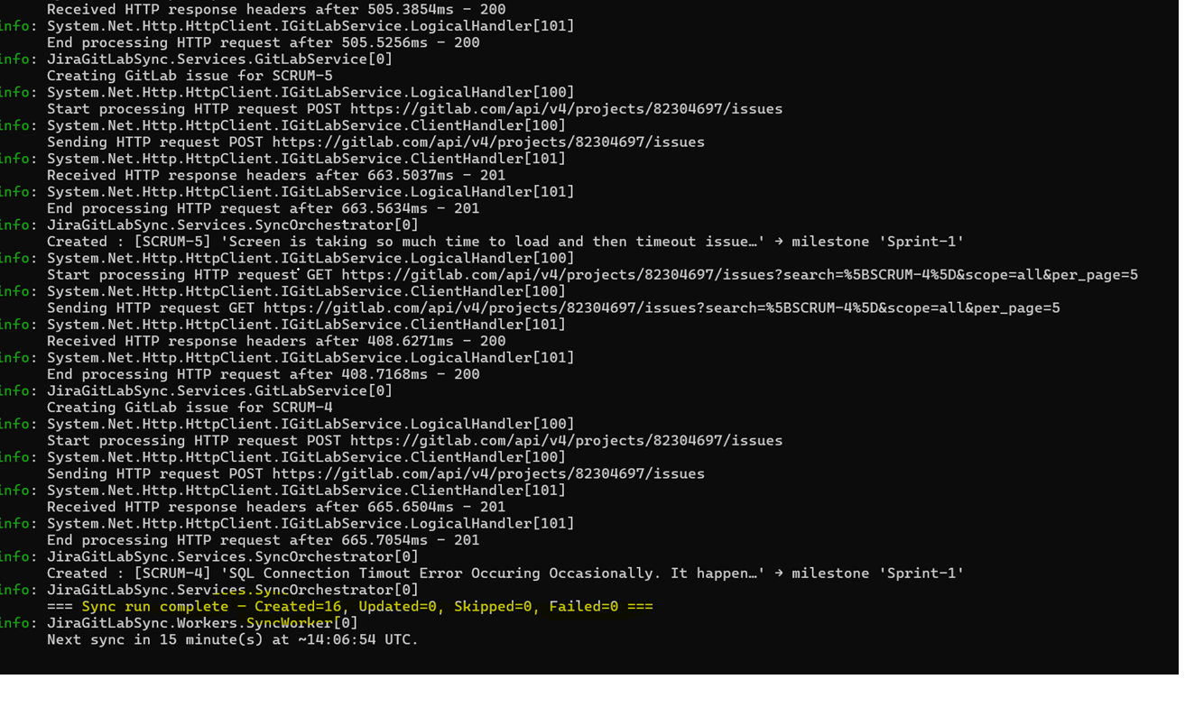
Execution Screenshots
Jira → GitLab Sync Service | POC

Slide 8
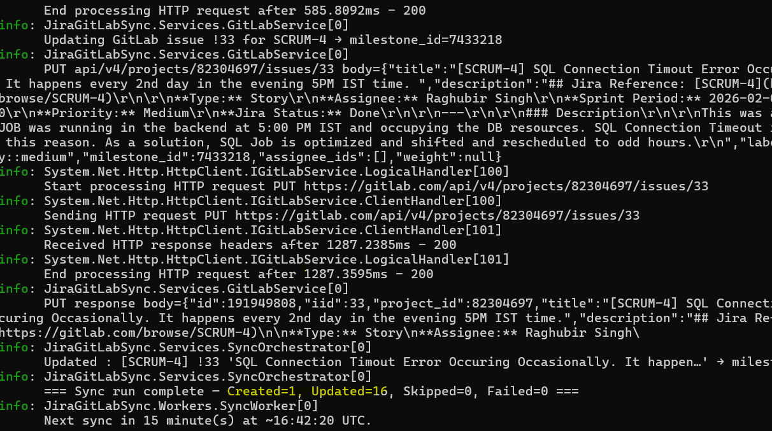
Execution Screenshots
Jira → GitLab Sync Service | POC

Slide 9
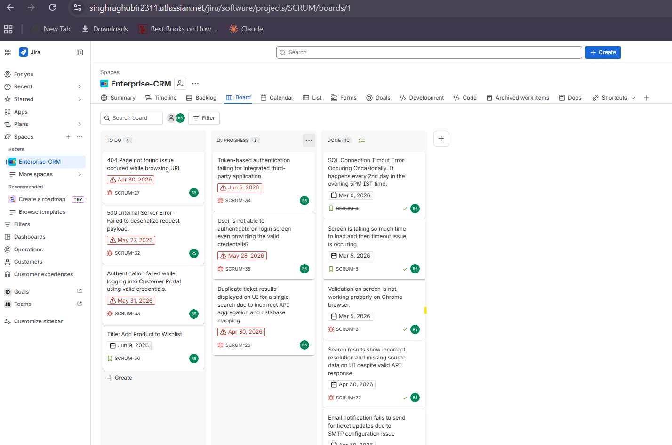
Jira Tickets - Screenshot
Jira → GitLab Sync Service | POC

Slide 10
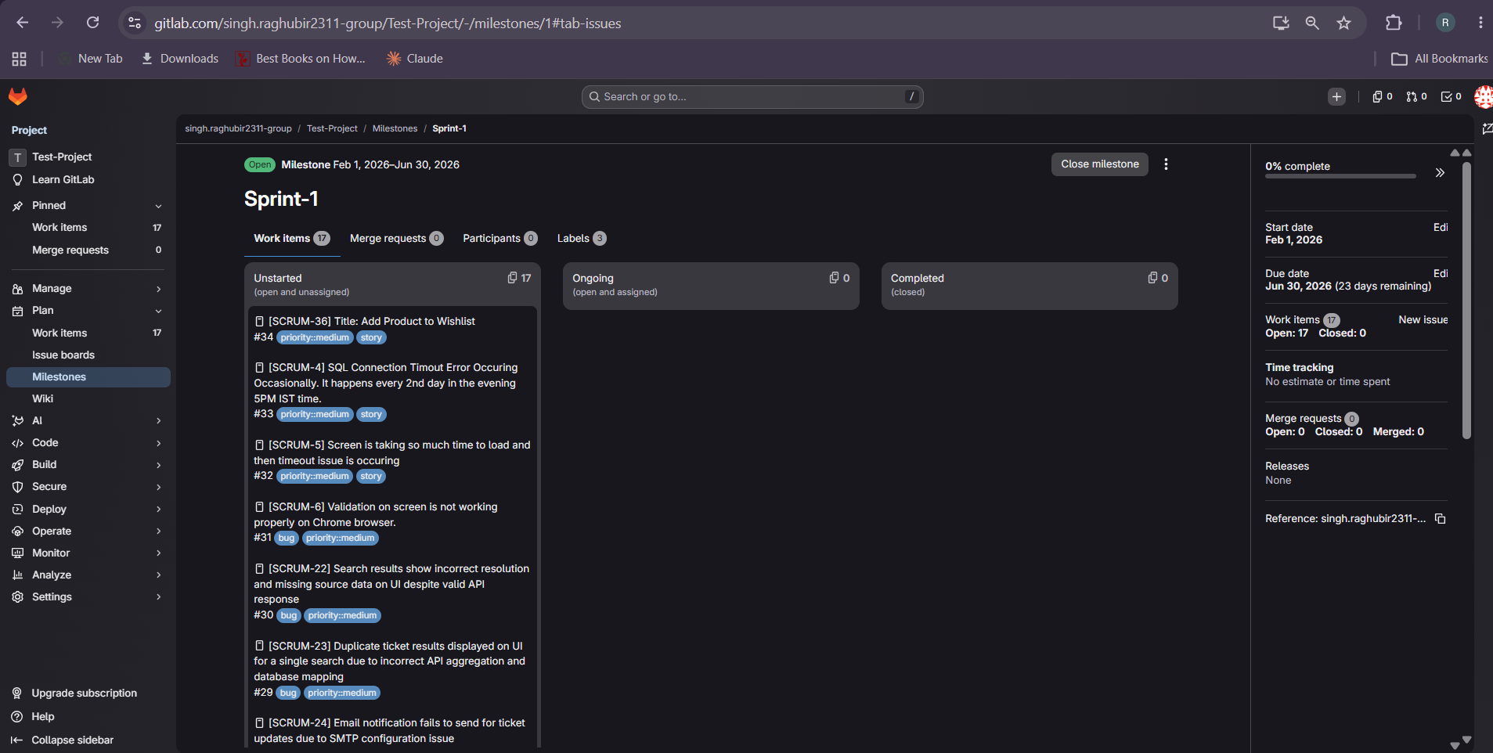
Replicated Jira Tickets to GitLab - Screenshot
Jira → GitLab Sync Service | POC

Slide 11
Jira and GitLab Authorization
Setup on Atlassian Developer Console
Step 1 — Create an OAuth App:
Go to https://developer.atlassian.com/console/myapps/
Click Create → OAuth 2.0 integration
Give it a name e.g. JiraGitLabSync
Click Create
Step 2 — Add permissions:
Go to Permissions tab
Add Jira API → enable read:jira-work
Step 3 — Get your credentials:
Go to Settings tab
Copy Client ID and Client Secret
Step 4 — Get Cloud ID:
https://singhraghubir2311.atlassian.net/_edge/tenant_info
Setup on GitLab
Step 1 — Create an OAuth App:
Go to GitLab → User Settings → Applications (or https://gitlab.com/-/profile/applications)
Fill in:
Name: JiraGitLabSync
Redirect URI: http://localhost (required field, not actually used)
Scopes: check api
Click Save application
Copy the Application ID (Client ID) and Secret
Jira → GitLab Sync Service | POC

