Slide 1








Slide 2

Data Analysis on Movies (IMDB)
Presented By :
Ch.Rakesh Yadav : 7702393847
N Raghu Suraj : 6370049788

Slide 3
CONTENTS
Objectives
Libraries Used
Website
Web Scraping
Challenges Faced
Summary
Exploratory Data Analysis
Conclusion

Slide 4
OBJECTIVES
Our Analysis basically on finding top reviews and rating in IMDB .
Our Analysis on finding top grosser movies in IMDB.
Exploratory Data Analysis on our dataset to find top most rated movies & top grosser movies in IMDB .

Slide 5
Libraries Used
Requests
BeautifulSoup
Pandas
Seaborn
RegEX
Matplotlib
Numpy

Slide 6

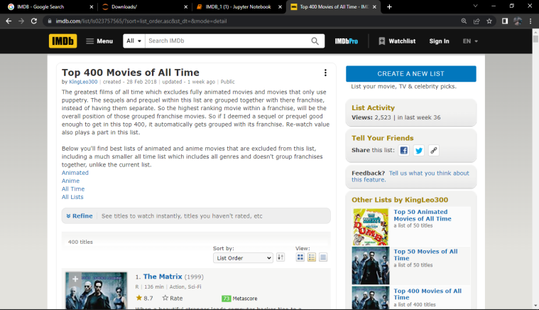
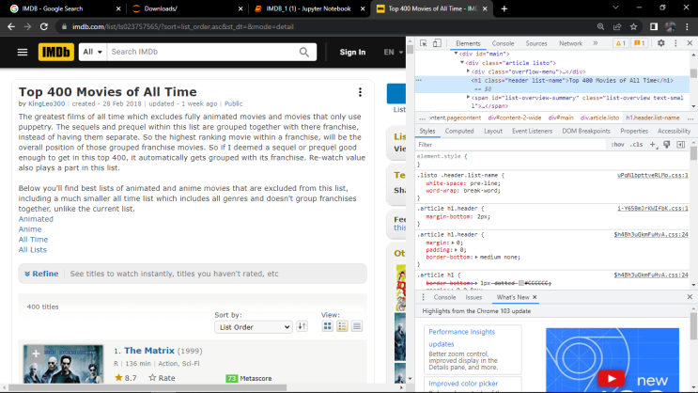
Websites
https://www.imdb.com/list/ls023757565/
https://www.imdb.com/list/ls023757565/?sort=list_order,asc&st_dt=&mode=detail&page=2
https://www.imdb.com/list/ls023757565/?sort=list_order,asc&st_dt=&mode=detail&page=3
https://www.imdb.com/list/ls023757565/?sort=list_order,asc&st_dt=&mode=detail&page=4

Slide 7
Web Scraping
To Extract data using web scraping with python, you need to follow these basics
URL that you want to scrape
Inspecting Page
Find Data which you want to extract
Enter the code
Run Code and extract the data
Store data in a DataFrame format

Slide 8
Challenges Faced
Gathering data from various websites
Creating dataframe from a raw data
Sorting columns in ascending order based on ratings
Removing unwanted characters like($,(),M)
Removing Nul Values.
Converting columns to specific datatypes like converting objectives into integers.

Slide 9
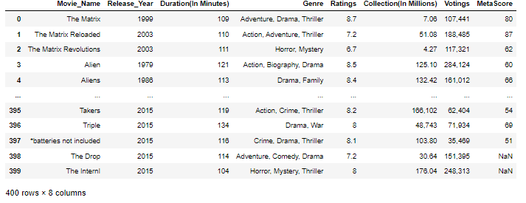
Summary
From the above libraries and code used , we are now able to make dataframe and compare the number of movies between 2 particular numbers.
Our dataset contains 400 unique rows and 8 unique columns .

Slide 10
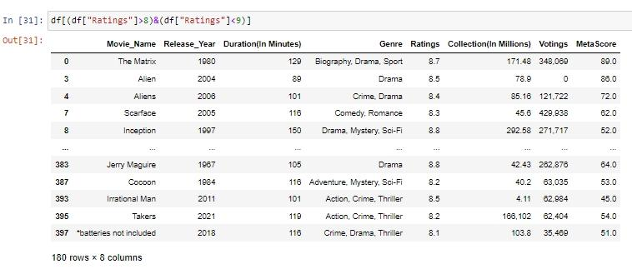
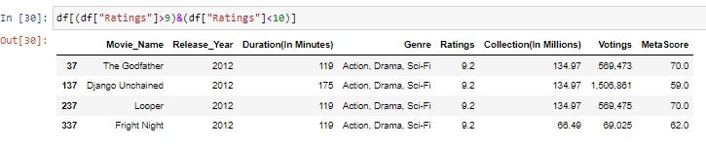
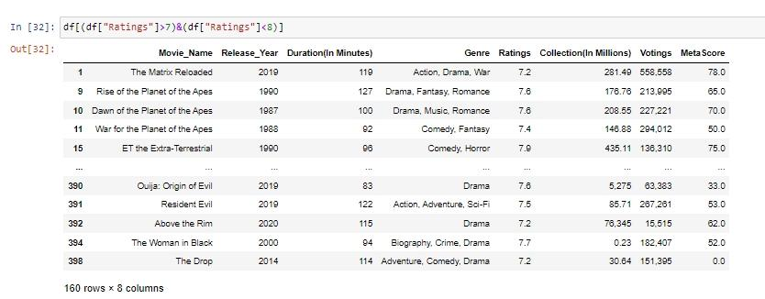
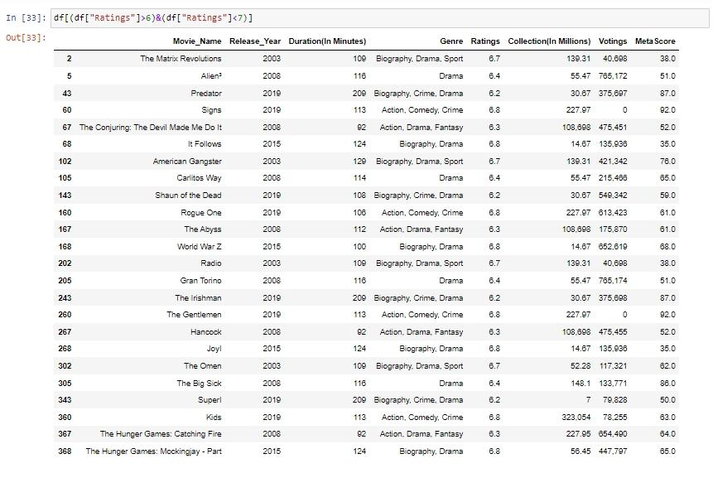
Number of Rated Movies

Slide 11
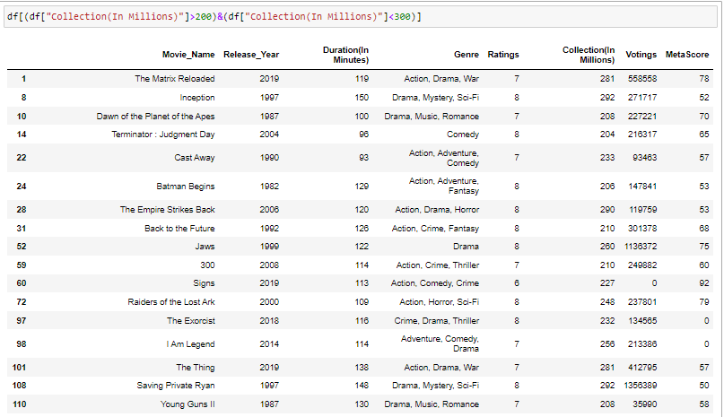
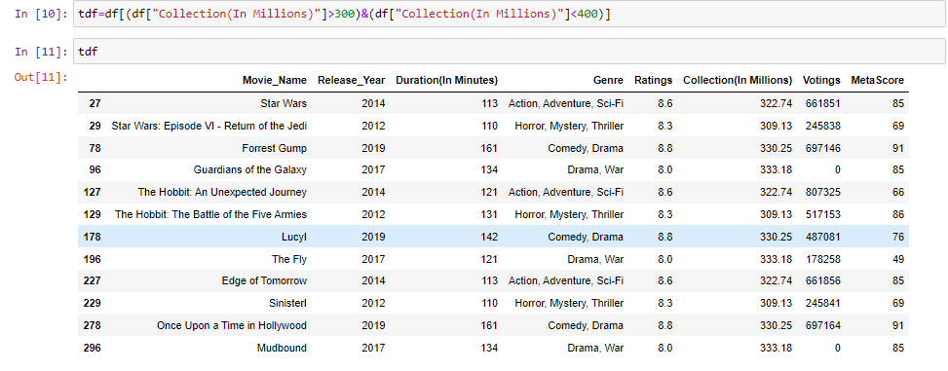
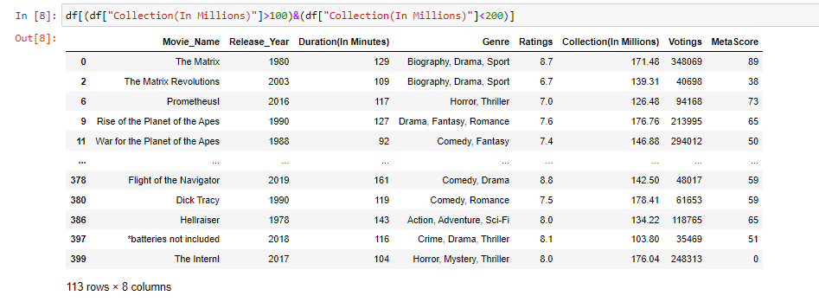
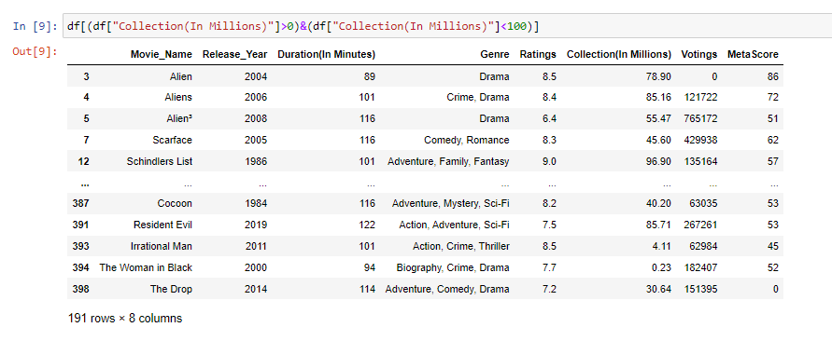
Number of Top Grosser Movies

Slide 12
Exploratory Data Analysis
Exploratory Data Analysis is a method of evaluating or data in order to derive insights or key characteristics. EDA is a critical component of data science or machine learning process.
TYPES OF EXPLORATORY DATA ANALYSIS :
Univariate Graphical
Bi-Variate Graphical
Multi-Variate Graphical

Slide 13
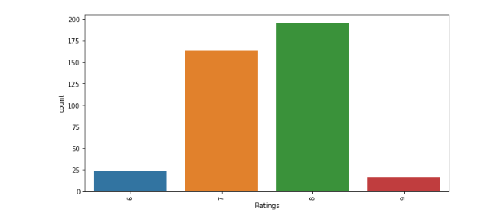
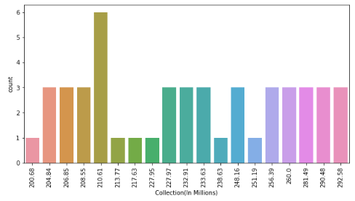
Univariate
Countplot
Ratings Collections

Slide 14
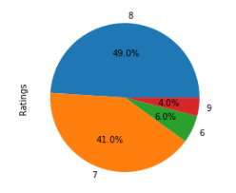
Pie Chart

Slide 15
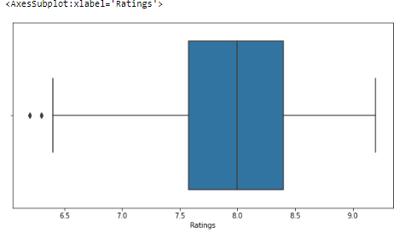
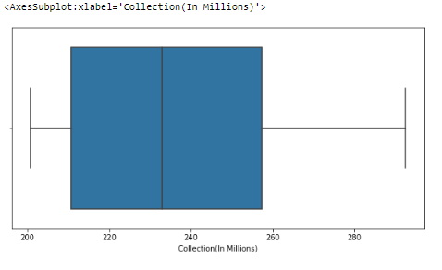
Boxplot

Slide 16
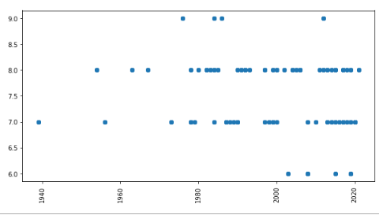
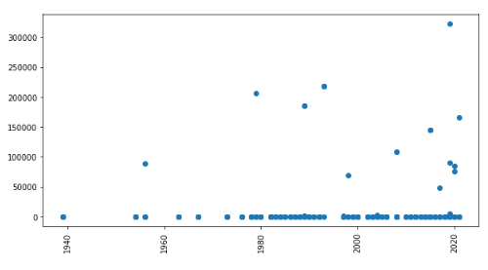
Bi-Variate
Scatter Plot

Slide 17
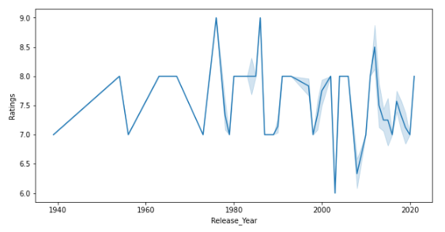
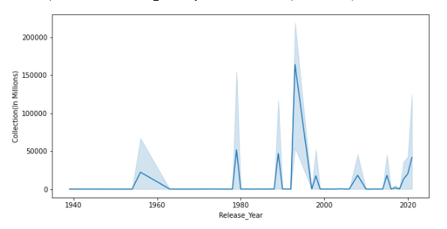
Line Chart

Slide 18
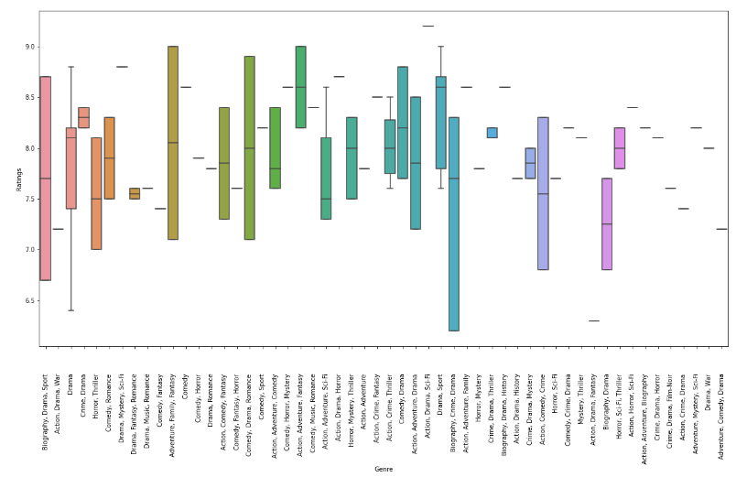
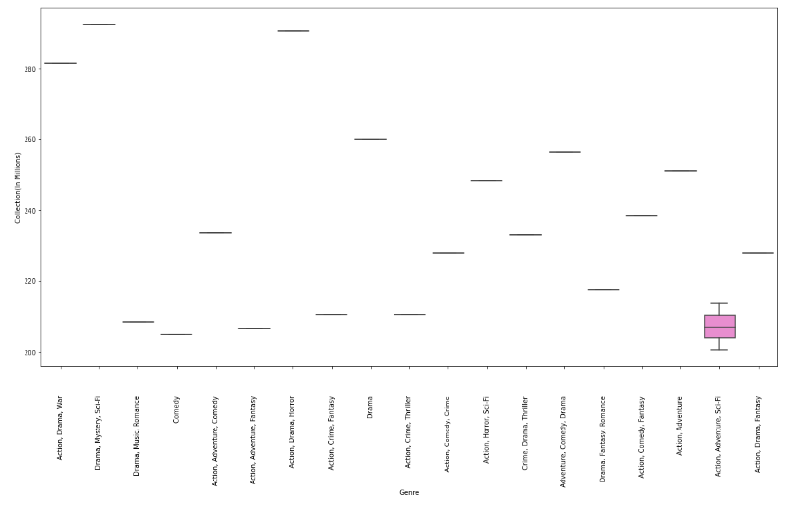
Boxplot(Bi-Variate)

Slide 19
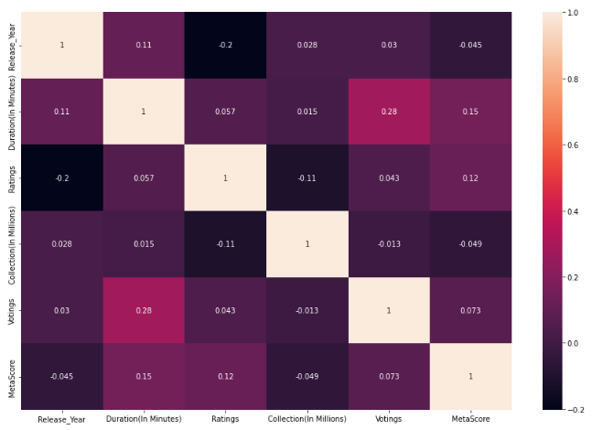
Multi-Variate
Correlation (Heatmap)

Slide 20
Conclusion
From the above observation we can say that collections and ratings are positively correlated with release year. We are recommending to users to watch top rated movies .

Slide 21

THANK YOU

