Slide 1

Amazon Sales Performance Analysis: 2022 Q1-Q4 Overview
This presentation outlines key findings from our Amazon sales data, highlighting trends and opportunities for growth.
by RAGHU VARMA

Slide 2





Rigorous Data Preparation Process
Cleaned Data
Standardized Fields
Streamlined Columns
Removed duplicates and null values
Consistent dates and categories
Dropped irrelevant data points
Created Helper Fields
Added weekday, fast delivery status

Slide 3
Sales Performance Snapshot
₹7.85Cr
1.29L
₹2.05Cr
₹648
Total Revenue
Total Orders
April Peak
Avg. Order Value
Strong sales performance
High volume of customer purchases
Highest revenue month
Consistent customer spend
MONTHLY SALES

Slide 4








Key Product Insights
Top Apparel
Popular Sizes
T-shirts, shirts, blazers
M & L (34.2% share)
Watches Lag
Seasonal Peaks
Only one sale recorded
T-shirts, shirts in Apr-Jun,
Perfumes in May,

Slide 5
Fulfillment & Delivery Efficiency
70%
37%
69%
85%
Amazon Orders Handled
Merchant Return Rate
Expedited Delivery Demand
On-Time Delivery
Merchants face a significant 37% return/cancellation rate, indicating a key area for improvement.
Amazon achieves 85% on-time delivery for orders it handles, demonstrating strong operational efficiency.
Amazon handles 70% of orders, with 85% on-time delivery, showcasing strong operational efficiency.
A high preference for speed is evident as 69% of orders choose expedited delivery options.

Slide 6




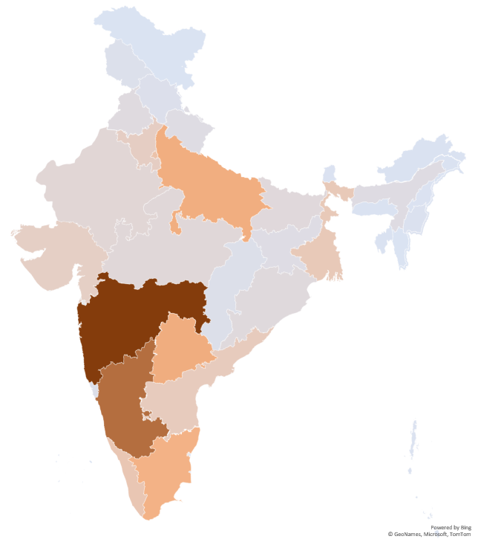
Understanding Regional Demand
Top States
MH, KA, TS drive 48% of orders
Leading Cities
Bengaluru (11.8k orders), Hyderabad (9.1k orders)
Urban Dominance
3x higher sales than rural areas
State Preferences
Maharashtra favors t-shirts, shirts

Slide 7
Customer Segmentation Overview
B2C Dominance
99.3% of all orders are business-to-consumer.
Metro Preferences
Customers in metropolitan areas prefer faster shipping options.

Slide 8






Strategic Recommendations for Growth
Sales Strategies
Push summer combos in top states; promote underperformers
Inventory Optimization
Stock more M/L/XL sizes; establish local hubs
Customer Experience
Train merchants, offer shipping discounts, alert on cancellations

Slide 9




Key Takeaways
Seasonal and Product-Driven Sales
Fast Shipping Critical in Metros
Sales performance influenced by category and time of year.
Expedited delivery preferred by urban customers.
Merchant Order Improvement Needed
Actionable Insights for Growth
High return/cancellation rates from merchant orders.
Data-driven changes lead to satisfaction and revenue.

Slide 10
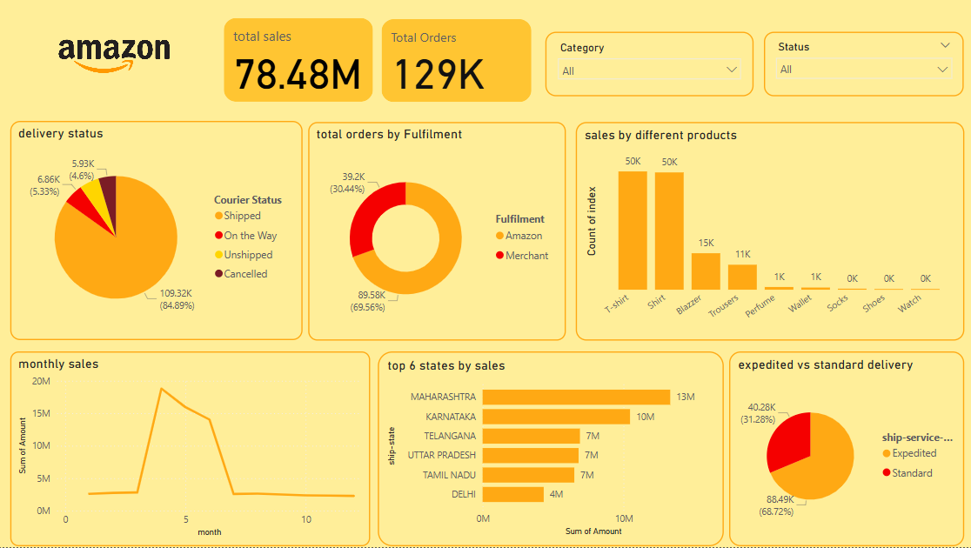
Appendix: Data Details
Dashboard image

Slide 11
Appendix: Data Details
Pivot tables used:
- Sales by Category & Order Count
- Quantity by Size Distribution
- Fulfillment Method vs. Delivery Status
- Expedited vs. Standard Delivery Split
- Sales by Month & Seasonality
- Sales by Weekday Pattern
- State-Level Sales Heatmap
- Top 20 Cities by Order Volume
- B2C vs. B2B Order Breakdown
- Preferred Delivery Type in Major Cities

