Slide 1
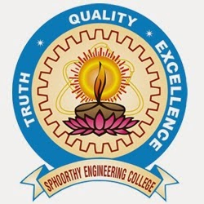
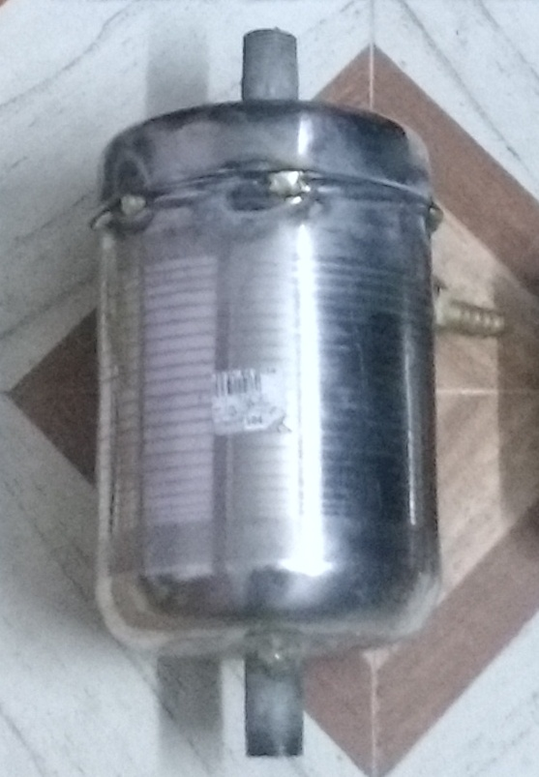

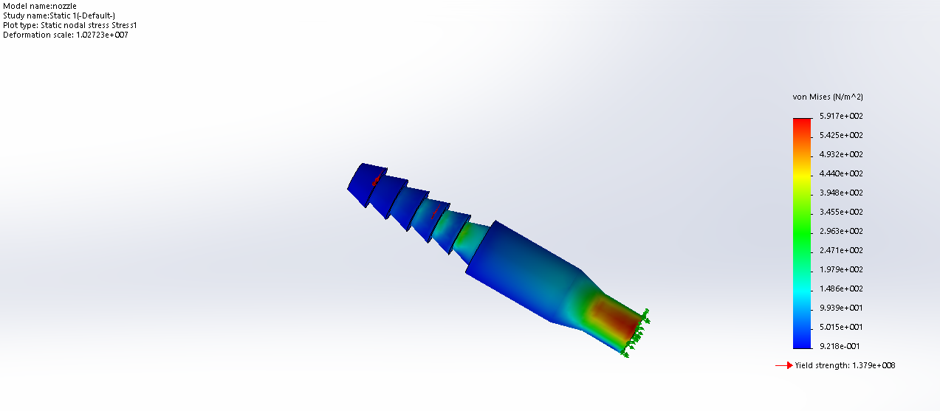
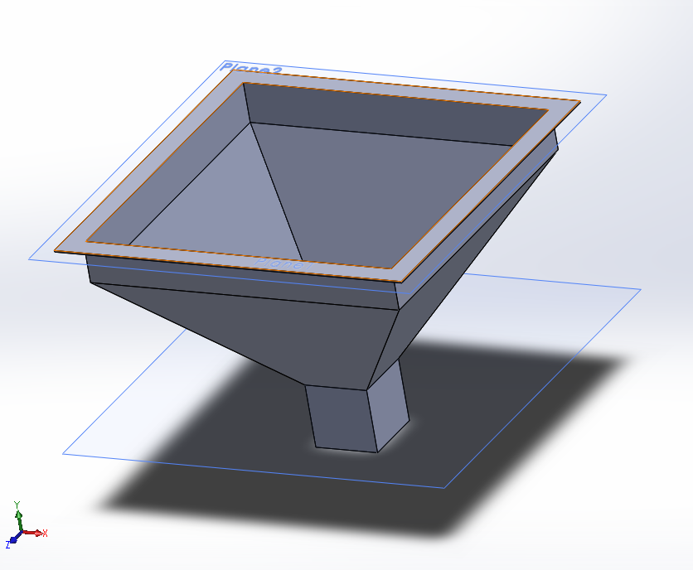
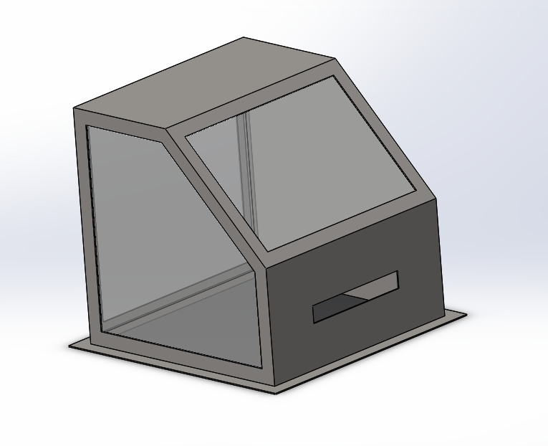
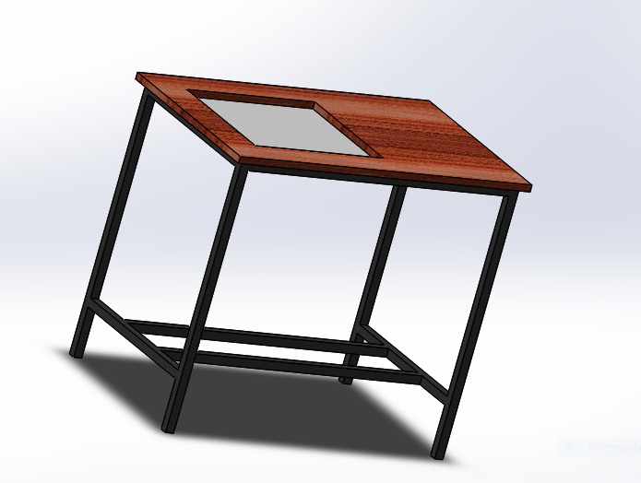
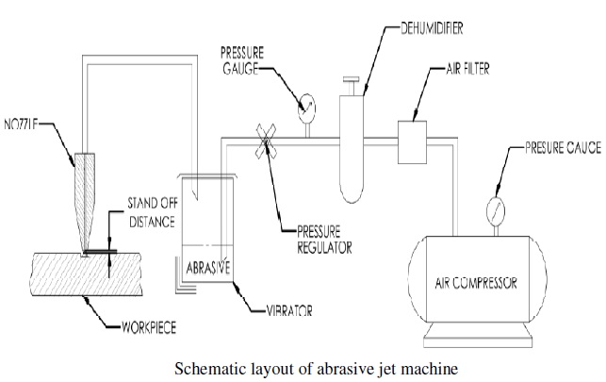
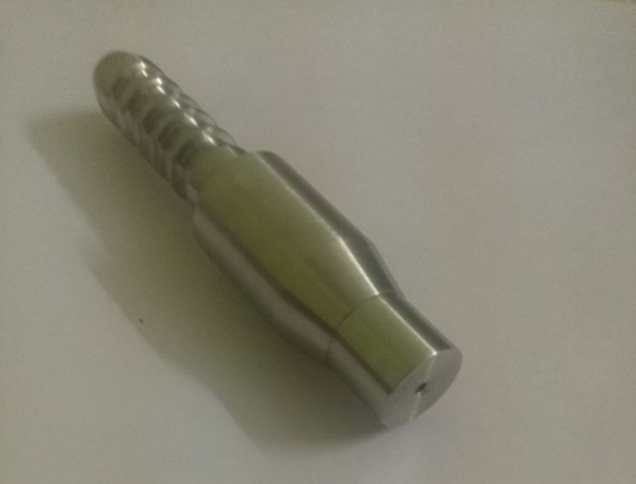
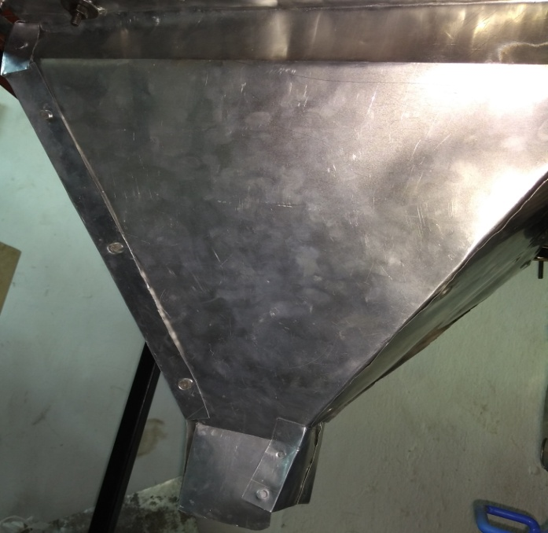
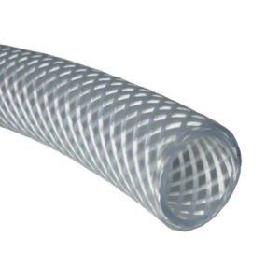
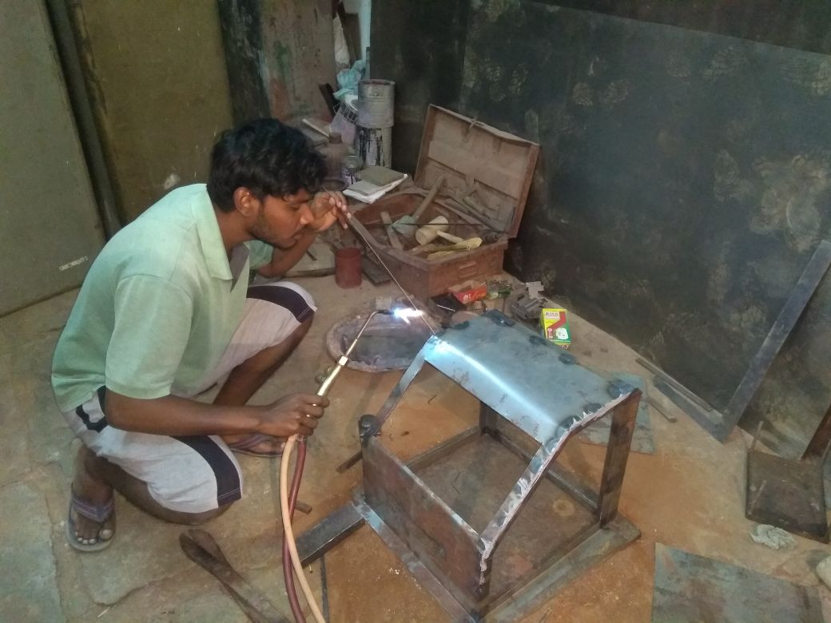
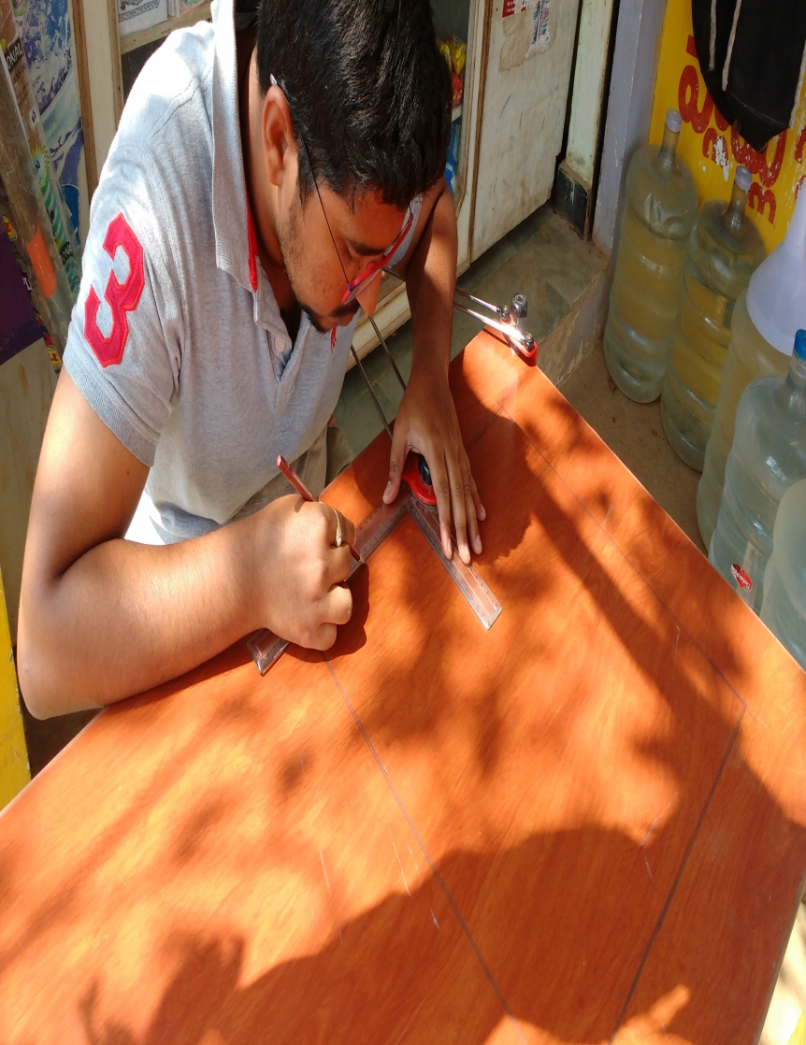
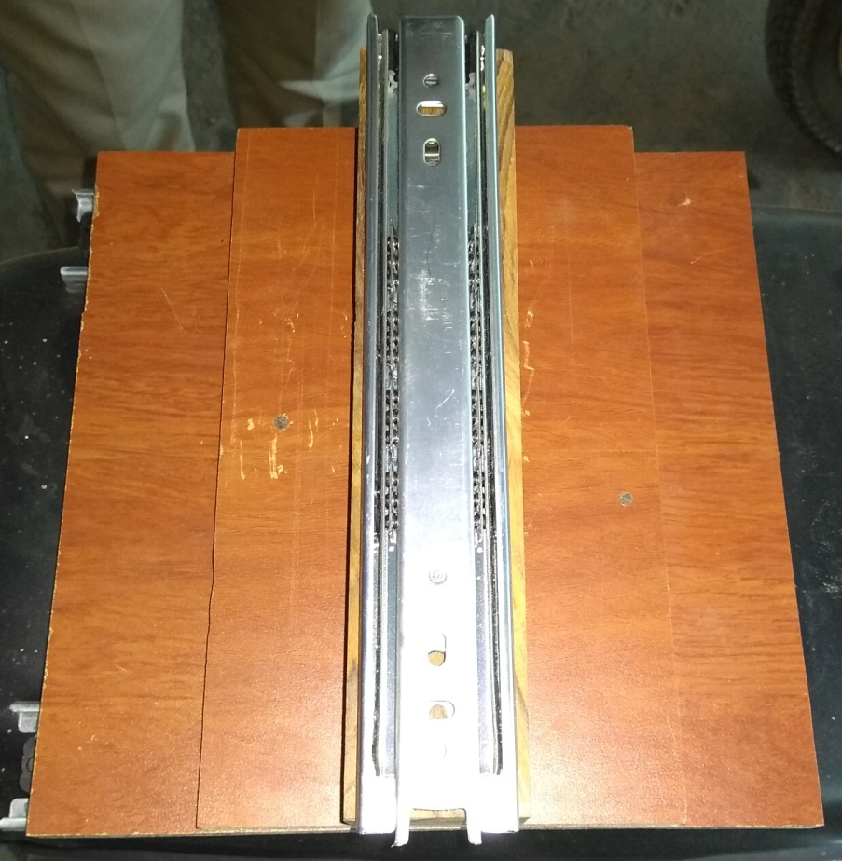
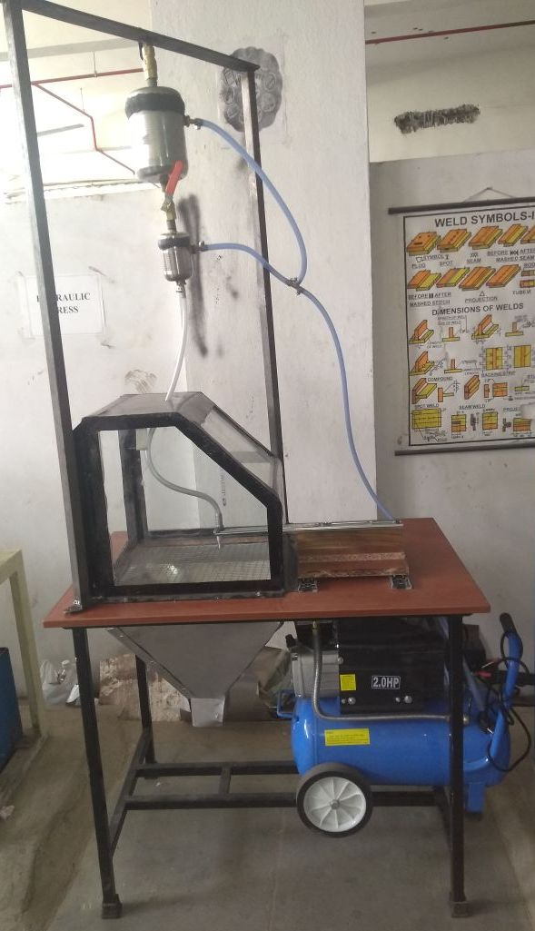
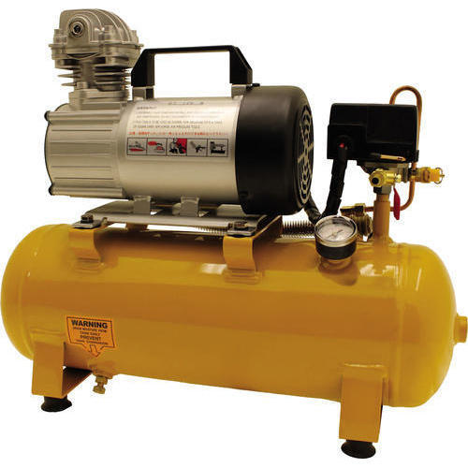
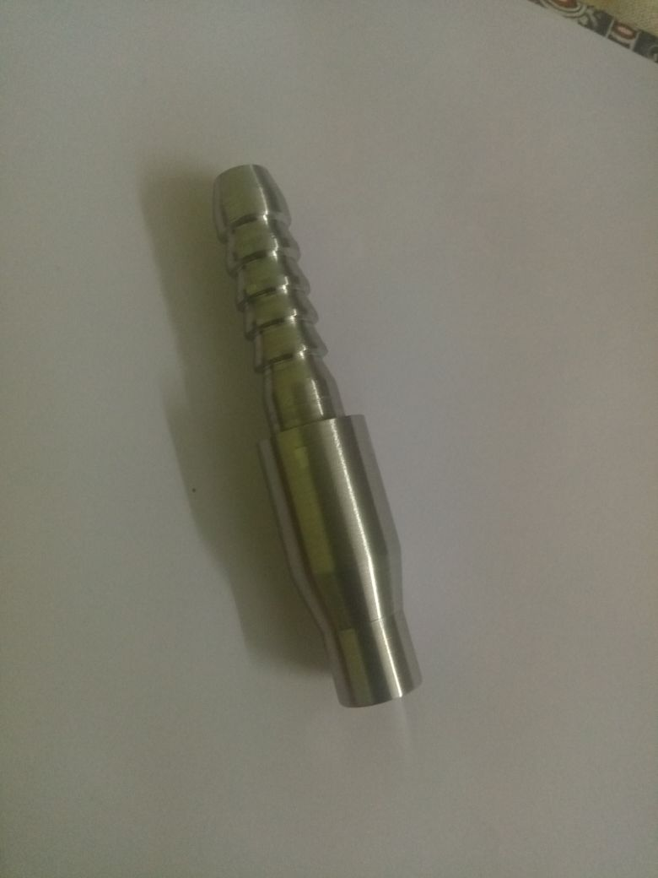
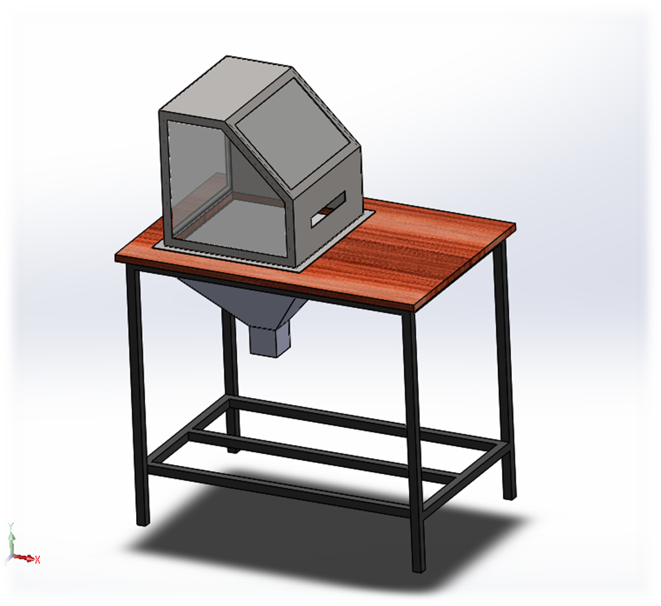
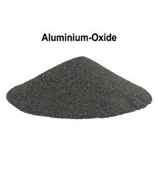
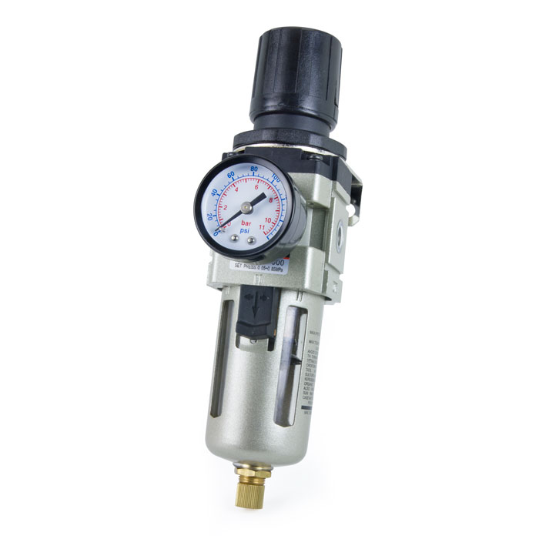
SPHOORTHY ENGINEERING COLLEGE
DEPARTMENT OF MECHANICAL ENGINEERING
DESIGN, FABRICATION AND ANALYSIS OF
ABRASIVE JET MACHINE
ABSTRACT
INTRODUCTION
5. Hopper. 6. Mixing chamber.
7. Cabinet. 8. Abrasive collector.
9. Table 10. Hose pipe.
11. XY motion module.
DESIGN OF NOZZLE, CABINET, COLLECTOR
AND TABLE
Abrasive Jet Machining is a non-conventional subtraction-type machining process in which brittle-fracture mechanism is used to remove the material from work-piece. The small but hard abrasive particles hit the work-piece material with very high velocity (which is imparted by the pressurised air) & the ensuing collision results in minute fractures on the work-piece. This explains why this process can be used only for brittle materials. If the work-piece is ductile, the abrasive particles simply embed in or bounce off the work-piece surface and there is no material removal.
The real beauty of this machining process is that it can be used to drill holes & make cuts in extremely thin & brittle materials like silicon wafers & egg-shells.
Abrasive jet machining (AJM) is the removal of material from a work piece by the application of a high speed stream of abrasive particles carried in gas medium from a nozzle. The AJM process differs from conventional sand blasting in that the abrasive is much finer and the process parameters and cutting action are carefully controlled.
The process is used chiefly to cut intricate shapes in hard and brittle materials which are sensitive to heat and have a tendency to chip easily. The process is also used for deburring and cleaning operations. AJM is inherently free from chatter and vibration problems. The cutting action is cool because the carrier gas serves as a coolant.
FABRICATION
ASSEMBLE OF COMPONENTS
EQUIPMENT
PRESENTED BY
The major components are:
1. Air compressor with tank. 2. Nozzle.
3. Abrasive. 4. Pressure regulator.
k
GUIDES
1. Mr. B . NAGA MURLI.
2. Mr. SHREENIVAS.
TEAM MEMBERS.
1.N.UTTEJ (14N81A0359)
2.S.RAGHUVEER (14N81A0362)
3.P. MADHUSUDHAN (14N81A0347)
4.S SAI SREEKAR (14N81A0364)
5.U.ACHYUTH (14N81A0375)
CONCLUSION
EXPECTED OUTPUT
This project is a prototype of abrasive jet machine. Complete design, analysis and fabrication in given. The designing and assembling or components was a tremendous task and was completed on time. The project can go beyond its current position and capabilities by employing automation into it.
AJM process mainly deals with brittle materials and heat sensitive materials. It is also used in cutting slot, thin sections, countering, drilling, for producing integrate shapes in hard and brittle materials. Delicate cleaning, such as removal of smudges from antique documents, is also possible with AJM.

