Slide 1
Customer Shopping
Behavior Analysis
Purchase trends, customer segments, and revenue growth levers
Executive Briefing · Portfolio Retail Dataset
Notes:
Welcome everyone. Today we examine transaction patterns across 3,900 customer purchases to understand who buys, what categories drive revenue, and where our clearest growth levers lie.

Slide 2

3,900 purchases, 18 data points each
3,900
$59.76
3.75
Average review rating out of 5.0
Total recorded purchases
Average transaction value
A robust baseline spanning customer demographics, product categories, discount usage, and frequency.
Source: Transaction database · 3,900 verified customer records
Notes:
We analyze 3,900 distinct customer transactions. The baseline numbers establish a stable retail footprint: an average cart of $59.76 and a healthy 3.75 customer satisfaction rating across 18 measured attributes.

Slide 3
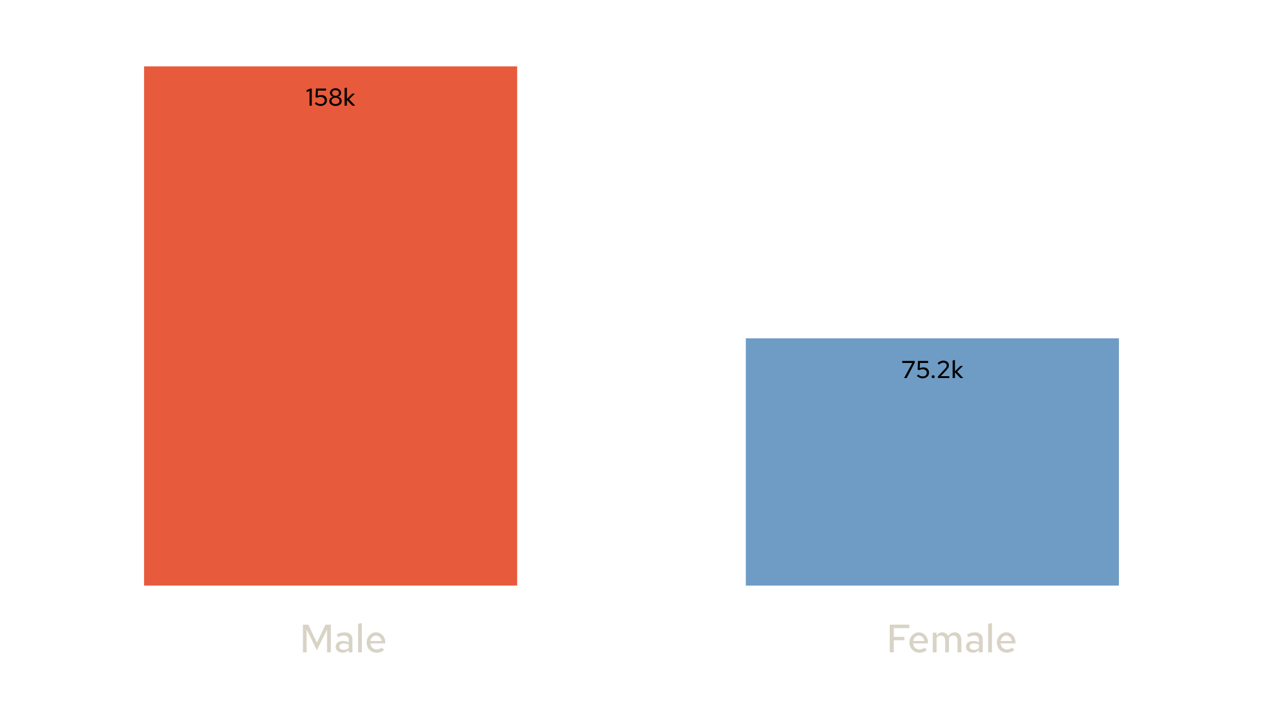
Male customers drive twice the revenue
Total revenue by gender ($)
2.1×
Male shoppers generated $157,890 across the period.
Female shoppers accounted for $75,191.
Male buyer volume represents the largest revenue concentration in the portfolio.
Source: Customer purchase ledger by demographic segment
Notes:
Male buyers drive more than double the total revenue of female buyers, generating over $157K compared to $75K. This indicates strong existing male engagement while revealing female conversion as a major upside opportunity.

Slide 4
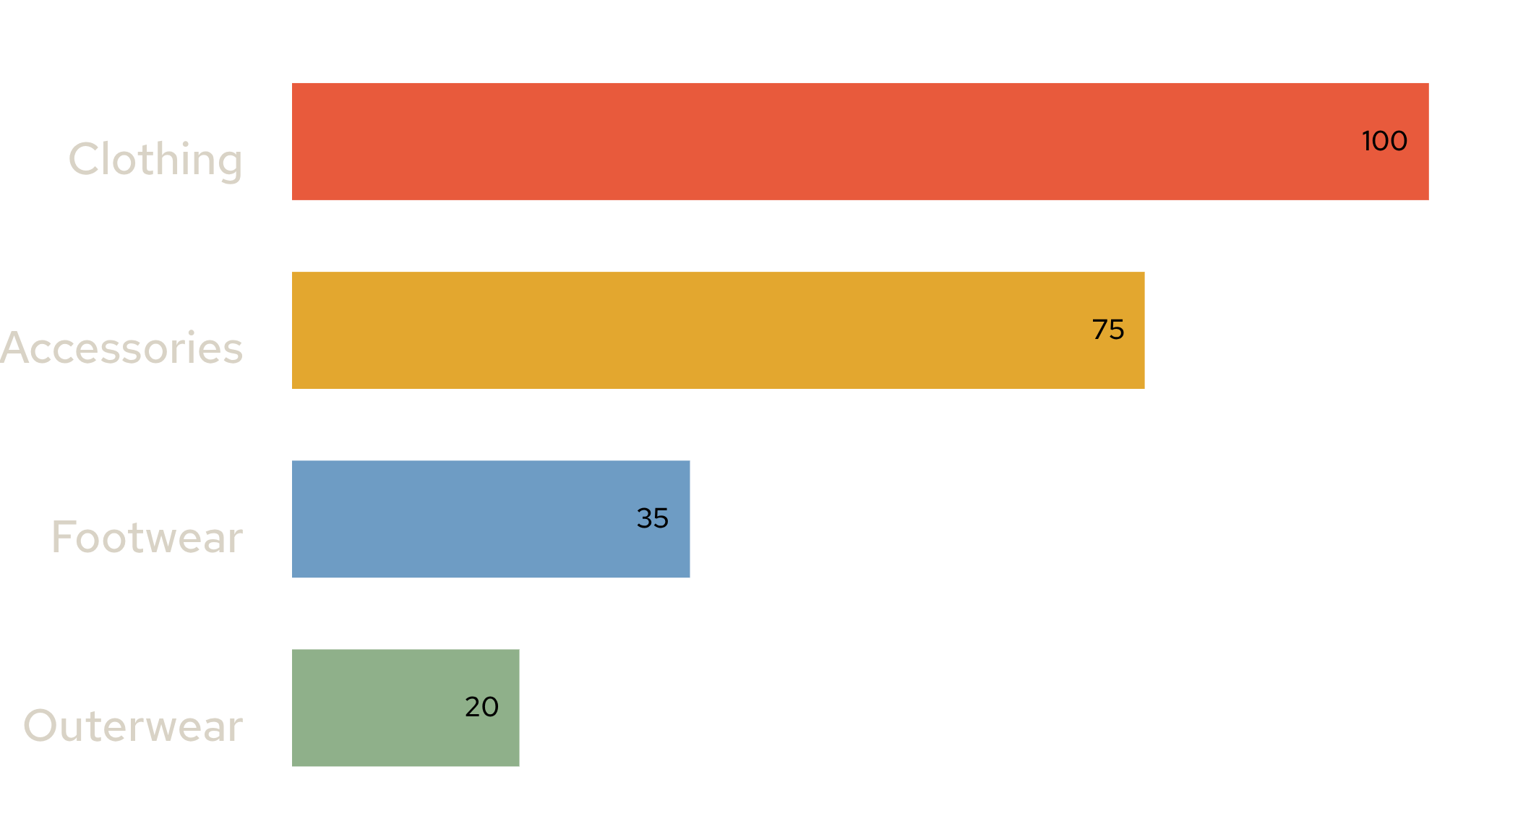
Clothing leads revenue
Category revenue ($K)
CATEGORY ANCHOR
$100K
Clothing accounts for nearly half of total sales volume.
Accessories follow strongly at $75K, while Footwear ($35K) and Outerwear ($20K) represent complementary tiers.
Source: Departmental merchandise sales ledger
Notes:
Clothing anchors the product portfolio at roughly $100K in revenue, followed closely by accessories at $75K. Footwear and outerwear trail significantly, highlighting where cross-merchandising could lift basket size.

Slide 5
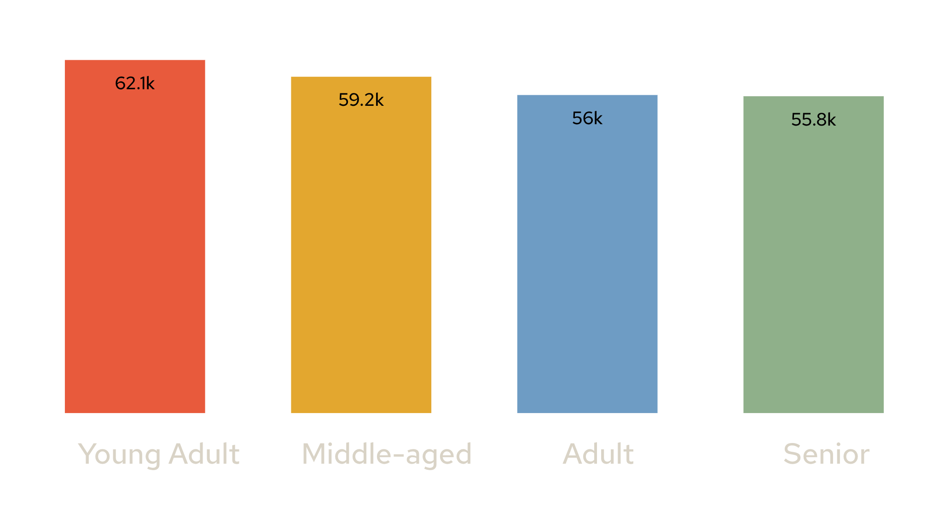
Young adults spend the most
Total revenue by age bracket ($)
$62,143
Young adults lead aggregate customer spending.
Remarkably, all four demographic brackets contribute evenly between $55K and $62K, demonstrating broad multi-generational appeal.
Source: Customer age demographic cohort summary
Notes:
While young adults lead overall spending at $62,143, spending across all age groups is remarkably balanced. Each bracket generates at least $55K, showing that our catalog appeals across generations.

Slide 6
80% of customers are loyal
80%
Buyer | Purchase history | Customers
Loyal Buyers | 25+ prior purchases | 3,116
Returning Buyers | 2 to 24 prior purchases | 701
New Buyers | First recorded purchase | 83
of all shoppers show repeat loyalty
The vast majority of transaction volume comes from established, satisfied patrons returning repeatedly.
Total sample: 3,900 customers across three tenure tiers
Source: Customer purchase frequency and tenure distribution
Notes:
3,116 out of 3,900 customers qualify as loyal buyers. Retention is an enormous core strength, whereas only 83 buyers are first-timers, suggesting new customer acquisition needs attention.

Slide 7
Only 27% subscribe, and spend the same
27%
subscribed.
SUBSCRIBERS
NON-SUBSCRIBERS
$59.49
$59.87
Average order value
Average order value
A large untapped pool of 73% non-subscribers remains open for recurring enrollment.
Subscribers currently show no premium basket lift over non-subscribers.
Source: Subscription status cohort and average cart value comparison
Notes:
Only 27% of customers subscribe, and their cart average of $59.49 is virtually identical to non-subscribers at $59.87. Subscriptions currently capture commitment without driving higher spend.

Slide 8


Top-rated and most discounted products
TOP RATED
MOST DISCOUNTED
3.86
50% of sales
Gloves
Hat

Slide 9
Five moves to grow revenue
01
02
03
04
05
PRIORITY 01
PRIORITY 02
PRIORITY 03
PRIORITY 04
PRIORITY 05
Boost subscriptions
Reward loyal buyers
Review discount policy
Spotlight top products
Target high-revenue ages
Convert the 73% non-subscriber base with exclusive perks.
Introduce VIP tiers for the 3,116 dedicated loyalists.
Protect margins on heavily promotional items like hats.
Feature top-rated gloves in bundles and front-page displays.
Tailor digital campaigns to young adult high spenders.
Action roadmap derived from customer behavior analysis
Notes:
Here are our five strategic recommendations: scale subscription enrollment, reward the 3,100+ loyal customers, tighten discounting, merchandise top-rated products, and market directly to our strongest demographic brackets.

