Slide 1
Transformation Assignment
Raghvendra Yadav

Slide 2
Introduction
Hospital CAHPS (HCAHPS) is the national, standardized, publicly-reported survey of patients' perspectives of hospital care. It measuring patients’ perceptions of their hospital experience
The HCAHPS Survey captures the patient’s experience of communication with doctors and nurses, responsiveness of hospital staff, communication about medicines, cleanliness and quietness of the hospital, discharge information, transition to post-hospital care and overall rating of the hospital.

Slide 3
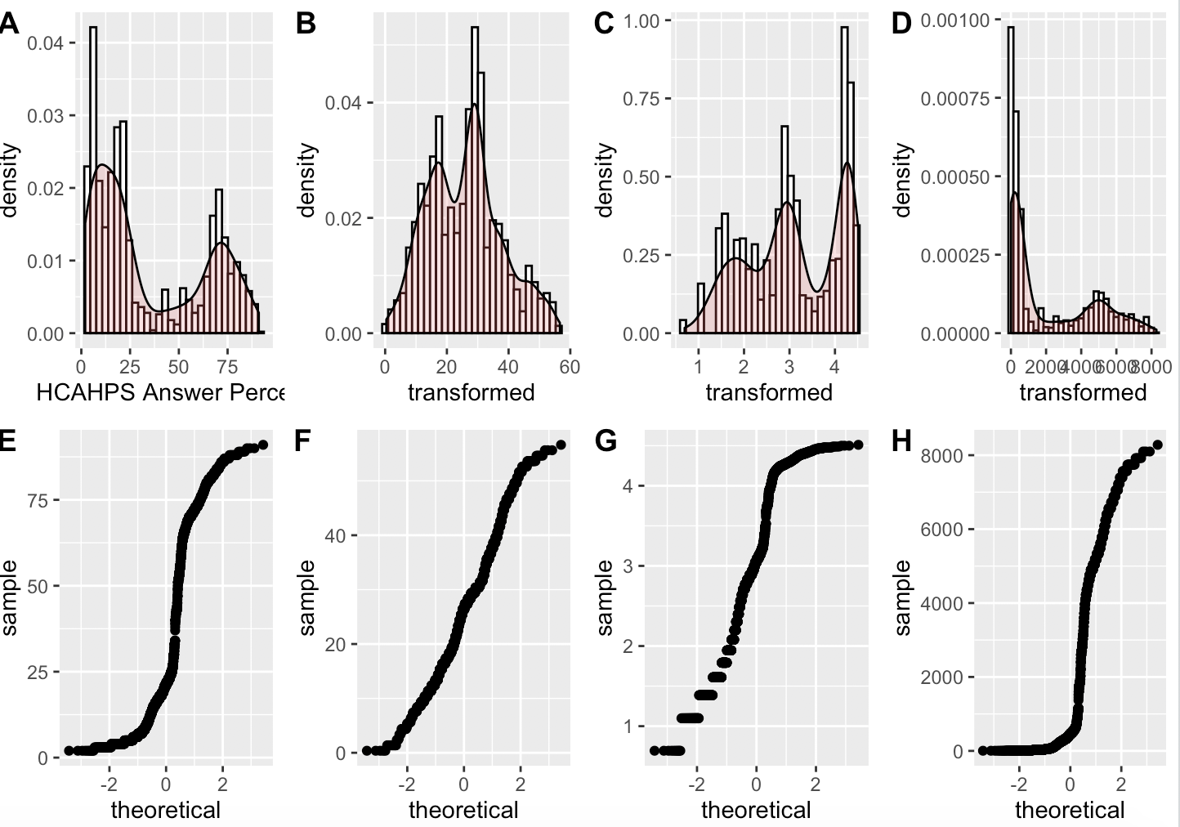
Requirement Specification
Data Transformation: data should transform to follow close to a normal distribution.
HCAHPS - Data
EDA and Transformation

Slide 4
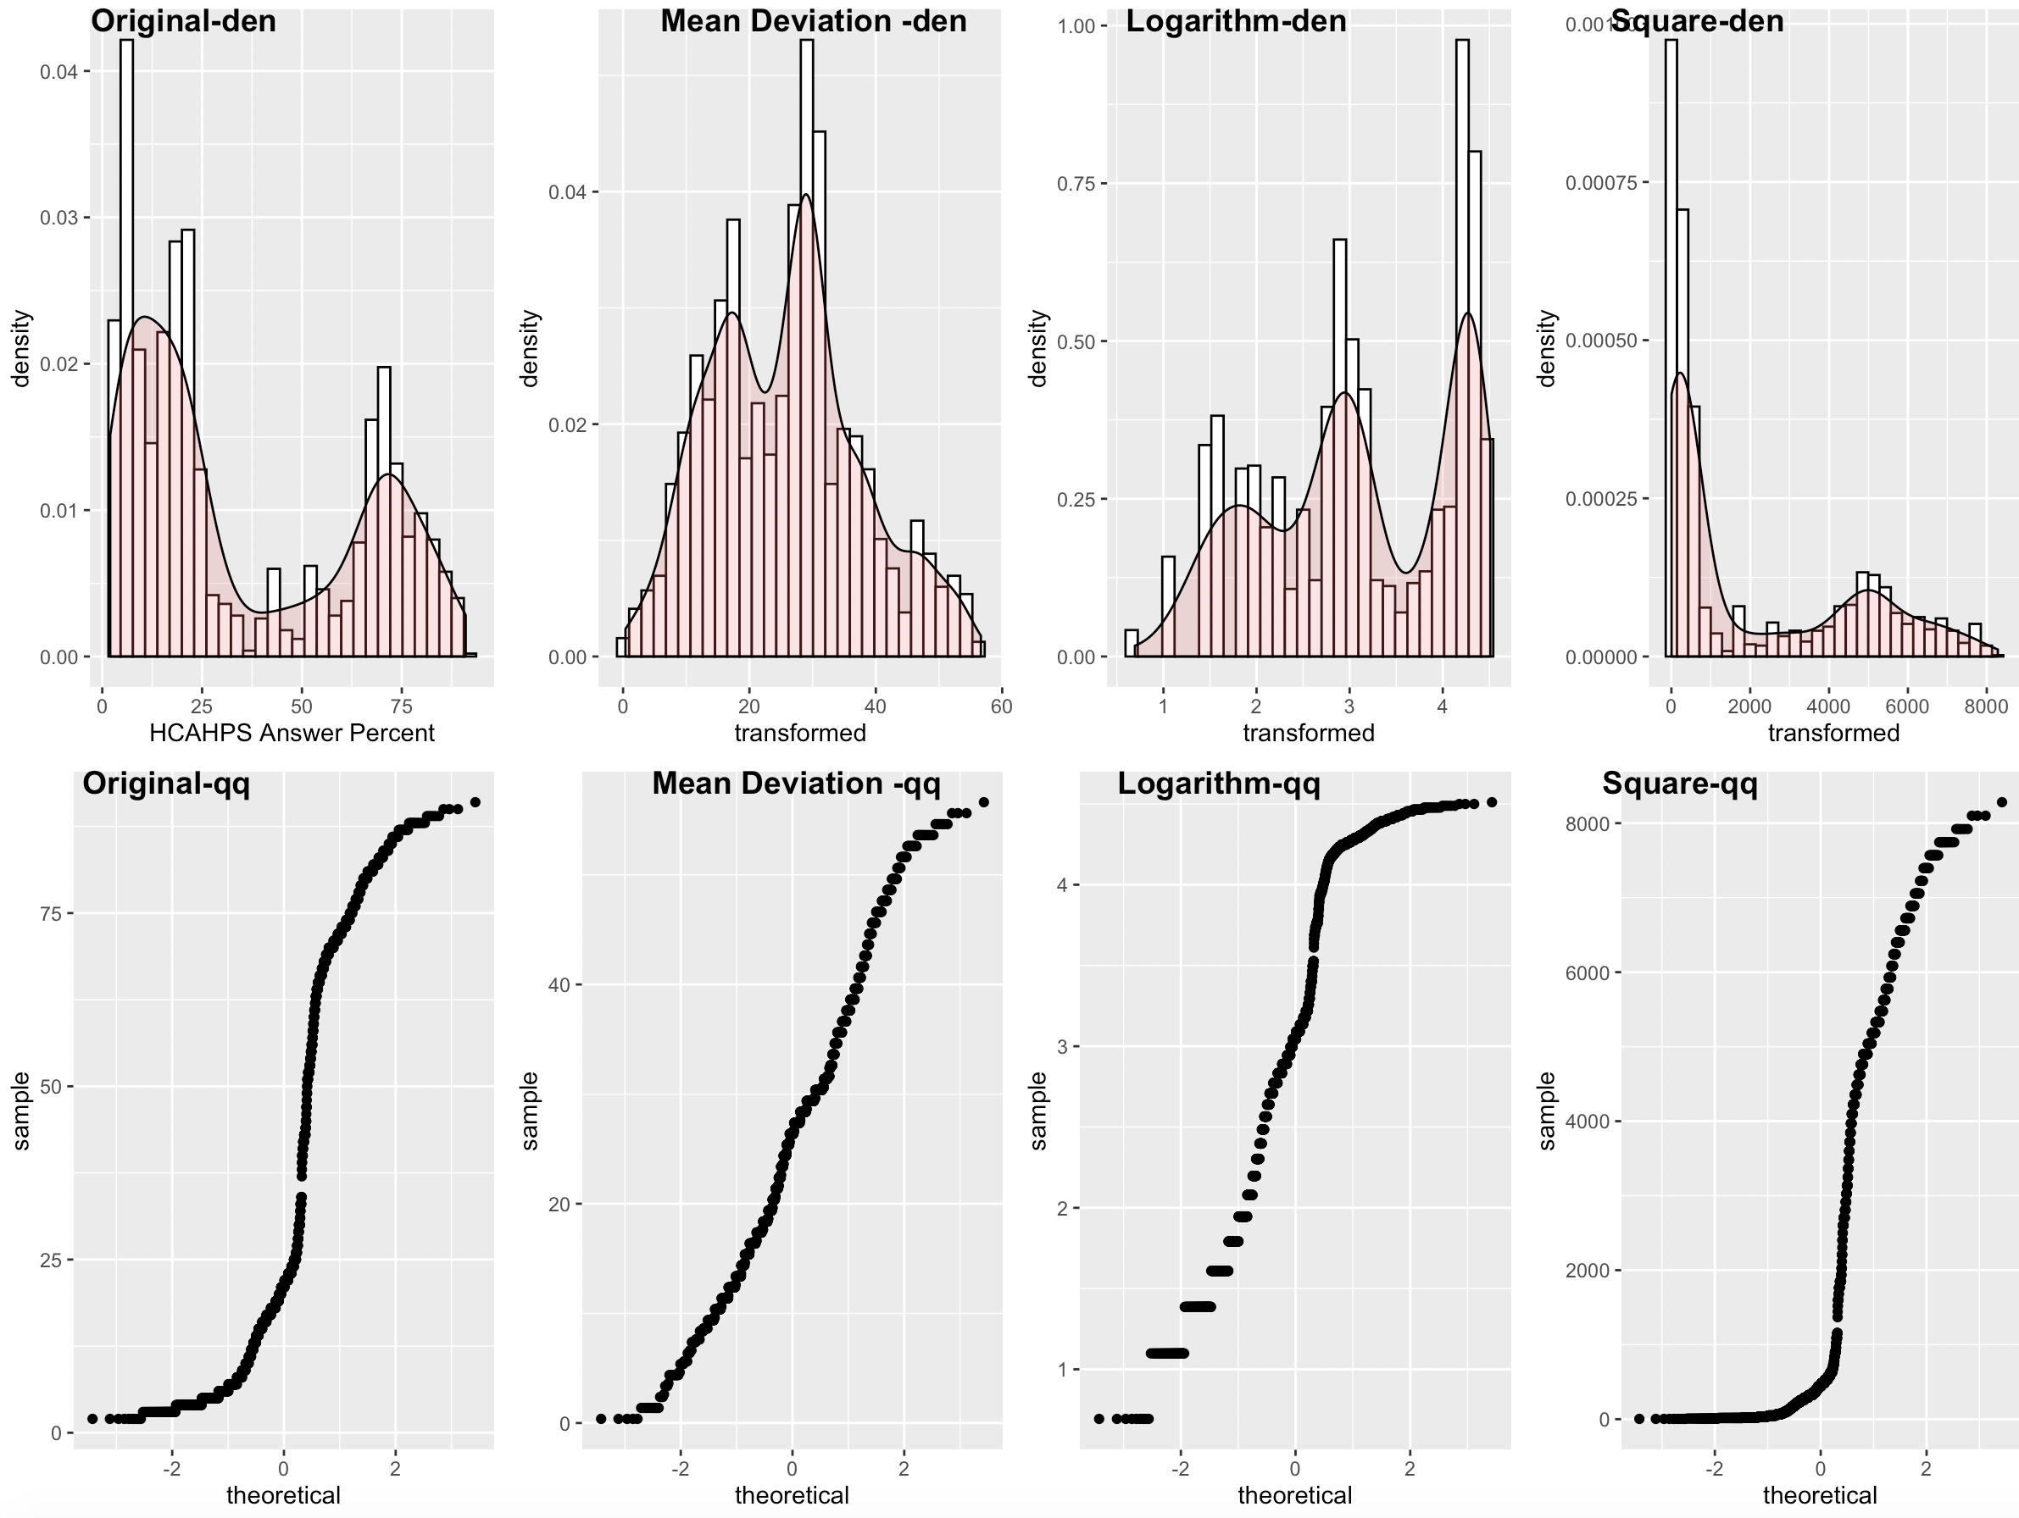
Implementation: HCAHPS Answer Percentage
HCAHPS Answer Percentage is bi-model in nature
To normalize we are performing following transformation
Mean deviation
Logarithm log(x): It is used to reduce skewness
Squar(x) : It is used to reduce skewness

Slide 5
RI State Analysis
There is no NA in RI state
No missing value treatment required

