Slide 1
Research Paper Title:
PT-AML: Machine learning framework to identified personalized treatments for acute myeloid leukemia
Journal: TBD
Authors: Raghvendra Mall^{1#}, Siddhi Jani², ...
Keywords: []
SC: Deep Learning; Machine Learning; AML; Drug Sensitivity; Precision Medicine; Mutations; Cell State; Mechanism of Action
Abstract: [Checklist: Statements are factually accurate; provides a concise summary that is interesting and attracts attention; provides key background, purpose of article, and key findings from the study]
ABSTRACT EXAMPLE:
First line: State the topic; should be related to the title
Resistance to cell death is a leading hallmark of cancer. Therapies aimed at activating cell death are therefore of high interest to improve treatment and understanding the induction of cell death during cancers is a key strategy to identify therapies.
Second and third sentences: Expand on the critical background information relating to the topic, including why it is a relevant
Fourth sentence and beyond: These sentences should mirror the subsections from your results outline
.
Last sentence: These results demonstrate…
SC:

Slide 2
Research Article Outline:
PT-AML: Machine learning framework to identified personalize treatments for acute myeloid leukemia
[Checklist: Statements are factually accurate, key references from Kanneganti lab and Others ref lists are included]
Introduction [Checklist: limit to 3 paragraphs; describe the key concepts; provide relevant background information in the context of our lab’s interests; attract the readers attention and inform about the purpose of the article and what you aim to achieve]
SC:
2.
3.
4.
5.
6. Discussion
----------------------------------------------------------------------------------------------------------------------------------------------------------------------------------------------------------------------

Slide 3
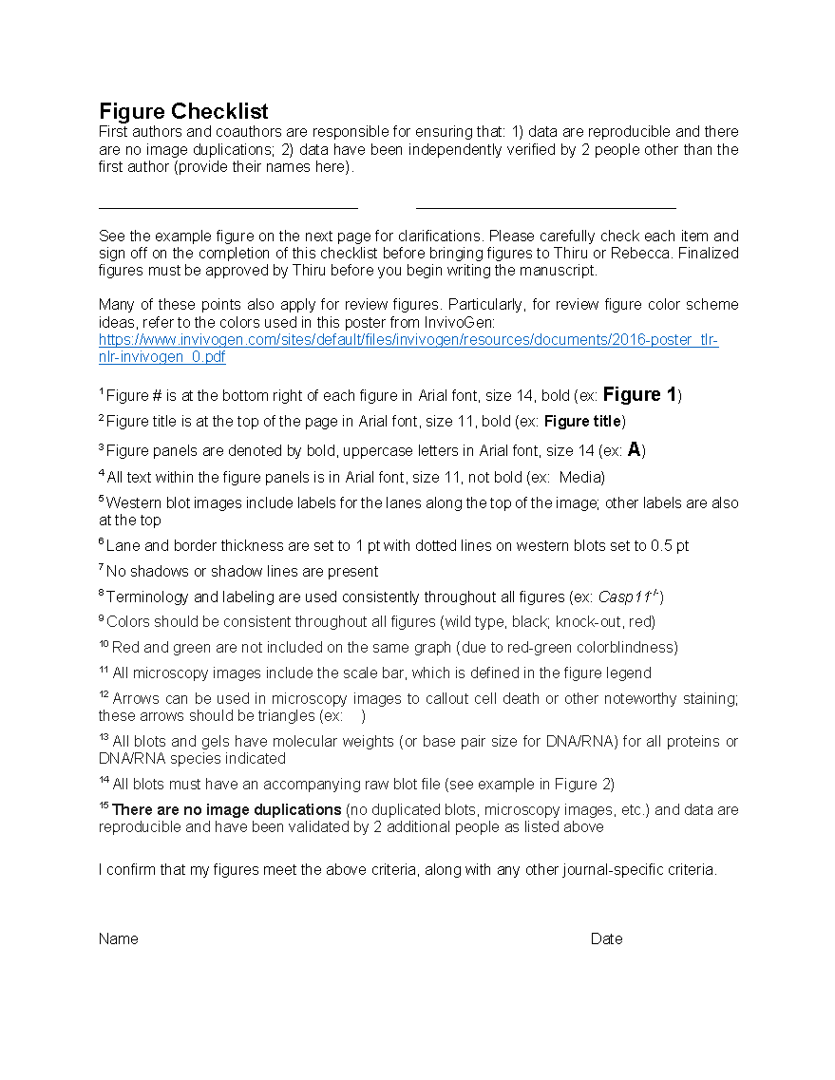
Figures
[Checklist: concise title and legend; include labels and enough detail to be understood without the text; fonts and colors follow lab template, and the formatting is correct; no image duplications]

Slide 4






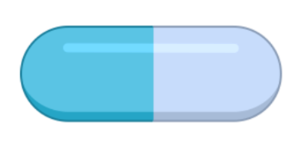







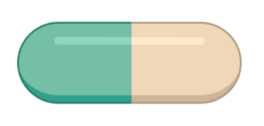
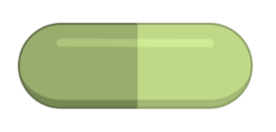
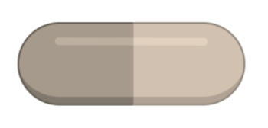
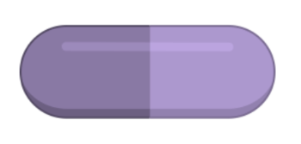
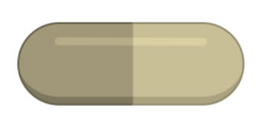

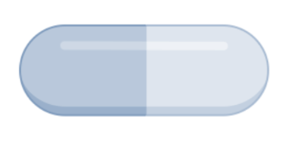

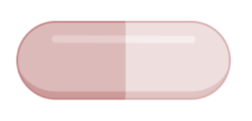
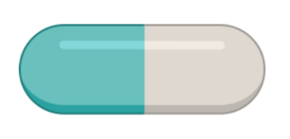
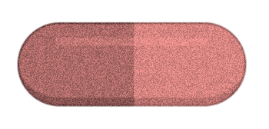

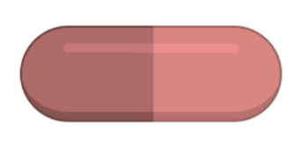

PT-AML: Machine learning framework to identified personalized treatments for acute myeloid leukemia
Graphical Abstract
AML Multi-Omic Profiles
Screening + Report
Predictive Artificial Intelligence Oracle
Drug Info
Personalized Medicine
Prior Knowledge

Slide 5
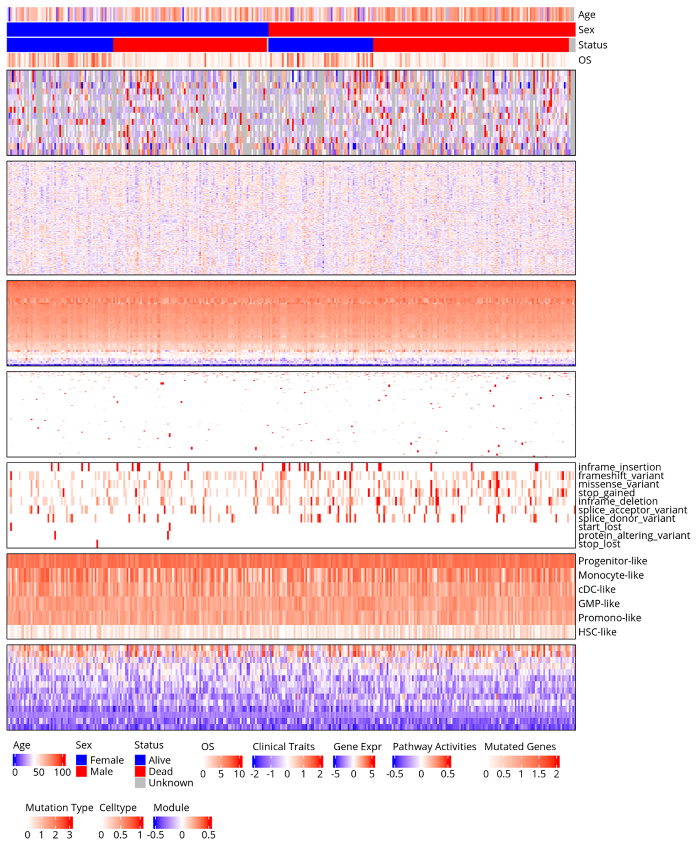
Clinical Traits
Gene Expression
Pathway Activities
Mutated Genes
Mutation Types
Cell type Enrichment
Module Enrichments
Figure 1

Slide 6
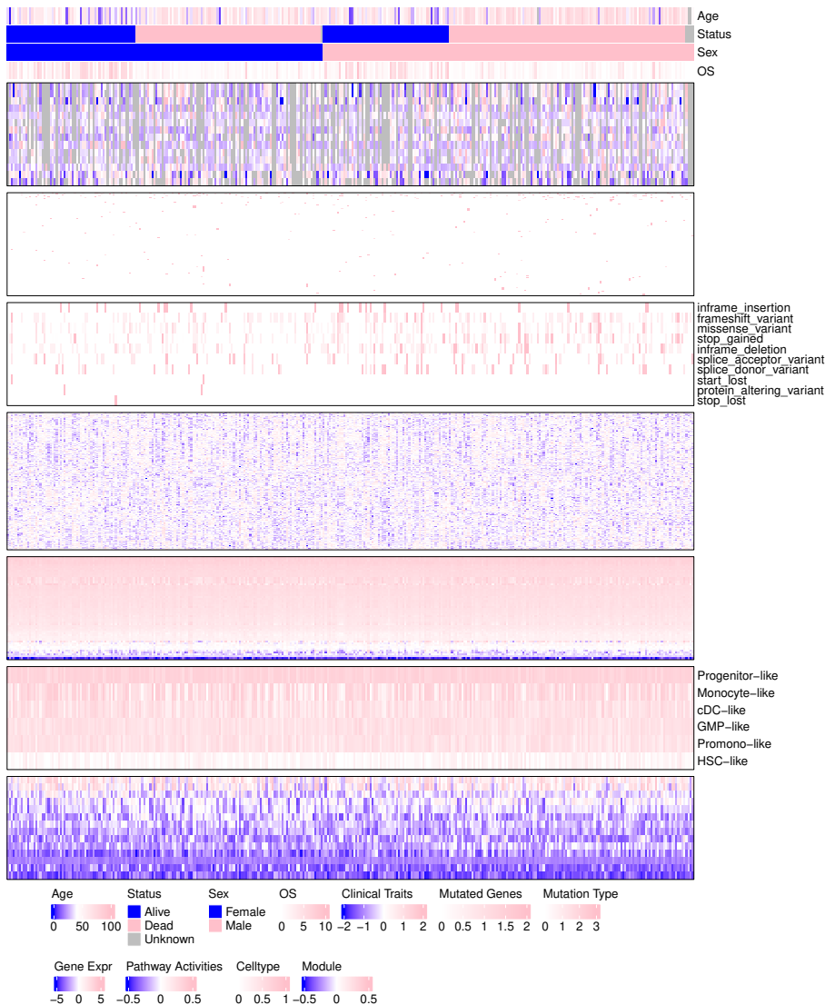
Clinical Traits
Mutated Genes
Mutation Types
Gene Expression
Pathway Activities
Cell type Enrichment
Module Enrichments
Figure 1

Slide 7
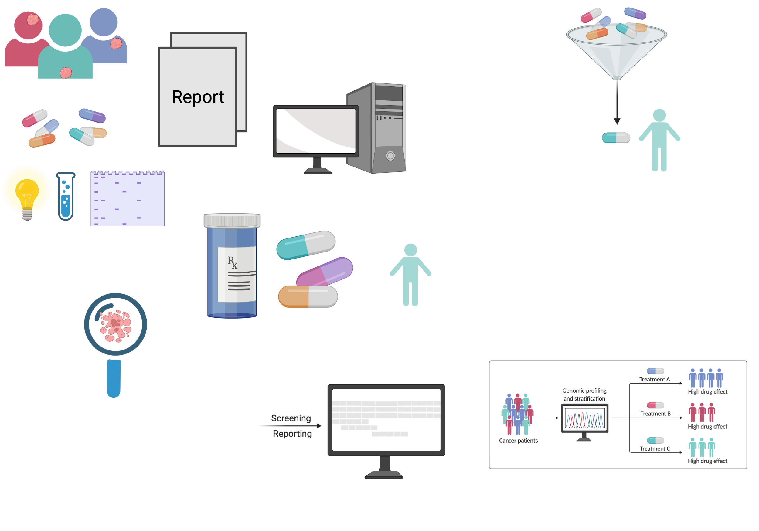

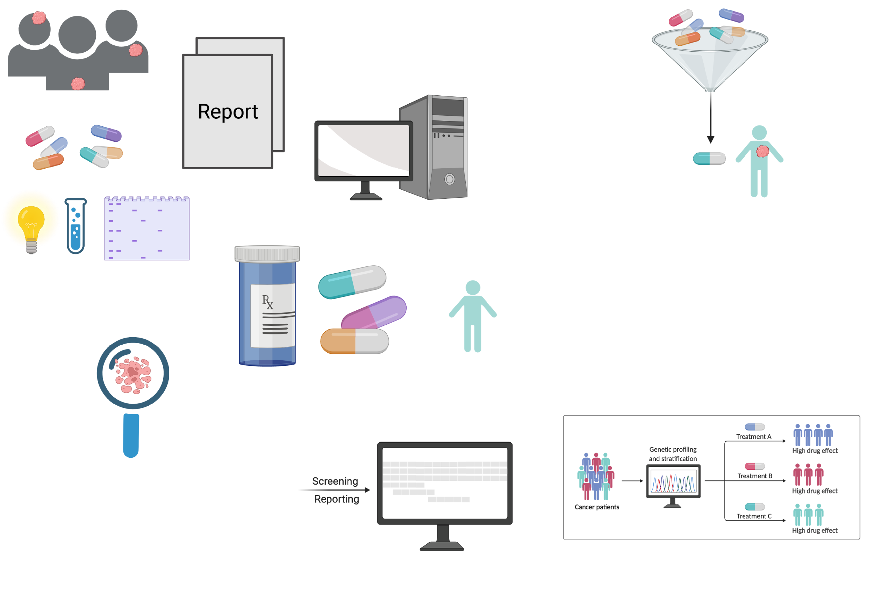
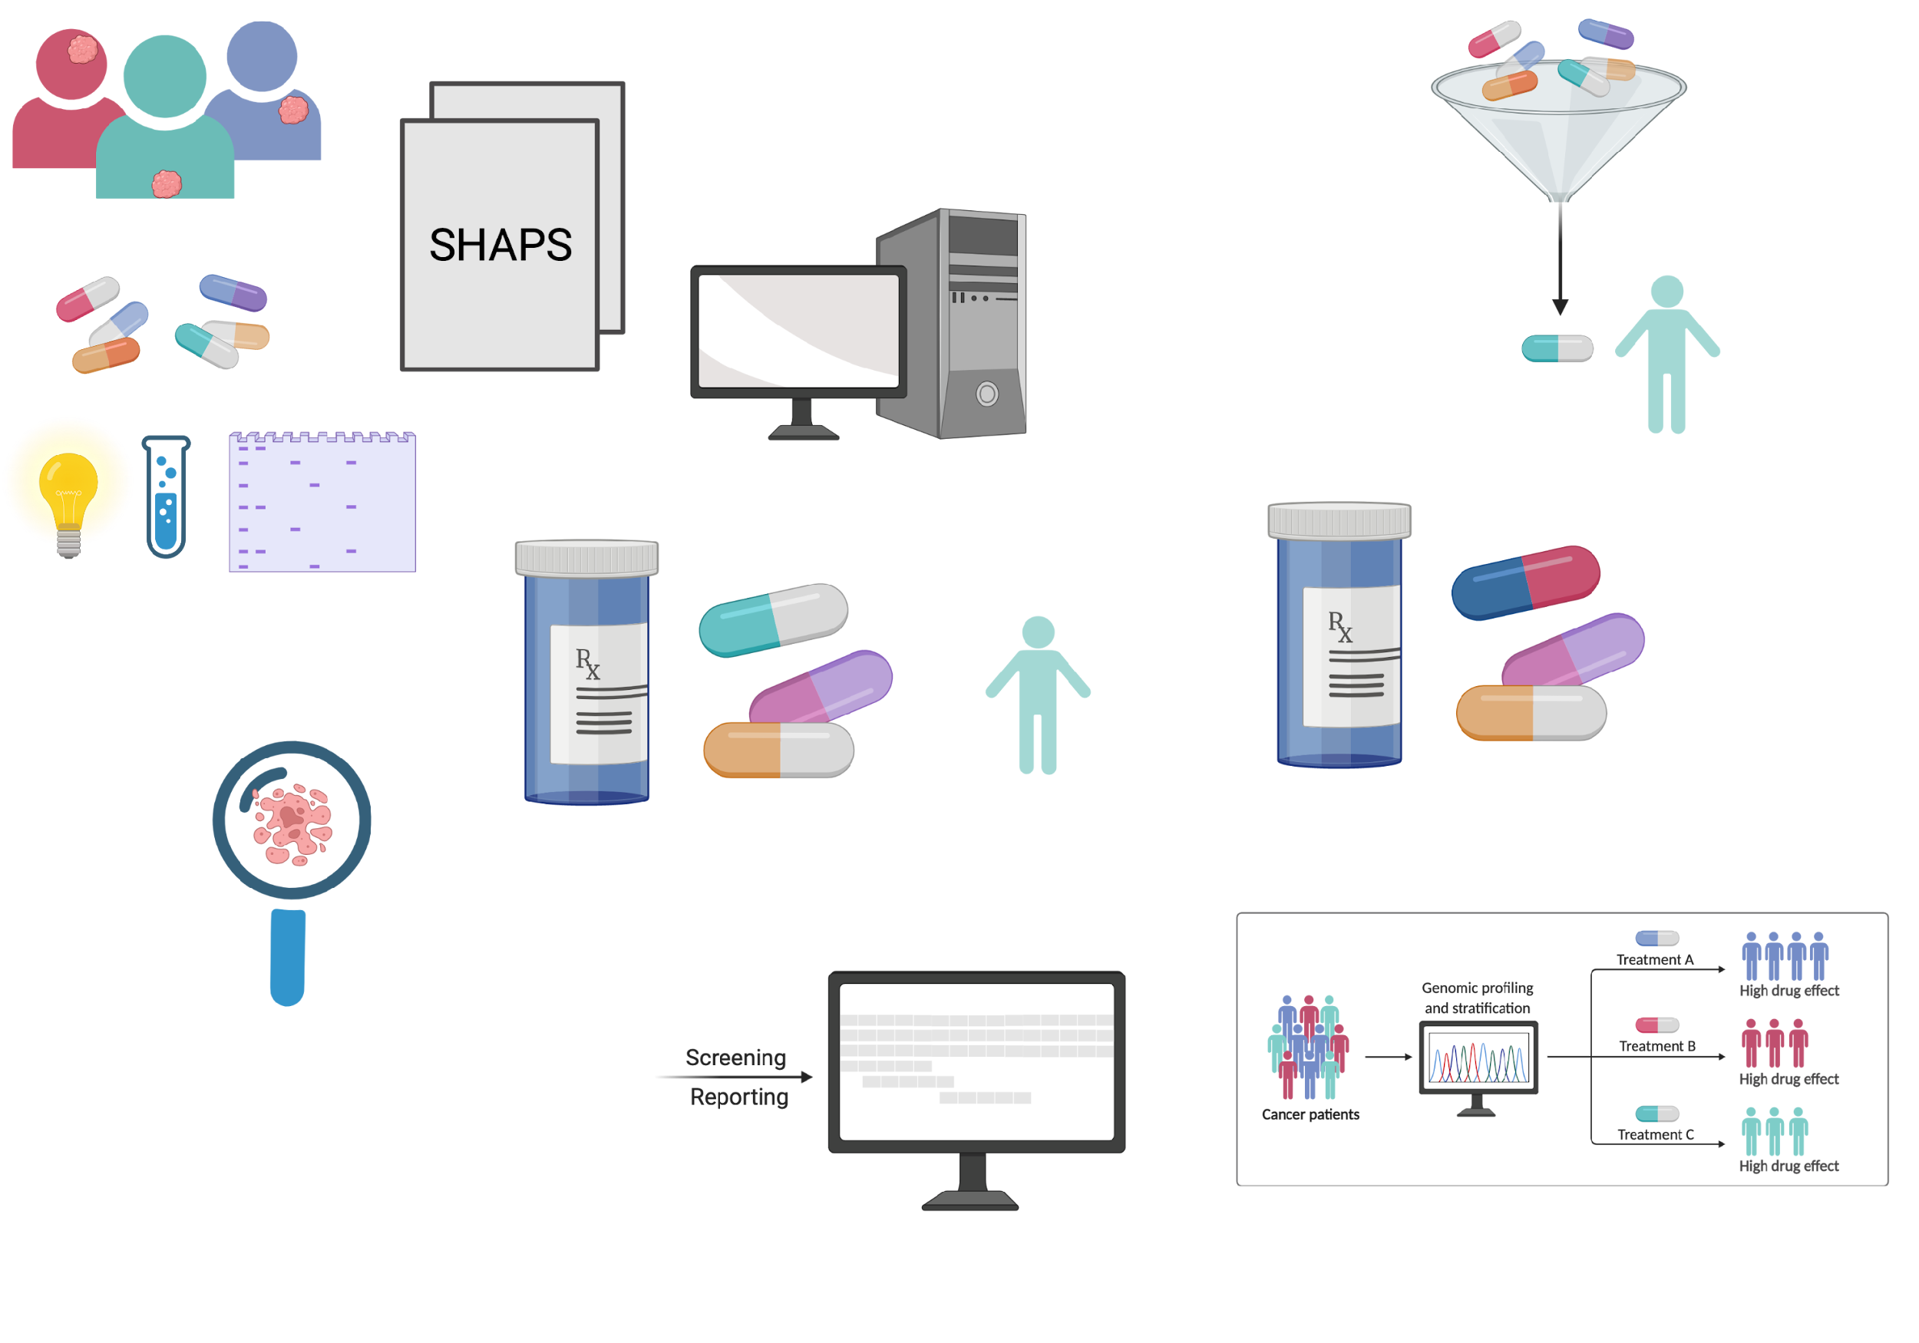
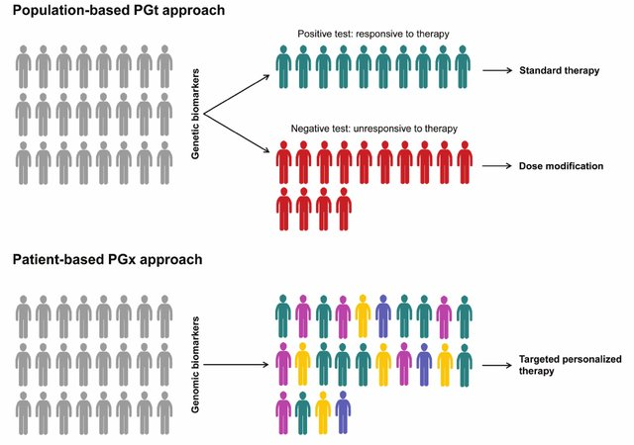
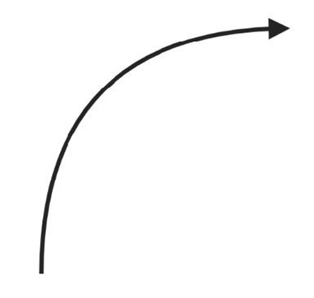
Expression
Train - BeatAML
(Wave 1+2)
Test – BeatAML
(Wave 3+4)
Cancer Samples
Mutated Genes
Mutation Types
Cell + Module Enrichment
Molecular fingerprint
Pathway enrichment
BeatAML Drugs
DrugBank
DeepRepurpose
(SMILES)
RDKiT
Embedding vector
Pathway AUC
Drugs
Transfer learning
Cell + Module Genesets
BeatAML (Cell +
Module States)
Pathway Database
STRING PPI
Existing data
Pathway Genesets
PPI + drug targets
Data
Feature Extraction
Results
Modeling
Pathway AUC
Linear Models:
Ridge Regression
Linear SVM
MFP /
SMILES
Output
Pathway Enrich
AUC ~ f(c,d,p)
Tree Models:
Random Forests
XGBoost
LightGBM
Catboost
TOP MODEL
Inhibition
Cell / Module Enrich
Drug Conc.
Mut Types
Deep Learning Models:
Deep Neural Networks (DNN)
CNN + DNN
LSTM + DNN
Sensitivity vs
Resistance
Mut Genes
New drug
Stratification
Expr
Figure 2

Slide 8
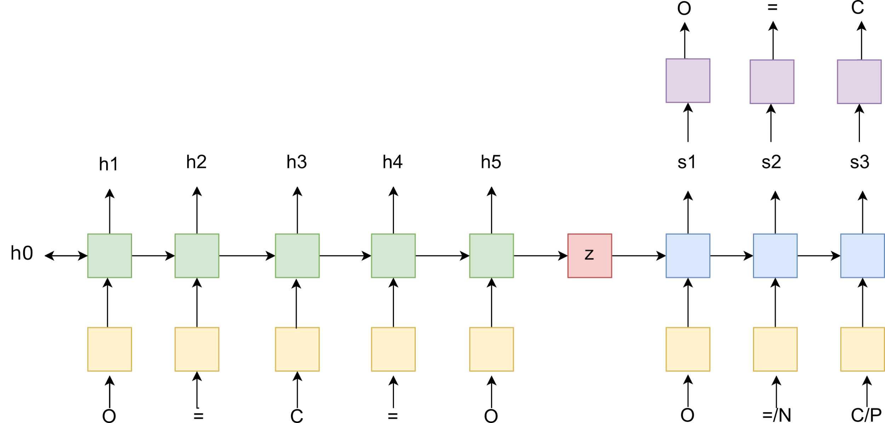
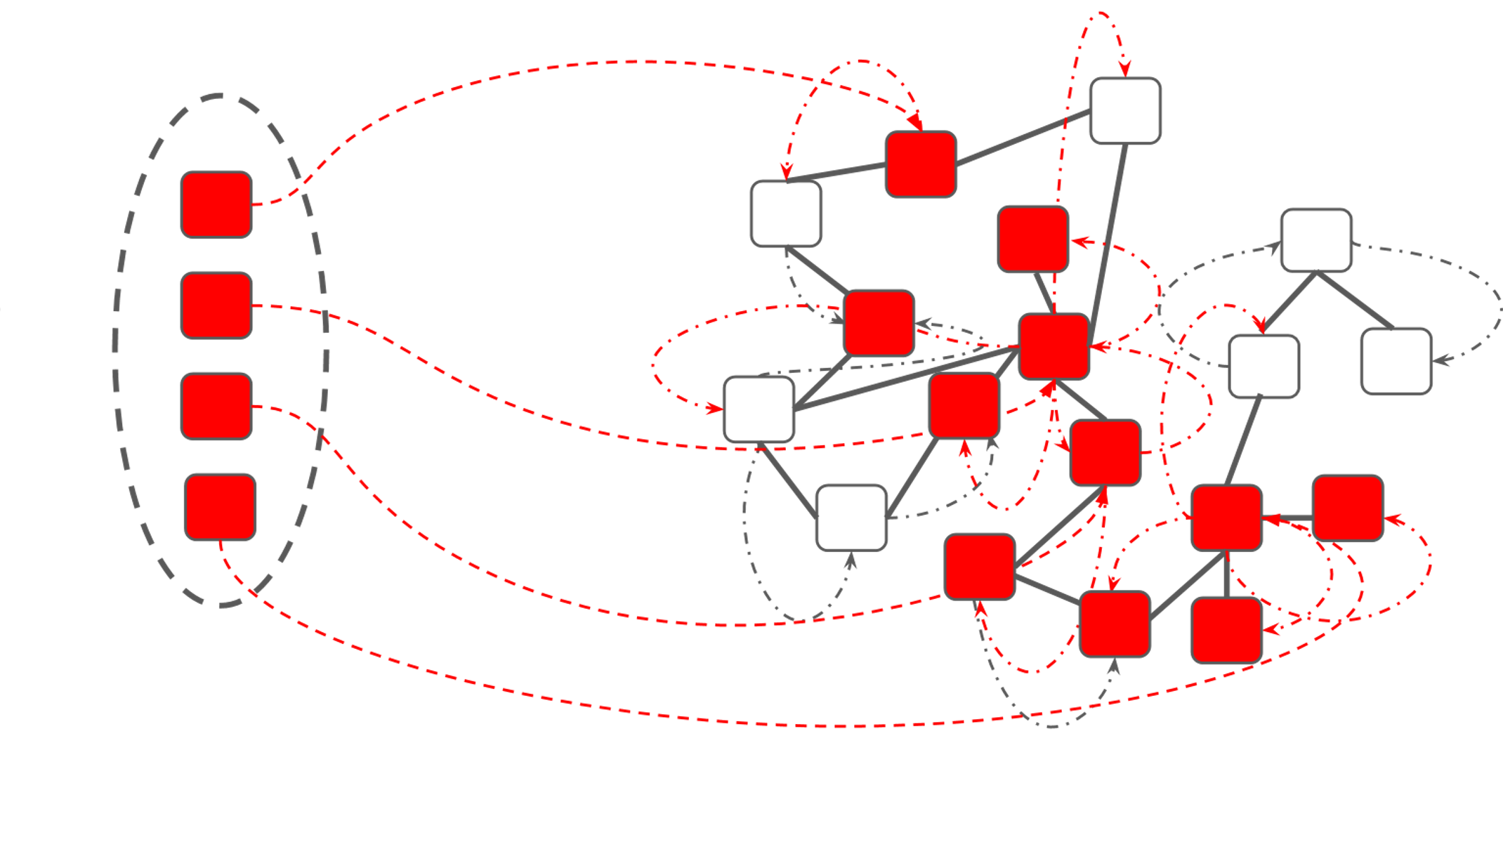

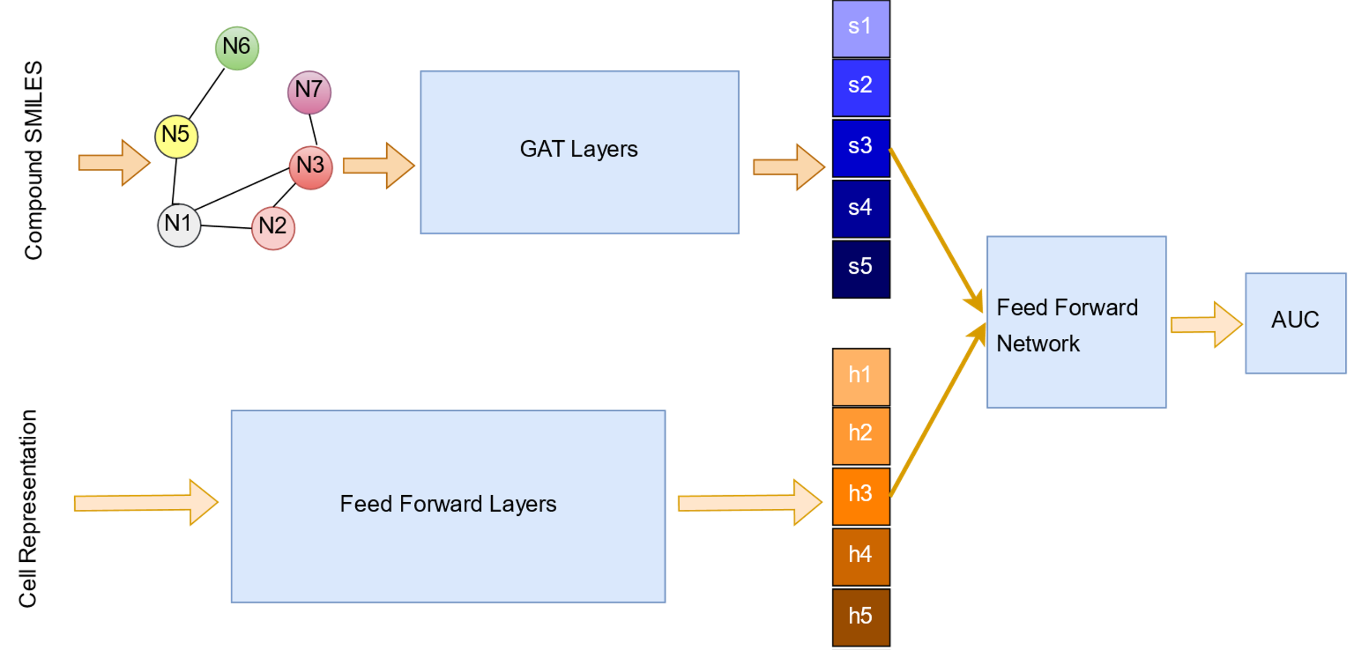
A
Transfer Learning
Output
DeepRepurpose:
TF-LSTM model trained on 2.5 million compounds from PubChem + MOSES.
96.7% reconstructed compounds are valid.
μ_{error} per sample is 0.001
Input
TF– LSTM Model
Embedding Vector
B
Pathway Distance Estimation
Expression
Profile
Pathway
X
AUcell
Distance = 1 - AUC
Random Walk with Restart
on the STRING PPI network
Probability (p∞)
p∞= β(I – (1- β)W)⁻¹p₀
Drug Targets
C
GATNET Model
Figure 3

Slide 9
Transfer Learning
Output
Input
TF– LSTM Model
Embedding Vector
Pathway Distance Estimation
Expression
Profile
Pathway
X
AUcell
Distance = 1 - AUC
Random Walk with Restart
on the STRING PPI network
Probability (p∞)
p∞= β(I – (1- β)W)⁻¹p₀
Drug Targets
GATNET Model
Patient Representation
Figure 3

Slide 10
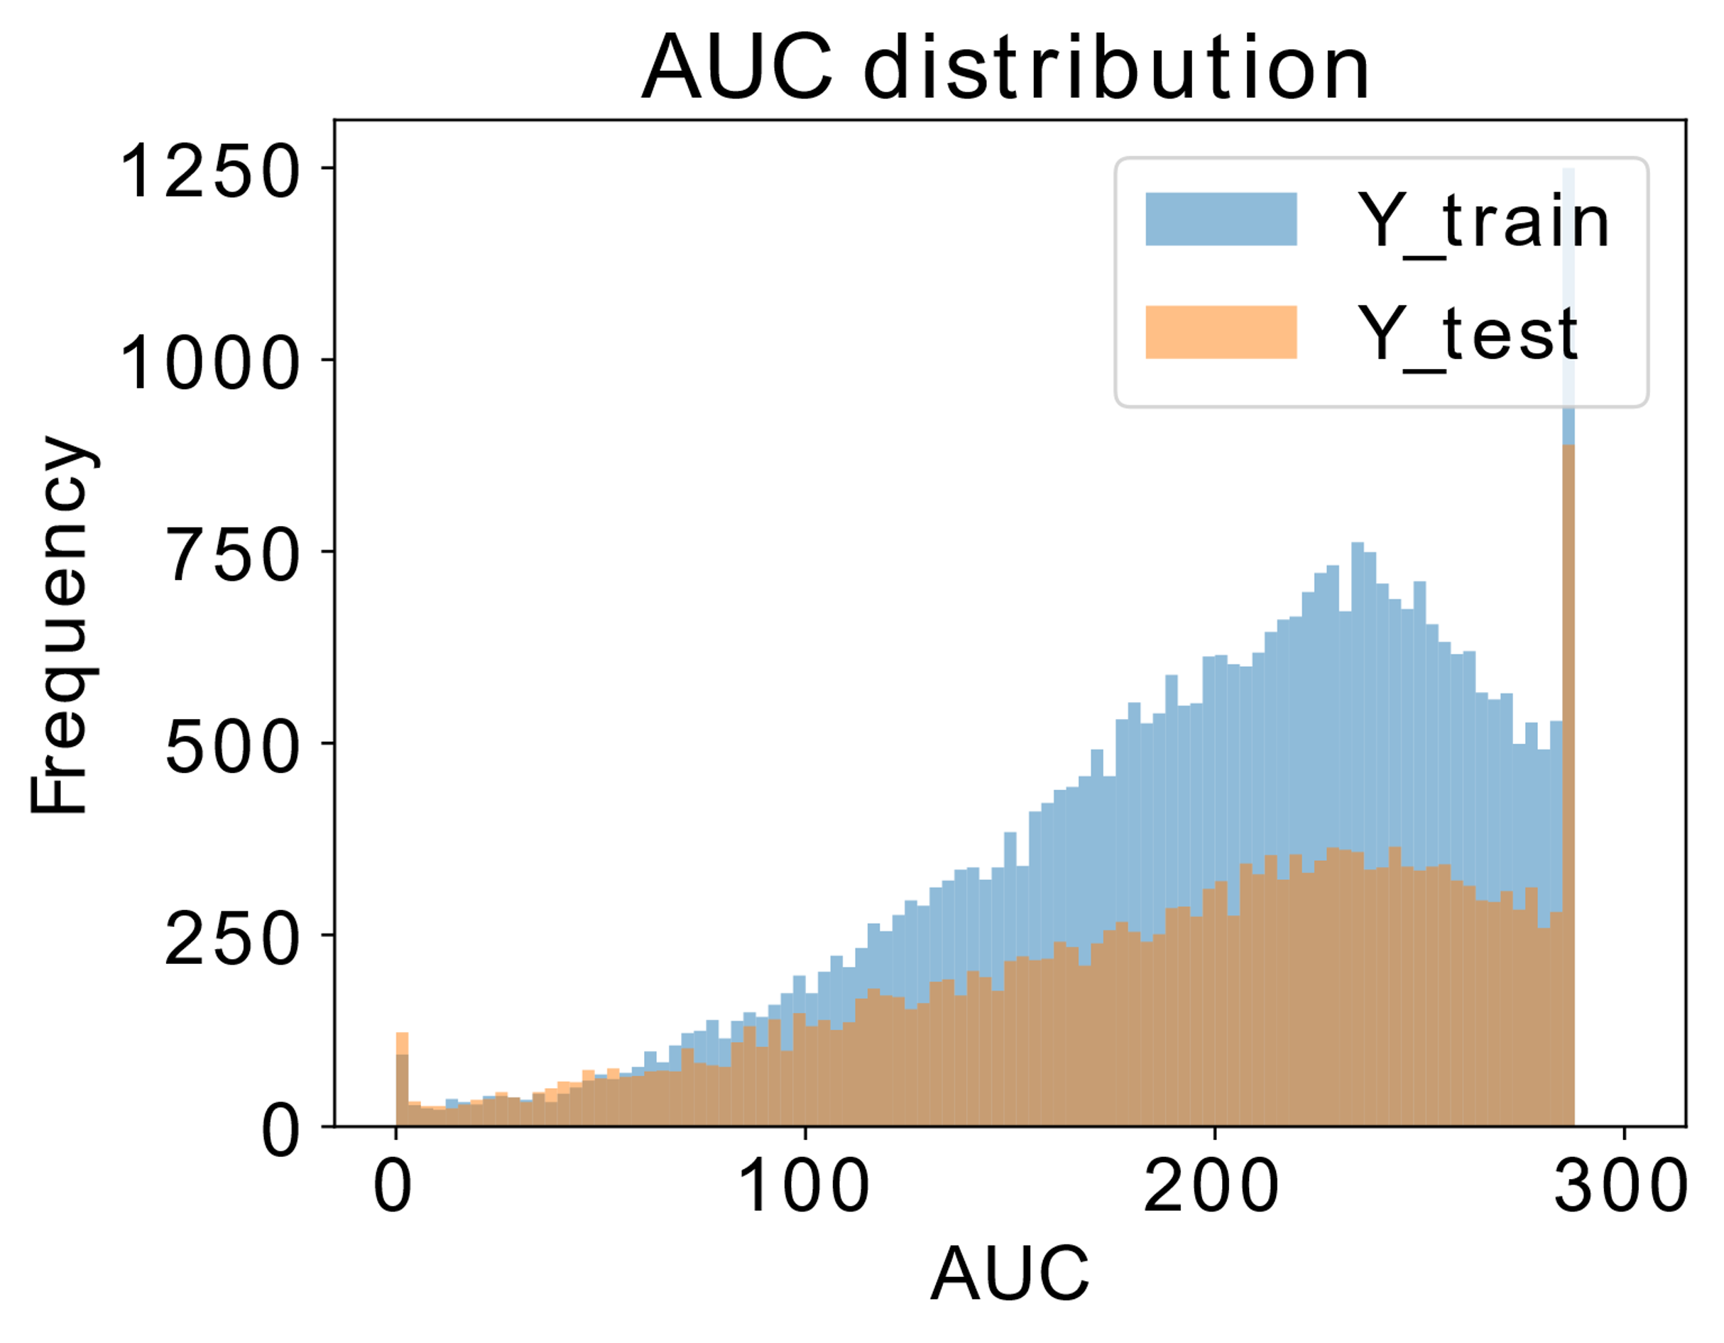
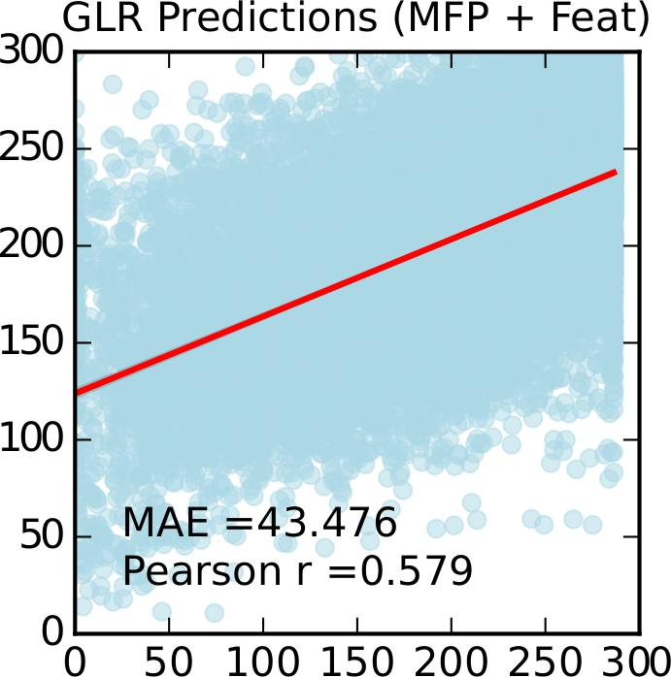
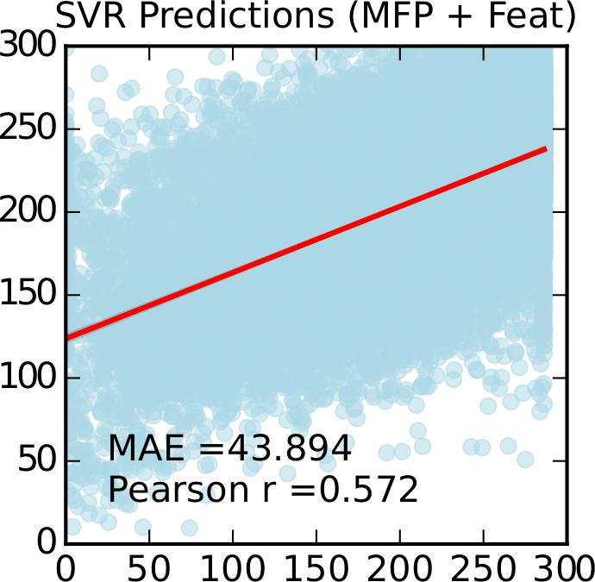
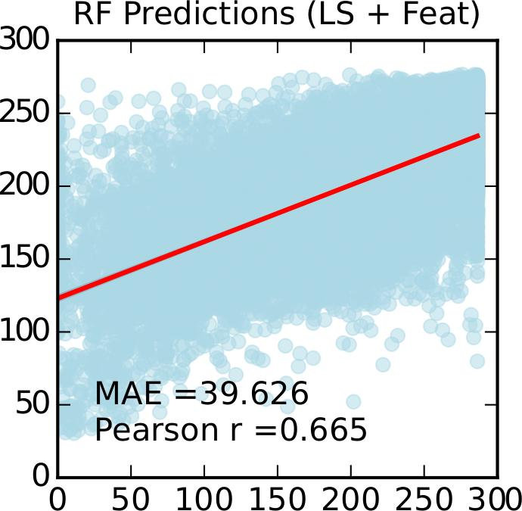
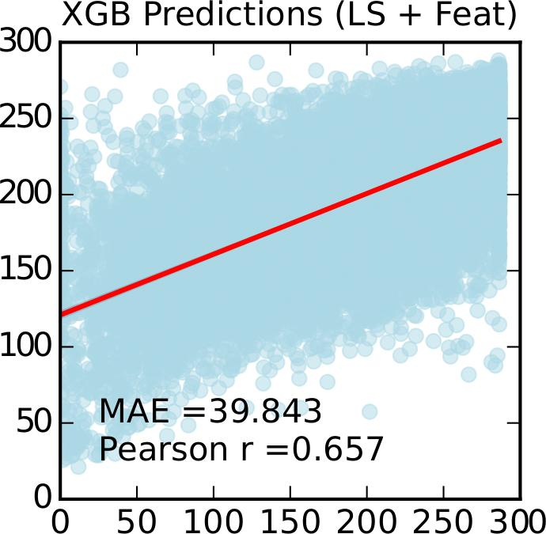
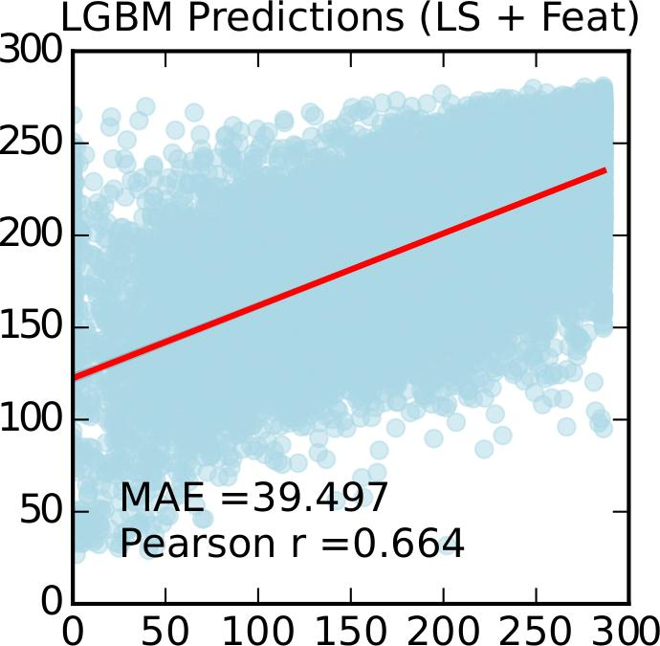
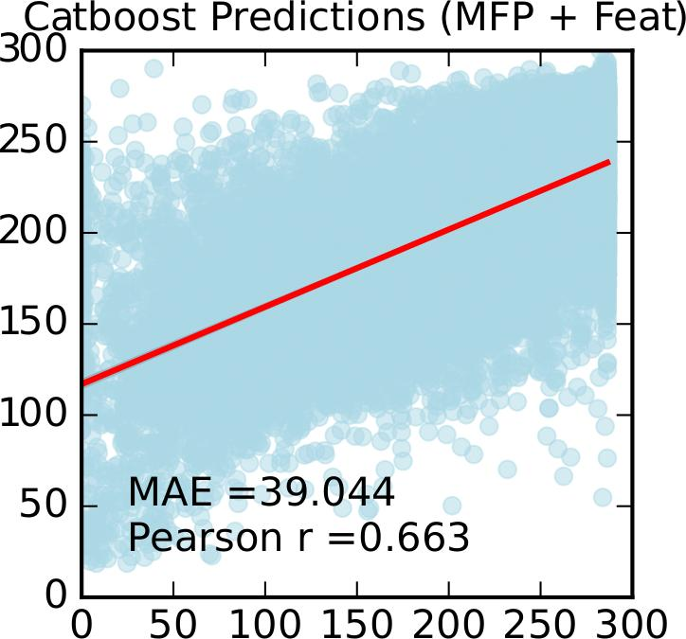
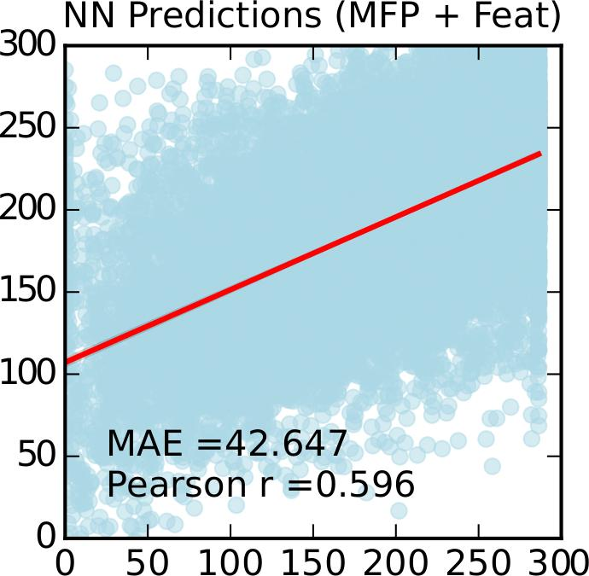
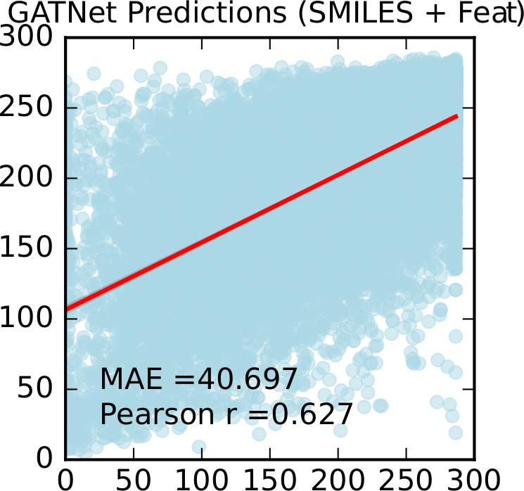
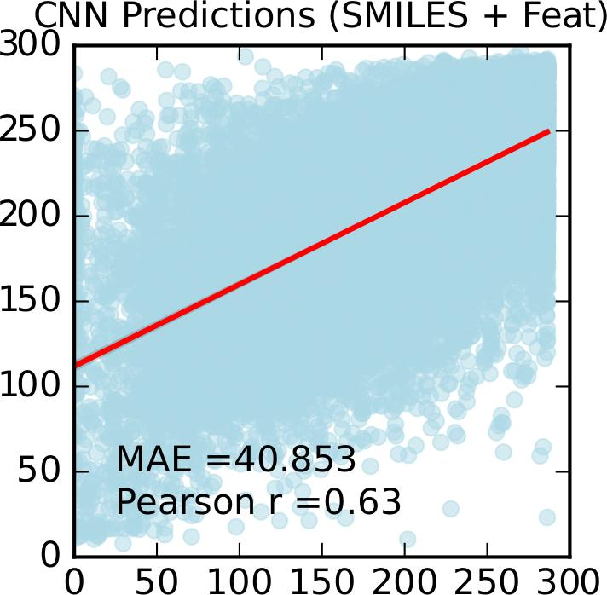
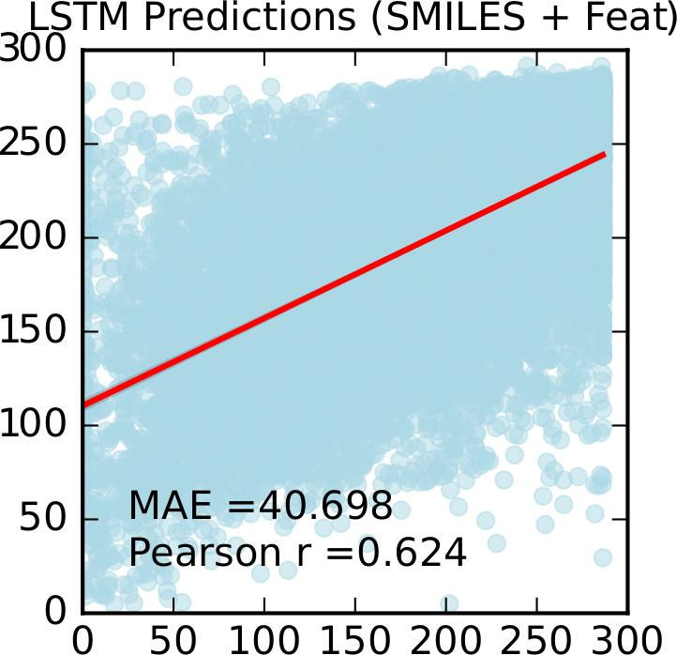
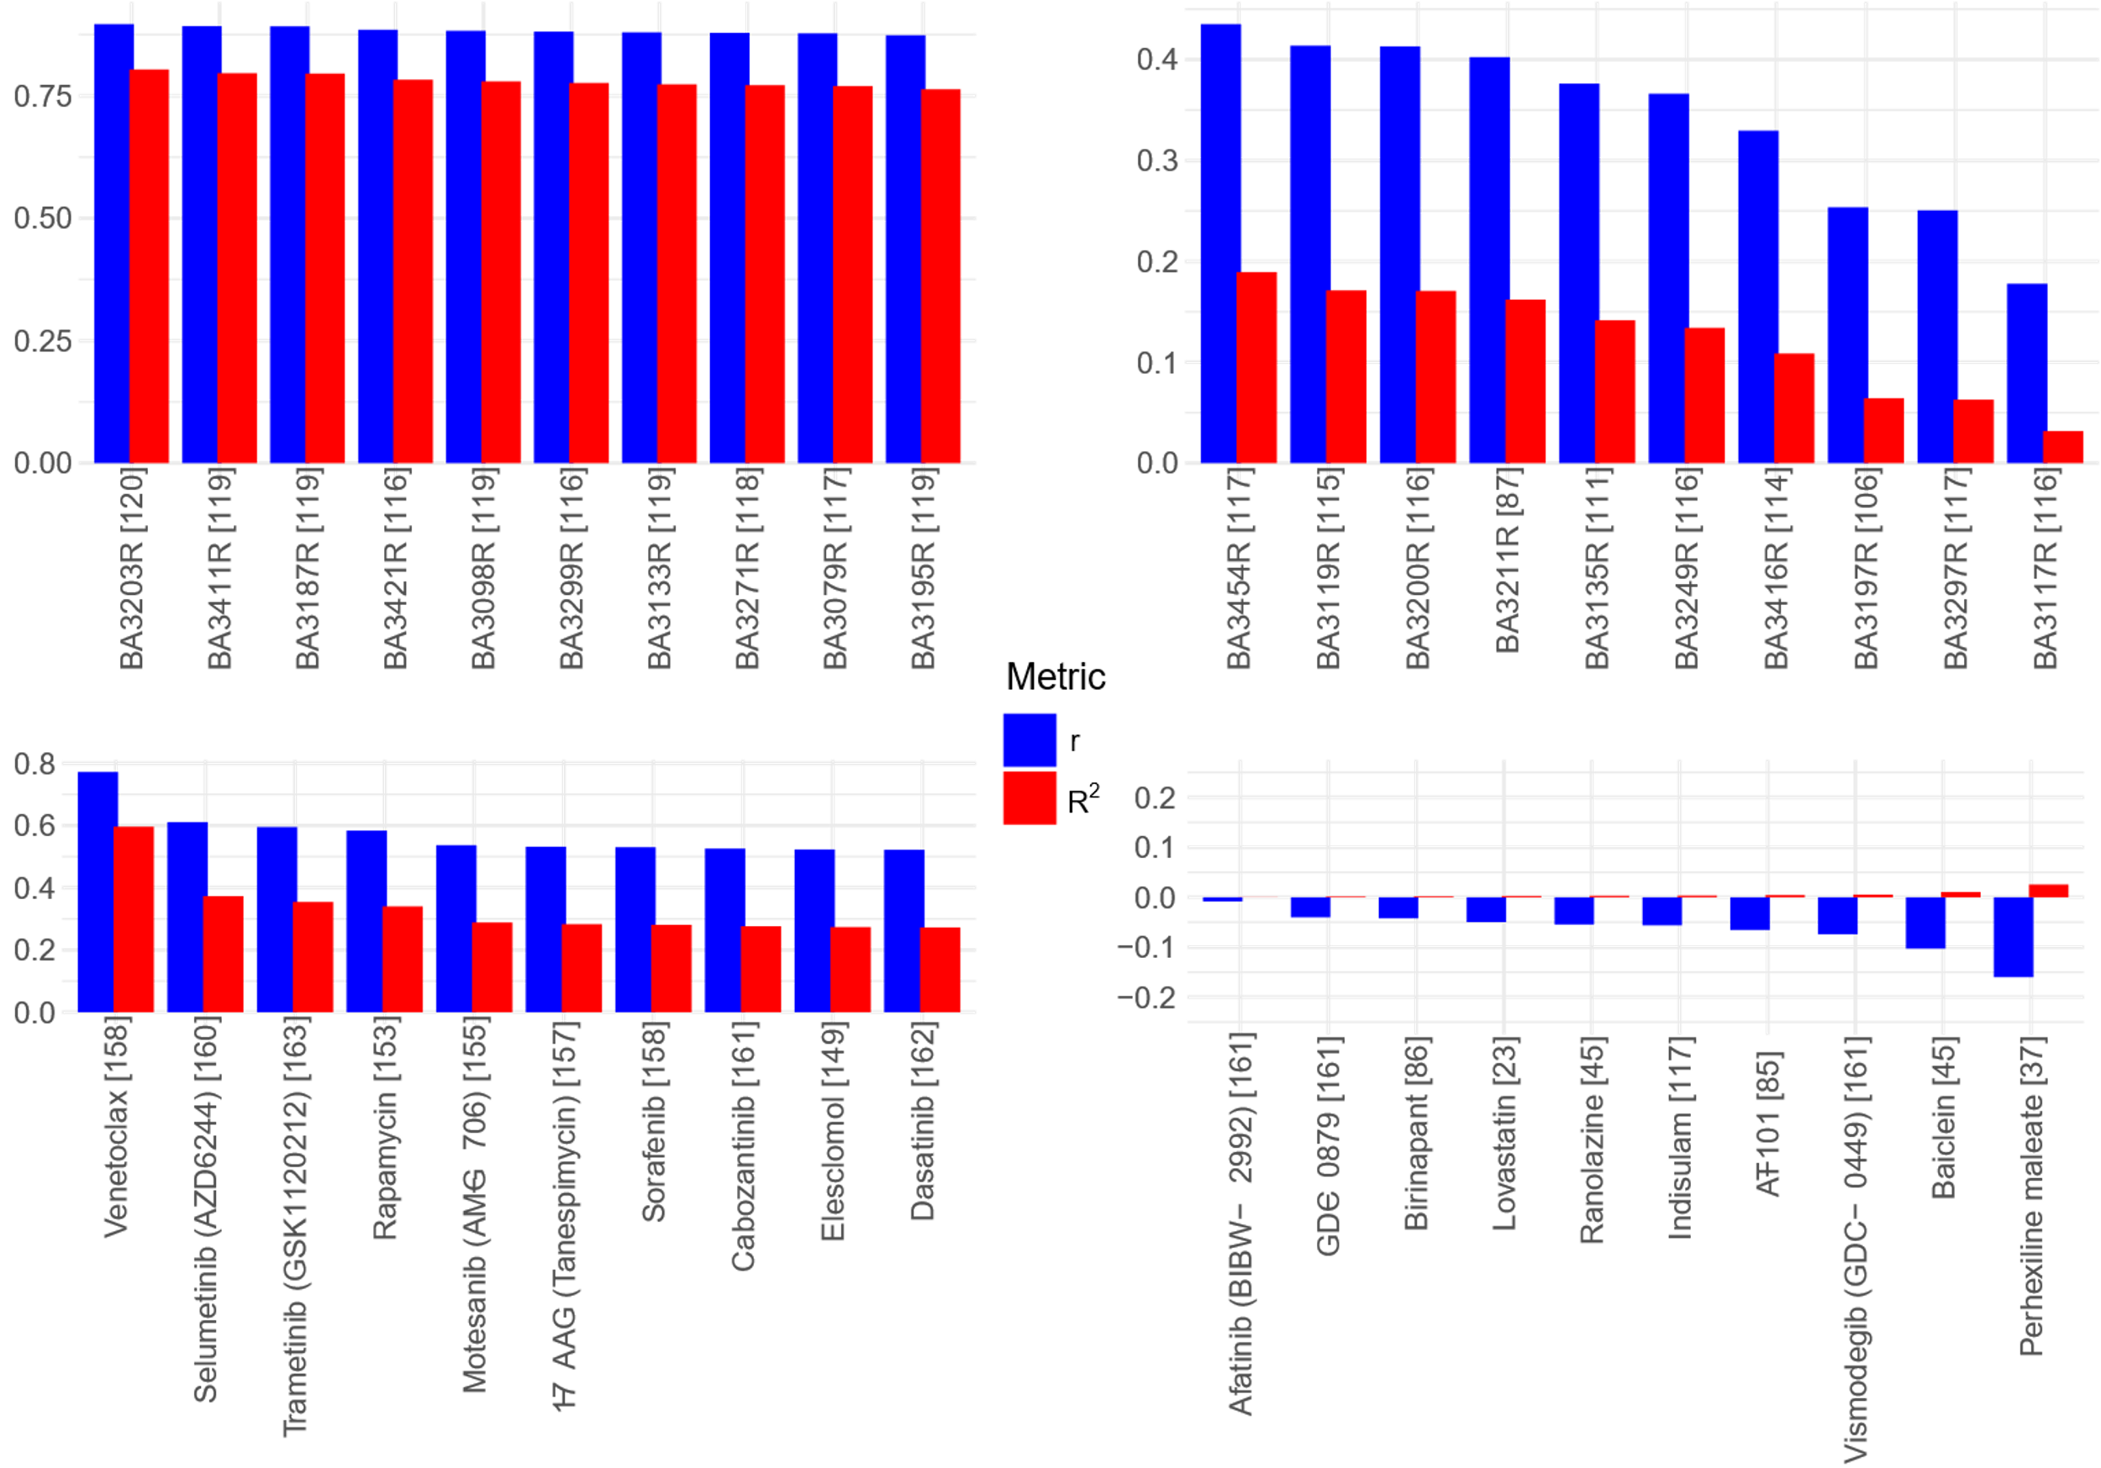
A
B
C
D
E
F
G
H
Predicted AUC
True AUC
I
J
K
L
Top Best Patient Predictions
M
Bottom Worse Patient Predictions
Top Best Drug Predictions
Bottom Worse Drug Predictions
Figure 4

Slide 11
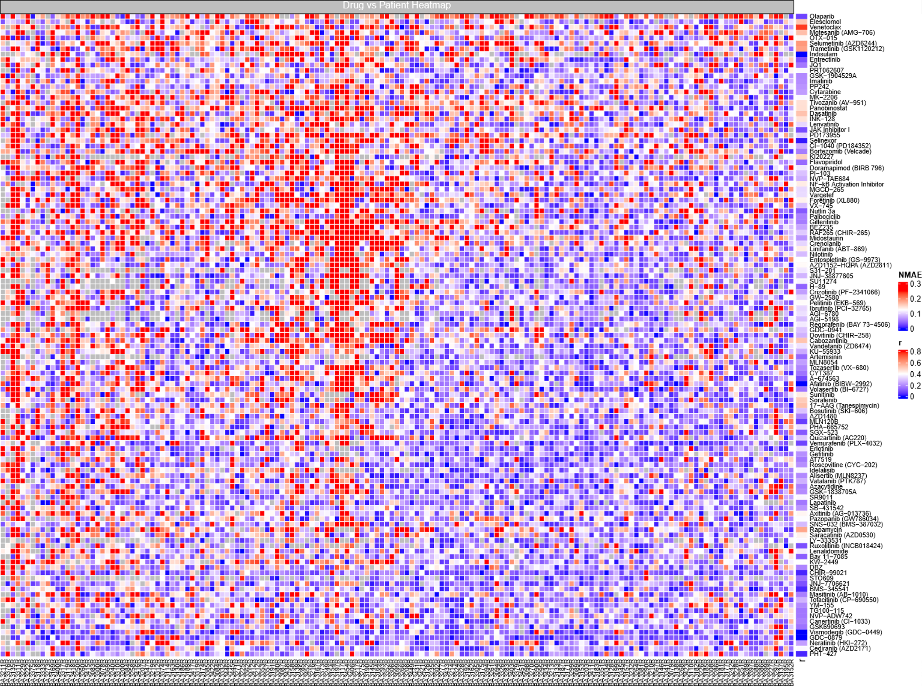
Figure 5

Slide 12
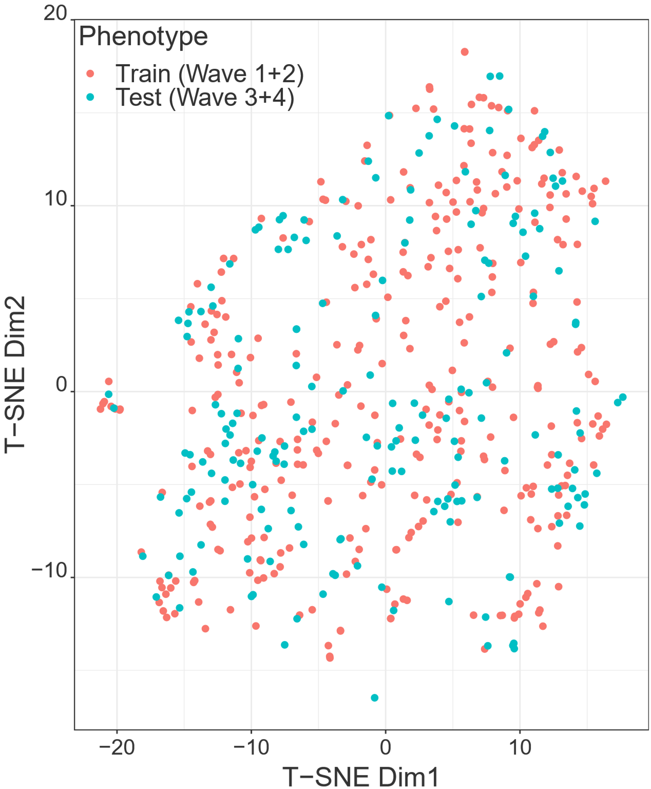
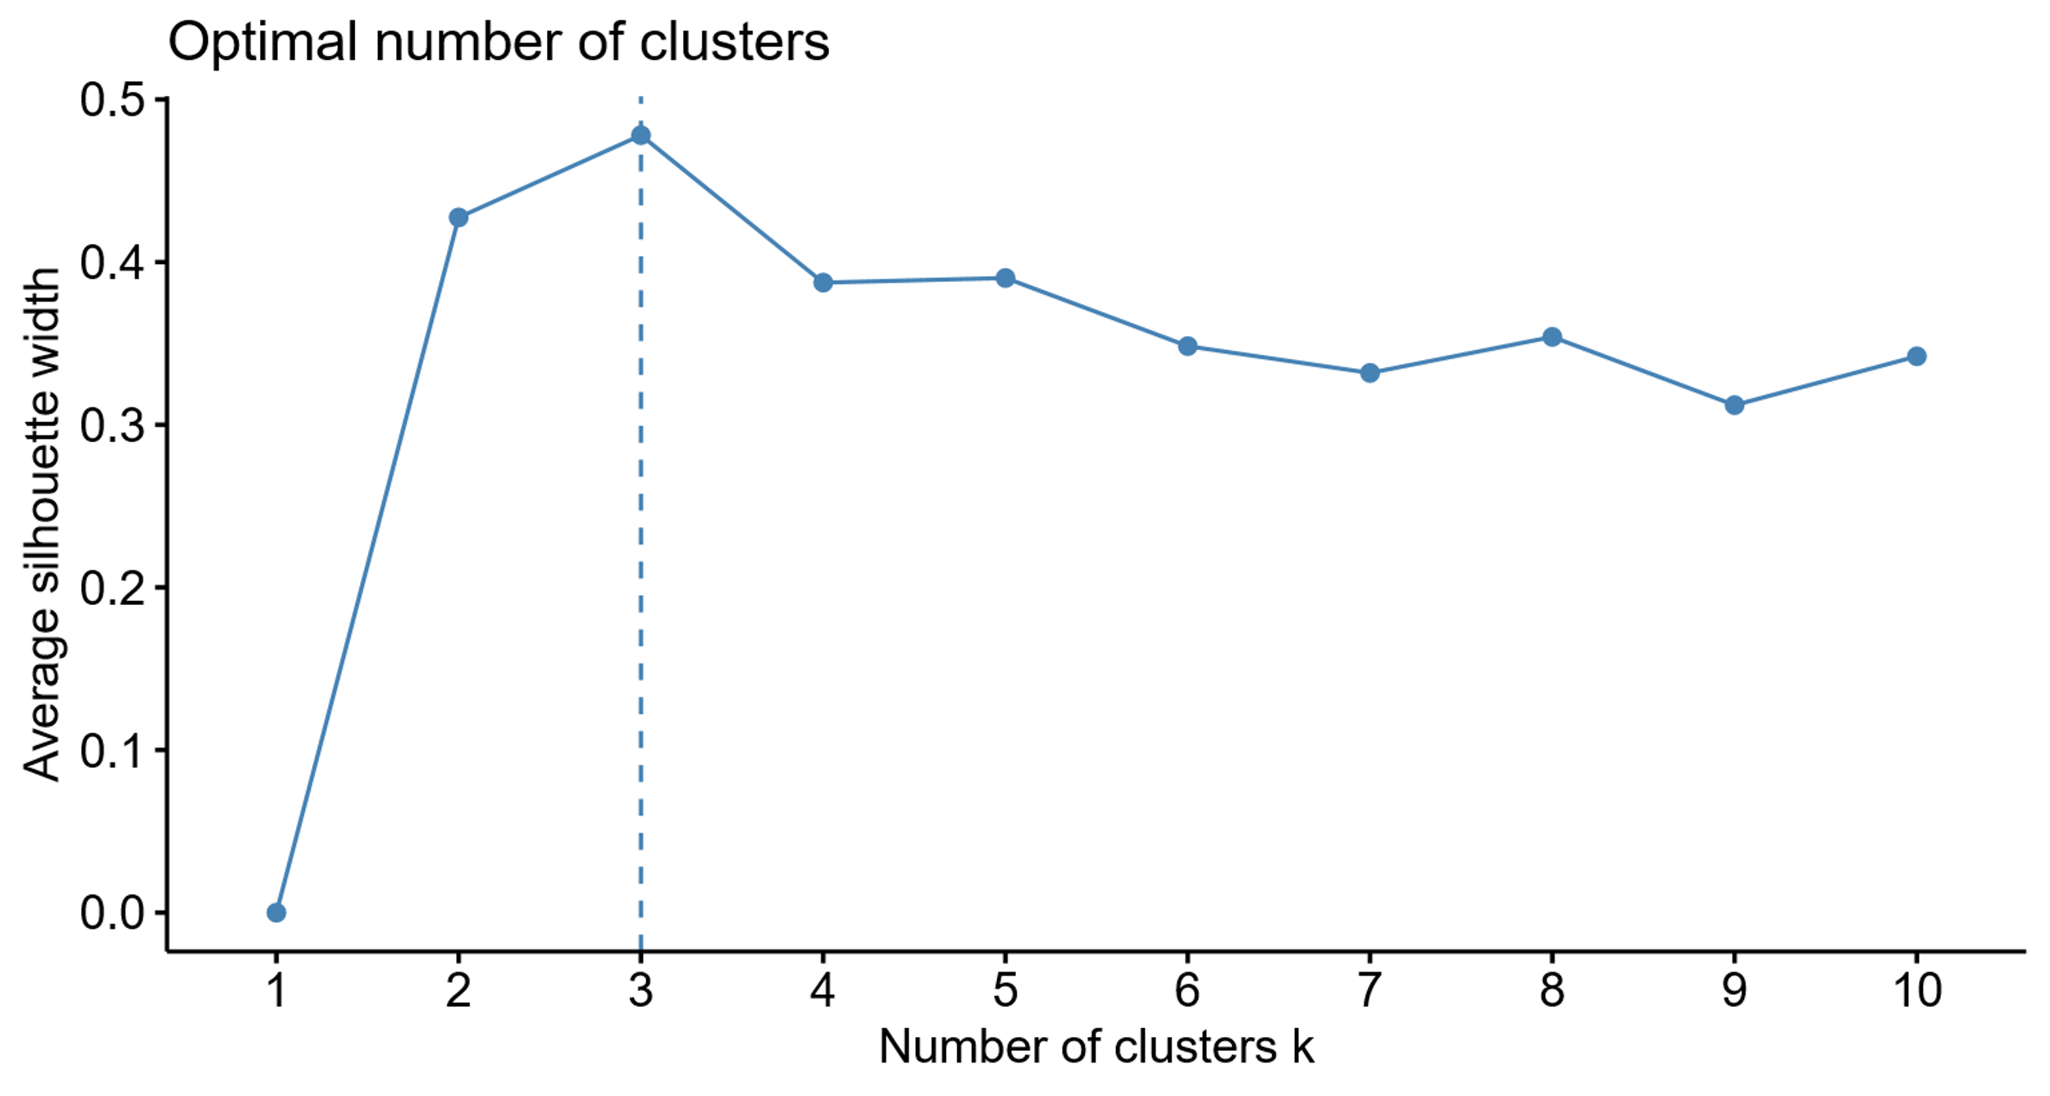
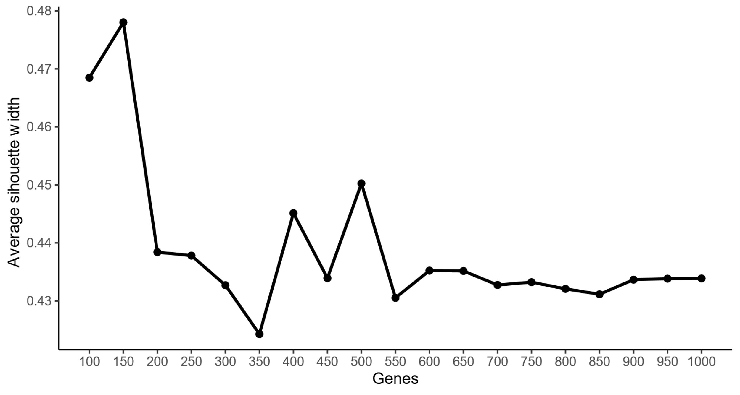
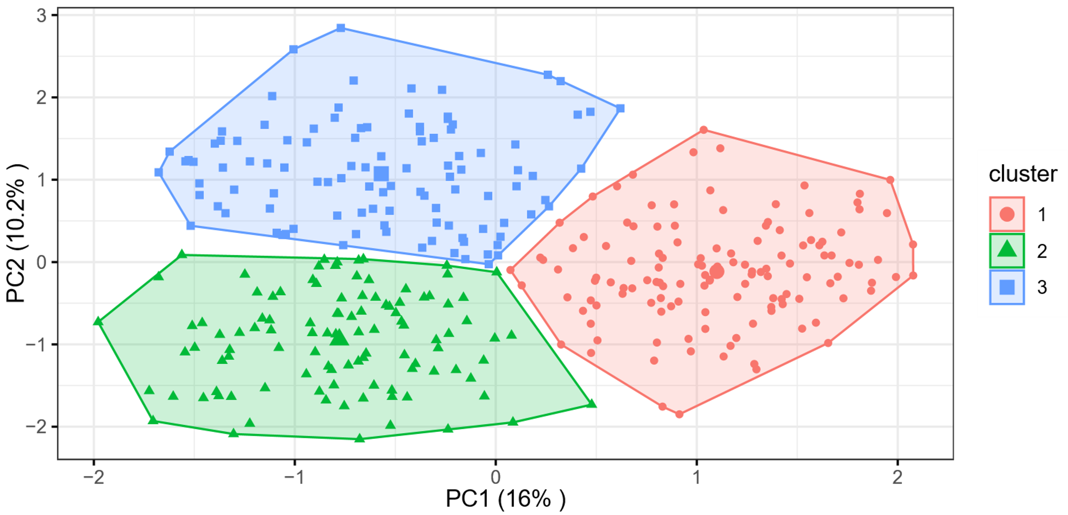
A
C
B
D
Supplementary Figure 1

Slide 13
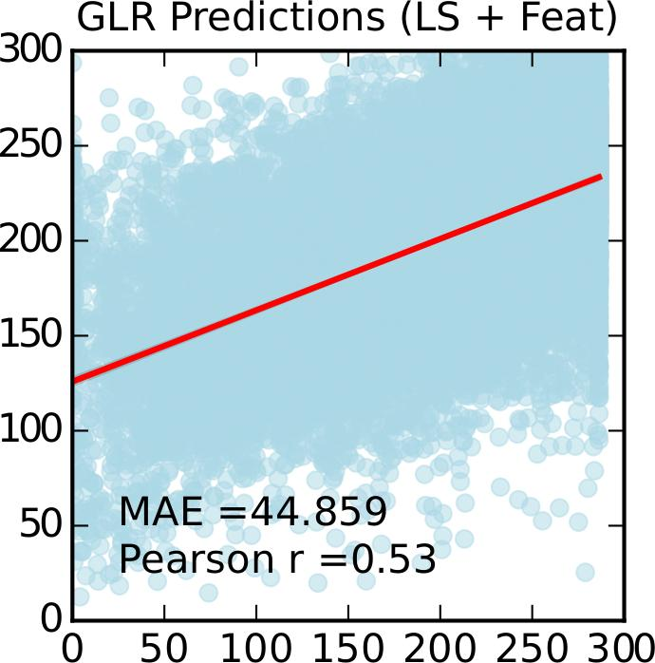
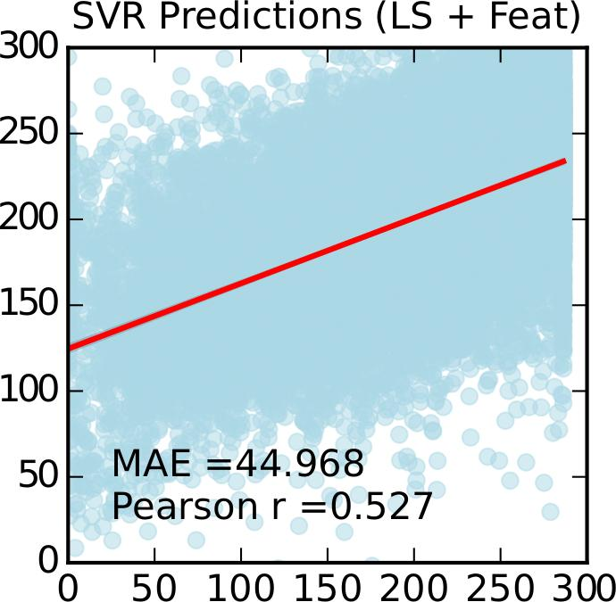
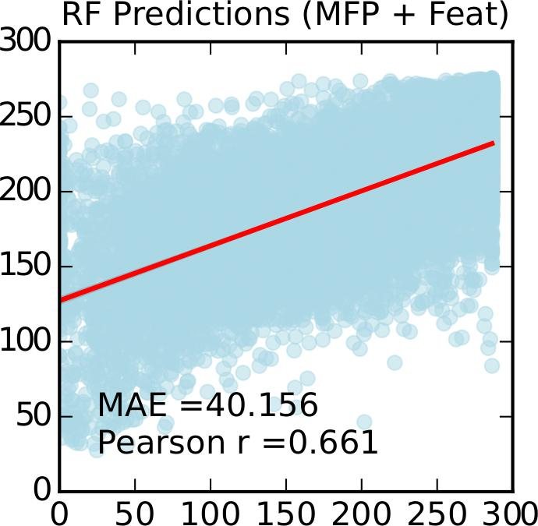
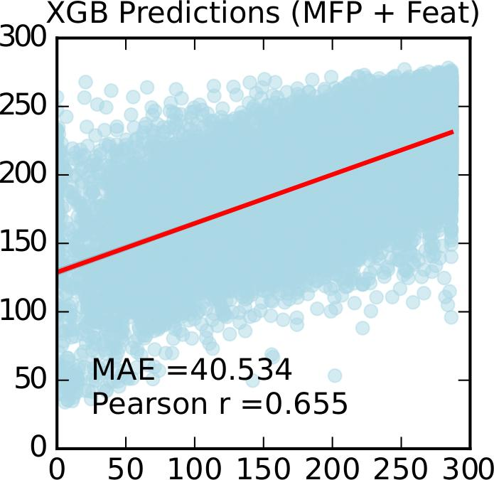
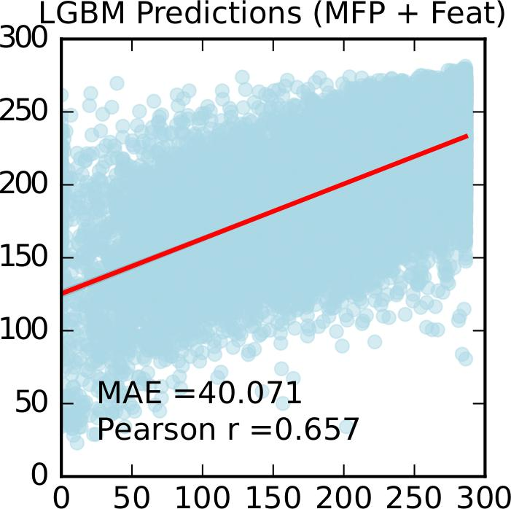
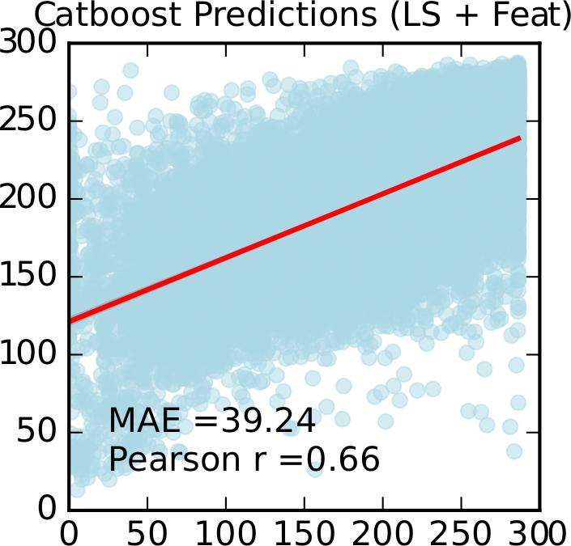
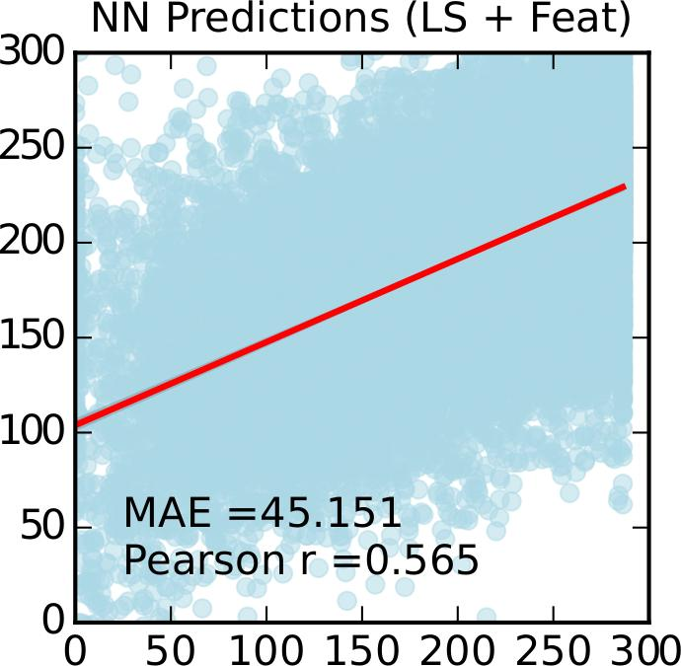
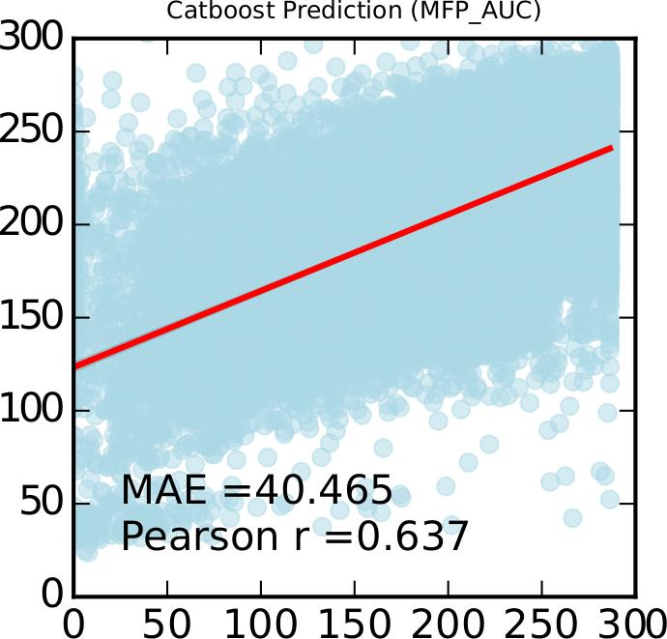
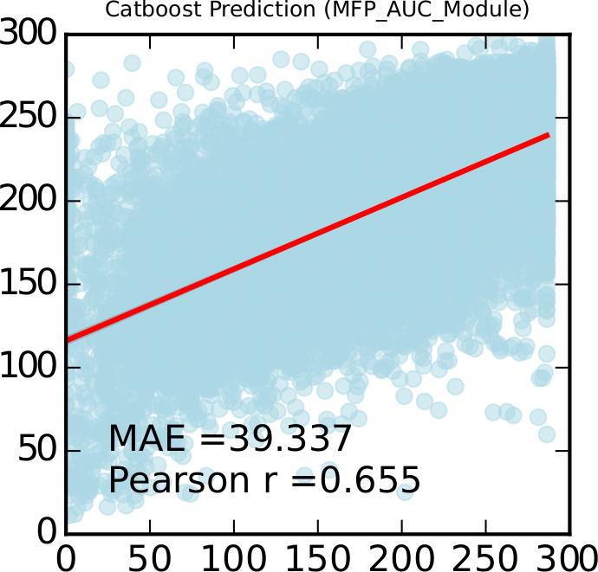
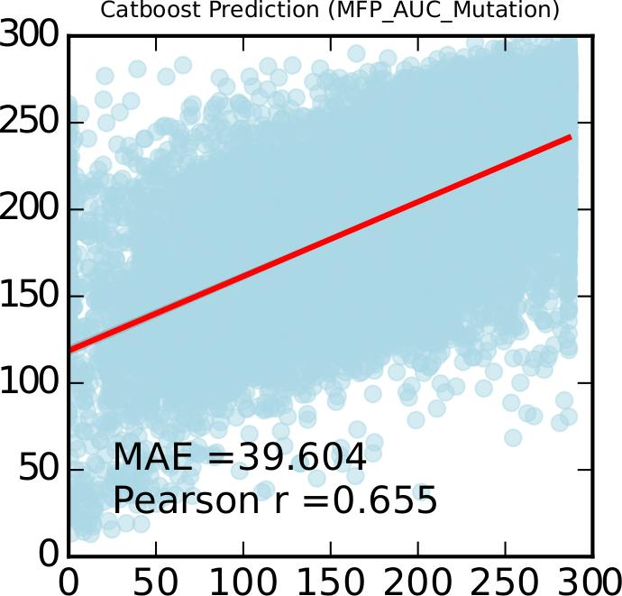
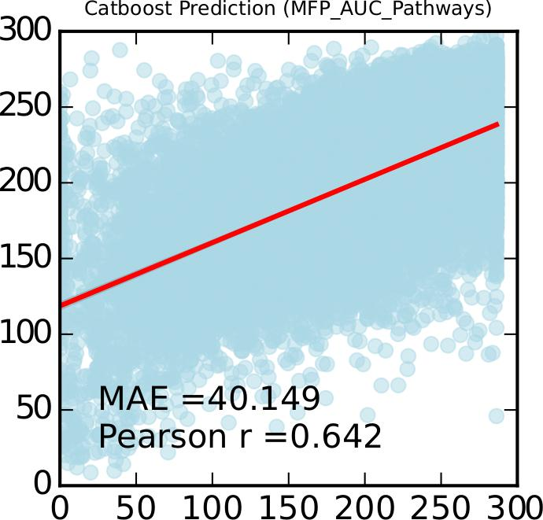








A
B
C
D
Supplementary Figure 2
E
F
G
Predicted AUC
True AUC
H
I
J
K
L
M
N
O
P
Q
R
S

Slide 14



A
B
C
Supplementary Figure 3

Slide 15
Methods | Features Used | CV (MAE) | Test (MAE) | CV (RMSE) | Test (RMSE) | CV (r2) | Test (r2) | CV Pearson (r ) | Test Pearson (r ) | CV Spearman (r ) | Test Spearman (r )
Ridge Regressor | LS + Cell Line | 30.224 +/- 1.972 | 44.859 | 40.342 +/- 2.906 | 60.005 | 0.555 +/- 0.052 | 0.281 | 0.744 +/- 0.034 | 0.53 | 0.742 +/- 0.032 | 0.556
Ridge Regressor | MFP + Cell Line | 29.925 +/- 1.917 | 43.476 | 40.103 +/- 2.891 | 57.257 | 0.559 +/- 0.052 | 0.336 | 0.747 +/- 0.034 | 0.579 | 0.745 +/- 0.033 | 0.578
Linear SVR | LS + Cell Line | 30.125 +/- 1.955 | 44.968 | 40.249 +/- 2.898 | 60.366 | 0.556 +/- 0.051 | 0.278 | 0.745 +/- 0.034 | 0.527 | 0.743 +/- 0.032 | 0.557
Linear SVR | MFP + Cell Line | 29.934 +/- 1.922 | 43.894 | 40.088 +/- 2.894 | 57.731 | 0.559 +/- 0.052 | 0.328 | 0.747 +/- 0.034 | 0.572 | 0.745 +/- 0.033 | 0.571
RF | LS + Cell Line | 21.824 +/- 0.973 | 39.626 | 29.865 +/- 1.514 | 52.277 | 0.787 +/- 0.021 | 0.442 | 0.887 +/- 0.012 | 0.665 | 0.886 +/- 0.009 | 0.656
RF | MFP + Cell Line | 20.749 +/- 1.221 | 40.156 | 28.287 +/- 1.834 | 52.528 | 0.817 +/- 0.021 | 0.437 | 0.904 +/- 0.012 | 0.661 | 0.9 +/- 0.01 | 0.649
XGBoost | LS + Cell Line | 24.288 +/- 1.212 | 39.843 | 31.939 +/- 1.755 | 52.339 | 0.728 +/- 0.038 | 0.432 | 0.853 +/- 0.022 | 0.657 | 0.835 +/- 0.022 | 0.65
XGBoost | MFP + Cell Line | 22.937 +/- 1.009 | 40.534 | 30.101 +/- 1.445 | 52.876 | 0.782 +/- 0.037 | 0.43 | 0.884 +/- 0.21 | 0.655 | 0.867 +/- 0.022 | 0.642
LightGBM | LS + Cell Line | 21.02 +/- 1.48 | 39.044 | 31.919 +/- 2.432 | 52.032 | 0.725 +/- 0.036 | 0.439 | 0.851 +/- 0.021 | 0.663 | 0.85 +/- 0.017 | 0.652
LightGBM | MFP + Cell Line | 23.232 +/- 1.079 | 40.071 | 31.123 +/- 1.651 | 52.554 | 0.752 +/- 0.037 | 0.432 | 0.867 +/- 0.021 | 0.657 | 0.854 +/- 0.021 | 0.644
Catboost | LS + Cell Line | 26.35 +/- 1.559 | 39.24 | 37.256 +/- 2.51 | 52.449 | 0.623 +/- 0.044 | 0.436 | 0.789 +/- 0.028 | 0.66 | 0.789 +/- 0.024 | 0.655
Catboost | MFP + Cell Line | 21.529 +/- 1.119 | 39.497 | 28.748 +/- 1.63 | 52.091 | 0.786 +/- 0.029 | 0.441 | 0.887 +/- 0.016 | 0.664 | 0.872 +/- 0.016 | 0.656
DNN | LS + Cell Line | 23.511 +/- 1.431 | 45.151 | 32.091 +/- 2.1 | 58.69 | 0.718 +/- 0.032 | 0.32 | 0.847 +/- 0.019 | 0.565 | 0.836 +/- 0.018 | 0.552
DNN | MFP + Cell Line | 18.189 +/- 1.05 | 42.647 | 25.422 +/- 1.582 | 56.177 | 0.824 +/- 0.018 | 0.356 | 0.908 +/- 0.01 | 0.596 | 0.899 +/- 0.01 | 0.587
Graph Attention Network + FFNN | SMILES + Cell Line | 26.312 +/- 0.370 | 40.697 | 37.113 +/- 0.644 | 54.904 | 0.643 +/- 0.0069 | 0.393 | 0.802 +/- 0.0042 | 0.627 | 0.800 +/- 0.0057 | 0.617
CNN + FFNN | SMILES + Cell Line | 26.026 +/- 0.228 | 40.85 | 37.031 +/- 0.489 | 55.6 | 0.646 +/- 0.0067 | 0.397 | 0.803 +/- 0.0043 | 0.63 | 0.800 +/- 0.0041 | 0.627
LSTM + FFNN | SMILES + Cell Line | 26.267 +/- 0.420 | 40.70 | 36.871 +/- 0.611 | 55.14 | 0.645 +/- 0.0076 | 0.389 | 0.803 +/- 0.0047 | 0.624 | 0.799 +/- 0.0056 | 0.618
Table 1: Performance comparison of different machine learning models

Slide 16
Features Used | CV (MAE) | Test (MAE) | CV (RMSE) | Test (RMSE) | CV (r2) | Test (r2) | CV (Pearson r) | Test (Pearson r) | CV (Spearman r) | Test (Spearman r)
MFP + AUC | 27.458 +/- 1.207 | 40.465 | 38.85 +/- 1.856 | 54.114 | 0.591 +/- 0.054 | 0.406 | 0.768 +/- 0.035 | 0.637 | 0.774 +/- 0.028 | 0.626
MFP + Onco +Var + AUC | 20.862 +/- 1.39 | 39.542 | 31.731 +/- 2.305 | 52.46 | 0.728 +/- 0.037 | 0.43 | 0.853 +/- 0.022 | 0.656 | 0.852 +/- 0.017 | 0.642
MFP + Pathways + AUC | 19.556 +/- 1.005 | 40.149 | 30.409 +/- 1.866 | 53.287 | 0.751 +/- 0.03 | 0.412 | 0.866 +/- 0.017 | 0.642 | 0.867 +/- 0.014 | 0.628
MFP + Modules + AUC | 20.996 +/- 1.183 | 39.337 | 31.81 +/- 2.001 | 52.509 | 0.728 +/- 0.033 | 0.429 | 0.853 +/- 0.019 | 0.655 | 0.854 +/- 0.015 | 0.644
MFP + Mutations + AUC | 22.004 +/- 1.185 | 39.604 | 32.911 +/- 1.944 | 52.854 | 0.709 +/- 0.038 | 0.429 | 0.842 +/- 0.022 | 0.655 | 0.843 +/- 0.018 | 0.64
MFP + AUC + Pathways + Modules | 25.35 +/- 1.324 | 39.398 | 36.136 +/- 2.137 | 52.482 | 0.646 +/- 0.044 | 0.432 | 0.803 +/- 0.027 | 0.657 | 0.804 +/- 0.023 | 0.647
MFP + AUC + Pathways + Mutations | 25.59 +/- 1.377 | 39.507 | 36.397 +/- 2.138 | 52.792 | 0.641 +/- 0.044 | 0.431 | 0.8 +/- 0.027 | 0.657 | 0.801 +/- 0023 | 0.648
MFP + AUC + Pathways + Onco +Var | 24.765 +/- 1.473 | 39.718 | 35.574 +/- 2.351 | 52.744 | 0.658 +/- 0.042 | 0.427 | 0.81 +/- 0.026 | 0.654 | 0.81 +/- 0.021 | 0.643
MFP + AUC + Modules + Mutations | 25.858 +/- 1.415 | 38.94 | 36.688 +/- 2.168 | 52.229 | 0.635 +/- 0.045 | 0.441 | 0.796 +/- 0.028 | 0.664 | 0.797 +/- 0.023 | 0.656
MFP + AUC + Modules + Onco + Var | 24.768 +/- 1.405 | 39.517 | 35.575 +/- 2.239 | 52.653 | 0.657 +/- 0.042 | 0.432 | 0.81 +/- 0.026 | 0.657 | 0.809 +/- 0.021 | 0.648
MFP + AUC + Mutations + Onco + Var | 24.749 +/- 1.477 | 39.289 | 35.578 +/- 2.396 | 52.387 | 0.657 +/- 0.044 | 0.437 | 0.81 +/- 0.027 | 0.661 | 0.81 +/- 0.022 | 0.651
MFP + AUC + Mutations + Modules + Onco + Var | 24.743 +/- 1.51 | 39.177 | 35.559 +/- 2.445 | 52.323 | 0.657 +/- 0.043 | 0.44 | 0.81 +/- 0.026 | 0.664 | 0.81 +/- 0.021 | 0.655
MFP + AUC + Mutations + Pathways + Onco + Var | 25.675 +/- 1.556 | 39.803 | 36.518 +/- 2.458 | 53.268 | 0.638 +/- 0.045 | 0.419 | 0.798 +/- 0.028 | 0.647 | 0.797 +/- 0.023 | 0.638
MFP + AUC + Modules + Pathways + Onco + Var | 24.718 +/- 1.461 | 39.422 | 35.531 +/- 2.354 | 52.581 | 0.658 +/- 0.046 | 0.433 | 0.811 +/- 0.028 | 0.658 | 0.81 +/- 0.023 | 0.648
MFP + AUC + Mutations + Modules + Pathways | 27.653 +/- 1.425 | 39.403 | 38.459 +/- 2.177 | 52.601 | 0.599 +/- 0.48 | 0.436 | 0.774 +/- 0.03 | 0.66 | 0.775 +/- 0.026 | 0.652
Supplementary Table 1: Ablation study of different feature sets used for the optimal model construction.

Slide 17
Background:
1. 699 cell lines from CCLE with 19,177 gene expression profiles. This information was downloaded from Cancer Dependency Map Public 21Q3. We filtered the original data consisting of 1,377 cell lines 🡪 699 cell lines to keep only those cell lines with COSMIC ids to match the drug-response dataset from GDSC portal. We include 10 features related to cell line metadata including age, gender, type, name of cell line etc. for the cancer cell lines.
2. Genes of interest include genes which are part of several inflammasome/inflammatory cell death pathways including:
a) Reactome inflammasome, b) KEGG nod like signaling pathway, c) GO biological process inflammasome complex, d) Reactome pyroptosis, e) Necroptotic signaling pathway from GO, f) PANoptosis pathway, g) Immunogenic cell death pathway (ICR) 🡪 total of 170 (167 of which are present in the 19,177 genes)
3. Seven pathways considered for inflammatory cell death as mentioned above.
4. We got the mutation profile and copy number variation profile for the 170 genes of interest. The mutation profile and copy number variation was obtained from Harmonizome database from Mayan lab.
5. We removed genes which had no variation in expression, mutation or CNV across cell lines including:
Mutation_ERBIN, Mutation_NLRP2B, Mutation_STMP1, Mutation_PYDC2, Mutation_CARD18, CNV_ERBIN, CNV_NLRP2B, CNV_STMP1
6. Total Features include:
Cell Line Features (10); b) Pathways (7); c) Expression (167); d) Mutation (162); e) CNV (164)
7. The dose response information is obtained from GDSC portal. It contains drug response for a particular cell line with prediction variables: IC50score and Z-score. In the GDSC portal, the Z-score is used to determine sensitive and resistant drugs with cut-offs of -2 and 2 respectively. We use the –log10(IC50score) as our y variable (term to predict). It contains 398 unique drugs and 989 cell lines.
8. The viability information is also obtained from GDSC portal. It contains cell viability at different dosage levels. Currently not used.
Methods:
The gene expression profile for each cell line is quantile normalized (19,177 genes), scaled and converted to z-scores.
T-sne plots are made for 699 cell lines with cancer types based on expression profiles as well as the features we have engineered.
A complexheatmap visualization of the different features used and how they look across the 699 cancer cell lines.

Slide 18
Background:
We obtained drug information for 399 drugs from GDSC portal and the cell line information for 699 cell lines from CCLE.
2. We curated and added each drug’s target from resources like Drug Bank, its SMILES, Inchikey, Molecular weight, molecular formula representations from PubChem, CheMBL and NCBI API.
3. There are a total of 373 unique drugs available from this dataset.
4. We find a total of 379,005 drug-cell line sensitivity profiles from GDSC portal (GDSC 1 & 2 combined).
After filtering, removing duplicates and combined drug plus cell line features, we end up with a total of 151,636 drug-cell line combination profiles consisting of 253 drugs and 693 cell lines.
Method:
We perform inner joins with drug profiles and cell line profiles to get drug-cell features used for the predictive models.
For each drug, we have its known targets. We perform a random walk with restart to get a random walk score for each drug using ‘diffusr’ package in R. It provides the probability of a drug impacting all the genes in our cell line’s expression profile. This affinity is based on topology and doesn’t consider individual gene’s expression in a particular cell line. To get a cell line specific affinity, we multiply the random walk scores with corresponding genes’ expression levels. Using this information and the gene set for each pathway, we estimate the distance of a drug from each of the 7 inflammasome related pathways using ‘AUCell’ package in R.
For each drug, we can estimate its molecular fingerprint representation using the RDKIT package in python.
For each drug, we can also estimate its representation using a transfer-learning based approach. We pass the drug SMILES to a TF-LSTM autoencoder trained on over 2 million drug SMILES and obtain a embedding vector representation of the drug which can be fed to a machine learning algorithm.
All the cell line information (expression, mutation, copy number) + drug information (vector representation) + pathway enrichments (pathway activation based on expression) and distance of a pathway from a drug’s known targets are used as features to predict the drug response.
We used a variety of machine learning methods including:
Linear Regression
Elastic Net
SVM
Random Forests
Xgboost
LightGBM
Feed Forward Neural Networks (DNN)
Graph Attention Network (GAT) + DNN
Convolutional Neural Network (CNN) + DNN
Long-Short Term Memory (LSTM) + DNN
We built different models on training set (565 cell lines) and test on a complete independent test set (128 cell lines on which no training is performed)
We highlight the variable importance (i.e. the top features) driving the prediction for each of these different machine learning models and performance is highlighted in Table.

Slide 19


A
Transfer Learning
Output
DeepRepurpose:
TF-LSTM model trained on 2.5 million compounds from PubChem + MOSES.
96.7% reconstructed compounds are valid.
μ_{error} per sample is 0.001
Input
TF– LSTM Model
Embedding Vector
B
Pathway Distance Estimation
Expression
Profile
Pathway
X
AUcell
AUC = 1 - Distance
Random Walk with Restart
on the STRING PPI network
Probability (p∞)
p∞= β(I – (1- β)W)⁻¹p₀
Drug Targets
C
Immune Profiling
SSGSEA
Immune Cell Activations
Thorsson et al,
Immunity 2018
Expression Profile
De-convolution
MCPcounter
Immune Cell Fractions
Immune Celltypes
Unused Data

Slide 20

Research Article Checklist should be placed after presentation

