Slide 1
STUXNET
Analysis and Demonstration of the Stuxnet Cyberattack
By:
Ethan Deakin - 22529799
Harin Ramji - 21521277

Slide 2
Introduction
Introduction to Stuxnet:
Stuxnet is a complex computer worm discovered in 2010 targeting Iran’s nuclear program. It is believed to be developed by the United States and Israel.
Stuxnet is unique in that it is one of the first known viruses to directly affect physical infrastructure.
Introduction to Natanz:
Natanz is a uranium enrichment facility located in Iran.
It was one of the main targets of the Stuxnet attack.
Purpose of the Presentation:
The aim of this presentation is to learn about the details of the Stuxnet attack on Natanz.
We will explore how Stuxnet works, focusing on its ability to exploit known vulnerabilities in industrial systems.
We will also discuss the implications of such cyber attacks on global security and propose strategies to mitigate such threats in the future.

Slide 3
Relevance:
A groundbreaking cyber weapon, marking the dawn of a new era where industrial systems became targets in digital warfare.
Impact
Significant damage to centrifuges- over speeding/slowing down centrifuges, delayed nuclear progress.
Awareness- Presence of cyber attacks and the potential impacts it could have if in the wrong hands.
Notes:
Stuxnet is a incident, showcasing the capabilities of cyber warfare on industrial control systems. It was specifically created to attack Iran nuclear program.
The primary focus of this attack was to exploit SCADA systems particularly those using siemens Software.
It is widely believed to be created by USA and Israel (None of the countries have owned up to creating this Virus) and was used to target Iran’s Nuclear program. The most devastating aspect of it was a t Natanz where the virus overspeed/slowed down centrifuges used to enrich uranium.

Slide 4
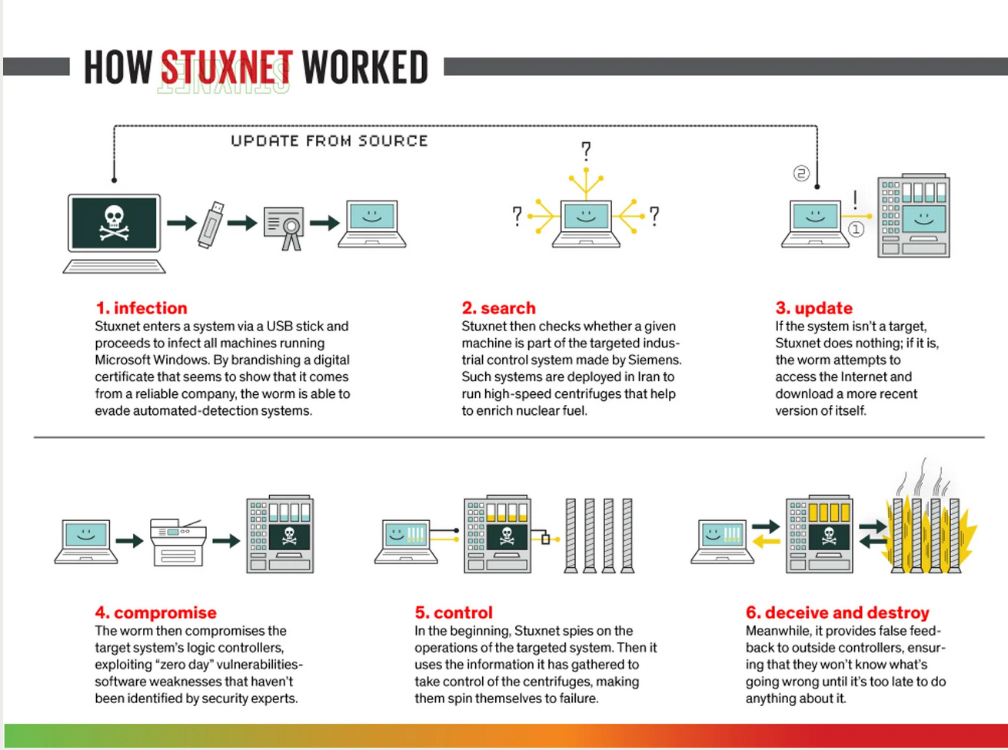
Brief Description
https://spectrum.ieee.org/the-real-story-of-stuxnet

Slide 5
Technical details
Target: Stuxnet specifically targets programmable logic controllers (PLCs), which allow the automation of electromechanical processes such as those used to control machinery and industrial processes including gas centrifuges for separating nuclear material1.
Impact: Stuxnet reportedly compromised Iranian PLCs, collecting information on industrial systems and causing the fast-spinning centrifuges to tear themselves apart1.
Stuxnet Components:
Worm: Executes all routines related to the main payload of the attack.
Link File: Automatically executes the propagated copies of the worm.
Rootkit: Responsible for hiding all malicious files and processes, to prevent detection of Stuxnet
Exploited Vulnerabilities: Stuxnet exploited no fewer than four zero-day bugs:
A Windows Shortcut flaw, A bug in the print spooler, Two escalation of privilege vulnerabilities, Along with a zero-day flaw in the Siemens PLC’s
Stuxnet explained: The first known cyberweapon | CSO Online
Notes:
Highlighted the risk of unpatched systems.
Stolen digital certificates:
Legitimate digital signatures used for authentication.
Made malware appear trustworthy
Bypassed security measures.
Undermined trust in digital certificate systems.

Slide 6
Continued…
Dwell Time: As this virus took years to create and lots of planning to propagate, we cannot make an exact figure on the dwell time but we can make a rough estimate- 1 Year (+/- 6months). This means that the worm was lurking around the air-gaped intranet in Natanz trying to spread out and inflict maximum damage.
Propagation Methods:
USB drives
Network spread
Notes:
Propagation
USB drives:
Initial infection through physical USB drives.
Spread malware to isolated networks.
Showed the vulnerability of offline systems.
Network spread:
Once inside, malware moved laterally through the network.
Quickly infected multiple systems.
Demonstrated the danger of internal network vulnerabilities

Slide 7
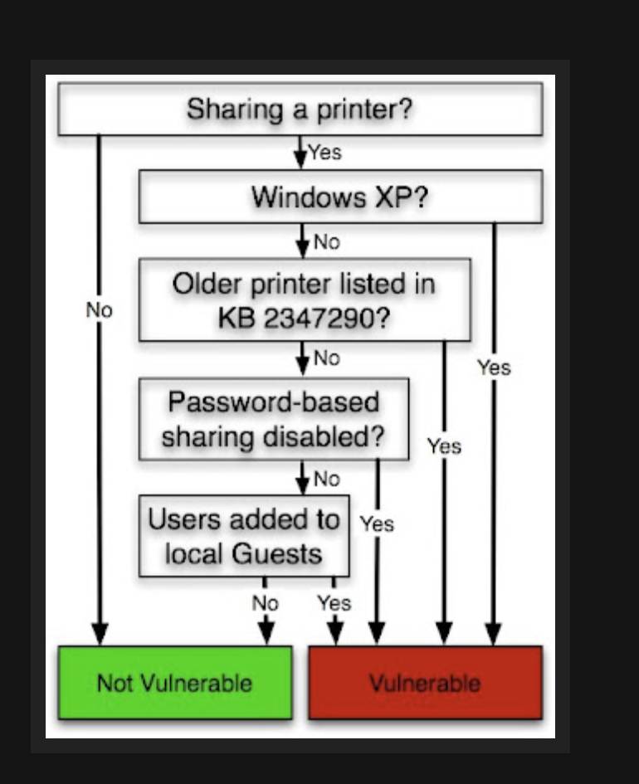
Propagation
This picture shows us how the virus exploits 1 of the zero day exploits. The (MS10-061) vulnerability permits to remotely execute code with SYSTEM privilege on a Windows XP machine if a printer is shared on the network.
http://poppopret.blogspot.com/2011/09/playing-with-mof-files-on-windows-for.html

Slide 8
Demonstration

Slide 9
Fallout Analysis
Immediate Consequences:
Increased Cybersecurity Awareness
Discovery and Analysis of Advanced Malware
Development of Defensive Technologies
Impact on Iranian Nuclear Program
Long-term Consequences:
Focus on ICS Security: Stuxnet brought to light the vulnerabilities in ICS and SCADA systems.
Enhanced Protection Measures
Increased Public Awareness.
Education and Training.
Notes:
The cybersecurity community gained deeper insights into reverse engineering complex malware, improving overall capabilities in malware analysis and defense.
Enhanced Protection Measures:
There was an increase in the development of security measures specifically designed for ICS and SCADA systems using specialized firewalls, intrusion detection systems, and security protocols.
Increased Public Awareness: Stuxnet brought cybersecurity issues into the public eye, raising awareness among the general public and policymakers about the importance of cybersecurity.
There was a push for improved education and training programs to build a more robust cybersecurity workforce capable of addressing emerging threats.

Slide 10
TIMELINE
2005-2007: Planning and Development
2005: Initial development starts.
2006: Early testing and refinement.
2007-2009: Deployment and Initial Spread
2007: Deployment begins, spreads unnoticed.
2008: Continues spreading through USB drives and networks.
2009: Initial Impact and Detection
June: Disruptions in Iran’s nuclear facilities.
June: VirusBlokAda identifies new malware.
2010: Discovery and Analysis
June: Stuxnet publicly identified and analyzed.
July: Symantec reveals sophisticated nature.
September: Siemens acknowledges impact.
Notes:
2005-2007: Development of Stuxnet
The malware's primary objective was to sabotage Iran's nuclear enrichment capabilities by targeting Siemens software running on
Windows operating systems, which controlled industrial processes at the Natanz uranium enrichment facility.
2008: Deployment of Stuxnet Deployment: Stuxnet is deployed into the Iranian nuclear facility's network via infected USB drives, exploiting zero-day vulnerabilities to infiltrate the system
.Initial Spread: The worm spreads within the network, seeking out specific PLCs (Programmable Logic Controllers) to modify the code controlling the centrifuges used for uranium enrichment.
June 2010: Discovery of Stuxnet Discovery by VirusBlokAda:
Stuxnet is first discovered by VirusBlokAda, a Belarusian cybersecurity firm, when it infects a computer outside Iran.Analysis Begins: The discovery leads to a detailed analysis by cybersecurity researchers worldwide, including experts from Symantec and Kaspersky Lab, who uncover its sophisticated and unprecedented capabilities.
.

Slide 11
2011: Public Awareness and Impact
January: NYT reports U.S.-Israeli project.
February: Iran admits significant damage.
June: Further analysis reveals targeting mechanisms.
2013-Present: Legacy and Continued Impact
2013: Confirmation of Stuxnet’s role in cyber warfare.
2015: Intensified cybersecurity discussions.
Notes:
July 2010: Public Disclosure
Public Awareness: The existence of Stuxnet is publicly disclosed, leading to widespread media coverage and discussions about its implications.
Detailed Reports: Researchers publish detailed reports on Stuxnet's functionalities, revealing its use of multiple zero-day exploits and its targeted nature.
Late 2010: Attribution Speculations
Speculations of State Involvement: Speculations arise about the involvement of nation-states in the development of Stuxnet, with evidence suggesting it was a joint operation by the United States and Israel aimed at disrupting Iran's nuclear program.
Geopolitical Implications: The malware's discovery and suspected origins lead to increased geopolitical tensions, particularly between Iran, the United States, and Israel.
2011: Impact on Iranian Nuclear Program
Delayed Nuclear Progress: Stuxnet successfully disrupts Iran's uranium enrichment process, causing significant damage to around 1,000 centrifuges and delaying Iran's nuclear program.
Iran's Response: Iran acknowledges the attack and announces measures to enhance its cybersecurity defenses, while continuing to develop its nuclear capabilities.
2011-2012: Further Analysis and Awareness
In-Depth Analysis: Continued analysis of Stuxnet reveals its complexity and advanced nature, contributing to a deeper understanding of cyber warfare capabilities.
Awareness Campaigns: Increased efforts to raise awareness about the potential risks and impact of cyber attacks on critical infrastructure.
2013: Legacy and Influence
Security Enhancements: Organizations and governments worldwide begin implementing enhanced cybersecurity measures to protect critical infrastructure from similar attacks.
Cyber Warfare Dialogue: The international community engages in discussions about the norms and rules governing state behavior in cyberspace, influenced by the implications of Stuxnet

Slide 12
Mitigation Strategies
Immediate Measures:
Isolate affected systems- helps prevent further spread of the virus
Apply patches.-
Long-term Measures:
Network segmentation-limit the spread of the attack
Regular updates and patches especially windows systems.
Advanced IDS(Intrusion Detection Systems) – can detect unusual activity that might show a breach
Behavioral Analytics – this involves monitoring for abnormal behaviour
ICS-CERT recommends that control system owners and operators review system upgrades and consider applying available patches to mitigate the risks for Stuxnet infections
Stuxnet Malware Mitigation (Update B) | CISA
Notes:
Implementation of Advanced Intrusion Detection Systems (IDS):Intrusion Detection Systems (IDS) and Intrusion Prevention Systems (IPS) can help identify and mitigate threats early. They monitor network traffic for suspicious activity and alert administrators.Deploying SIEM (Security Information and Event Management) systems to gather and analyze security data from multiple sources in real-time.
Behavioral Analytics:Use machine learning and AI to understand normal network behavior and detect anomalies indicative of a cyber attack.Identifying unusual access patterns or changes in network traffic that may signal an infiltration attempt.
Strengthening Critical Infrastructure Security:
Segmentation of Networks:
Isolate critical systems from less secure networks to limit the spread of malware.Using VLANs (Virtual Local Area Networks) to separate different segments of an organization's network.
Regular Software and System Updates:
Ensure all systems are regularly patched and updated to fix known vulnerabilities.Implementing a rigorous patch management process to ensure timely updates of all critical systems.
Multi-Factor Authentication (MFA):
Strengthen access control to sensitive systems and data by requiring multiple forms of verification.Combining something the user knows (password) with something the user has (smartphone for OTP) or something the user is (biometrics).
Proactive Cybersecurity Measures:
Threat Intelligence Sharing:
Participate in information sharing groups to stay updated on the latest threats and vulnerabilities.Joining industry-specific ISACs (Information Sharing and Analysis Centers) to receive threat intelligence and best practices.

Slide 13
Future Implications
The Stuxnet attack has far-reaching cybersecurity and policy implications, as it demonstrates that nation-states are susceptible to crippling cyber actions from other nation-states or private entities

Slide 14
Recommendations
Preventive Measures:
Regular Updates on Computers- It is important that all devices are up-to date so that patches for security vulnerabilities are available on your machine.
Regular security assessments-Regular security assessments can help identify vulnerabilities and risks in your systems before they can be exploited
According to NIST implementation of Multi-factor authentication (MFA) also delays attacks. It makes attacking systems becomes much harder since there are more obstacles to overcome. Employee Training: Regular training can help employees recognize and avoid potential threats, such as phishing emails.
Least Privilege Principle: Limiting user access rights to only what’s necessary for their work can reduce the potential impact of a breach
Proactive Strategies:
Incident response plans-Having a well-defined incident response plan can help organizations respond to a security incident, minimizing damage and reducing recovery time and costs
Threat intelligence- staying updated on recent threats in the industry.
Collaboration for information sharing.
Notes:
Regular security assessments:
Identify and fix vulnerabilities.
Conduct regular tests and prioritize fixes.
Multi-factor authentication (MFA):
Adds extra security layers.
Use various methods like SMS, apps, or tokens.
Proactive Strategies
Incident response plans:
Ensure swift response to incidents.
Train and drill the response team regularly.
Threat intelligence:
Stay updated on emerging threats.
Analyze threat data and share with stakeholders.
Collaboration for information sharing:
Join industry-specific ISACs.
Participate in cybersecurity communities

Slide 15
Ethical Considerations
Ethical Hacking & Disclosure
Promote responsible disclosure practices.
International Norms & Laws:
Challenge to existing laws; need for clear and precise cyber warfare regulations.
Responsibility of Developers:
Ensure cyber weapons are not used irresponsibly and code/software is written with security in mind
Humanitarian Impact:
Risks to critical infrastructure and civilian safety.
UNGGE
Efforts to establish international cyber norms.
Disclosure Practices:
Inform affected parties to minimize harm.
Notes:
Debate on Cyber Weapons: The use of Stuxnet raised ethical questions about the use of cyber weapons and their potential consequences, sparking debates on international norms and laws governing cyber conflicts.
Legal Frameworks: Efforts were made to develop international legal frameworks and agreements to regulate the use of cyber weapons and establish norms for state behavior in cyberspace.
the United Nations Group of Governmental Experts (UNGGE) and their efforts to develop norms and guidelines for state conduct in cyberspace.
informing affected parties when vulnerabilities or breaches are discovered. This practice helps to minimize harm and allows for timely remediation, protecting both systems and users from potential attacks.
potential risks that cyber attacks pose to critical infrastructure, such as power grids, water supply, and healthcare systems. Emphasize the ethical concerns regarding the safety and well-being of civilians who rely on these essential services.
ethical responsibility of developers and organizations in creating cyber weapons. They must ensure their tools are used ethically and proportionately, avoiding unnecessary harm to civilian infrastructure and populations.
Stuxnet attack highlighted the gaps in international laws governing cyber warfare. Emphasize the need for international agreements and clearer regulations to prevent future conflicts and ensure responsible state behavior in cyberspace

Slide 16
References
https://web-assets.esetstatic.com/wls/2017/12/Stuxnet_Under_the_Microscope-2.pdf
https://www.cvedetails.com/cve/CVE-2008-4250/
Britannica, T. Editors of Encyclopaedia (2024, May 24). Stuxnet. Encyclopedia Britannica. https://www.britannica.com/technology/Stuxne
https://www.zdnet.com/article/stuxnet-attackers-used-4-windows-zero-day-exploits/
Stuxnet – Wikipedia
Stuxnet explained: The first known cyberweapon | CSO Online
Working of Stuxnet Virus – GeeksforGeeks
https://www.nti.org/analysis/articles/after-stuxnet-acknowledging-cyber-threat-nuclear-facilities/

