Slide 1

Entertainer Data Analysis
Powerbi | Python

Slide 2
Project Details
Title | Entertainer Data Analysis
Technologies | Business Intelligence
Domain | Film and Entertainment
Project Difficulties level | Intermediate
Programming language used | Python
Others tools | PowerBi, Excel, Colab Notebook, MS power point

Slide 3
Problem statement
Normal life can be stressful, and people need to relax. Being entertained by others is a wonderful way to take some time out of life. It can reduce stress and make life’s issues easier to face. The media and entertainment industry consists of film, television, radio and print. These segments include movies, TV shows, radio shows, news, music, newspapers, magazines, and books. Entertainment industry is a group of sub-industries devoted to entertainment. Entertainment industry is used to describe the mass media companies that control the distribution and manufacture of mass media entertainment.

Slide 4
Objective
The Goal of this project is to develop a PowerBi Dashboard, which can be used to analysis entertainer’s filmography and their career as well as movie analysis over the year.
Benefits
Entertainer’s filmography can be analysed with a click
Awards of the entertainers can be consumed by the end user
Different KPIs will indicate the main information about the entertainer
Movie count trend or rating of the movies trend over the year can be consumed based on the filters applied

Slide 5
Data preparation
As the provided data is not sufficient for data analysis, I have populated data for the given entertainers and stored them in CSV file using IMDBpy and pandas library.

Slide 6
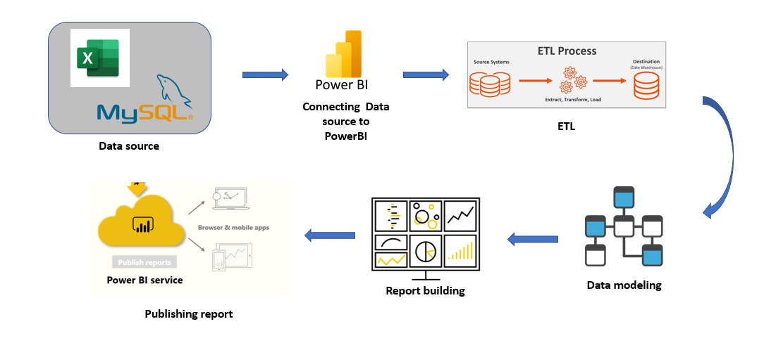
PowerBI Architecture
Overall architecture of the project, which was used to build the dashboard

Slide 7
Dataset Information
Provided Dataset:
Entertainer-Basic Info: It consists of list of 70 Entertainers Name, Birth year and Gender
Entertainer-Breakthrough Info: It consists of details about the 70 entertainers like breakthrough year, first major award, breakthrough movie name
Entertainer-Last major work Info: It consists of the details about the 70 entertainers last major work and if died, Year of death details.

Slide 8
Populated Dataset:
Final_Entertainer_data:
Entertainer: Entertainer’s name
Profession: Entertainer belong to which profession.
Gender: Male of Female
Birth Year: Date of birth of the Entertainer
Runtime: Runtime of the movies
Genre: What type of acting in the movie they did
IMDB Rating: Imdb rating given to the movies.
Meta score: Meta score given to each entertainer
Gross: How much earned by the entertainer
Director: Director name of the movies
Year of Breakthrough: In which year did the entertainer got the breakthrough

Slide 9
Breakthrough Name: Name of the Breakthrough movies, song, tv programs.
Year of First Oscar: Year of first Oscar award received.
Year of last Work: Year in which they last worked
Picture: URL of the entertainers headshot
Films act: Total Number of films act by the entertainer
Actors_films_list:
Actor Name: Name of the entertainers.
Movie Title: Movie name which the entertainer acted
Year of Publish: Release year of the movie

Slide 10

Individual Entertainer Details

Slide 11
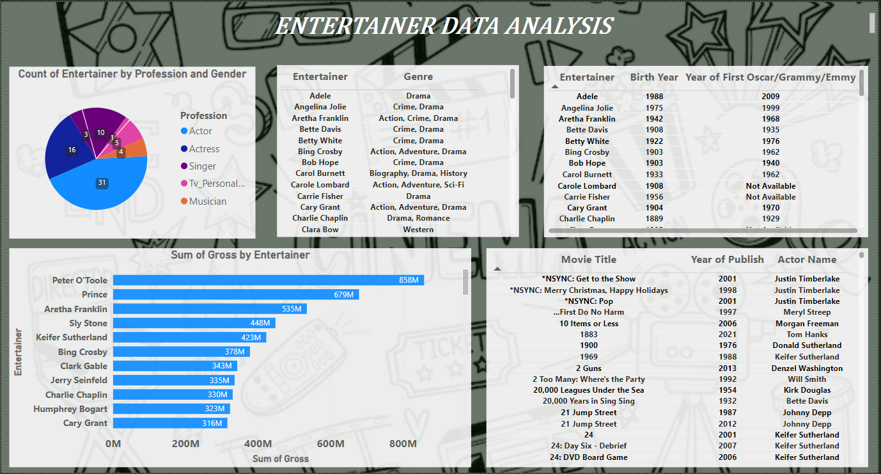
Entertainer Data Analysis

Slide 12
KPIs (Key Performance Indicators)
Total number of movies acted by the Entertainer
Total number of awards
Breakthrough Movie year
Break through Movie name
First major award year
Date of birth of the Entertainer

Slide 13
Some of the insights from the Report
Top 6 entertainers who received most of the awards
Meryl Streep
Lady Gaga
Leonardo DiCaprio
Mariah Carey
Justin Timberlake
Will Smith
Highest number of movies (55) released till date was on 1998
Highest average rating of movies was on 1949
Donald Sutherland acted in highest number of movies till date, which was 198 movies
As it is a entertainer’s analysis project, based on the end user need they can consume a lot of insights from the dashboard.
For the filtering purpose based on the end user need, in entertainers analysis page, there is a drop down filter to select the particular entertainer.

Slide 14


