Slide 1
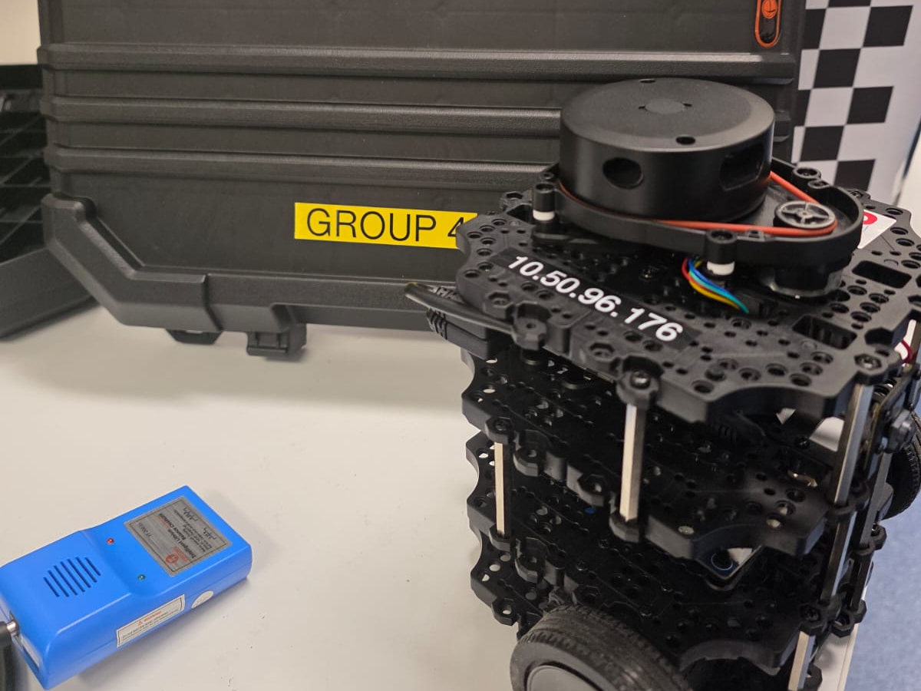
ENG612 PROJECT 2
A TurtleBot3 that follows a wall at 0.30 m
PID control, tested in Gazebo and on the real robot
Kazi Ragib Yeahsar (35502987)
Mir Tahir Tahsin Ahmad (35624701)
Notes:
Introduce the group and the task. The robot must keep 0.30 m from a wall using only its laser scanner. We built it in simulation first, then ran it on the real robot. About 15 minutes: how it works, results, what went wrong, then a live demo.

Slide 2
The task in three numbers
0.30 m
2 PIDs
2 × 2 m
Distance to keep from the wall
Normal PID against Advanced PID (two PIDs)
Size of the demo box, with four corners
Built with ROS 2 Humble on a TurtleBot3 Burger, following the left wall. The robot only knows what its laser scanner sees.
Notes:
Restate the goal. The only sensor is the laser scanner. The robot follows the left wall. The demo box is 2 by 2 metres, so it must also handle four corners.

Slide 3
System architecture and code tags
Robot or Gazebo
wall_follower_node
Key tags
/scan
side:=left
mode:=baseline
mode:=extended_pid
target:=0.30
v_max v_min
lookahead
LDS laser
Scan processing
Steering PID
alpha, D, e = D - target
kp_w ki_w kd_w
Wheels
/cmd_vel
Speed PID
Corner logic
kp_v ki_v kd_v c_err
front_stop front_clear
Odometry
/odom
data_logger
sim.launch.py
lab_terrain.world
docs/logs/*.csv
listens to /scan /odom /cmd_vel and writes CSV logs. It never changes the robot.
Normal PID = baseline. Advanced PID = extended_pid.
Notes:
Read the diagram left to right. The laser scan comes in on the scan topic, the controller node turns it into a speed and a turn rate, and publishes them on cmd_vel. The data logger is a separate node that only listens, so measuring never changes how the robot behaves. The tags in monospace are the names used in the code and on the command line. The same node runs in Gazebo and on the real robot.

Slide 4
Step 1: turning a scan into a distance
Two side beams give the distance and the angle to the wall.
A short look-ahead lets the robot react before it drifts.
Median filtering ignores bad readings from the scanner.
Error = measured distance − 0.30 m
Wall
target 0.30 m
Robot
Notes:
Two laser beams, one at 45 degrees and one at 90 degrees to the side, give both how far the wall is and the angle of the robot to the wall. We then look slightly ahead, so the robot reacts before it drifts. Beams are chosen by angle and averaged with a median, which removes bad readings.

Slide 5
Step 2: PID steering, in plain words
P
Proportional
Steer harder when the robot is further from 0.30 m
I
Integral
Fixes a constant offset. Set to zero in all our runs
D
Derivative
Calm the steering when the error is changing fast, to stop wobbling
The result is a turn rate that keeps the robot on the left wall at 0.30 m.
Notes:
PID has three parts. P reacts to how big the error is now. D reacts to how fast the error is changing, which stops overshoot. I fixes a constant offset, and we left it at zero in every reported run because on a straight wall there is no steady push.

Slide 6
PID 2: controlling the speed
Normal PID
Rule-based speed
Advanced PID
One PID for steering. Constant speed. (baseline)
Speed set by simple rules. Not a true second PID. (extended)
Two PIDs: one steers, one sets the speed. Our final design. (extended_pid)
Slow down when a wall is close ahead or the robot is off the 0.30 m line.
Speed up when the path is clear and the error is small. Speed is kept between a minimum and maximum.
Notes:
The brief asks for two PIDs. The second one sets the forward speed. It slows the robot near a corner or when it is off the target, and lets it speed up on a clean straight. The earlier modes are kept in the same code so we could compare all three on the same runs.

Slide 7
Handling corners
1
2
3
4
Wall ahead
Turn in place
Front clear
Follow again
The front distance drops below the stop limit
The robot rotates away from the wall
Free space opens up beyond 1.2 m
Wall following resumes at 0.30 m
If the wall is lost, the robot slows down and turns back toward where it was.
Notes:
At a corner the wall disappears and a new one appears ahead. The robot stops moving forward, turns in place, and only resumes wall following once the front is clear. Two separate thresholds, stop and clear, stop it from flicking back and forth. If the wall is lost completely, it slows and turns back toward it.

Slide 8
Gazebo results (left wall)
Gazebo, true position | Normal PID | Advanced PID
RMS error | 31.1 mm | 5.8 mm
95th percentile | 50.3 mm | 14.4 mm
Worst error | 5.6 cm | 1.8 cm
Forward speed | 0.080 m/s fixed | 0.067 m/s mean
Lap time | 79 s | 92 s
The Advanced PID is tighter and a little slower.
Notes:
These errors come from the true robot position in Gazebo. The first baseline run used our first gains, so it shows the starting point of tuning. The speed-PID design held the wall much more tightly, and it did so a little slower: lap 92 s against 79 s.

Slide 9
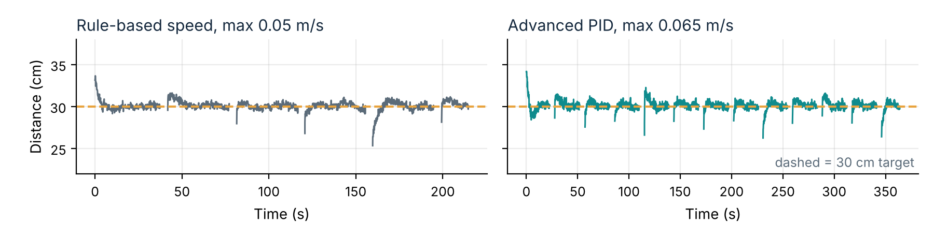
Real robot results (left wall)
Run (max speed, m/s) | RMS | 95th pct | Worst | Jitter | Lap
Rule-based speed (0.05) | 4.1 mm | 8.4 mm | 5.9 cm | 0.032 | 158 s
Advanced PID (0.05) | 3.8 mm | 6.5 mm | 5.4 cm | 0.037 | 132 s
Advanced PID (0.065) | 4.1 mm | 8.2 mm | 5.4 cm | 0.036 | 116 s
Advanced PID (0.065), repeat | 9.9 mm | 16.7 mm | 7.4 cm | 0.051 | 117 s
RMS and 95th percentile: straights only. Worst: largest error outside turns. Jitter: variation of the steering command.
Notes:
These runs use the robot's own laser as the measurement. Rule-based means the speed came from simple rules, not a PID. Straights are held within a few millimetres in three of the four runs. The repeat run at 0.065 m/s was less accurate, which shows run-to-run variation. The largest errors always appear just after a corner. The line plot shows measured distance during straight following only.

Slide 10
Comparing the controllers
Same accuracy, faster lap: the Advanced PID is 16% quicker than rule-based speed at 0.05 m/s, and 27% quicker at 0.065 m/s. Results vary between runs.
Notes:
The Advanced PID gives the same accuracy as the rule-based speed, but finishes a lap sooner. At the same 0.05 m/s limit the lap time falls from 158 s to 132 s, which is 16 percent. Raising the limit to 0.065 m/s cuts it to 116 s with a similar error. The repeat run shows that results vary from run to run.

Slide 11
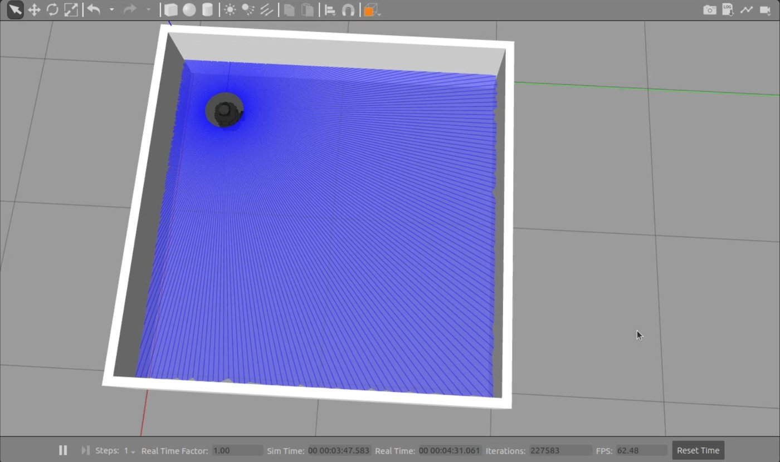
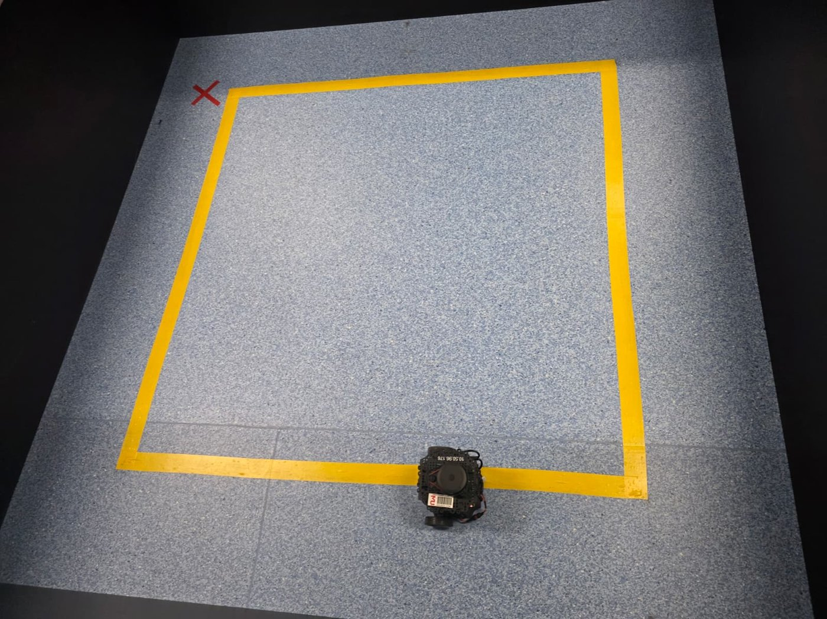
From Gazebo to the real robot
Same code
The node reads the scan by angle, so the real scanner needs no code changes
Slow first
Early real runs were slow, then raised to 0.065 m/s once the error stayed small
Noise-proof
Medians and a range cap handle the dropped readings of the real scanner
Repeatable
The logger waits for a good starting position before it records
Top: Gazebo box. Bottom: real lab box.
Notes:
The strategy: keep the controller identical, make the input robust to real scanner noise, raise the speed gradually, and make each run repeatable. Left photo: the Gazebo box. Below it: the real 2 by 2 metre box from above. The network problem cost us time and is on the next slide.

Slide 12
Problems we hit and how we solved them
What we saw | What we did
Robot dipped toward the wall after corners | Compared the distance and front-distance logs, then added corner hysteresis and the second (speed) PID
Negative distances in a log | Checked the column against the known box size first. It was a start-frame error, not a controller bug
No data from the robot | Laptop and robot were on different networks, so multicast found nothing. Fixed with a unicast peer file
Runs could not be compared | The logger now waits for a valid start position, and estimates it from the first scan
Notes:
Pick two to tell as a story: the negative distance (our first explanation was wrong) and the network problem. The lesson in both is to check the data against known geometry and the setup before changing code.

Slide 13
GitHub and teamwork
What is in the repository
The ROS 2 package: node, logger, launch file, world
Analysis script and all run logs
A README with the run commands
How we worked
Commits from both members, each under their own name
Pull before every push
Logs saved next to the code that made them
Contributors: Kazi Ragib Yeahsar (ragib-yeahsar) and Mir Tahsin (jackutsa)
github.com/ragib-yeahsar/ENG612-Project-2
Notes:
Have the repository open in a browser and show the commit history with commits from both members. Check the address is the final one before the demo.

Slide 14
Lessons and limits
What we learned
Measure first, then tune
Check strange data against known geometry
Make runs repeatable before comparing them
Simulation hides sensor noise and network problems
Limits
The largest errors come just after corners (5.4 to 7.4 cm)
Results vary between runs: one repeat was less accurate
Ki was not explored beyond zero
Our three lab boxes differ in size, so runs are not identical
Notes:
Say the limitations yourselves before anyone asks. With more time we would tune the corner exit, test a non-zero Ki, and repeat the real runs in one fixed box.

Slide 15
Conclusion: which controller to use
Recommended: Advanced PID, left wall, up to 0.065 m/s
Gazebo: 5.8 mm RMS against 31.1 mm for the Normal PID
Real robot: same accuracy as rule-based speed, with 16% to 27% shorter laps
Fallback: restart at 0.05 m/s if the robot misbehaves
What we learned
Measure first, then tune
Check odd data against known geometry
Simulation hides sensor noise and network problems
Limits
Largest errors come just after corners
Results vary between runs
Normal PID not yet run on the real robot
Notes:
Our recommendation is the Advanced PID: a steering PID plus a speed PID, on the left wall, with a maximum speed of 0.065 metres per second. Reasons: in Gazebo it held the wall much more tightly than the Normal PID with our first gains, and on the real robot it matched the accuracy of rule-based speed with laps 16 to 27 percent shorter. If the robot misbehaves during the demo, restart at 0.05. Be honest about the limits: we have not run the Normal PID on the real robot on the left wall, and one repeat run was less accurate.

Slide 16
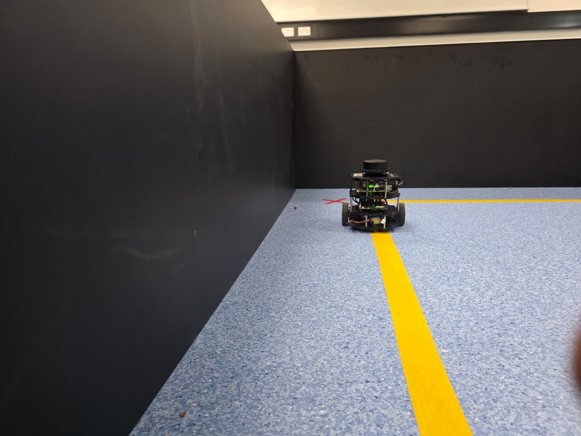
Live demo
Advanced PID on the real TurtleBot3, in the 2 m × 2 m box
Questions welcome
Notes:
Robot charged, laptop on the lab network, repository open. If the robot misbehaves, restart at the fallback speed of 0.05 m/s.

