Slide 1

Ragic Builder
Next Generation Database Development Tool

Slide 2

What we want is very simple…

Slide 3

“Simple Requirements” are never simple to developers.

Slide 4
Developer work for modifying a field on Web UI
Modify DB Schema.
Migrate old data to new schema.
Modify related trigger, view, stored procedure.
Modify related data access objects (DAO).
Modify all usage of the data access objects.
Modify UI presentation code.
Unit test and system integration test change.
Update code and deploy to production.
…

Slide 5
Customized application
is too valuable to overlook
Over 90% of enterprises benefits from customized database applications outside their ERP, HR, and CRM systems, outsourced or in-house.

Slide 6
Ragic Builder
Fastest way to build customized application

Slide 7
Business values
Revenue Increase business productivity Build great customer connection Identify market trend and opportunities Provide better service | Agility Dramatically reduce development time Rapidly satisfy new IT needs Grow with the business Consolidate data quickly
Cost Greatly reduce development cost Reduce maintenance cost Reduce data errors Reduce hardware purchase Reduce need for IT talent | Risk Reduce IT project risk Discover risk items sooner Adhere to regulations Increase control to data Increase data security

Slide 8
Ragic Builder Features

Slide 9
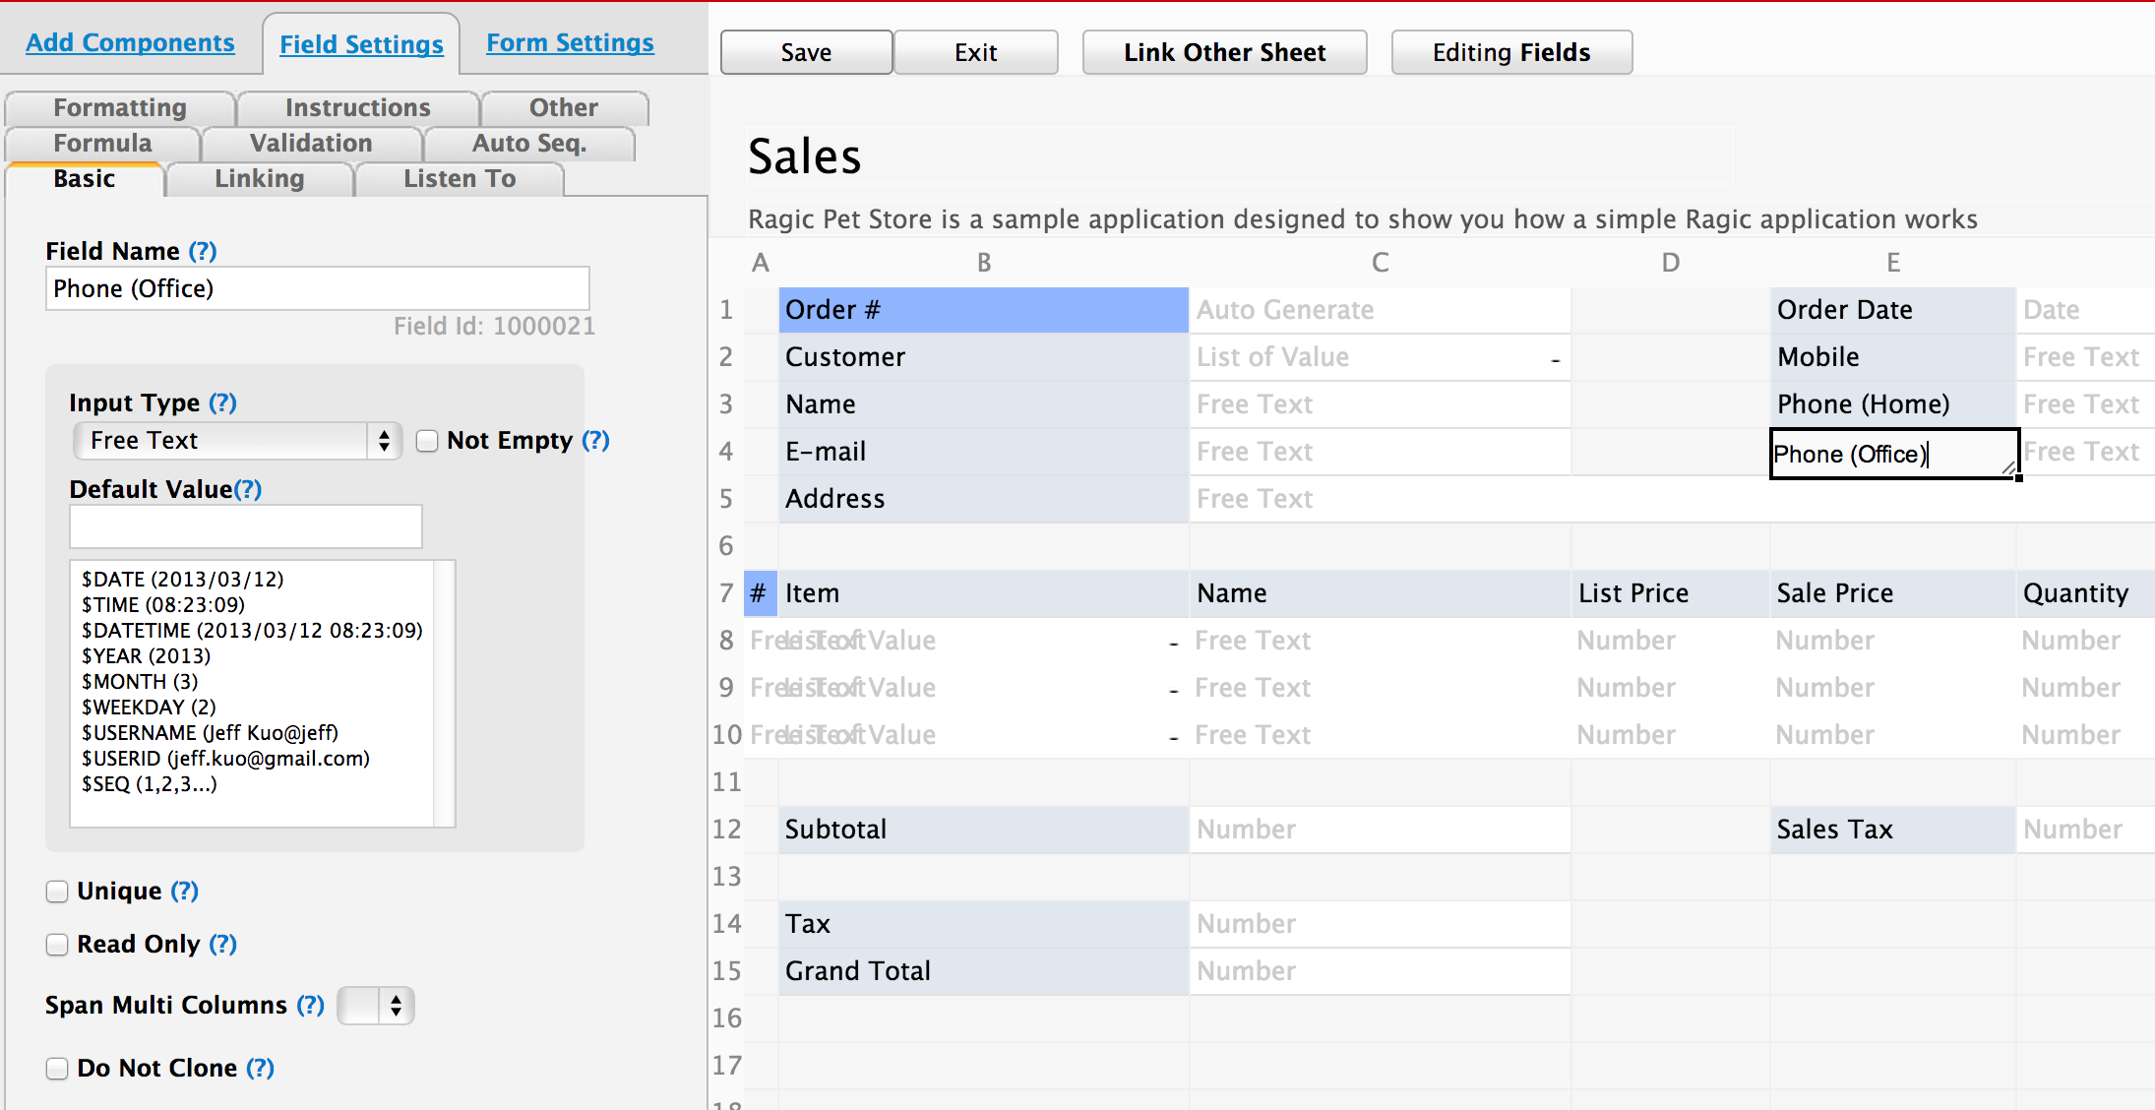
Spreadsheet style DB builder
The fastest way to build database applications.

Slide 10
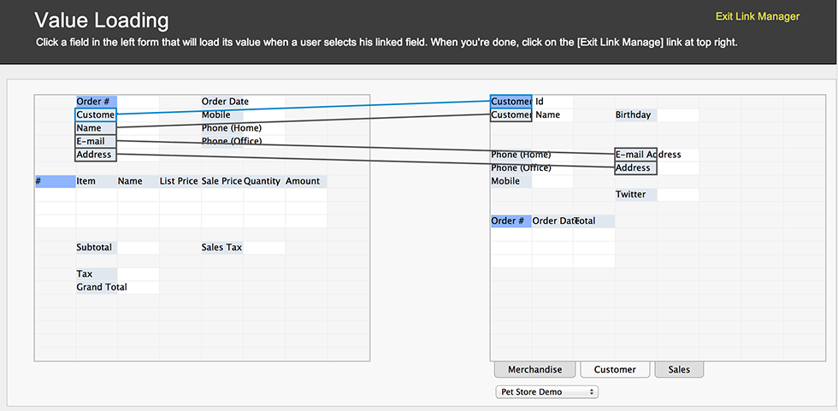
Linked fields and forms
Experience the power of database right on your spreadsheet. Link and load data from other forms as the user enters data.

Slide 11
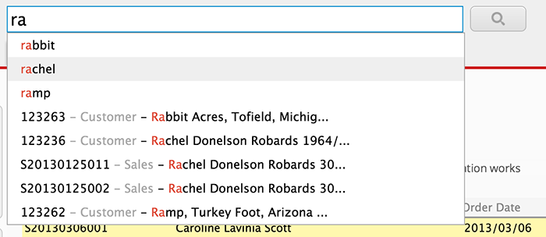
Full-text search
Powerful search engine built right in your database.

Slide 12
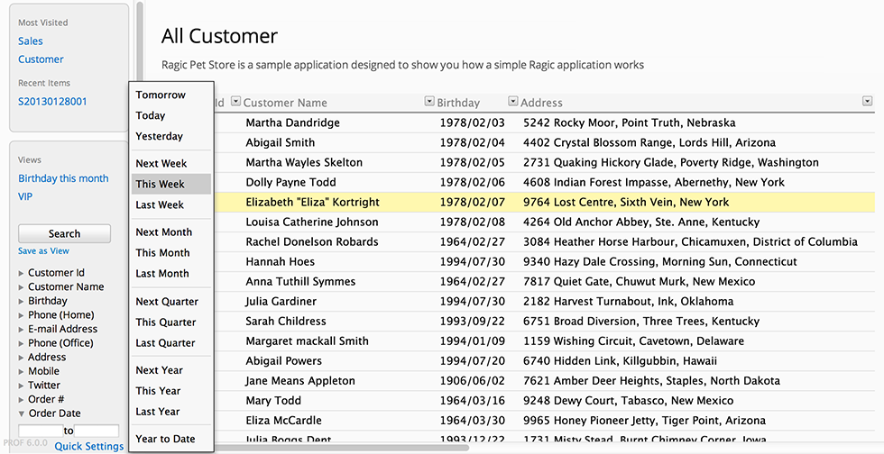
Query builder and data views
Create multiple views based on query criteria on any combination of fields.

Slide 13
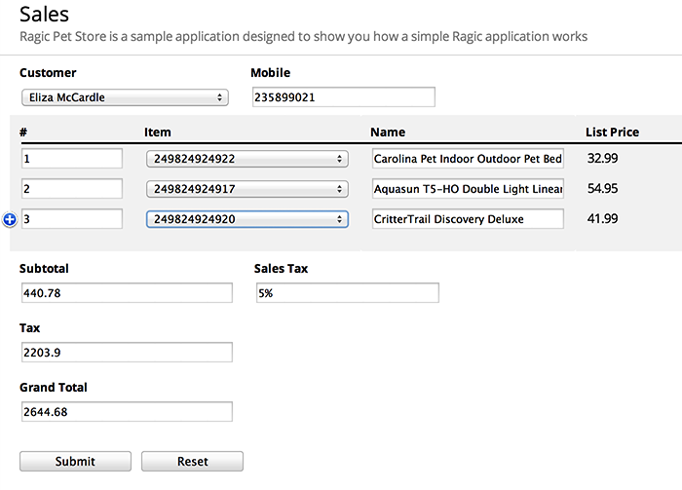
Embed on your website
Add the power of database to your web pages or blogs

Slide 14
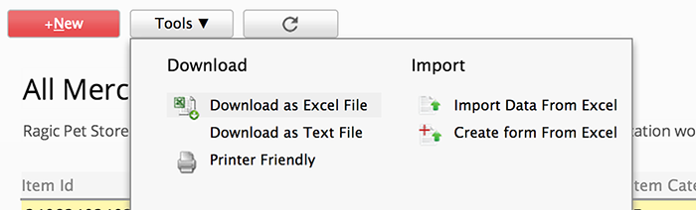
Import from Excel / Export to Excel
We turn your existing Excel files into databases. Turn them back to Excel when needed.

Slide 15
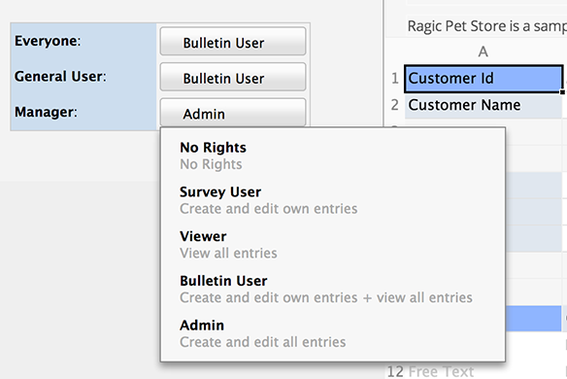
Access control
Fine grain control over who can read or write each entry.

Slide 16
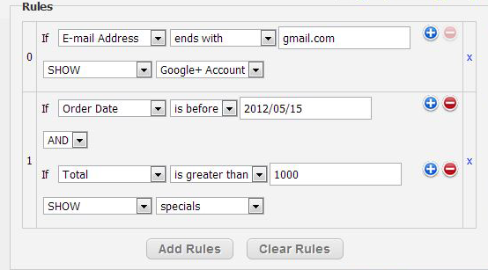
Form Rules
Dynamic form with customized logic

Slide 17
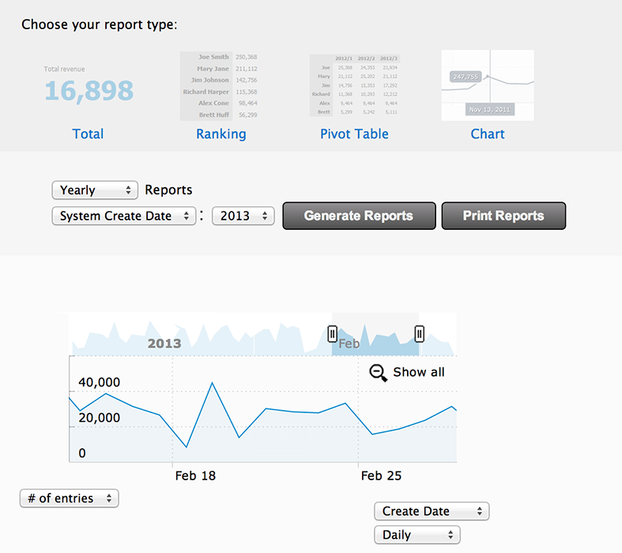
Auto generated reports
Ranking table, pivot table, charts and more.

Slide 18
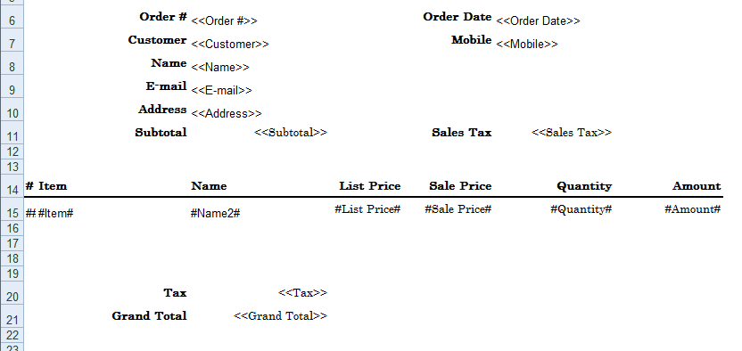
Printed Reports
Build customized print report with Excel

Slide 19
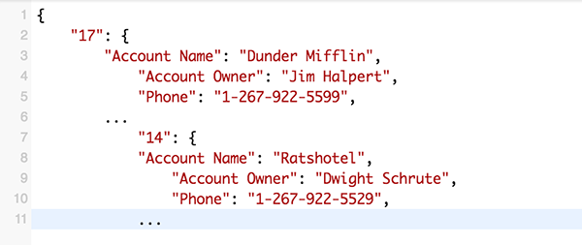
Simple, powerful API.
RESTful HTTP API for full programmic access
to your database.

Slide 20
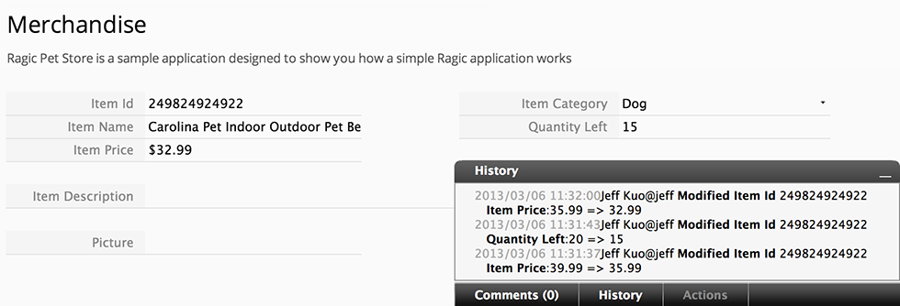
Version tracking
Full history on how the entry have been created and modified.

Slide 21
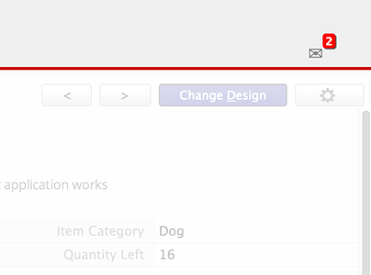
Instant notification
E-mail, on-screen, SMS notification on latest updates of your database.

Slide 22
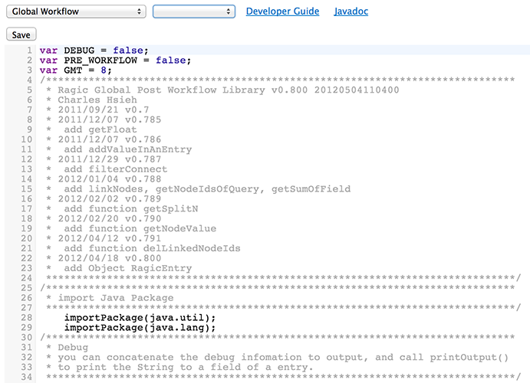
Customized scripting
However complex your business logic is, it can be done with our server-side Javascript workflow engine.

Slide 23
Technology Stack
Java-based application
  Deployed on Linux and Windows servers
Embedded application server (Jetty), embedded DB (Berekeley DB)
  Super easy to install and deploy
  NoSQL DB for high performance on flexible data structure
Server-side Javascript scripting engine
  A language familiar to all web developers
Tons of client-side Javascript to create the spreadsheet interface
Open API for developers to query / post data to Ragic

Slide 24
Company Overview
2008 Founded in Taipei as Interwoven service partner
2010 Launched Ragic Builder
2010 “Product to watch” by eWeek magazine
2011 top 10 Taiwan startups by Taiwan Venture Assoc.
2012 Red Herring Global 100 finalist
2012 Winner of Echelon Taiwan satellite
2013 Incorporated in Delaware, US
3 Global Fortune 500 customers

Slide 25
Contact
Ragic
Jeff Kuo
jeff@ragic.com
www.ragic.com

