Slide 1




Bhasha Bandhu Hackathon
Innovating for a Multilingual Judiciary
Innovating for a Multilingual Judiciary
Individual Name: Raginee Darade Individual bio: Female Date: 22-02-2025
Supported by

Slide 2
Problem Statement
Student Side Challenges:
🔹 No clear resume score or job-specific feedback. 🔹 Paid & expensive tools, limiting access. 🔹 Poor UI and confusing evaluation results. 🔹 Lack of hiring insights and career guidance.
Evaluator Challenges:
🔹 Time-consuming manual resume screening. 🔹 Existing ATS tools miss context, soft skills, and true potential. 🔹 Bias in hiring, leading to unfair selections. 🔹 Generic AI results, not tailored to specific job roles.
Notes:
Idea Submissions Form – Details of the form Topic
Thesis Abstract Concept Note What is the solution Build? Business use case (Less than 100 – 200 words) Judge and filter becomes easy

Slide 3
Solution
Resume Ranker – Matches resumes intelligently with job descriptions. Bias Detector – Ensures fair selection by removing hidden biases. Job Fit Predictor – Suggests best-suited roles based on skills & experience. Skill Enhancer – Recommends learning paths to improve hiring chances.
User Benefits (Completely Free Service): Instant AI-Powered Reports – Users get detailed insights without paying. Free Resume Download & Sharing – Users can download reports in PDF/PNG format. Accessible to Everyone – Open for students, job seekers, and recruiters. Search-Based Resume Insights – Users can quickly analyze resumes with AI.
Outcome: Faster, fairer, and completely free AI-driven hiring decisions!
Notes:
Idea Submissions Form – Details of the form Topic
Thesis Abstract Concept Note What is the solution Build? Business use case (Less than 100 – 200 words) Judge and filter becomes easy

Slide 4
What the User Will Get
AI-Powered Resume Report – A PDF with:
Job Fit Score (Match Percentage)
Strengths & Weaknesses
Missing Keywords & Skill Gaps
Career Improvement Suggestions
Visual Resume Insights – Charts comparing resume vs. job requirements.
Easy Download & Sharing – Reports available in PDF & image formats (PNG/JPG).
Notes:
Idea Submissions Form – Details of the form Topic
Thesis Abstract Concept Note What is the solution Build? Business use case (Less than 100 – 200 words) Judge and filter becomes easy

Slide 5
ghgjhgjghjjchgjnbkjnfgj
Project Requirements
Technologies & Tools
Python
Streamlit
Python Libraries
PIL
Google Generative AI
Pdf2image
io
os
Base64
Dotenv
Development & Deployment Tools
VS Code
Virtual Environment
AI Tools
External Tools & APIs
Peppler
Third-Party APIs
Notes:
Idea Submissions Form – Details of the form Topic
Thesis Abstract Concept Note What is the solution Build? Business use case (Less than 100 – 200 words) Judge and filter becomes easy

Slide 6
AI Agents & Features
Resume Ranker – Uses NLP to rank resumes based on job fit
.Bias Detector – Ensures unbiased selection process.
Job Fit Predictor – Suggests best roles based on resume.
Skill Enhancer – Recommends improvements for career growth.
Functional Requirements
Resume Upload – Users upload resumes in PDF format.
Job Description Input – Users enter job details.
AI Matching Score – The system calculates resume-job fit percentage.
Evaluation Report – Highlights strengths, weaknesses & missing skills.
Notes:
Idea Submissions Form – Details of the form Topic
Thesis Abstract Concept Note What is the solution Build? Business use case (Less than 100 – 200 words) Judge and filter becomes easy

Slide 7
Future Scope
AI Interview Assistant – Generates job-specific interview questions.
Company Insights Agent – Provides company details & hiring trends.
Test Preparation AI – Helps candidates prepare for role-based tests.
Fraud Detection – Identifies fake resumes & certifications.
Multilingual Support – Processes resumes in multiple languages.
API Integration – Connects with HR tools & job portals.
Notes:
Idea Submissions Form – Details of the form Topic
Thesis Abstract Concept Note What is the solution Build? Business use case (Less than 100 – 200 words) Judge and filter becomes easy

Slide 8
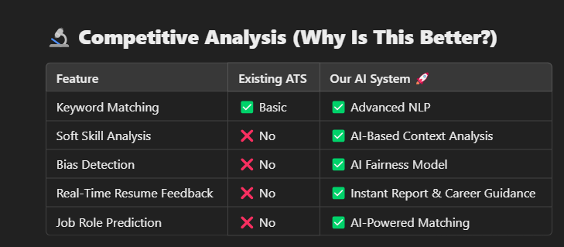
Notes:
Idea Submissions Form – Details of the form Topic
Thesis Abstract Concept Note What is the solution Build? Business use case (Less than 100 – 200 words) Judge and filter becomes easy

Slide 9

Innovating for a Multilingual Judiciary
Supported by

