Slide 1
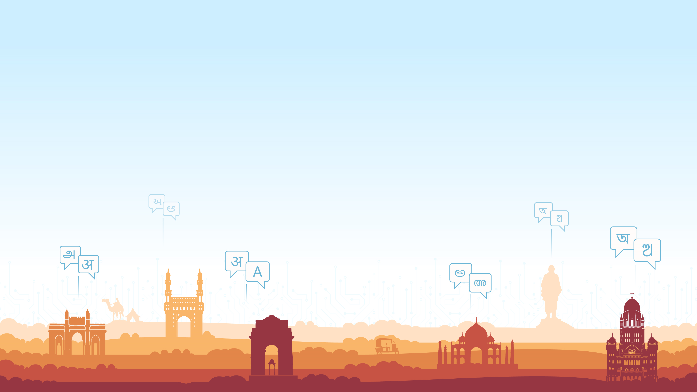
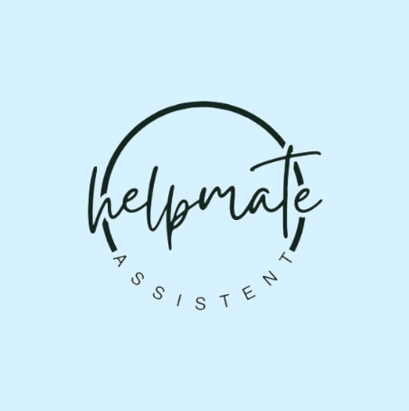

Al-powered real-time assistive technology system
Team Name : Bug Fighter’s
Domain : AI/ML
Collage : Shushila Devi Bansal Collage Of Engineering Indore

Slide 2
Problem statement.
Develop an Al-powered real-time assistive technology system to enhance accessibility for impaired individuals. The solution should leverage computer vision, and NLP to assist with mobility, communication, and daily tasks, ensuring inclusivity and independence.
Notes:
Idea Submissions Form – Details of the form Topic
Thesis Abstract Concept Note What is the solution Build? Business use case (Less than 100 – 200 words) Judge and filter becomes easy

Slide 3
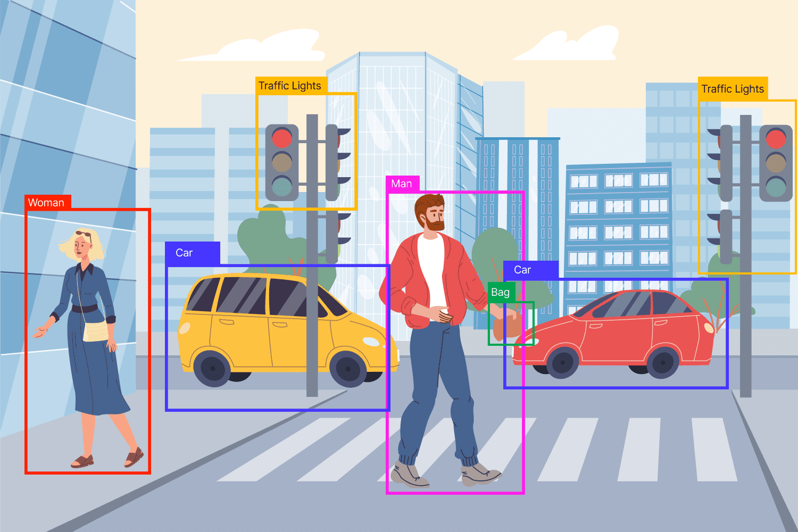
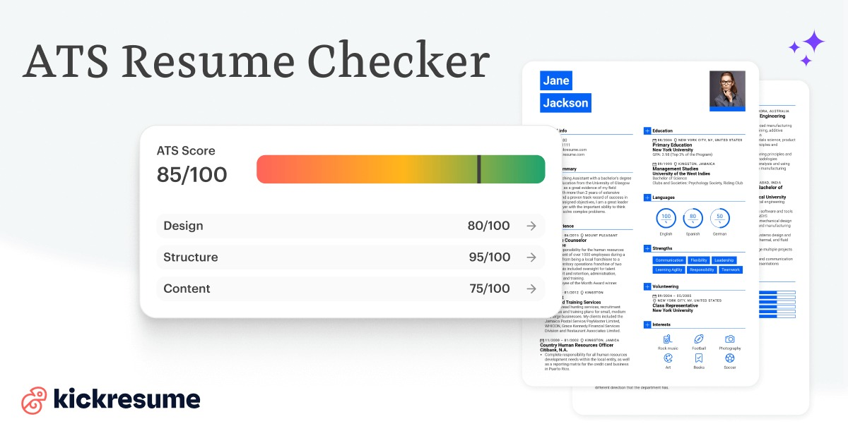
Object Detection Model:
computer vision-powered object recognition to accurately detect surroundings, people, and obstacles, enhancing navigation and safety for visually impaired users.
ProTech.AI(ATS):
It provides strength and weakness analysis, highlighting key areas for improvement. The tool also generates an ATS compatibility score (%)helping users enhance their resumes for better job success
Notes:
Idea Submissions Form – Details of the form Topic
Thesis Abstract Concept Note What is the solution Build? Business use case (Less than 100 – 200 words) Judge and filter becomes easy

Slide 4
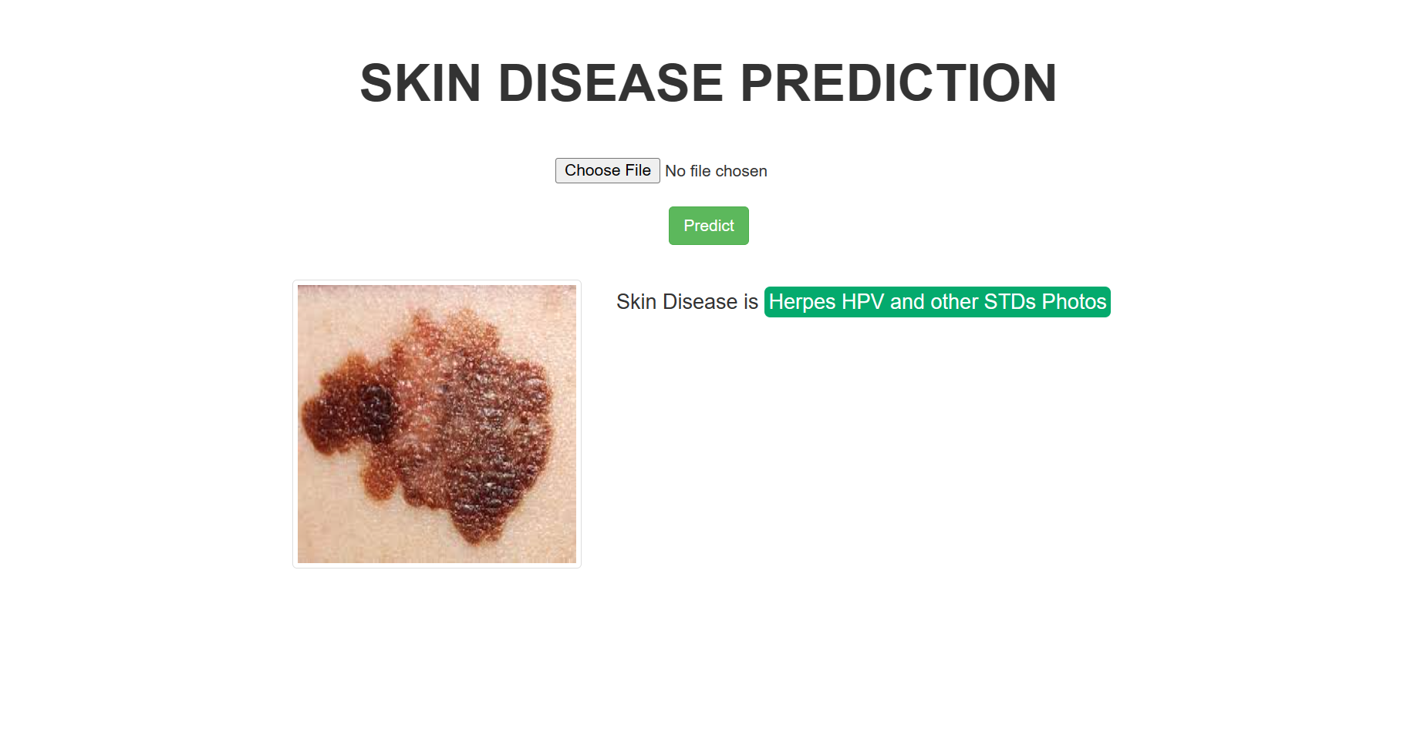
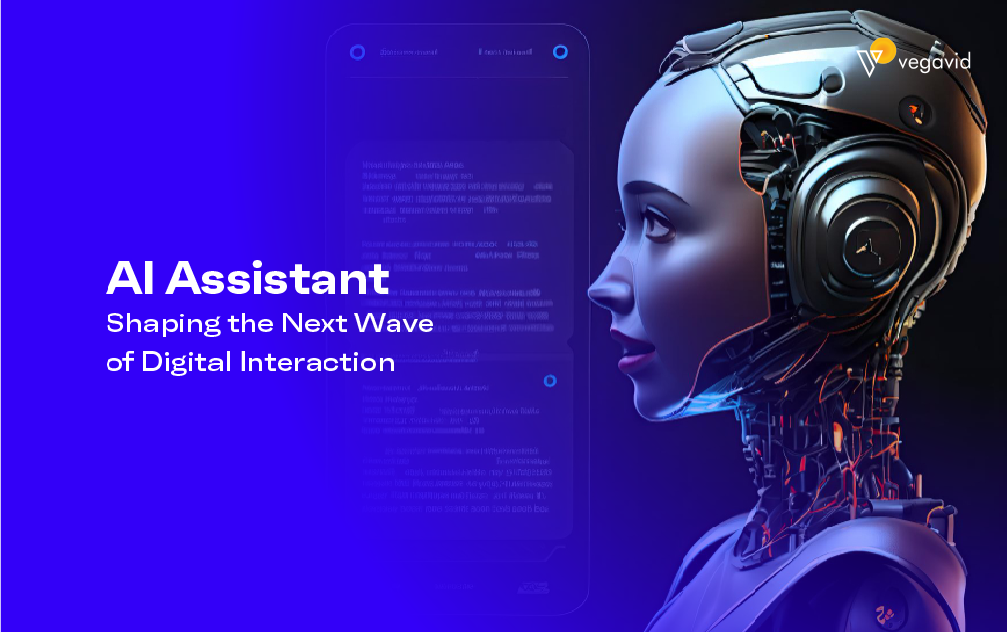
.
MeddyBuddy : Analyzes medical reports or images using Google Gemini Pro API. This app supports image uploads and provides AI-generated medical insights in Hindi or English.
Zora AI: Zora AI is an intelligent virtual assistant designed to provide accurate and instant responses to human queries across various domains, similar to google assistance or Siri.

Slide 5
Tools & Technologies Used in the Assistive AI System
Computer Vision (Object & Scene Recognition)
🔹 YOLO (You Only Look Once) – Enables real-time object detection, recognizing obstacles, people
AI & NLP Processing
🔹 Gemini AI API (Google AI 1.5) – Handles natural language processing (NLP), interprets user inputs, and generates intelligent responses.
Application Development
🔹 Streamlit – Used to build the interactive AI-powered web application, providing a seamless user interface.
Frontend Technologies
🔹 HTML, CSS, JavaScript – Ensure a responsive and visually appealing UI for the assistive system.

Slide 6
This Project Matters
📚 For Students:
Inclusive Learning – Assists visually & speech-impaired students with text-to-speech and object recognition.
Boosts Independence – Helps navigate, access content, and communicate effortlessly.
Equal Education – Bridges the accessibility gap for a more inclusive learning experience.
💻 For Developers:
AI & ML Experience – Hands-on with YOLO, Gemini AI, and real-time processing.
Real-World Impact – Builds assistive tech to solve accessibility challenges.
Tech Exploration – Works with Streamlit, AI APIs, and front-end tools. Why
Notes:
Idea Submissions Form – Details of the form Topic
Thesis Abstract Concept Note What is the solution Build? Business use case (Less than 100 – 200 words) Judge and filter becomes easy

Slide 7
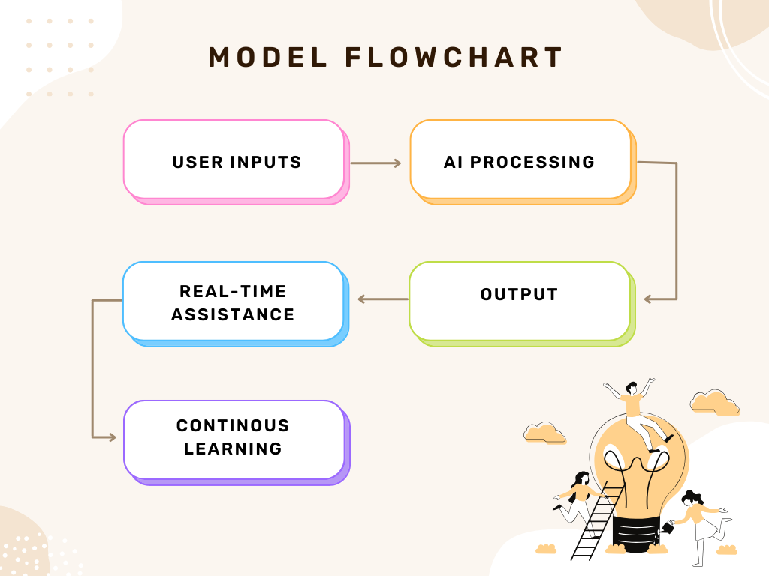
ghgjhgjghjjchgjnbkjnfgj
How the System Works:
b.
Notes:
Idea Submissions Form – Details of the form Topic
Thesis Abstract Concept Note What is the solution Build? Business use case (Less than 100 – 200 words) Judge and filter becomes easy

Slide 8
Conclusion:
This project not only improves accessibility for impaired individuals but also provides students and developers with valuable AI experience, promoting innovation, inclusivity, and real-world problem-solving.
Notes:
Idea Submissions Form – Details of the form Topic
Thesis Abstract Concept Note What is the solution Build? Business use case (Less than 100 – 200 words) Judge and filter becomes easy

Slide 9
