Slide 1
Cover Letter Generator
Michael Quick, Josh Muszka, Eunsung Kim, Nicholas Woo

Slide 2
Table of contents
01
02
03
04
The Problem
Our Solution
How it Works
Future Expansion

Slide 3
01
The Problem
The daily-life problem we can solve with AI

Slide 4
The Problem
Job applications are a common part of life. In highly competitive job markets, it is essential to stick out. Applicants often write personalized cover letters, which has many drawbacks. Many applicants struggle with letter wording, formatting, and tone. This can give a bad impression to recruiters.
Using form letters can help, but without significant rewriting, it fails to stand out. Finally, many applicants wish to apply to a large pool of jobs to better their chances of receiving an offer or interview. Customized letters take a long time, even with a pre-made form letter. This prevents them from applying for more opportunities.

Slide 5
02
Our Solution
Our AI solution to the cover letter problem

Slide 6
The Solution - Introduction
To solve the problem of customized cover letters, we created an automated cover letter generator utilizing OpenAI's LLM to analyze an applicant's existing resume and the description of the job they're attempting to apply for.
The applicant will be able to choose the format they would like to use and the LLM will apply the information gathered from the resume and job description to customize the format into a highly personalized cover letter which will be returned as a pdf file.

Slide 7
Our Solution – The process
React
LLM + Scraping
LaTeX
Users are presented with a webpage created using react, where they will input the needed information.
The job site is scraped for description information and the collected data, resume, and selected format are given as input.
The output given by the LLM is then compiled using LaTeX, providing a complete cover letter PDF file.

Slide 8
How it Works
User side
Server side
Users enter the website, provide the link to the job they're attempting to apply to, their resume as a pdf or docx file, and select the format they wish to use.
The program will scrape the job site for the description. The LLM will be given a prompt to make a cover letter using the selected format tex file with the provided resume and job description.

Slide 9
The prompt:
prompt = (
f"I need you to help me generate a professional-sounding cover letter for my "
f"job application at {job_name}. "
f"I will provide the job description, and the LaTeX template file that I made. "
f"I will also provide you my resume. "
f"I want you to fill in the information and tailor the cover letter to the job "
f"description, using information from my resume. You will only return the LaTeX "
f"source code.\n\n"
f"Job Description: {job_description}\n\n"
f"Extra Details: {extra_details}\n\n"
f"Cover Letter Style (it IS CRUCIAL that you follow EXACTLY this format): "
f"{letter_style}\n\n"
f"User Comments: {comments}\n\n"
f"Basic Qualifications: {job_basic_qualifications}\n\n"
f"Preferred Qualifications: {job_preferred_qualifications}\n\n"
f"Resume Content: {resume_content}\n\n"
f"Only return the latex do not include beginning messages or ending messages.\n"
f"If you can't determine the job position then simply put Software Developer, "
f"if there is no recruiter then simply put Recruiter. "
f"Do not, under any circumstances, leave any information unfilled. "
f"You may extrapolate information, and make it sound as professional and human-like "
f"as possible."
)

Slide 10
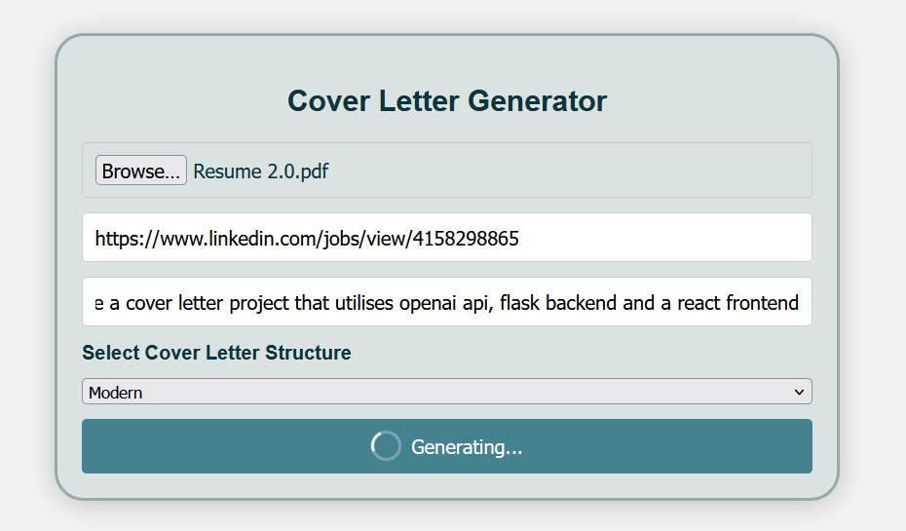
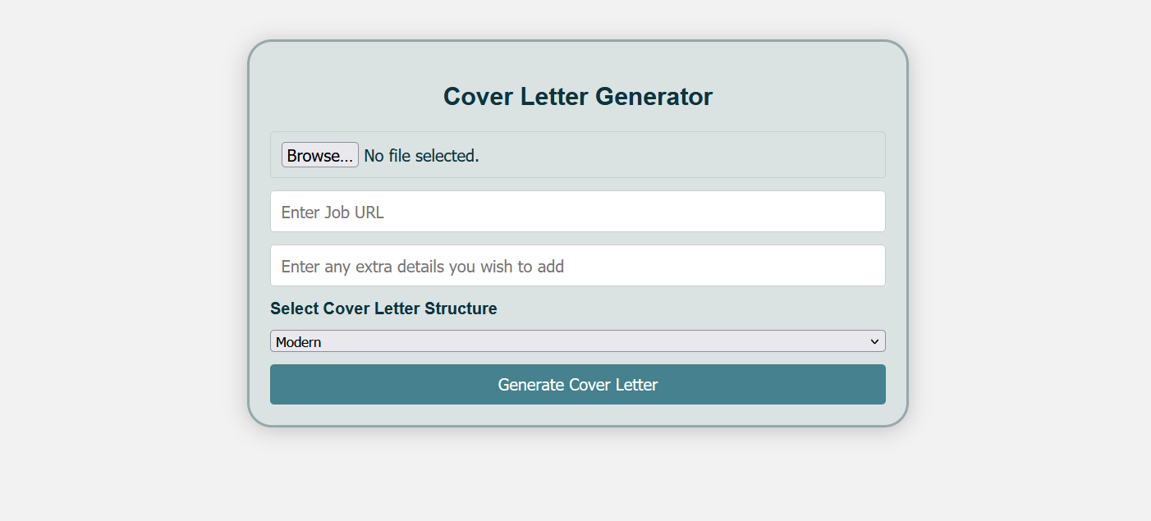
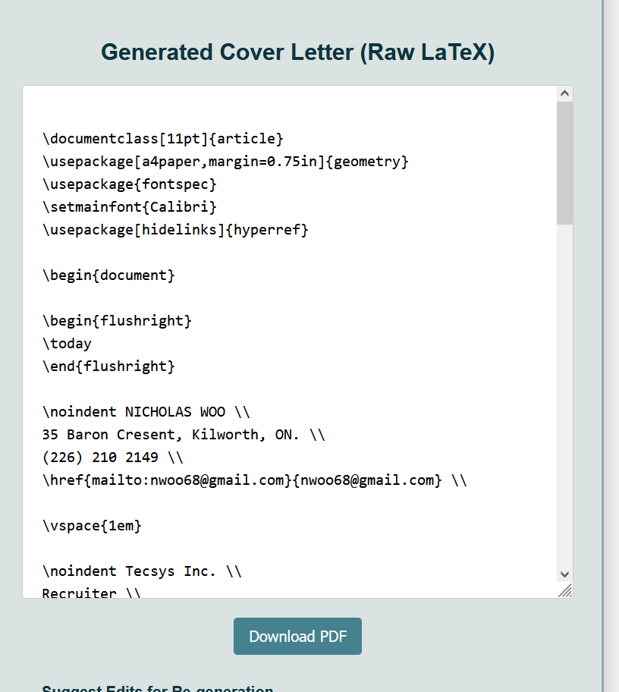
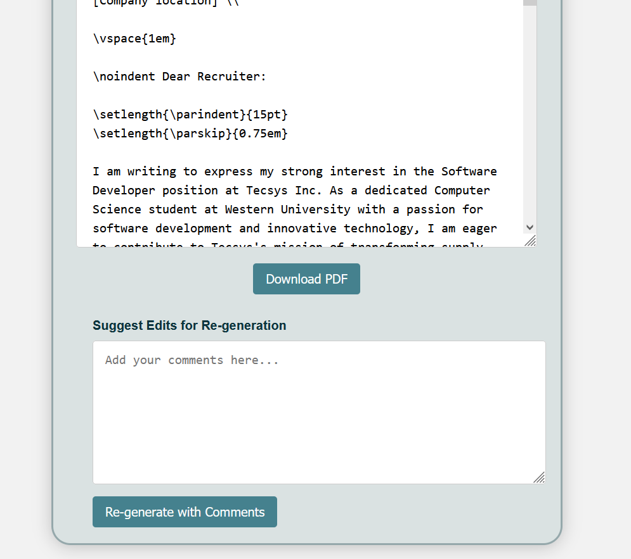
Example – The Website

Slide 11
How it Works - Benefits
Easy to Use
Reliable
React allows us to create a very user friendly website.
Finely tuned prompts with well trimmed data allows for quality cover letters.
Efficiency
Universal
The LLM works fast, saving time and allowing applicants to apply to more opportunities.
After LaTex has compiled the letter, it becomes a ATS friendly PDF.

Slide 12
Future Expansion
Applications
Models
Formatting
In the future, a similar process could be done for resumes as well.
Testing with various LLMs could provide quality improvements.
Improve formats with cover letter research.
Privacy
Customer
Code
Ensure the privacy of users is a top priority.
Receive and act upon customer feedback.
Update the code to be easier to work on and for better efficiency.

Slide 13
Thanks!
Feel free to ask questions and have a look at our project!
https://github.com/raginggoosedev/dataquest-2025

