Slide 1
Personality Detection from Resume
Project Mentor:
PROF. ARNAB CHAKRABORTY
Team Members:
Sharmistha Das (10800123186)
Rishika Mishra (10800123164)
Ragini Gupta (10800123145)
Shreya Banerjee (10800123192)

Slide 2
Contents
Project Objectives & Scope
Data Description
Methodology
Data Preprocessing
Models Used
Accuracy Comparison
Inference
Future Scope of Improvements

Slide 3
Project Objective and Scope
Objectives:
Predict candidate personality traits using resume text.
Provide insights for recruitment and career guidance.
Apply on the test datasets and compare the differences in the results
Scope:
Useful for HR teams to shortlist candidates.
Helps in training and career recommendation.
Can be applied across industries.

Slide 4
Data description
The dataset used for this project consists of structured resume information collected from Kaggle. It contains ~9,500 records and multiple columns that describe various aspects of a candidate’s resume, such as skills, education, experience, and job positions. The target variable is the personality label (MBTI type), which is mapped to resumes based on their features.
Dataset Characteristics
Total Records: 9,544
Features: 30+ attributes including career objective, skills, education, job roles, certifications, etc.
Target Variable: MBTI personality type (INTJ, ENTP, INFJ, ESTJ, etc.).
Data Types: Mostly categorical/text, with one numeric column (matched_score).
Missing Values: Present in several columns (e.g., career_objective, experience_requirement, address, etc.

Slide 5
Table 1 : Feature Information
Column Name | Non-Null Count | Null Count | Data Type | Description
career_objective | 4740 | 4804 | object | Candidate’s professional goal/objective
skills | 9488 | 56 | object | Candidate’s listed skills
degree_names | 9460 | 84 | object | Academic degree(s) held
educational_institution_ name | 9460 | 84 | object | Name of university/college
job_position_name | 9544 | 0 | object | Current or desired job position
experiencere_requirem ent | 8180 | 1364 | object | Years of required/mentioned work experience
age_requirement | 5457 | 4087 | object | Age-related requirements if specified
certifications | 2008 | 7536 | object | Certifications acquired by candidate
Responsibilities | 9544 | 0 | object | Roles and responsibilities in past jobs
matched_score | 9544 | 0 | Float64 | Matching score between resume and job profile

Slide 6
Table 1 : Text Feature Length Statistics
Feature | Min Length | 25% | Median | 75% | Max Length | Description
career_objective | 26 | 144 | 210 | 268 | 1425 | Candidate’s objective/summary statement length
skills | 2 | 161 | 243 | 504 | 3104 | Length of skills list (characters)
degree_names | 6 | 10 | 22 | 39 | 472 | Degree names length (characters)
educational_instit -ution_name | 8 | 27 | 42 | 61 | 212 | Institution name length (characters)
job_position_ Name | 5 | 12 | 22 | 35 | 150 | Job title length (characters)

Slide 7
Insights from Dataset
1. Career Objective is available in ~50% of resumes; it varies from very short (26 characters) to detailed statements (1425 characters).
2. Skills are well populated, with a median length of ~243 characters, reflecting a mix of technical and soft skills.
3. Degree Names and Institutions are consistent with typical resume formats (median length ~22–42 characters).
4. Job Position Names are always present, with reasonable lengths (median ~22 characters).
5.Matched Score is a numeric column (0–0.97), representing how well a resume aligns with a job posting, which can be used as a strong feature for prediction.
6. Several columns like address, extracurriculars, certifications have high missing values and may need to be dropped or imputed.

Slide 8
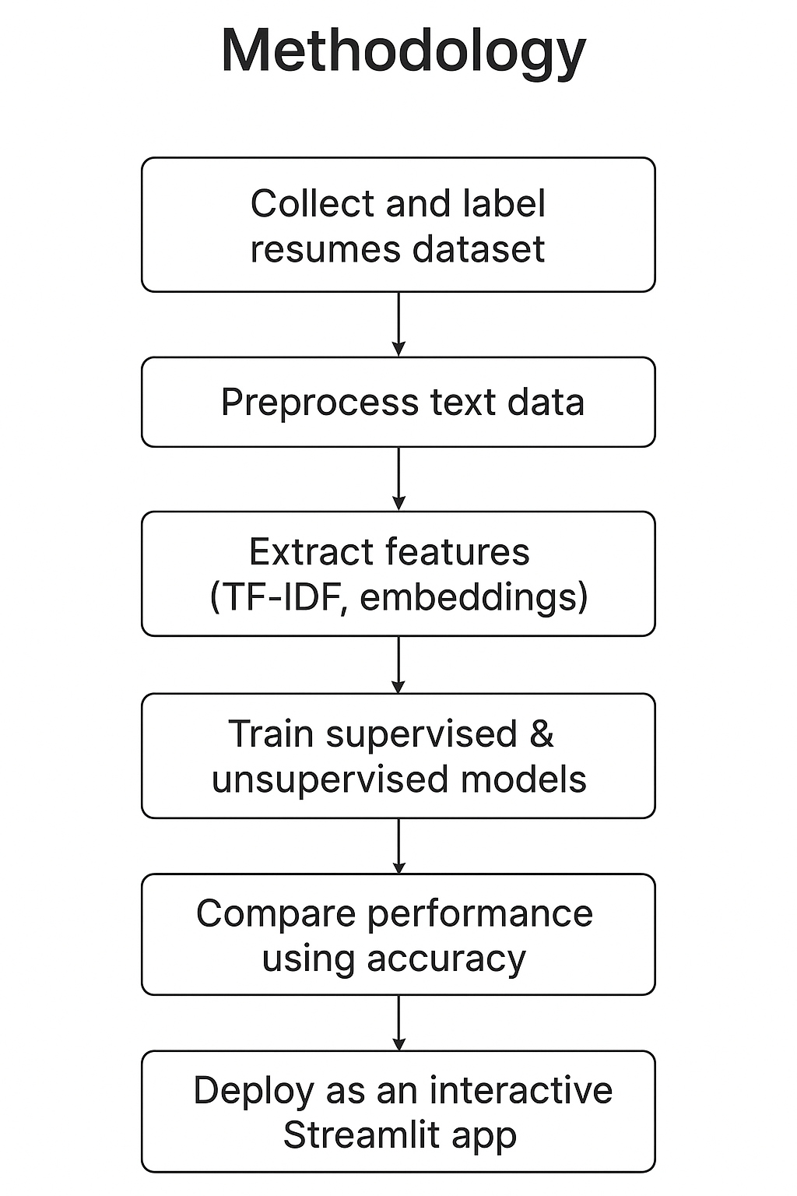
Methodology
Collect and label resume dataset.
Preprocess text (cleaning, normalization).
Extract features using TF-IDF (unigrams + bigrams).
Train supervised (Logistic Regression, Random Forest) & unsupervised (K-Means, Hierarchical) models.
Compare model performance using accuracy.
Deploy best model in an interactive Streamlit app.

Slide 9
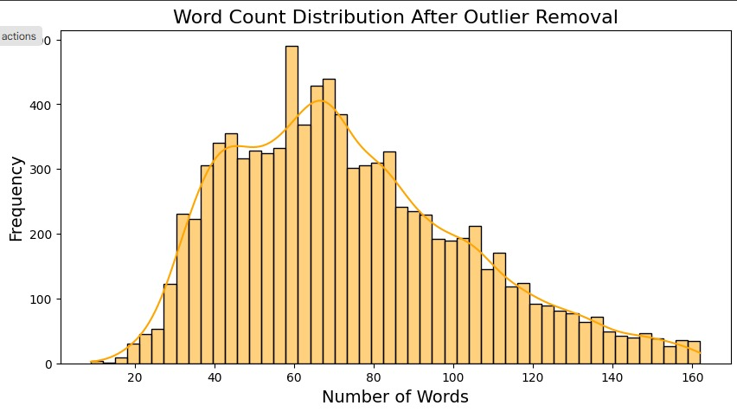
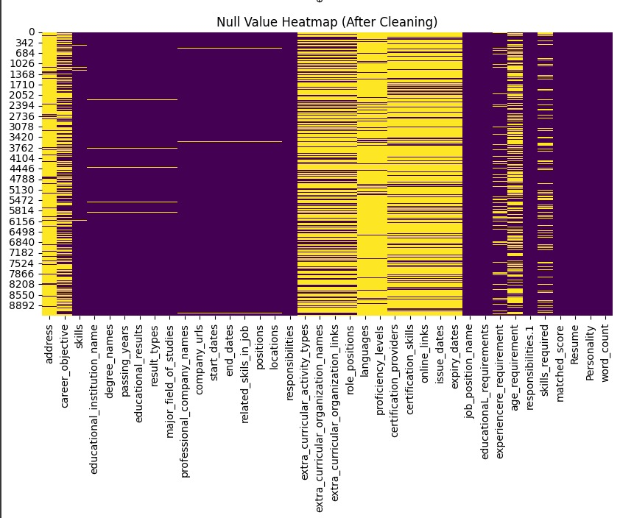
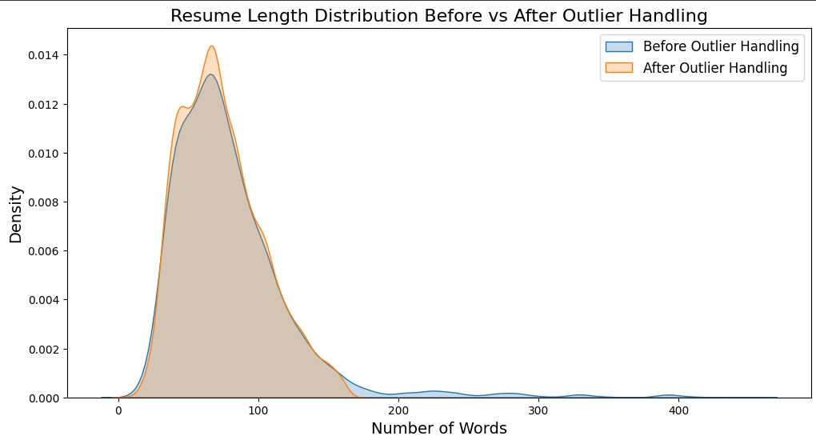
Data preprocessing
Converted all text to lowercase.
Missing Values(Null Values):
Rows with missing text (resume content) or missing labels (personality type) were dropped from the dataset to maintain data integrity.
Handling outliers:
Word count Distribution after Outlier Removal
After handling outliers, 3,881 resumes remained.
The plot showed that the dataset was complete, with no missing records.

Slide 10
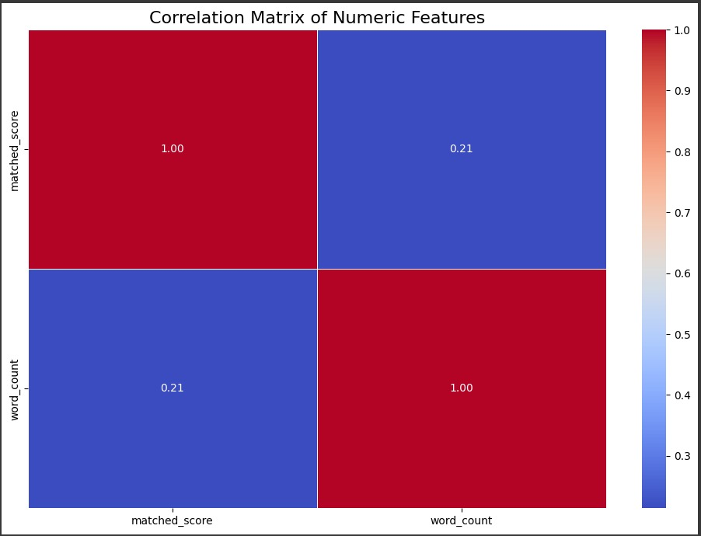
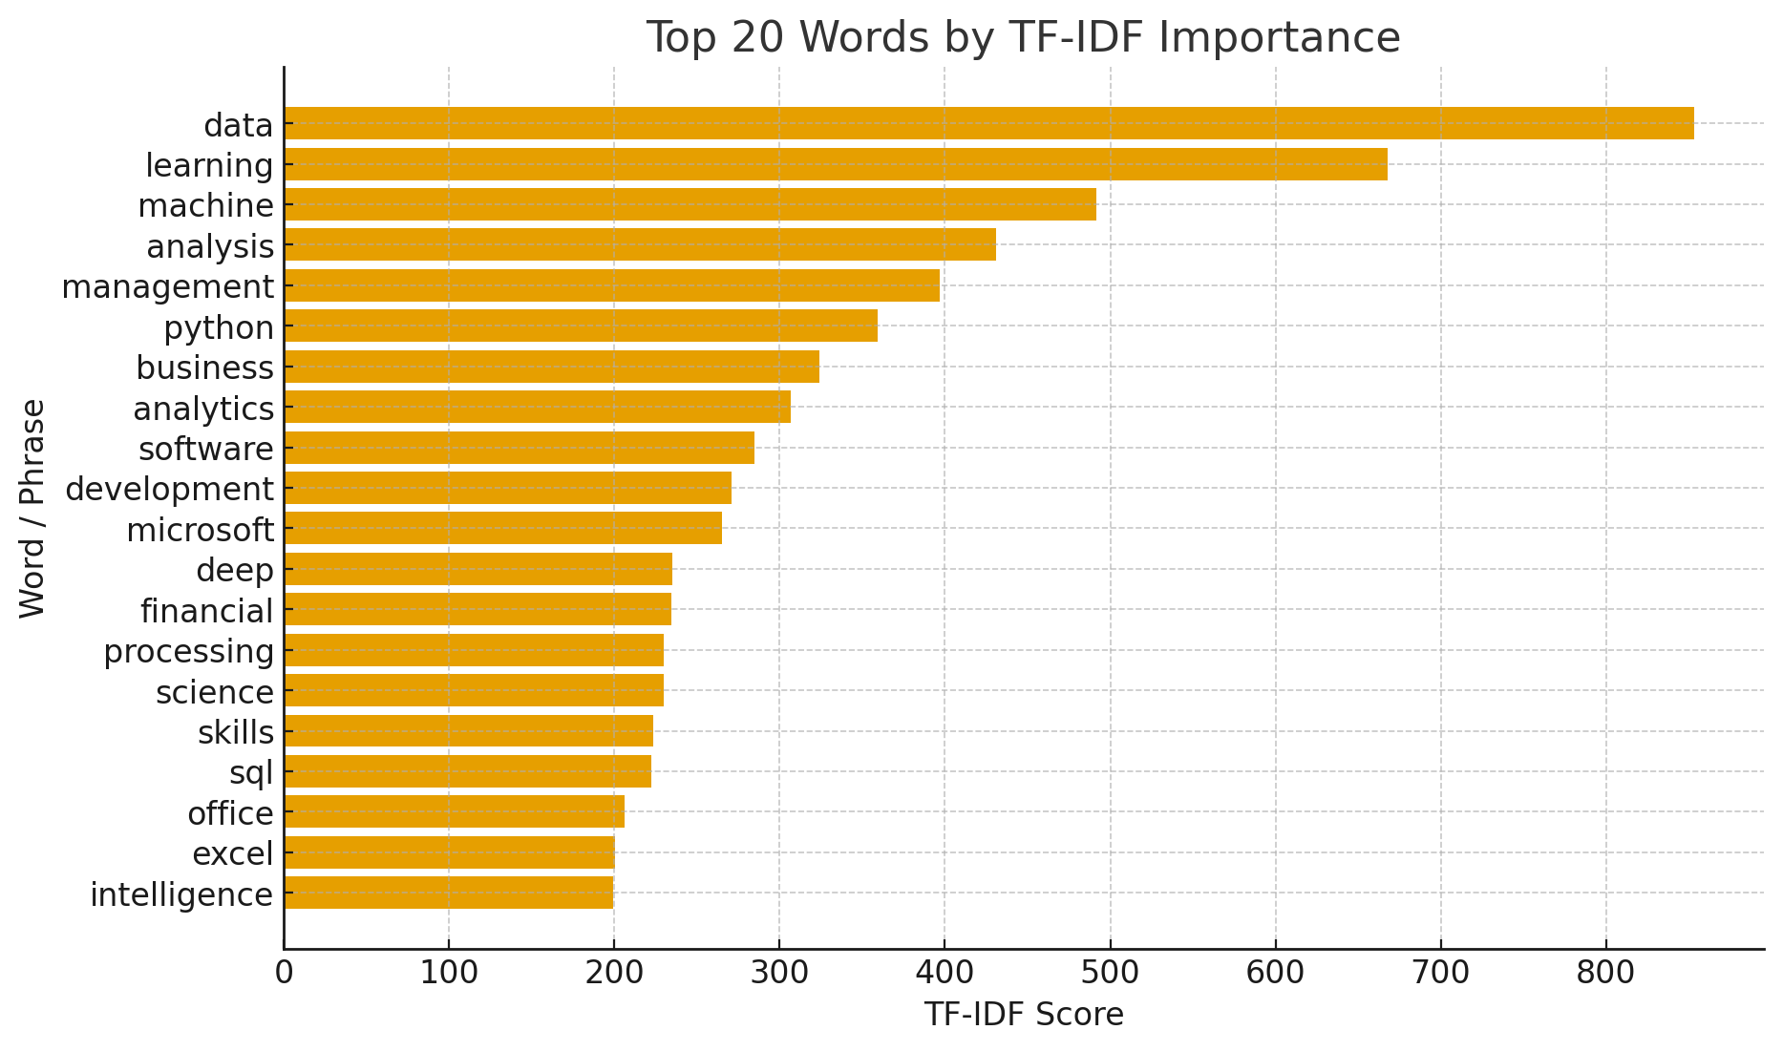
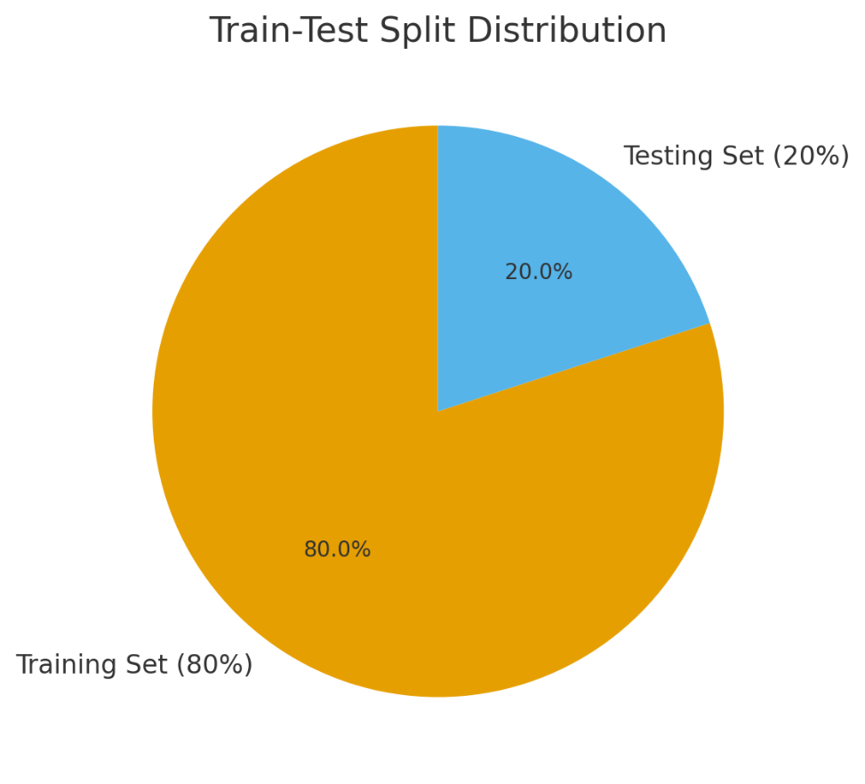
Feature Extraction with TF-IDF
Features by Correlation Matrix
Once the vocabulary was finalized, the resumes were converted into numerical feature vectors using TF-IDF (Term Frequency – Inverse Document Frequency).
we computed correlations between features and labels using Correlation Matrix feature selection.
Train-Test Split
Train-Test Split Pie Chart (80% training, 20% testing).
TF-IDF highlights words that are important in a given resume but less frequent across all resumes, making it well-suited for personality prediction.

Slide 11
Models used
The Machine Learning models used for this project are:
🔹Supervised Learning Models
🔹 Unsupervised Learning Models
Logistic Regression
K-Means Clustering
Random Forest
Hierarchical Clustering

Slide 12
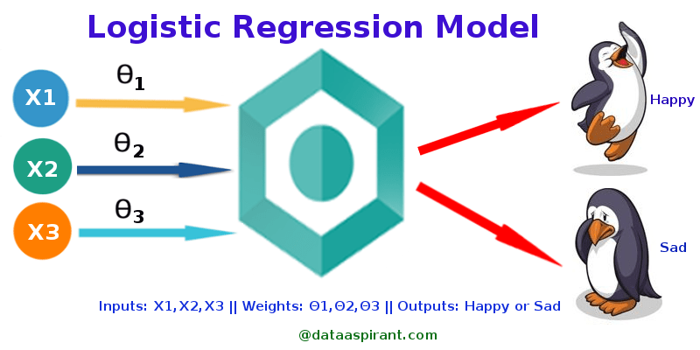
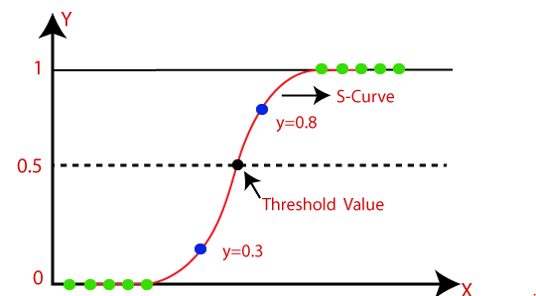


Logistic Regression(supervised)
Logistic Regression: is a popular and foundational model used for classification tasks, especially when the outcome variable is binary (i.e., it has two possible classes). Despite its name, logistic regression is not a regression model in the traditional sense (which predicts continuous outcomes); rather, it is used for predicting categorical outcomes.
The Logistic regression equation can be obtained from the equation. We know the equation of the straight line can be written as:
In this, y can be between 0 and 1 only, so for this let’s divide the above equation by (1-y):
But we need range between -[infinity] to +[infinity], then take logarithm of the equation:

Slide 13
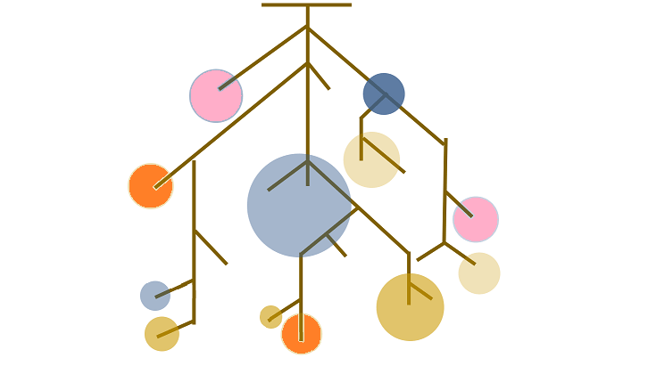
Random Forest(supervised)
Random Forest is an ensemble method that combines multiple decision trees to improve classification accuracy and robustness. Each tree is trained on a random subset of the data, and the final classification is made by majority vote among the trees.
Why Random Forest?
Handles high-dimensional data like resumes (thousands of words).
Captures complex, non-linear patterns in personality traits.
More robust and less prone to overfitting than single decision trees.
Application in Project
Trained on resume text features (TF-IDF vectors).
Compared against Logistic Regression and clustering models.
Showed good accuracy, but more complex than Logistic Regression.

Slide 14
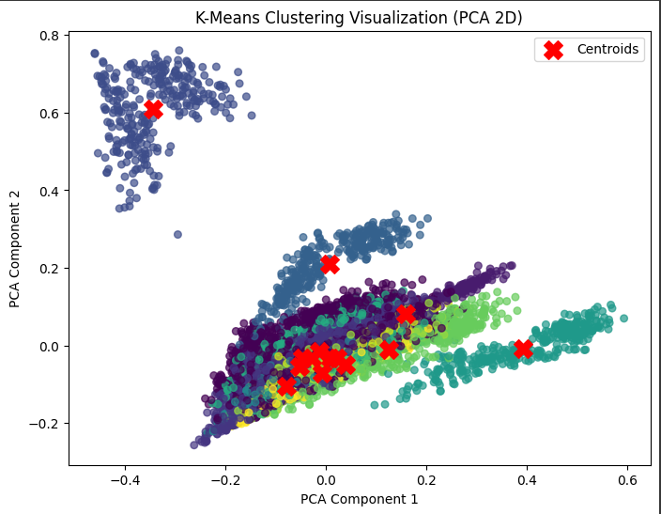
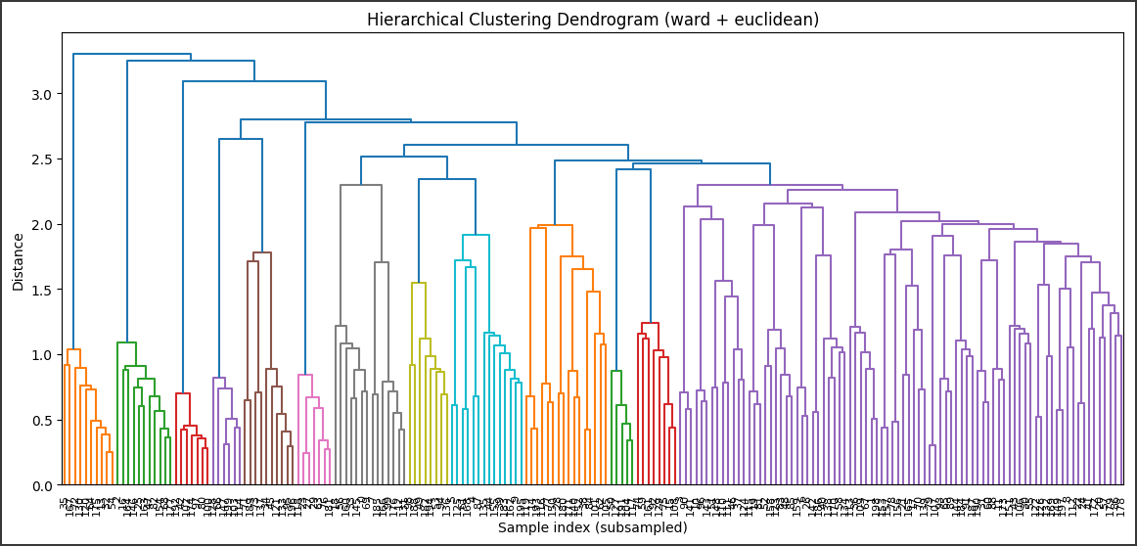
Clustering Models
Clustering and models are used in unsupervised learning to group similar data points into clusters based on their features. The goal is to find natural groupings within the data without predefined labels.
K-Means: Groups resumes into similar
clusters.
Hierarchical: Creates nested clusters
for analysis.
Useful for exploring hidden personality patterns, but less accurate.

Slide 15
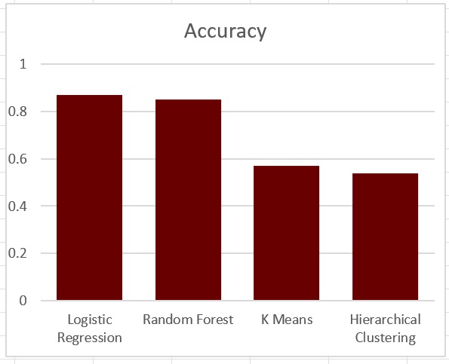
Accuracy comparison
Models were evaluated on the resume dataset using accuracy
as the metric.
Supervised models outperformed unsupervised models.
Random Forest was close, showing robustness but slightly
more complex.
Logistic Regression achieved the highest accuracy.
Clustering models (K-Means, Hierarchical) showed weaker
alignment with true labels.
Model | Accuracy
Logistic Regression | 0.87
Random Forest | 0.85
K-Means | 0.57
Hierarchical Clustering | 0.54

Slide 16
Inference
✅Logistic Regression provided the best balance of accuracy (0.87) and simplicity.Random Forest was stable but more complex.
✅Random Forest performed well (0.85) but was more complex and harder to interpret.Supervised ML > Unsupervised ML for this problem.
⚠️K-Means (0.57) and Hierarchical Clustering (0.54) showed weak alignment with true personality labels.
⚠️Supervised Learning models outperformed Unsupervised Learning for this problem.
✅Personality prediction from resumes is feasible, but requires:
High-quality labeled datasets.
Better text representation (e.g., embeddings, deep learning).

Slide 17
Future scope of improvements
Expand dataset with more diverse resumes.
Use advanced NLP models (Word2Vec, BERT).
Apply deep learning for higher accuracy.
Develop explainable AI for transparency.
Deploy as a cloud-based HR tool.
Integrate with LinkedIn/job portals.

Slide 18
Thank you
Asansol Engineering College
Sharmistha Das (aec.cse.sharmisthaj904@gmail.com)
Rishika Mishra (aec.cse.rishikamishra@gmail.com)
Ragini Gupta (aec.cse.raginigupta555@gmail.com)
Shreya Banerjee (aec.cse.shreyabanerjee002@gmail.com)

