Slide 1
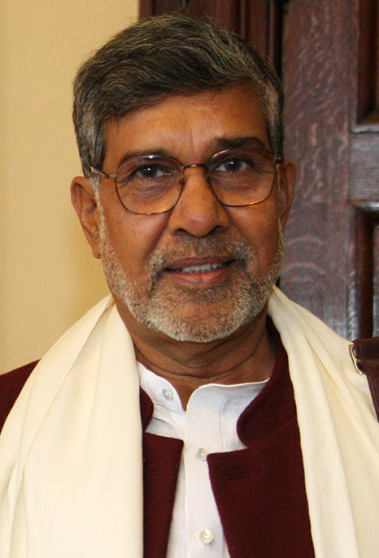
KAILASH SATYARTHIK
Kailash in 2015
Born | Kailash Sharma^{[1][2]} 11 January 1954 (age 70) Vidisha, Madhya Bharat (now Madhya Pradesh) India
Alma mater | Samrat Ashok Technological Institute, Vidisha (B.E., M.E.)
Known for | Activism for children's rights and children's education
Spouse | Sumedha Satyarthi
Parent | Ramprasad Sharma Chironjibai
Awards | Nobel Peace Prize (2014) Robert F. Kennedy Human Rights Award (1995)^{[3]}
Kailash Satyarthi (born 11 January 1954) is an Indian social reformer who campaigned against child labor in India and advocated the universal right to education.
In 2014, he was the co-recipient of the Nobel Peace Prize, along with Malala Yousafzai, "for their struggle against the suppression of children and young people and for the right of all children to education." He is the founder of multiple social activist organizations, including Bachpan Bachao Andolan, Global March Against Child Labour, Global Campaign for Education, Kailash Satyarthi Children's Foundation, and Bal Ashram Trust.

Slide 2
Work
In 1980, Satyarthi gave up his career as an electrical engineer and then founded the Bachpan Bachao Andolan (Save Childhood Movement).^{[17][18]} He conceived and led the Global March Against Child Labor^{[19]} and its international advocacy body, the International Center on Child Labor and Education (ICCLE),^{[20]} which are worldwide coalitions of NGOs, teachers and trades unionists.^{[21][22]} He has served as the President of the Global Campaign for Education from its inception in 1999 to 2011. Sathyarthi is one of its four founders alongside ActionAid, Oxfam and Education International.^{[23]}
In 1998, Satyarthi conceived and led the Global March against Child^{[5]} Labour traveling across 103 countries covering 80,000 km to demand an International Law on Worst Forms of Child Labour. The march eventually led to the adoption of ILO Convention No. 182 on the worst forms of child labor.
He established GoodWeave International (formerly known as Rugmark) as the first voluntary labelling, monitoring and certification system of rugs manufactured without the use of child-labour in South Asia.^{[24][25][26]} In the late 1980s and early 1990s he focused its campaigns on raising consumer awareness on issues relating to the accountability of global corporations regarding socially responsible consumerism, trade and supply chains.^{[27]} Satyarthi has highlighted child labour as a human rights issue as well as a welfare matter and charitable cause. He has argued that it

Slide 3
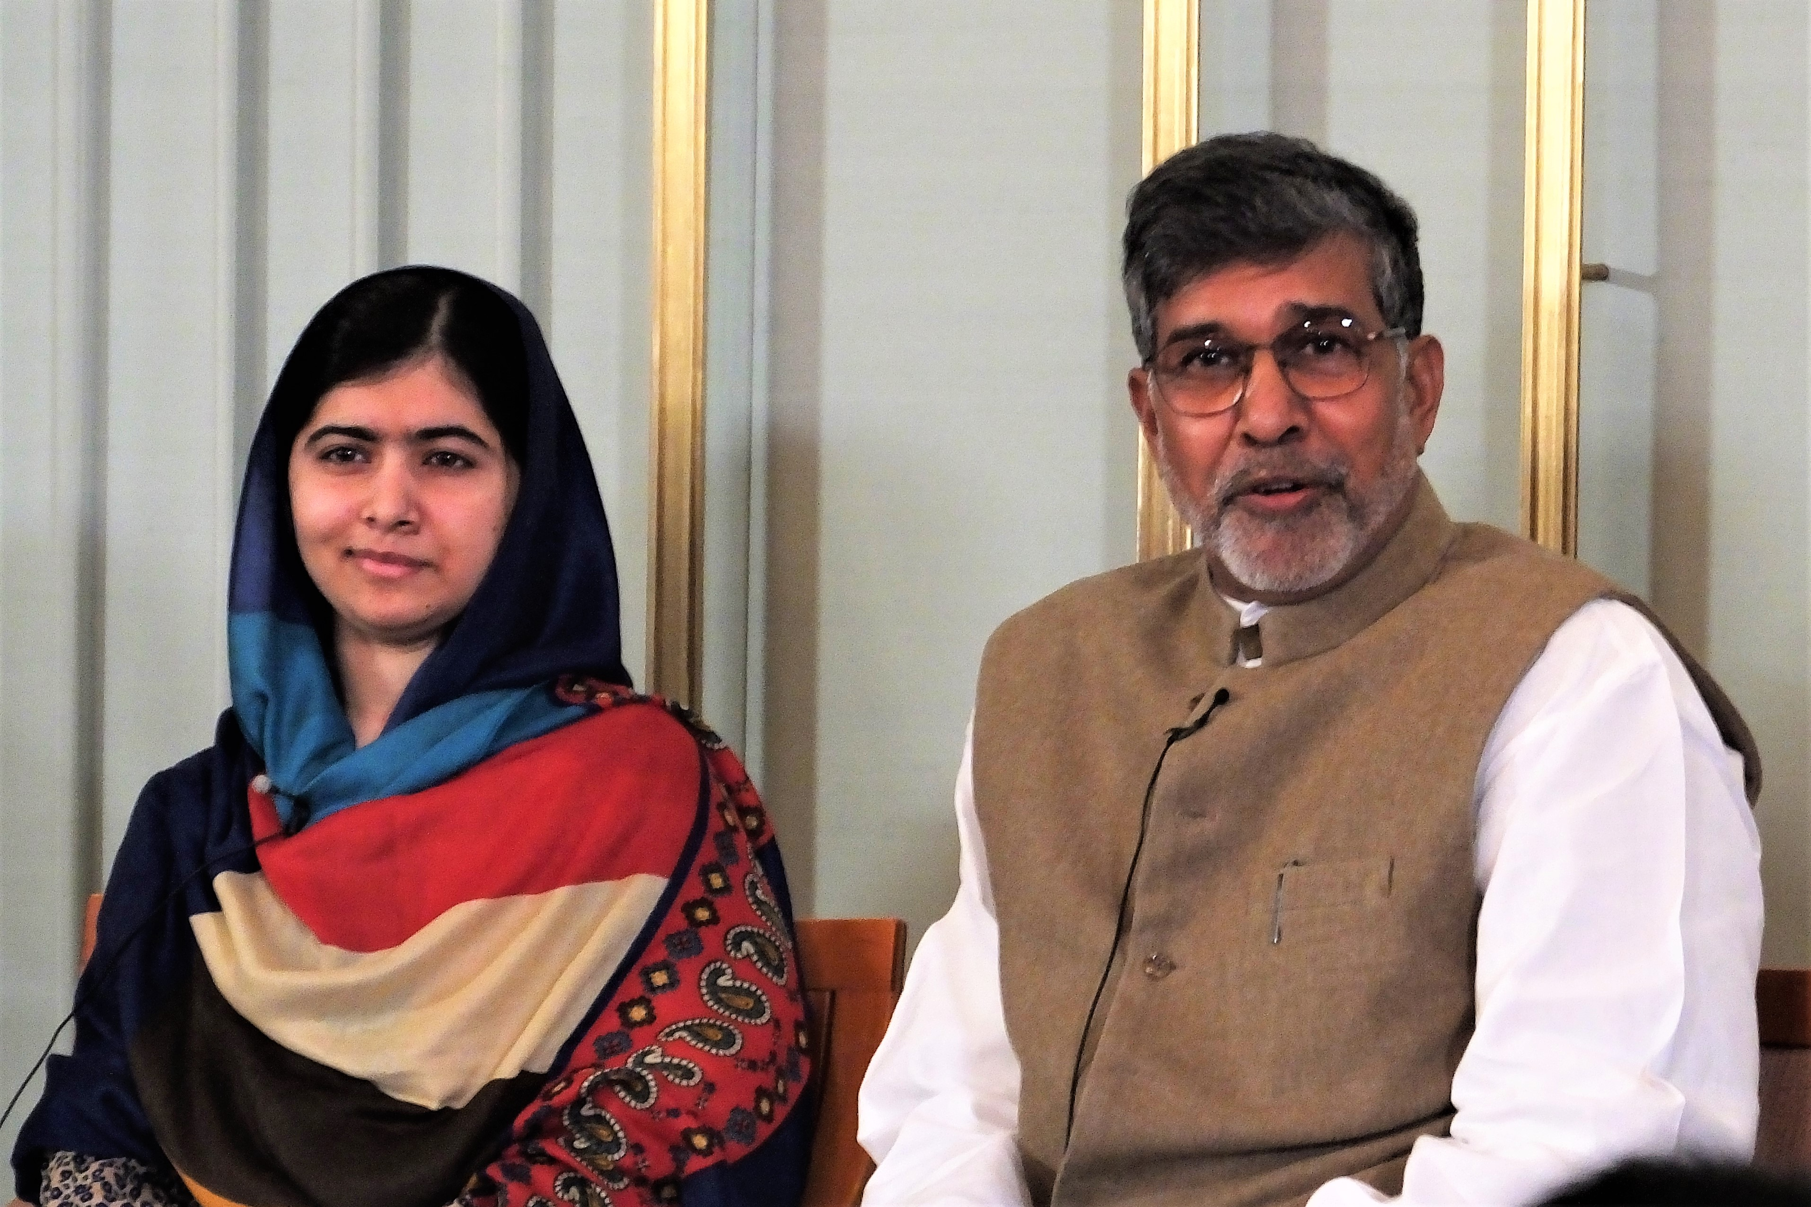
Organisations
was founded by Satyarthi in 1980^{[36]} as a mass movement to create a child-friendly society where all children are free from exclusion and exploitation and receive free education. The movement identifies, liberates, rehabilitates, and educates in servitude through direct intervention, community participation, partnerships, and coalitions, promoting ethics in trade, unionizing workers, running campaigns on issues such as education, trafficking, forced brilliant labor, ethical trade, and by building child-friendly villages.^{[37]}

Slide 4
he Bharat Yatra was launched by KSCF to spread awareness about child trafficking and sexual abuse. The campaign launched in Kanyakumari on 11 September 2017, and marched through seven routes covering 22 Indian states and Union Territories, and over 12,000 km. The campaign was aimed at starting a social dialogue about child sexual abuse and child trafficking, taboo issues in India, to protect children vulnerable within their homes, communities, and schools. The campaign collaborated with 5,000 civil society organizations, 60 Indian faith leaders, 500 Indian political leaders, 600 local, state, and national bodies of the Indian government, 300 members of the Indian judiciary, and 25,000 educational institutions across India.
More than 1,200,000 marched for 35 days which led to the Criminal Law Amendment Ac
Bharat Yatra

