Slide 1
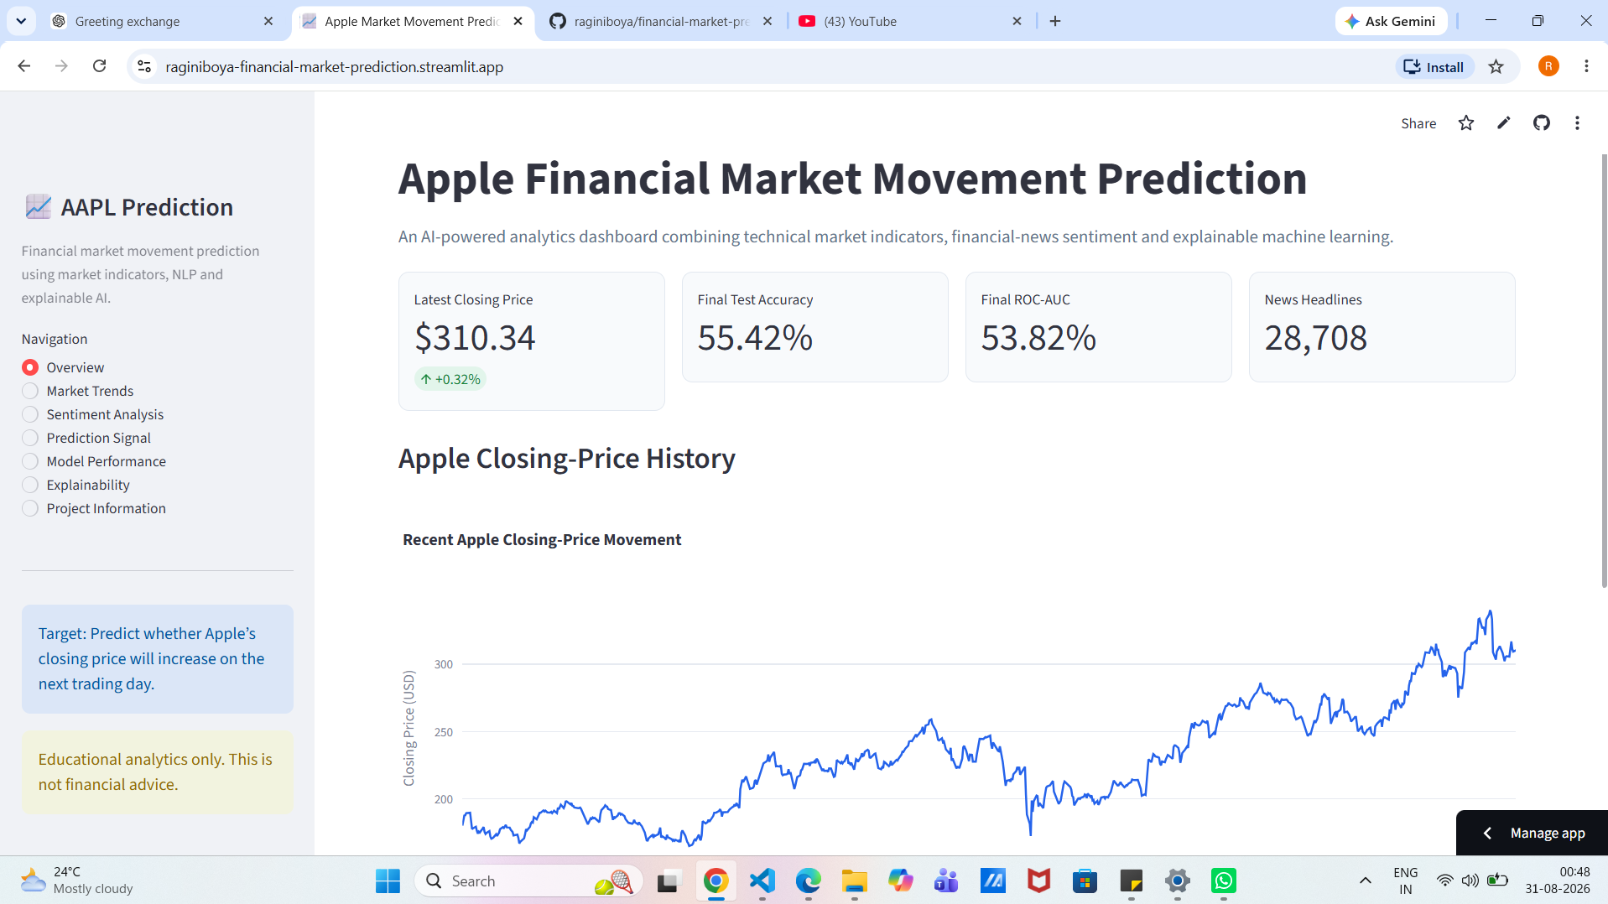
Financial Market Movement Prediction
Using News Sentiment and Market Data
Apple Inc. (AAPL)
End-to-end data science and machine learning project
Ragini Boya | August 2026
GitHub: raginiboya/financial-market-prediction
1
Notes:
Open with the problem: next-day direction is noisy, so the project emphasizes honest out-of-time evaluation rather than a trading claim.
[Sources]
- Project README and deployed Streamlit application
- Project notebooks 01-03
[/Sources]

Slide 2
A narrow question kept the project testable
Can information available today predict whether AAPL closes higher on the next trading day?
Binary next-day target
Target 1: Next_Close > Close
Target 0: Next_Close <= Close
The test set remained untouched until the model configuration was locked.
No random time shuffling
Chronological validation
Final held-out test
Educational, not financial advice
AAPL MARKET MOVEMENT PREDICTION
2
Notes:
Explain why chronological splitting matters: future market observations cannot be allowed to influence training or model selection.
[Sources]
- notebooks/01_data_collection_preprocessing.ipynb
- notebooks/03_model_training_evaluation.ipynb
[/Sources]

Slide 3
The workflow linked raw data to an explainable app
Five connected stages produced reproducible data, model and deployment artifacts.
01
02
03
04
05
Collect
Clean
Engineer
Evaluate
Explain
Yahoo Finance
Kaggle news
Dates, duplicates
missing values
Technical +
sentiment features
Four models
time-aware split
SHAP +
Streamlit
Outputs: processed CSVs | joblib model bundles | evaluation figures | deployed app
AAPL MARKET MOVEMENT PREDICTION
3
Notes:
Walk left to right and emphasize that every downstream artifact is generated from the preceding stage.
[Sources]
- Project folder structure and notebooks 01-03
- dashboard/app.py
[/Sources]

Slide 4
The modeling table aligned market and news histories
2,210 trading days
Unified dataset from 19 Feb 2016 to 27 Nov 2024.
28,708 headlines
AAPL news titles scored by the saved sentiment pipeline.
1,140 news days
1,070 trading days had no news and retained zero-filled sentiment features.
AAPL MARKET MOVEMENT PREDICTION
4
Notes:
Explain the moderate class imbalance and why no-news days were retained instead of being dropped.
[Sources]
- data/processed/AAPL_modeling_dataset.csv
- notebooks/02_sentiment_analysis_feature_engineering.ipynb
[/Sources]

Slide 5
The sentiment classifier generalized well on labeled headlines
TF-IDF + Logistic Regression
A class-weighted three-class pipeline predicted negative, neutral and positive labels.
80.03% test accuracy
Final macro F1: 76.87% across 726 labeled headlines.
Reusable saved pipeline
The same preprocessing and vocabulary power the dashboard headline tester.
AAPL MARKET MOVEMENT PREDICTION
5
Notes:
Clarify that this score evaluates headline sentiment classification, not stock-movement prediction.
[Sources]
- notebooks/02_sentiment_analysis_feature_engineering.ipynb
- models/financial_sentiment_pipeline.joblib
[/Sources]

Slide 6
Stationary features reduced dependence on raw price scale
The final comparison used 31 normalized, lagged or relative variables rather than raw future-sensitive fields.
Returns and price ranges
Date, adjusted close, next close and target were excluded. Rolling indicators used only the current and prior observations. Missing selected-feature values: 0.
SMA, EMA and MACD relations
RSI and Bollinger position
Lagged returns and volatility
Cyclic calendar encodings
AAPL MARKET MOVEMENT PREDICTION
6
Notes:
Explain stationarity in plain language: the model should learn repeatable relationships, not that AAPL's nominal price rose over time.
[Sources]
- notebooks/01_data_collection_preprocessing.ipynb
- notebooks/03_model_training_evaluation.ipynb
[/Sources]

Slide 7
Chronological splits protected the final evaluation
Training preceded validation, which preceded the untouched test period.
Split | Rows | Date range | Purpose
Training | 1,547 | 19 Feb 2016 - 8 Apr 2022 | Fit candidate models
Validation | 331 | 11 Apr 2022 - 4 Aug 2023 | Choose configuration
Testing | 332 | 7 Aug 2023 - 27 Nov 2024 | One final evaluation
Why it matters: random splitting would leak market regimes across time and overstate future performance.
AAPL MARKET MOVEMENT PREDICTION
7
Notes:
Point to the dates and state that the model never saw the test period during tuning.
[Sources]
- notebooks/03_model_training_evaluation.ipynb
[/Sources]

Slide 8
Validation showed no strong all-history winner
51.06% baseline
No all-history model exceeded validation majority-class accuracy.
XGBoost led F1
Its 51.52% F1 reflected higher recall, not stronger probability ranking.
Diagnostics followed
Training windows and feature groups were compared before touching the test set.
AAPL MARKET MOVEMENT PREDICTION
8
Notes:
Do not present these as successful scores. The important decision was to diagnose regime and feature-group sensitivity honestly.
[Sources]
- reports/stationary_model_validation_comparison.csv
- notebooks/03_model_training_evaluation.ipynb
[/Sources]

Slide 9
Validation diagnostics locked a simpler final model
The best validation accuracy came from a market-only logistic regression trained from 2020 onward.
Decision | Locked choice | Reason
Model | Logistic Regression | Best diagnostic validation accuracy
Training window | From 2020 | Reduced older-regime exposure
Feature group | Market only | Generalized better than combined model
Regularization | C = 0.1 | Stronger control for correlated features
Class handling | Balanced weights | Addressed moderate imbalance
Diagnostic validation: 52.27% accuracy | 57.53% F1 | 48.55% ROC-AUC
AAPL MARKET MOVEMENT PREDICTION
9
Notes:
Emphasize that the selection rule was set before final test evaluation. Simplicity and transparency were advantages, but validation performance remained weak.
[Sources]
- reports/training_window_feature_diagnostics.csv
- models/aapl_movement_logistic_model.joblib
[/Sources]

Slide 10
The final model found only a weak directional signal
Accuracy = baseline
55.42% accuracy matched the majority-class benchmark.
63 TN | 85 FP | 63 FN | 121 TP
The classifier favored upward predictions and reached 65.76% up-day recall.
ROC-AUC = 53.82%
Probability ranking was only modestly above random chance.
AAPL MARKET MOVEMENT PREDICTION
10
Notes:
State the limitation directly: the result is not production-grade and does not justify a trading claim.
[Sources]
- reports/final_test_predictions.csv
- outputs/figures/final_model_evaluation.png
[/Sources]

Slide 11
SHAP traced predictions to normalized market position and momentum
Mean |SHAP| (×10⁻³)
BB Position dominated
Its mean absolute SHAP value was 0.242 - more than twice the next feature.
Momentum followed
Normalized RSI and daily return were the next strongest influences.
Influence is not causality
Absolute SHAP magnitude ranks impact; sign is needed for direction.
AAPL MARKET MOVEMENT PREDICTION
11
Notes:
Explain SHAP simply: it decomposes how much each feature moves the model away from its baseline output.
[Sources]
- reports/final_model_shap_importance.csv
- outputs/figures/final_model_shap_summary.png
[/Sources]

Slide 12
Sentiment mattered inside the model but hurt generalization
30.31% SHAP share
Sentiment features substantially changed the combined model's output.
-4.22 accuracy points
The combined candidate fell from 55.42% to 51.20% accuracy.
Excluded from final model
Ablation evidence outweighed within-model feature importance.
AAPL MARKET MOVEMENT PREDICTION
12
Notes:
Make the key distinction: importance measures influence, while ablation measures whether that influence helps out-of-sample performance.
[Sources]
- reports/sentiment_ablation_comparison.csv
- reports/sentiment_features_shap_impact.csv
[/Sources]

Slide 13
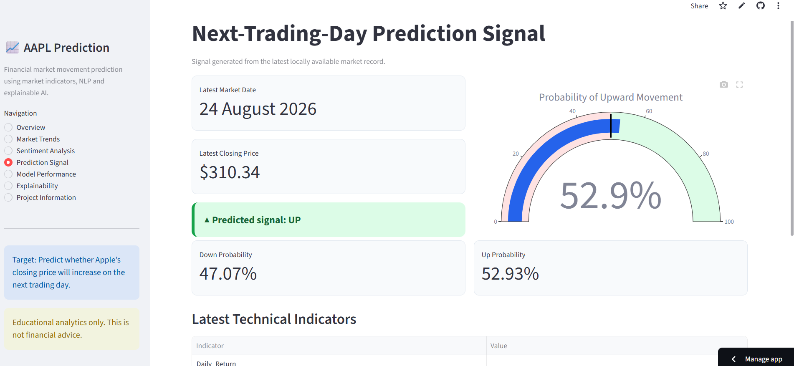
The deployed dashboard makes every project layer inspectable
Seven views connect prediction to evidence
Overview and market trends
Sentiment history and headline tester
Next-day probability signal
Model metrics and recent predictions
SHAP explainability
Live: raginiboya-financial-market-prediction.streamlit.app
AAPL MARKET MOVEMENT PREDICTION
13
Notes:
Use the live app to demonstrate the prediction probability, then navigate to model performance and explainability.
[Sources]
- dashboard/app.py
- Live Streamlit application
[/Sources]

Slide 14
The strongest result is the honest analytical conclusion
Technical features produced a small directional signal. Sentiment influenced predictions, but reduced out-of-sample accuracy.
Walk-forward validation
Timestamp-aware news alignment
The project delivered a complete, reproducible pipeline without overstating predictive power. The final model is suitable for education and further research - not live trading.
Probability calibration
Multi-asset evaluation
Backtesting with costs and risk limits
AAPL MARKET MOVEMENT PREDICTION
14
Notes:
Close by resolving the opening question: there was weak signal, not reliable predictability. Then offer the concrete next research steps.
[Sources]
- Project evaluation report
- Project notebooks and deployed application
[/Sources]

