Slide 1
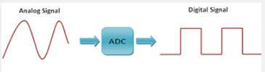
Raspberry Pi
Analog Input Operations using ATD

Slide 2
What is ADC?
An Analog to Digital Converter is a device that converts a continuous physical quantity (temperature/humidity/weight etc.) into a digital number that represents the quantity’s amplitude
The conversion involves some quantization of the input, so there is some scope of error
Instead of a single conversion, the ADC usually performs multiple conversions or “samples” the input periodically.
The result is a sequence of digital values that has been converted from a continuous-time analog signal to a discrete time digital signal

Slide 3
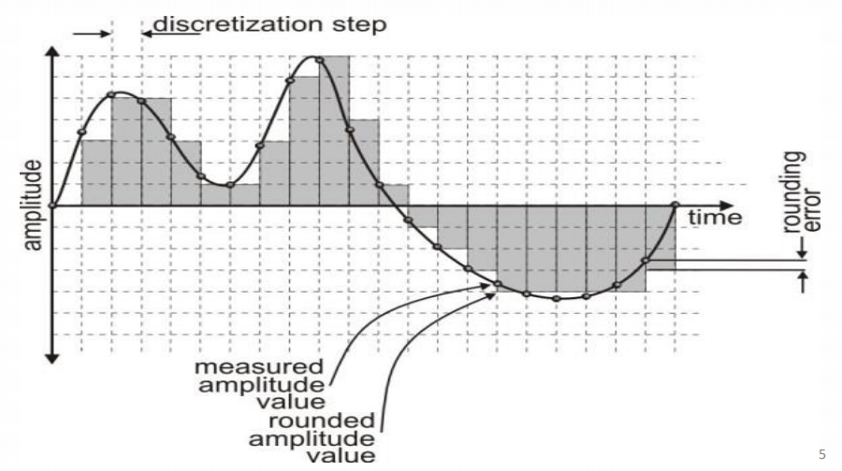
Analog to Digital Conversion

Slide 4
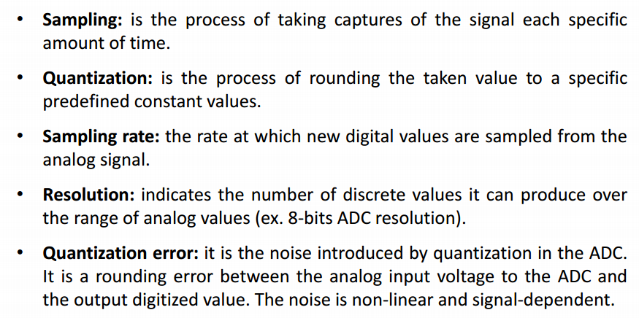
ADC Concepts
Notes:
file:///C:/Users/Lenovo/Downloads/lecture4-hardwareinterfacingspecialcases-150819171851-lva1-app6892.pdf

Slide 5
ADC Pi Plus
The ADC Pi Plus is an 8 channel 17 bit analogue to digital converter designed to work with the Raspberry Pi A+, Raspberry Pi B+ and Raspberry Pi 2 Model B.
The ADC Pi Plus is powered through the host Raspberry Pi using the GPIO port and extended pins on the GPIO connector allow you to stack the ADC Pi Plus along with other expansion boards.
The operating voltage or VDD for ADC Pi plus on I2C bus is 5.0 V. Thus, a voltage divider on the ADC Pi Plus board brings the input voltage range to a much more useful 0 – 5.06V. In this case, sample size is 17 bits for each channel.
A/D converter uses the internal 2.048V reference voltage
Notes:
https://www.abelectronics.co.uk/p/56/ADC-Pi-Plus-Raspberry-Pi-Analogue-to-Digital-converter

Slide 6
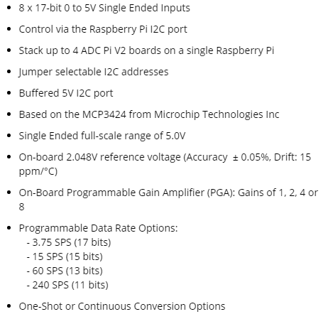
Features of ADC Pi Plus
Notes:
https://www.abelectronics.co.uk/p/56/ADC-Pi-Plus-Raspberry-Pi-Analogue-to-Digital-converter

Slide 7
The ADC Pi Plus is based on two Microchip MCP3424 A/D converters each of which contributes to 4 analogue inputs, thus giving a total of 8 analogue input channels to use on ADC pi board.
The two MCP3424 A/D converters use I2C to communicate with the Raspberry Pi.
Each MCP3424 board takes one I2C address. Thus, one board takes two I2C addresses.
The I2C address bits are selectable using the on-board jumpers.
The data rate for analogue to digital conversions is 3.75 (17 bit), 15 (15 bit), 60 (13 bit) or 240 (11 bit) samples per second. Data rate and resolution can be configured within software using the I2C interface.

Slide 8
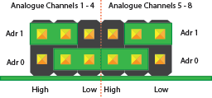
I2C Address bits selection
The MCP3424 supports up to 8 different I2C addresses so with two MCP A/D converters on each ADC Pi you can stack up to 4 ADC Pi boards on a single Raspberry Pi giving you 32 ADC inputs.
To simplify address selection on the ADC Pi Plus we have included a set of address selection pins which can be configured using the included jumpers.
Chip 1
Chip 2

Slide 9
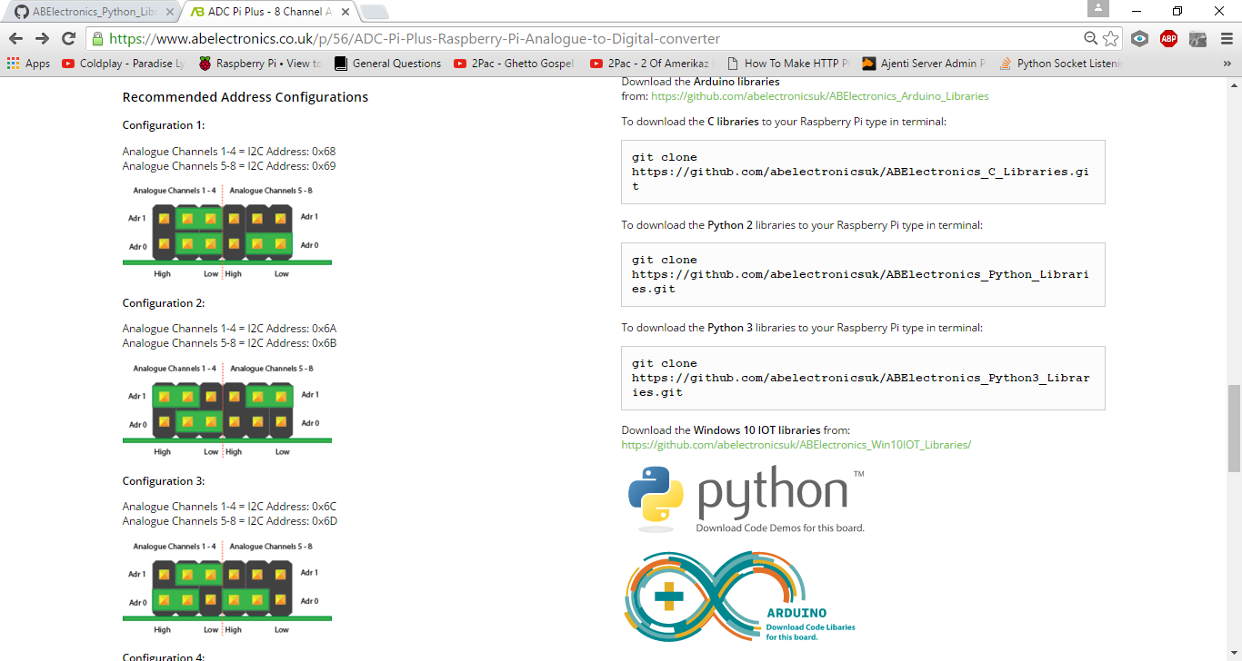
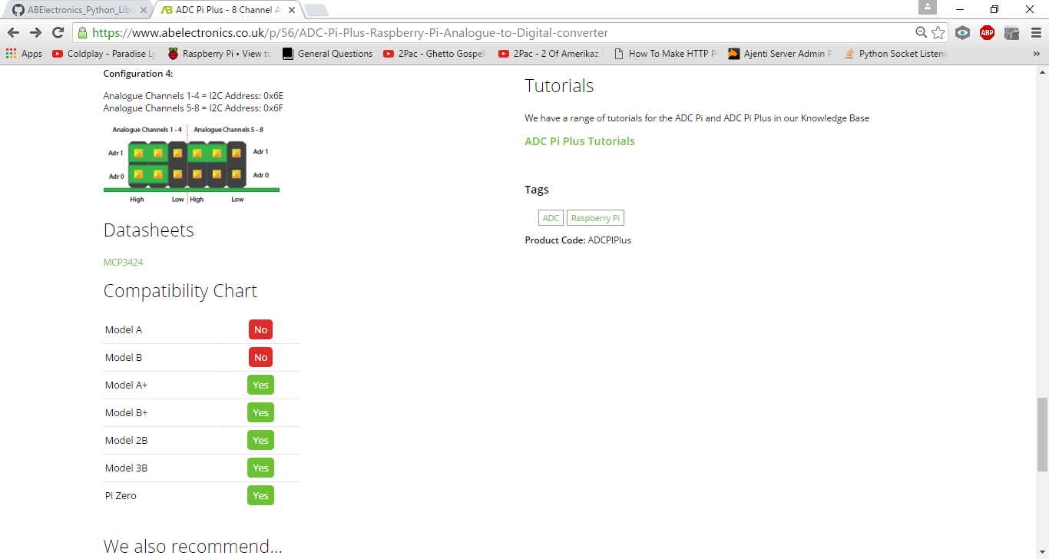
The illustrations below show the four recommended configurations for your ADC Pi Plus and the associated I2C addresses.
Notes:
https://www.abelectronics.co.uk/p/56/ADC-Pi-Plus-Raspberry-Pi-Analogue-to-Digital-converter

Slide 10
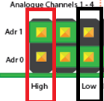
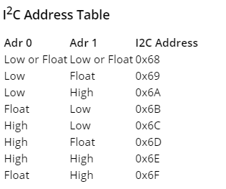
Question: the guidelines as given in I2C Address Table, set I2C address of Chip 1 of ADC Pi as 0x6A.
Solution: As shown in diagram below, we make Adr 0 as Low and Adr 1 as High.

Slide 11
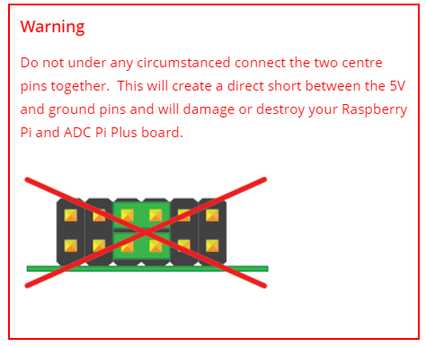
Handle with Care!
Disconnect the ADC Pi Plus from the Raspberry Pi before changing the address pins.

Slide 12
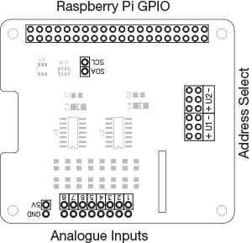
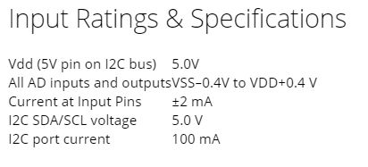
ADC Pi layout, Input Ratings & Specifications
ADC Board Layout
Notes:
https://www.abelectronics.co.uk/p/56/ADC-Pi-Plus-Raspberry-Pi-Analogue-to-Digital-converter

Slide 13
ADC Sample Rate
The ADC Pi Plus uses the MCP3424 analogue to digital converter from Microchip. The MCP3424 has programmable bit rates from 12 bits to 18 bits and the number of samples that can be taken each second depends on the bit rate you have chosen.
According to the datasheet for the MCP3424 the data rates are as follows : (SPS stands for samples per second)
240 SPS (12 bits) 60 SPS (14 bits) 15 SPS (16 bits) 3.75 SPS (18 bits)
Notes:
https://www.abelectronics.co.uk/kb/article/1047/adc-sample-rate-comparison

Slide 14

Setting up the ADC Pi
We will use the AB Electronics python library to talk to the ADC Pi, you can download the library from github using the following command in a terminal, and this will download the full python library into the currently selected folder.
The AB Electronics python library uses another library called python-smbus, you can install it using apt-get with the following commands.
Notes:
https://www.abelectronics.co.uk/p/56/ADC-Pi-Plus-Raspberry-Pi-Analogue-to-Digital-converter

Slide 15
Finally you will want to tell python where you download the AB Electronics python library by adding it into PYTHONPATH.
Notes:
https://www.abelectronics.co.uk/p/56/ADC-Pi-Plus-Raspberry-Pi-Analogue-to-Digital-converter

Slide 16
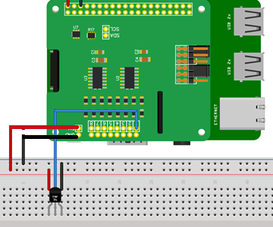
Connecting sensor to ADC Pi
Install your ADC Pi Plus onto the Raspberry Pi by connecting it onto the GPIO header. Make sure your Raspberry Pi is turned off when you do this to minimize the risk of damaging the Raspberry Pi or the ADC Pi Plus.
Next connect the TMP 36/Humidity sensor to the ADC Pi Plus. Pin 1 connects to +5V, Pin 2 to input channel 1 on the ADC Pi, Pin 3 connects to GND as shown in diagram here.
Create a python program file in IDLE and execute the program.

Slide 17
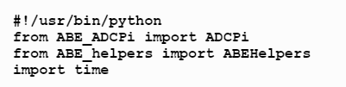

At the top of your program you will need to import the ABEHelpers library, ADCPI library and time library.
The ADCPI library is used for all communication with your ADC Pi Plus, it gives you control over almost everything that can be done with the MCP3424 controller.
The ABEHelpers class contains a function called get_smbus() that allows us to find out which I2C bus is being used on the Raspberry Pi. Create an instance of the ABEHelpers class called i2c_helper and use it to create an i2c_bus object.
Notes:
https://www.abelectronics.co.uk/kb/article/14/adc-pi-with-tmp36

Slide 18

ADC Pi object Initialization
Next we need to create an instance of the ADCPI class using the i2c_bus object and call it adc.
0x68 and 0x69 are the I2C address for the ADC chips, if you have changed the address selection jumpers on your ADC Pi Plus then you will need to change these numbers to match the new addresses.
Syntax: ADCPi(smbus, i2c_address1, i2c_address1, bit_rate)
The first argument is the smbus object followed by the two I2C addresses of the ADC chips. The values shown are the default addresses of the ADC board.The forth argument is the sample bit rate you want to use on the ADC chips. Sample rate can be 12, 14, 16 or 18
Notes:
https://www.abelectronics.co.uk/kb/article/14/adc-pi-with-tmp36

Slide 19
Usage Functions:
Function Name | Purpose | Parameter | Returns
read_voltage(channel) | Read voltage from selected channel | Channel 1-8 | Float between 0-5V
read_raw(channel) | Read the raw int value from the selected channel | Channel 1-8 | Number as int range: 0 – (2^(no. of bits) – 1)
set_pga(gain) | Set the gain of the PGA on the chip | Gain 1,2,4,8 | Null
setBitRate(rate) | Set the sample bit rate of the adc | Rate 12,14,16,18 | Null Bit-rate set is directly proportional to number of Samples per second (slide -13)
set_conversion_mode(mode) | Set the conversion mode for the adc | Mode 0-one shot Mode 1-continuous conversion | Null
Notes:
https://github.com/abelectronicsuk/ABElectronics_Python_Libraries/tree/master/ADCPi

Slide 20
Modes of operation in ADC
Two modes: one-shot sampling and continuous sampling.
During one-shot sampling the ADC wakes up from a sleep state, takes a sample, sends the result to the Raspberry Pi and then goes back to sleep. During continuous sampling mode the ADC takes samples continuously and returns the last sample when requested. One-time sampling uses less energy than continuous sampling mode but at the cost of a slower sample rate as it takes time to wake up and go to sleep between each sample.
One-shot mode may be useful if you only need to take single samples at well-spaced intervals but if performance is more important than power usage then it may be better using continuous conversion mode.
Function used : set_conversion_mode(mode)
Notes:
https://www.abelectronics.co.uk/kb/article/1047/adc-sample-rate-comparison

Slide 21
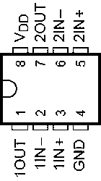
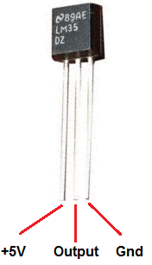
LM35 Precision Centigrade Temperature Sensor and TLC272 Dual Operational Amplifier
LM35 is a low-cost, precision, semiconductor-based temperature sensor. Its output voltage is linearly proportional to the Centigrade temperature. This complete integrated circuit can continuously measure temperature from –40Co to +110Co with 10mv/1Co.
The connection diagram for this sensor is shown in figures below. The figure shows the connection of TLC272 (Dual Operational Amplifier). The Op-Amp will be used as an interface (SCC) between the temperature sensor and MC9S12DP256 ADC port.
TLC272
LM35 Temperature Sensor
Notes:
http://www.ti.com/lit/ds/symlink/lm35.pdf

Slide 22
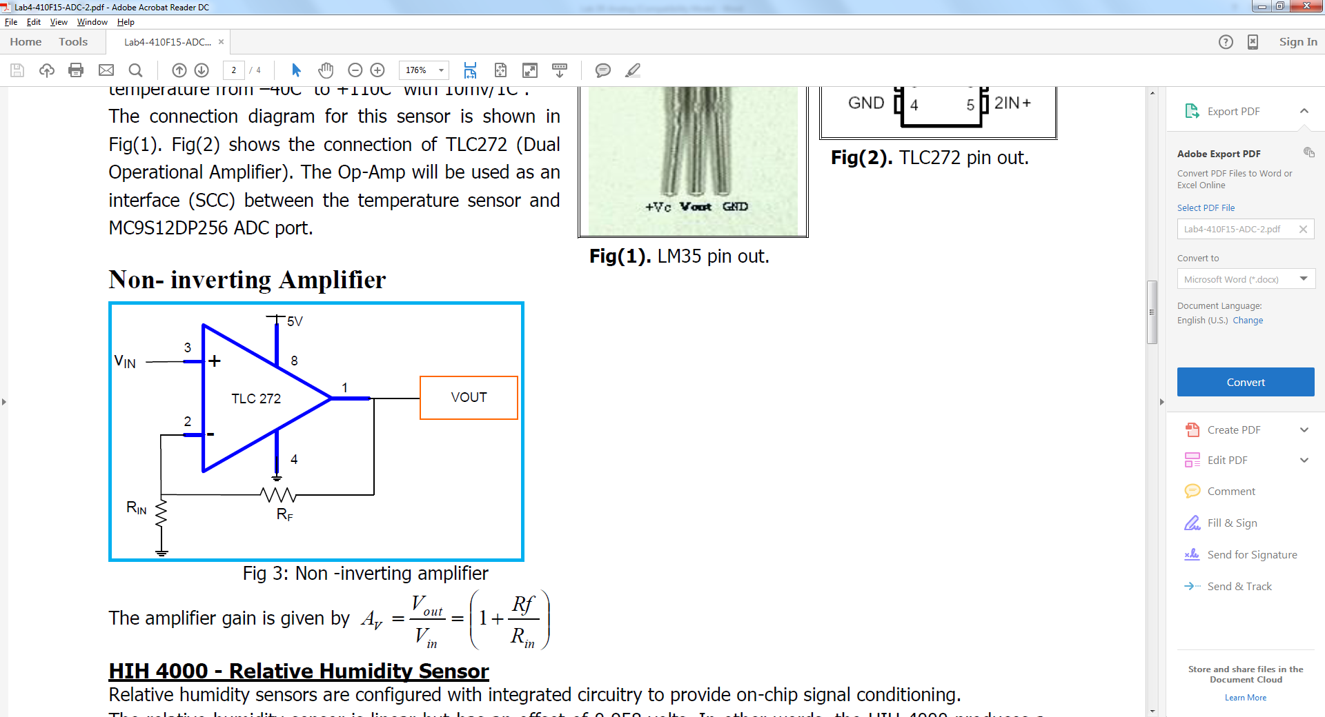
Non-inverting Amplifier
The amplifier gain is given by

Slide 23
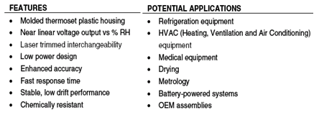
HIH 4000 - Relative Humidity Sensor
Relative humidity sensors are configured with integrated circuitry to provide on-chip signal conditioning.
The relative humidity sensor is linear but has an offset of 0.958 volts. In other words, the HIH-4000 produces a 0.958 volt output at 0% relative humidity (RH). A change of 0.0307 volts is a change of 1% RH. It is best used for refrigeration, drying, meteorology, battery-powered systems and OEM assemblies.
Notes:
http://www.phanderson.com/hih-4000.pdf

Slide 24
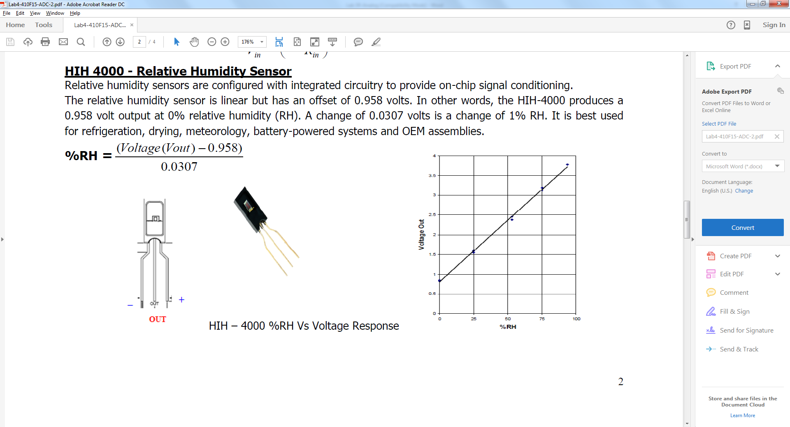

Slide 25
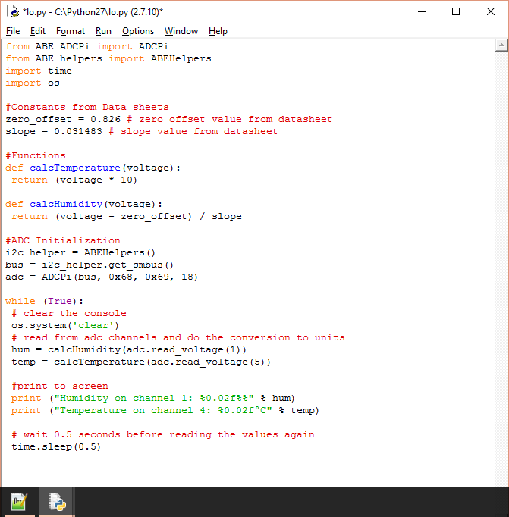
Practice Example
Write a program to read analog values given by temperature sensor connected at channel 1 and humidity sensor connected at channel 5. Sampling rate must be 18 bits. HINTS: Temperature Value is given by: (Voltage value * 10) Humidity Value is given by: (Voltage value- 0.826) / 0.031483

