Slide 1
Raspberry Pi Digital I/O in Raspberry Pi

Slide 2

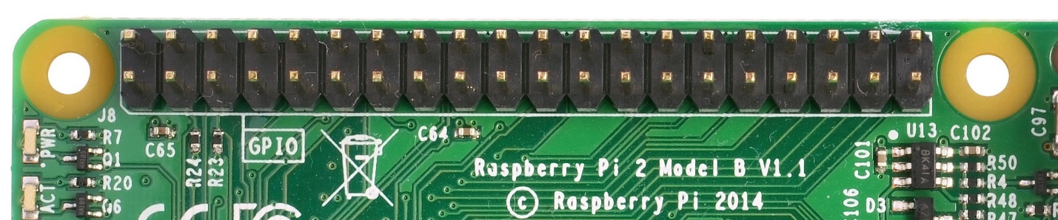
Raspberry Pi GPIOs
Pins in Raspberry Pi, as shown in Figure below, are used to perform digital input/output operations. Raspberry Pi 3 Model B has 40 pins. Of these 40 pins, 26 are GPIO pins and the others are power or ground pins.
These pins are a physical interface between the Pi and the outside world. At the simplest level, you can think of them as switches that you can turn on or off (input) or that the Pi can turn on or off (output).

Slide 3
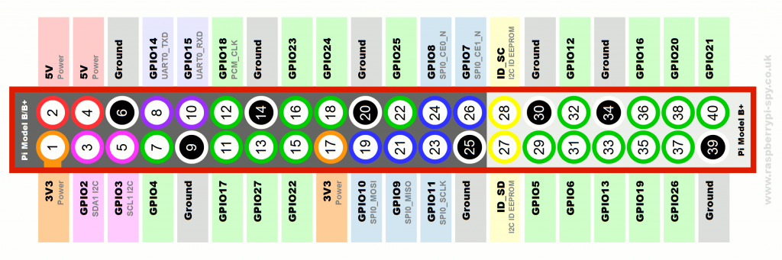
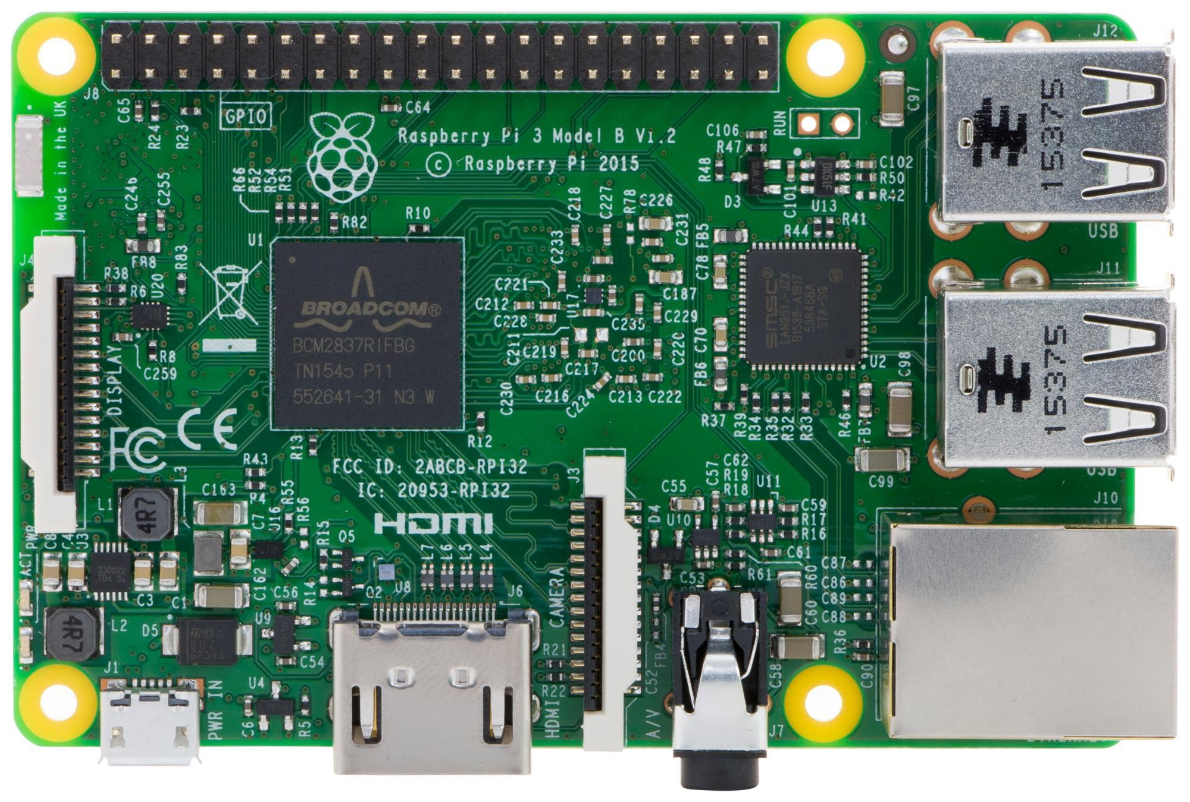
Raspberry Pi 3 model B : GPIO
Pin 2
Pin 40
Pin 39
Pin 1

Slide 4
General Purpose Digital Inputs/Outputs (GPIO)
Can be configured as Outputs to control external circuits like switch LED ON/OFF, switch relays ON/OFF
Can be Configured as Inputs to monitor status such as read switch status or alarm inputs
GPIOs can be enabled/disabled
GPIOs Input values are readable (high=1,low=0)
GPIOs Output values are writable/readable
GPIOs input values can be used as Interrupts/IRQs (for example in case of wakeup events)
Notes:
http://www.slideshare.net/nipunmaster/a-seminar-report-on-raspberry-pi

Slide 5
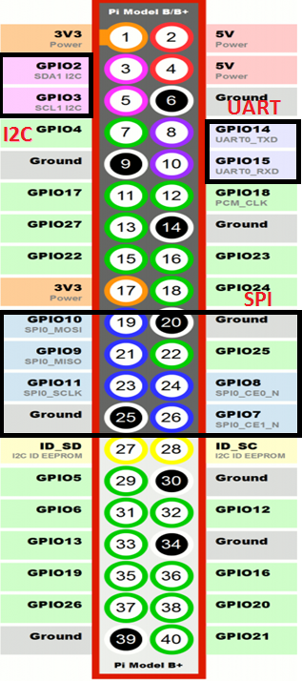
GPIOs Layout
The following communication protocols can be used with GPIOs when not being used in their bus modes:
UART, I2C, and SPI Bus
2 Pins for I2C, 2 Pins for UART and 5 pins for SPI
I2C and SPI can be used to interface ATD or DAC convertor, & oscillators
UART can be used for serial data input and output
Two voltages on GPIO: 3V3 and 5.0 V

Slide 6
GPIO Libraries
Rpi. GPIO: A module to control Raspberry Pi GPIO channels, allows you to easily configure and read-write the input/output pins on the Pi’s GPIO header within a Python script.
Wiring Pi : is a GPIO access library written in C for the BCM2835 used in the Raspberry Pi. It supports analog reading and writing on the pins and to control them from shell scripts. This library can be used to access the GPIOs via Arduino style programming.
We will be working with Rpi. GPIO library in the lab
Notes:
http://wiringpi.com/
https://learn.sparkfun.com/tutorials/raspberry-gpio/python-rpigpio-api

Slide 7
Rpi.GPIO installation
GPIO library installation from terminal window:-
$sudo apt-get update
$sudo apt-get install python-dev
$sudo apt-get install python-rpi.gpio
If you are using the most popular Raspbian OS, the Rpi.GPIO library is already included in it and there is no need to download

Slide 8

Setting up Rpi.GPIO API
To us RPi.GPIO throughout the rest of your Python script, you need to put this statement at the top of your file:

Slide 9
Pin Numbering Declaration
For the GPIO Pins to be usable, pin mode has to be configured first. There are two modes of operation-
1. GPIO.BOARD mode:- Board numbering scheme. It refers to the pin numbers on header and the number goes from 1-40.
2. GPIO. BCM mode :- Broadcom chip-specific pin numbers. These are the numbers after "GPIO".
For e.g.: GPIO25 in BCM corresponds to Pin 22 in BOARD mode.
Warning - the BCM channels move around a little between previous revisions of the Raspberry Pi board. The BOARD numbering system stays the same between board revisions. It is recommended to use Board numbering to make the script more meaningful and avoid revision checking.

Slide 10
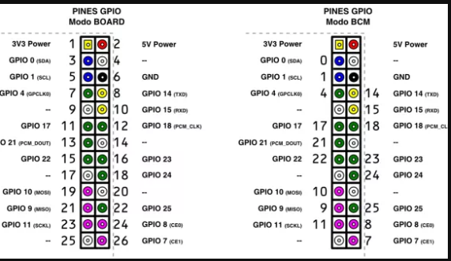
BCM Vs. Board Mode (Raspberry Pi model A-old version)

Slide 11
BCM Vs. Board Mode (RPi model 3 B)
GPIO.BOARD MODE
Use the setmode() function to specify which number system is being used. Example:
GPIO.setmode (GPIO.BOARD)
GPIO.BCM MODE

Slide 12

Setting up pins as Input or Output
Declare a “pin mode” before you can use a pin as either an input or output. To set a pin mode, use the setup([pin], [GPIO.IN, GPIO.OUT] function. So, if you want to set pin 18 as an output, for example, write:

Slide 13
Setting up Pin Mode
Taking the following example:
To configure pin 7 as output and GPIO14 as input
In BCM mode | In BOARD mode
GPIO.setmode(GPIO.BCM) | GPIO.setmode(GPIO.BOARD)
GPIO.setup(4,GPIO.OUT) | GPIO.setup(7,GPIO.OUT)
GPIO.setup(14,GPIO.IN) | GPIO.setup(8,GPIO.IN)

Slide 14

Inputs:
If a pin is configured as an input, you can use the GPIO.input([pin]) function to read its value in BCM/BOARD Mode. The input()function will return either a True or False indicating whether the pin is HIGH or LOW. You can use an ifstatement to test this, for example :
will read pin 17 and print whether it’s being read as HIGH or LOW.

Slide 15

Digital Outputs:
To write a pin high or low, use the GPIO.output([pin], [GPIO.LOW/GPIO.HIGH]) function.
For example, if you want to set pin 18 high, write:
GPIO.HIGH will drive it to 3.3V, and GPIO.LOW will set it to 0V. Another alternative to GPIO.HIGH and GPIO.LOW, is to use either 1/True, or 0/False to set a pin value.

Slide 16


Delays
If you need to slow your Python script down, you can add delays. To incorporate delays into your script, you’ll need to include another module: time
Use time.sleep([seconds]) to give your script a rest. For example, to delay 250 milliseconds, write:

Slide 17
Garbage Collecting
Use the GPIO.cleanup() command at the end of your script to release any resources your script may be using.
It is not mandatory but a good practice to cleanup for the next processes that might be using GPIOs

Slide 18
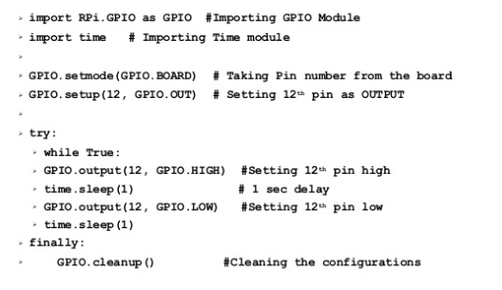
GPIO Basics Summary

Slide 19
Handle with Care!
The two 5V supply pins on the breakout board are very useful for powering complex chips and sensors, but you must take care to never accidentally use them to directly interface with the GPIO pins. The GPIO system is only designed to handle 3.3V signals and anything higher will most likely damage your Raspberry Pi.
While connecting the Hardware, double check the connections and then power it up. Raspberry Pi GPIO’s are not 5V tolerant!
Notes:
http://raspberry.io/projects/view/reading-and-writing-from-gpio-ports-from-python/

Slide 20
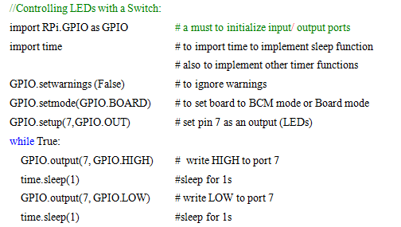
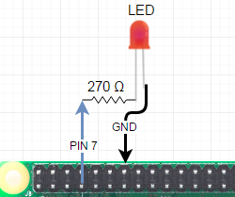
Practice Example #1
Write a python program to flash 1 LED with an interval of 1 second
Notes:
More examples for practice:
http://raspi.tv/2013/rpi-gpio-basics-4-setting-up-rpi-gpio-numbering-systems-and-inputs
http://raspberry.io/projects/view/reading-and-writing-from-gpio-ports-from-python/

Slide 21
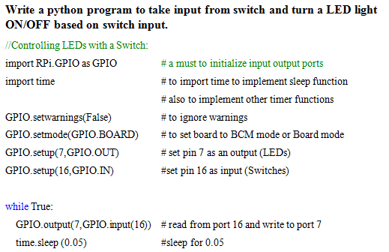
Practice Example #2

