Slide 1
IndiaMart Hackathon
Team Id: sheetal.sahu804_ef69
Team Member: Sheetal Sahu
Ragini Sharma

Slide 2
Table Of Contents
Assumptions
Project objective
Problems to Solve
Approach
Data Exploration
Conclusion

Slide 3
Assumptions
The actual data will have more intuitive information. For example Price of a product is 5000 and for the same unit is 1000. So the underlying assumption is the price is recorded for the same number of quantities. i.e. the number of unit purchased is x and the price is 5000 and for same number of unit x the price is 1000. Per unit price would be more effective.
Seasonality in the data is constant. Say the price for a product is same for all season. Even in the sale period the price is same.

Slide 4
Project Objective
IndiaMART is India’s largest online marketplace, connecting buyers with suppliers, The online channel focuses on providing a platform to SMEs, large enterprises as well as individuals.It has a total of 50Mn products mapped into ~1Mn micro-categories with UGC content and a lot of different prices with different units.
Phase 2 Objective:
A dataset of 100 categories and based on each category and unit an associated price is given. Build a working prototype to gauge the appropriate price range for each unit and each category. Also find the three most common prices. Gauge Price range for each pair of category, ISQ and unit.

Slide 5
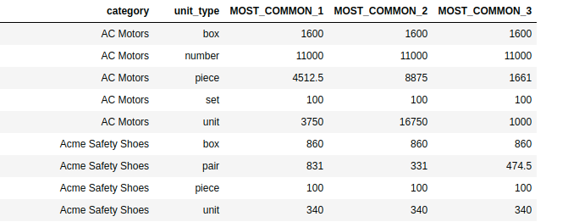
Problem To Solve
MCAT - Unit wise Min-Max price
The solution will need to have three ranges as mentioned below:
3. MCAT-Unit wise-Three most common prices..
Category | Unit | Min_range | Max_range
AC Motors | number | 22000 | 25000
AC Motors | piece | 45 | 12000
2. MCAT - Unit - ISQ wise Min-Max price
Category | Unit | ISQ | Min Range | Max Range
AC Motors | box | Speed | 1600 | 1600
AC Motors | number | Brand | 25000 | 25000

Slide 6
APPROACH
Data Exploration to study hidden patterns in the dataset.
Data preparation/cleaning
Data sub-setting and clustering : So the idea is to drill down to required analysis level(Say Mcat, Unit or Mcat,unit or ISQ level) . For each subset of a given unit and category, we try to create clusters on the Price column. The number of set clusters are two. We select the cluster in which most of the data points falls into. In a sense that the selected cluster predominantly generalizes the data.
Kmeans clustering to identify predominant cluster
Further Data Exploration to identify patterns in data
Outlier detection to remove data points that don’t follow the pattern in that cluster. So any value that are above 3 standard deviation on the upper scale and below 3 standard deviation on the lower scale are flaged as outlier and they are removed.
Identify the minimum and maximum range of data points in the desired cluster
Dynamic programming(bayesian blocks method for optimal binning edges) has been used to decide best optimal bin value. Top 3 bins that capture most data points (frequency of data points falling in that bucket is high) becomes top 3 most common price ranges in that category and unit.

Slide 7
DATA EXPLORATION

Slide 8
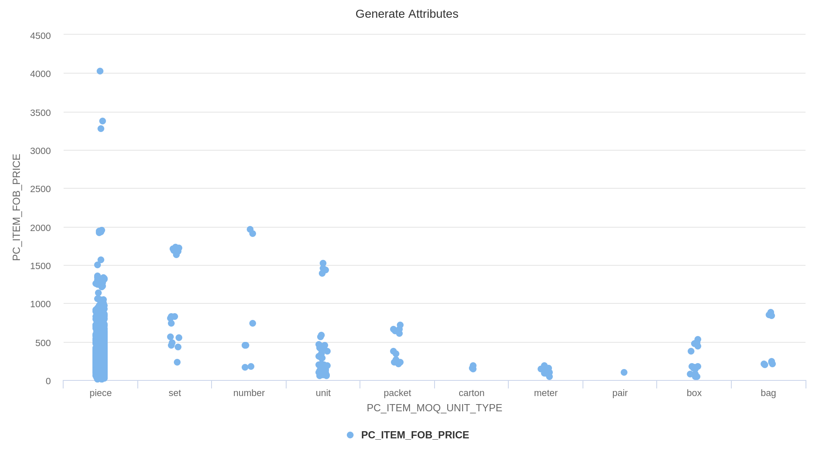
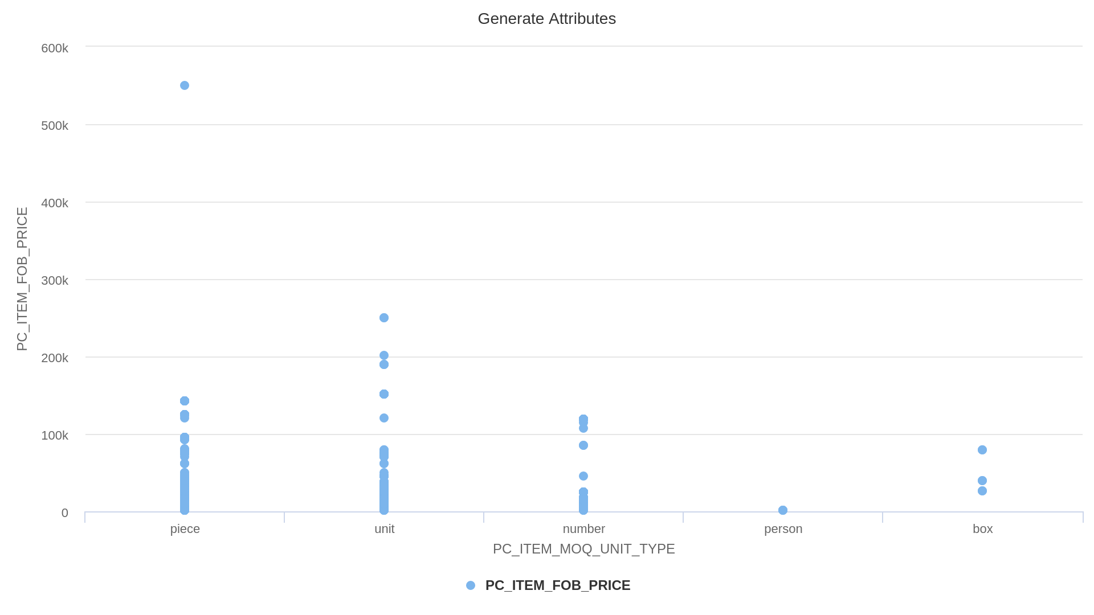
PART -1(MCAT - Unit wise Min-Max price)
For solving the first part of the solution, we drilled down the data according to the Mcat name and PC_ITEM_MCQ_UNIT_TYPE, and plotted a scatter plot against the PC_ITEM_FOB_PRICE.

Slide 9
CONTINUED
INFERENCE : As per the visualization, there were some outliers present in the data which would have created bias while calculating the minimum and maximum range of price.
SOLUTION: After drilling down the data, we followed the following approach:
First we tried to remove the high potential outliers using statistical outlier detection technique.
After removing the outliers, the maximum and minimum range of price was selected.

Slide 10
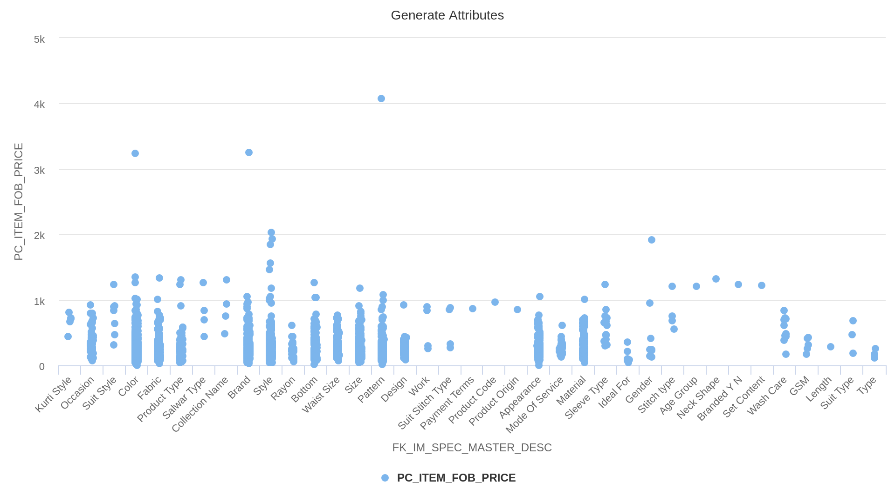
PART -2(MCAT - Unit - ISQ --- Min Max price.)
For solving the second part of the solution, we drilled down the data according to the Mcat name, PC_ITEM_MCQ_UNIT_TYPE and FK_IM_SPEC_MASTER_DESC, and plotted a scatter plot against the PC_ITEM_FOB_PRICE.

Slide 11
CONTINUED
INFERENCE : Further drilling down the data to ISQ level, we got to see that there were some outliers present in the data which would have created bias while calculating minimum and maximum range of price.
SOLUTION: After drilling down the data, we followed the following approach:
First we removed the high potential outliers using IQR technique.
After removing the outliers, the maximum and minimum range of price was selected.

Slide 12
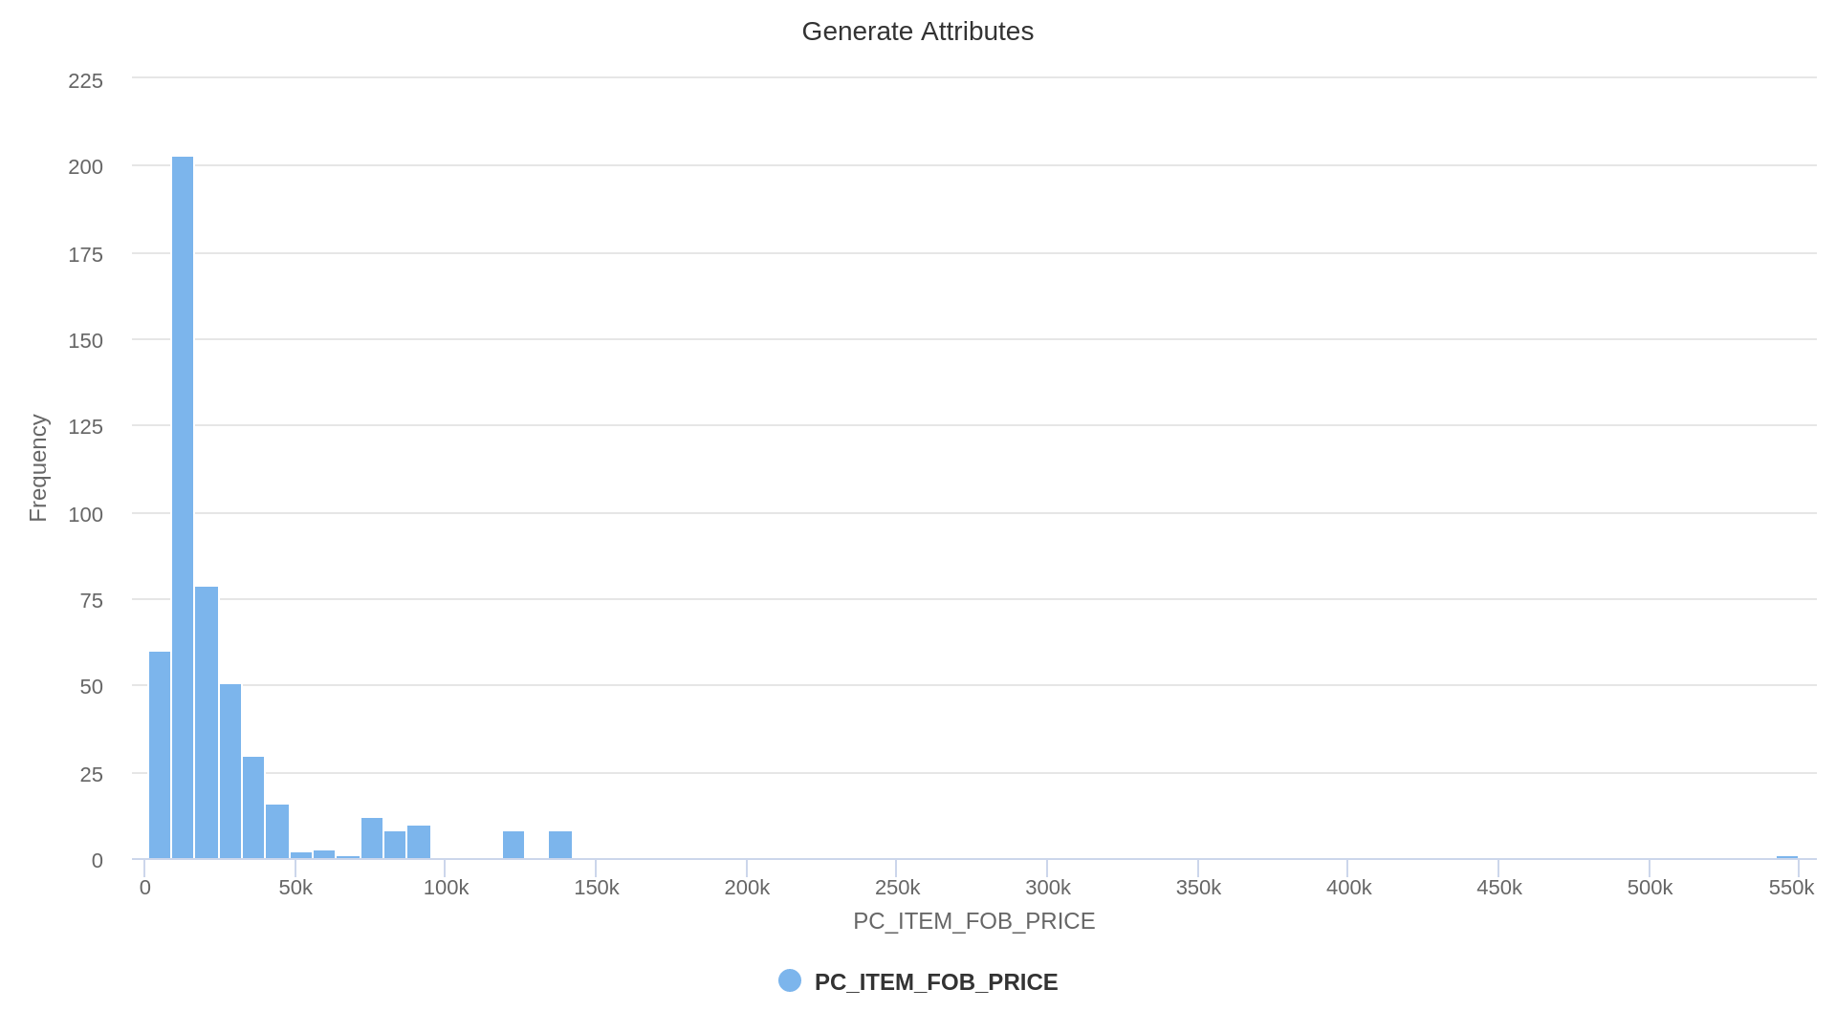
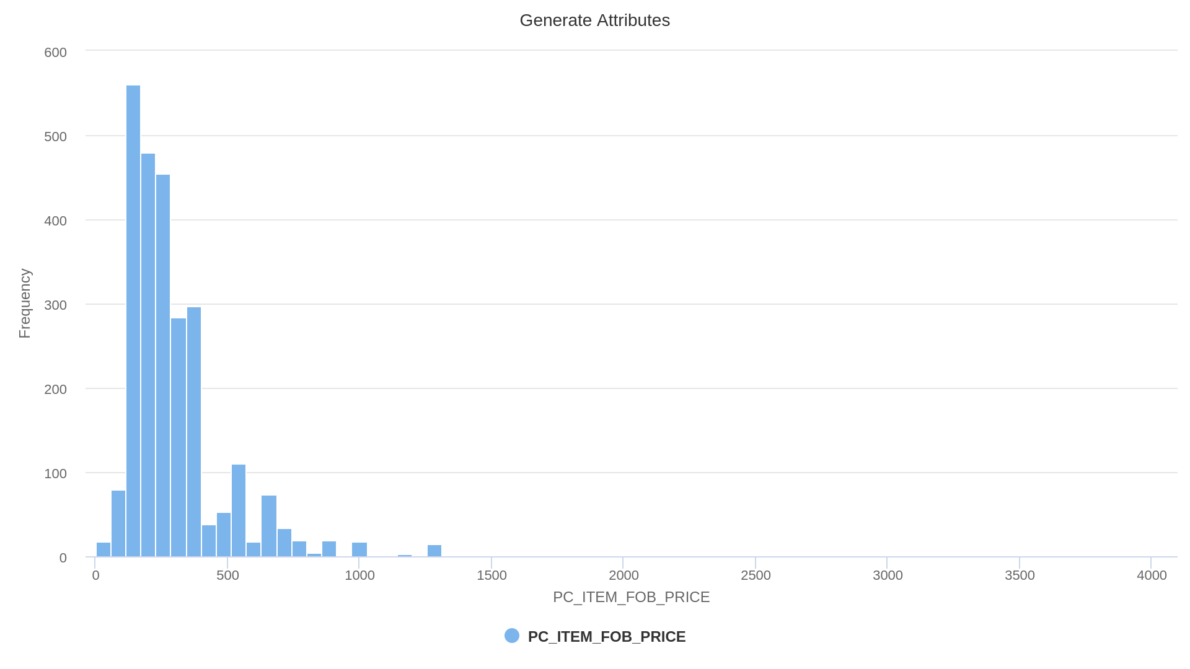
PART -3(MCAT-Unit wise-Three most common prices.)
For solving the second part of the solution, we drilled down the data according to the Mcat name and PC_ITEM_MCQ_UNIT_TYPE ,and plotted a histogram against the PC_ITEM_FOB_PRICE.

Slide 13
CONTINUED
INFERENCE : From histogram, the count of values for each bucket is visible.
SOLUTION: Main challenge while solving this problem was to decide the binning value. So we used the following approach to solve this problem:
Dynamic programming(bayesian blocks method for optimal binning edges) has been used to decide best optimal bin value,
According to that bin value, the three most common buckets would be selected.

Slide 14
CONCLUSION
Based on the assumptions and the given data set, the solution can effectively find out
Min-Max range for each category and unit
Min-max range for each category, unit and ISQ
Three most common price range for each category and unit.

