Slide 1

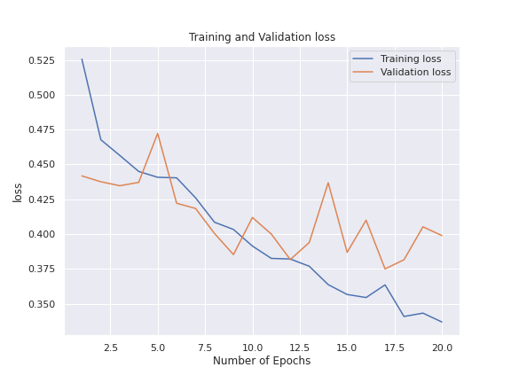
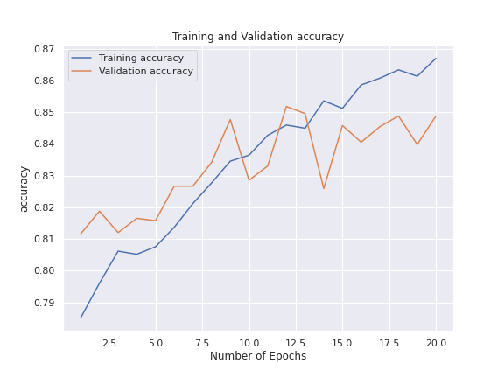
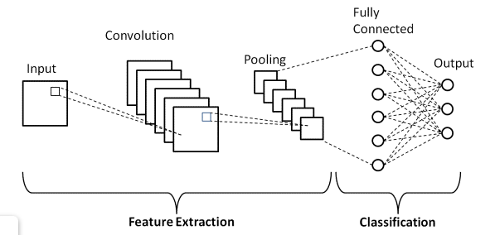
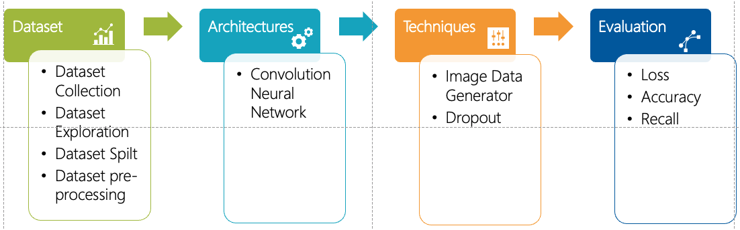
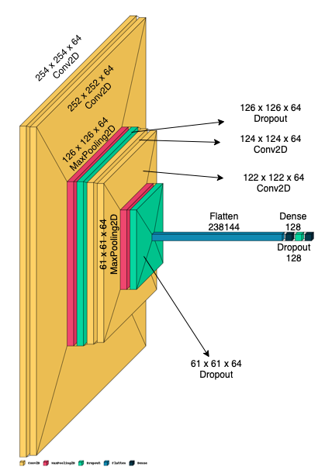
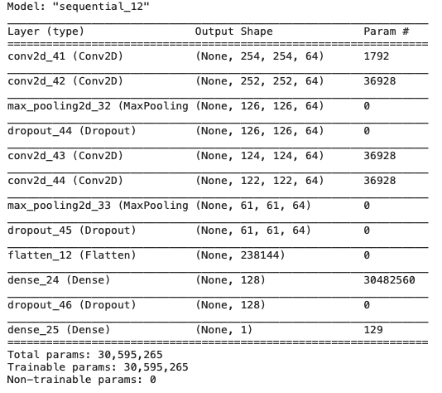
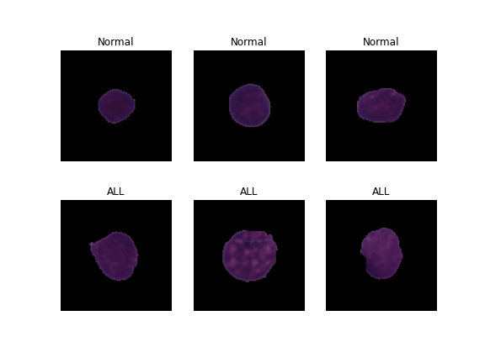
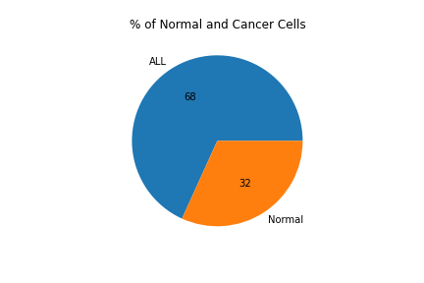
Detection of Acute Lymphocytic Leukemia (ALL) with Convolutional Neural Network
Unnithan, Ragi| Dr. Liu, Xinlian | M.S. Computer Science | Hood College | Frederick, MD, USA | ru3@hood.edu
Abstract
ARCHITECTURES
Evaluation
Acute Lymphocytic Leukemia (ALL) is a deadly cancer that not only affects adults but also accounts for 25% of childhood cancers. Timely and accurate diagnosis of the cancer is an important factor for an effective treatment to improve survival rate. The image of ALL cells under the microscope is very similar in morphology to that of the normal cells. In this work, we are trying to answer whether a Convolutional Neural Network (CNN) can reliably classify cancer and normal cell images to assist in the diagnosis of ALL. This project aims to build a CNN model that can classify ALL from normal cells as diagnosing ALL is difficult even for trained medical operator.
Convolutional Neural Network
With 100 epochs
Training accuracy – 94%
Validation accuracy – 85%
Testing accuracy – 61%
Introduction
Acute Lymphocytic Leukemia (ALL) is a type of cancer of the blood and bone marrow. ALL is the most common cause of pediatric cancer and the most frequent cause of death from cancer before 20 years of age. Cell classification usually depends on morphological characteristics of the cell and requires a skilled medical operator. These procedures are time consuming, tedious, costly and error prone. In this project, we are trying to see whether a Convolutional Neural Network can classify Normal and ALL cells from microscopic blood images
Conclusion
CNN can be used for classification of ALL cells from normal cells and can be used as a tool by a physician for verifying his diagnosis.
performance of the model can be improved by implementing different methods. In this project, we were able to improve the performance of the model by increasing the number of epochs to 100. We also tried two different optimizers – RMSprop and Adam optimizer. But we see increase in performance when using RMSprop. Batch Normalization and Dropout were also implemented to improve the performance. We experimented with different dropout values ranging from 0.1 to 0.5 and we settled on 0.5 as this increased the accuracy.
Implementation
Three common layers are used, convolution, pooling, and fully connected
Input layers accepts 256x256x3 input (RGB images)
Four convolution layers, with 64 filters of 3 X3.
All convolution layers use relu activation function and 3x3 stride.
The max pooling layer uses 2x2 pooling window.
Three Dropout layers with a value of 0.5
Flatten layer
Two Dense layer
Data
Collection
Data
Pre-Processing
Model
Building
Model
Selection
Handle missing values if there is any, normalize attributes upon needed, and add new attributes upon necessary.
Build various Classification Models using different Algorithms and train the model with training dataset.
FUTURE WORK
Data Overview
In future we can implement early stopping and cross-validation for avoiding overfitting. Image data augmentation can be implemented to the normal dataset for the eliminating class im-balance. Try implementing Alexnet or other pre-trained models to improve the accuracy
Obtained from Kaggle – C_NMC_Leukemia. Images are segmented from microscopic images. Total of 15,135 images from 118 patients with 2 labels.
Cell Type | Train | Validation | Test
ALL | 47 | 13 | 9
Normal | 26 | 15 | 8
Total | 73 | 28 | 17
Dataset - subtype | Total | Normal | ALL
Training | 7996 | 2542 | 5454
Validation | 2665 | 847 | 1818
Test | 1867 | 1219 | 648
Acknowledgement
I would like to express sincere thank to Professor Dr. Xinlian Liu for this course and guidance throughout the semester as it helped me in learning various unknown topics related to deep learning, image classification.
REFERENCE
https://www.hindawi.com/journals/complexity/2021/6658192/
https://www.hindawi.com/journals/cin/2021/7529893/
https://www.upgrad.com/blog/basic-cnn-architecture/
https://towardsdatascience.com/detecting-leukemia-with-a-cnn-af699b19ab99
Normal cells– Spherical and non- clefted
Cancer cells – Non-spherical and clefted

