Slide 1

Detection of Acute Lymphocytic Leukemia (ALL) with Convolutional Neural Network
M.S. Computer Science
Hood College
Frederick
MD
Name: Ragi Unnithan
Professor: Xinlian Liu
Date: 12/08/2021

Slide 2
Introduction
Acute Lymphocytic Leukemia (ALL) is a type of cancer of the blood and bone narrow
ALL is the most common cause of pediatric cancer and the most frequent cause of death from cancer before 20 years of age
Cell classification usually depends on morphological characteristics of the cell and requires a skilled medical operator
These procedures are time consuming, tedious, costly and error prone
In this project, we are trying to see whether a Convolutional Neural Network can classify Normal and ALL cells from microscopic blood images

Slide 3
Understanding the Dataset
Obtained from Kaggle – C_NMC_Leukemia
Images are segmented from microscopic images
Total of 15,135 images from 118 patients with 2 labels
49 patients without ALL
69 patients with ALL
Cell Type | Train | Validation | Test
ALL | 47 | 13 | 9
Normal | 26 | 15 | 8
Total | 73 | 28 | 17
Dataset – subtype | Total | Normal | ALL
Training | 10661 | 3389 | 7272
Validation | 1867 | 1219 | 648
Test | 2586 | - | -

Slide 4
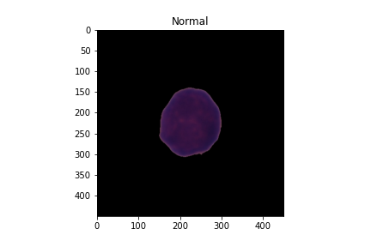
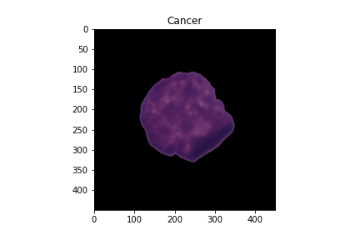
Exploratory Data Analysis
Normal Cells
Spherical
Non-clefted
Few vacuoles
Caner Cells
Non-Spherical
Clefted
Vacuoles

Slide 5
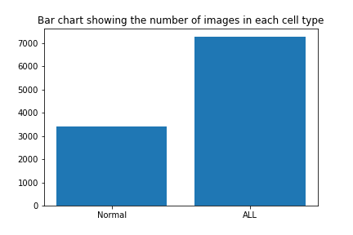
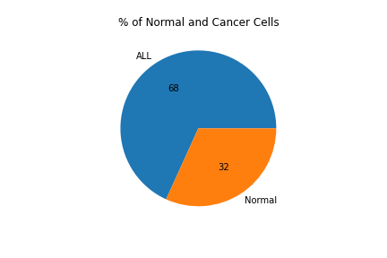
Data Distribution
Imbalanced dataset; 68% is ALL and 32% is Normal

Slide 6
Dataset Split
Training and Validation dataset are labelled
Test dataset not labelled
So, the 10661 data in the training is split into training (75%) and validation (25%)
The validation dataset is used as testing
Dataset - subtype | Total | Normal | ALL
Training | 7996 | 2542 | 5454
Validation | 2665 | 847 | 1818
Test | 1867 | 1219 | 648
Dataset Preprocessing
Images are 450 x 450 RGB images stored as .bmp files
Images are resized to 256 x 256
Rescaled between ranges 0 to 1.

Slide 7
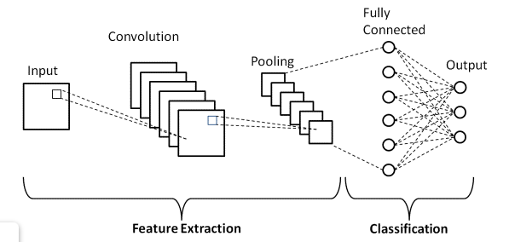
Convolutional Neural Network (CNN)
Convolutional Neural Network is composed of
Convolutional layers
Activation Function
Pooling Layers
Fully Connected Layers
Source: https://www.upgrad.com/blog/basic-cnn-architecture/
Notes:
CNN architecture has 2 main parts – 1. feature extraction 2. classification

Slide 8
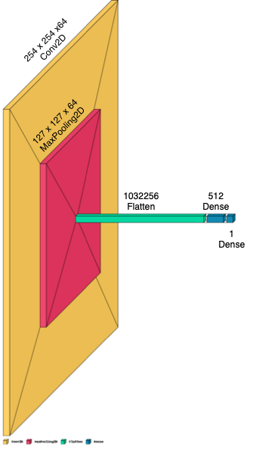
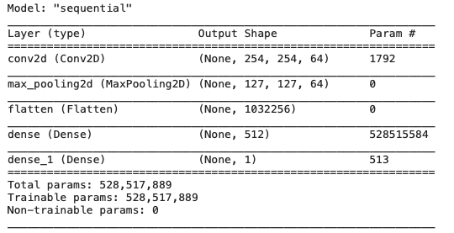
A simple Vanilla Model (1C1D)
Input is an image of size 256 x 256 x 3
A single convolutional layer
64 filters
filter size is 3 X 3
Relu activation [
Max Pooling
2 x 2 pooling window
Flatten layer
Two fully connected dense layer
[(W−K+2P)/S]+1
W is the input volume
K is the Kernel size
P is the padding
S is the stride
Parameters = (3*3*3 + 1) * 64
Result
Model | Optimizer | Training |  |  | Validation |  |  | Test
 |  | Accuracy | Recall | Loss | Accuracy | Recall | Loss | Accuracy | Recall | Loss
1C1D | RMSprop | 0.88 | 0.7545 | 0.2951 | 0.848 | 0.702 | 0.393 | 0.602 | 0.1636 | 1.1343

Slide 9
Model Selection
Many models with successive larger layers and complex architectures were build
Multiple convolutional layers
Max pooling layers
Dropout layers (0.25 and 0.5)
Batch Normalization
Binary-cross entropy is used for the loss function as this is a binary classification problem
Optimizer – Adam and RMSProp

Slide 10
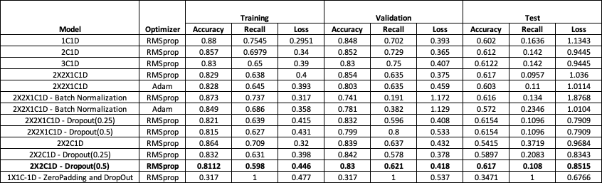
Summary from all the Models

Slide 11
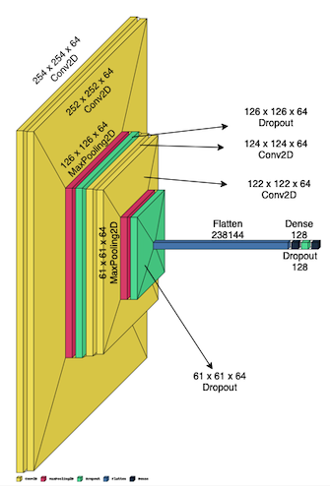
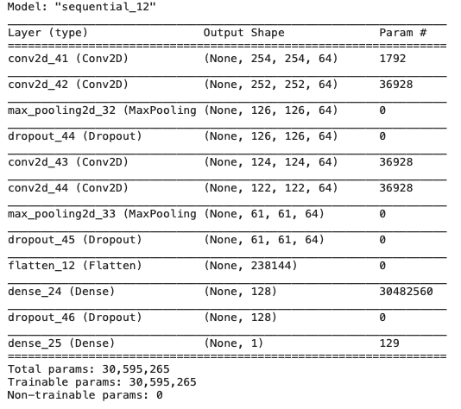
Chosen Model – 2x2C1D
Input is an image of size 256x256x3
Four convolutional layer
64 filters
filter size is 3 X 3
Relu activation
Two Max Pooling
2 x 2 pooling window
Three Dropout layers with a value of 0.5
Flatten layer
Two Dense layers

Slide 12
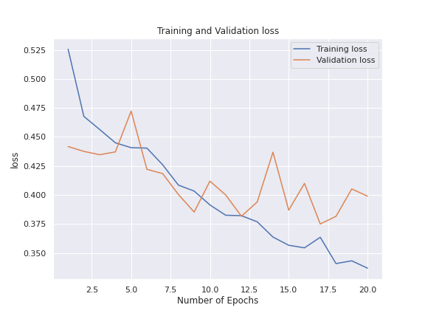
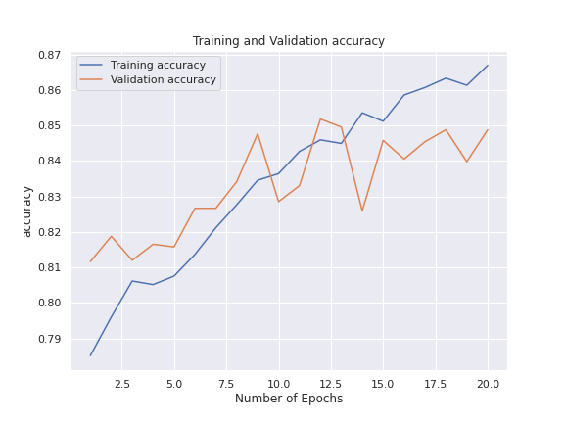
Result – 2x2C1D
With 100 epochs
Training accuracy – 94%
Validation accuracy – 85%
Testing accuracy – 61%

Slide 13
Conclusion and Future Goals
CNN can be used for image classification and as a tool for identifying ALL
This method can be used by a physician to verify his diagnosis
Batch Normalization and Dropout can be used for reducing overfitting
In future we can implement early stopping and cross-validation for avoiding overfitting
Image data augmentation can be implemented to the normal dataset for the eliminating class imbalance
Try implementing Alexnet or other models to improve the accuracy

Slide 14
Questions ?

Slide 15
Thank you

