Slide 1
Predicting and Forecasting with Big Data: LASSO
Eleonora Granziera
AI/ML workshop

Slide 2
Outline
How to predict and forecast with big data?
Linear Predictive Regression
Course of dimensionality
Penalized regression: Ridge, Lasso
Codes

Slide 3
Linear predictive regression
The model:
y_{s} =x’_{s}β+ε_{s} ε_{s} i.i.d. N(0,σ²) s=1,…,S
y_{s} , 1x1 response variable
x_{s} , 1xK vector of predictors
cross-section or time series
Big data: K large relative to S
Example:
E_{t-1}π_{t} = x’_{t-1}β+ε_{t}
E_{t-1}π_{t} expectations at t made at t-1, one quarter ahead US SPF inflation expectations from 1995Q1 till 2023Q4
x_{t-1} vector of predictors observed at t-1, 245 time series variable from Quarterly Databases for Macroeconomic Research (FRED-QD)

Slide 4
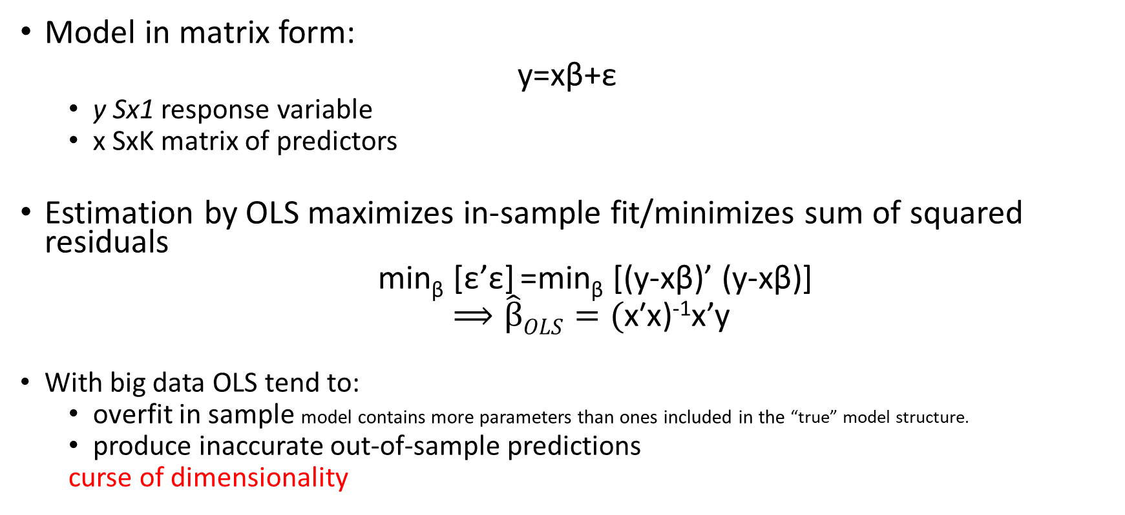
OLS Estimation
Model in matrix form:
y=xβ+ε
y Sx1 response variable
x SxK matrix of predictors
Estimation by OLS maximizes in-sample fit/minimizes sum of squared residuals
min_{β} [ε’ε] =min_{β} [(y-xβ)’ (y-xβ)]
$⟹\hat{β}OLS=(\text{x}\text{′}\text{x}$)⁻¹x’y
With big data OLS tend to:
overfit in sample model contains more parameters than ones included in the “true” model structure.
produce inaccurate out-of-sample predictions
curse of dimensionality

Slide 5
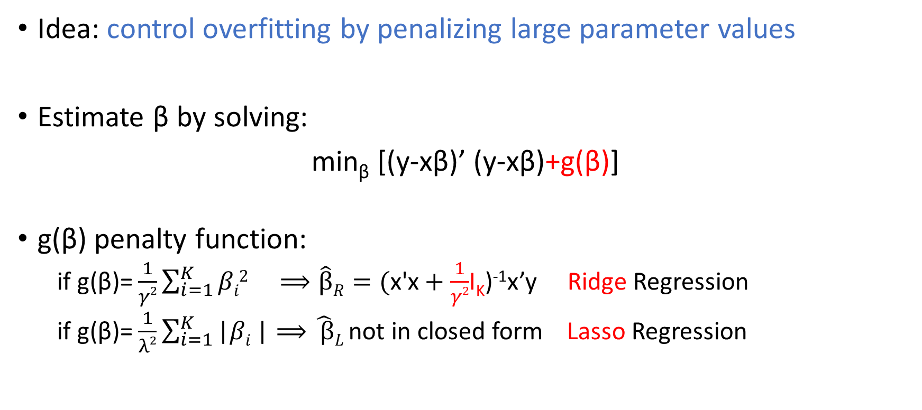
Penalized Regression
|
|
Idea: control overfitting by penalizing large parameter values
Estimate β by solving:
min_{β} [(y-xβ)’ (y-xβ)+g(β)]
g(β) penalty function:
if g(β)= $\frac{1}{γ2}\sum_{i=1}^{K}{βi2} ⟹\hat{β}R=(\text{x}\text{′}\text{x}+\frac{1}{γ2}$I_{K})⁻¹x’y Ridge Regression
if g(β)= $\frac{1}{λ2}\sum_{i=1}^{K}{\text{|}βi}\text{|}⟹\hat{ β}L$not in closed form Lasso Regression

Slide 6
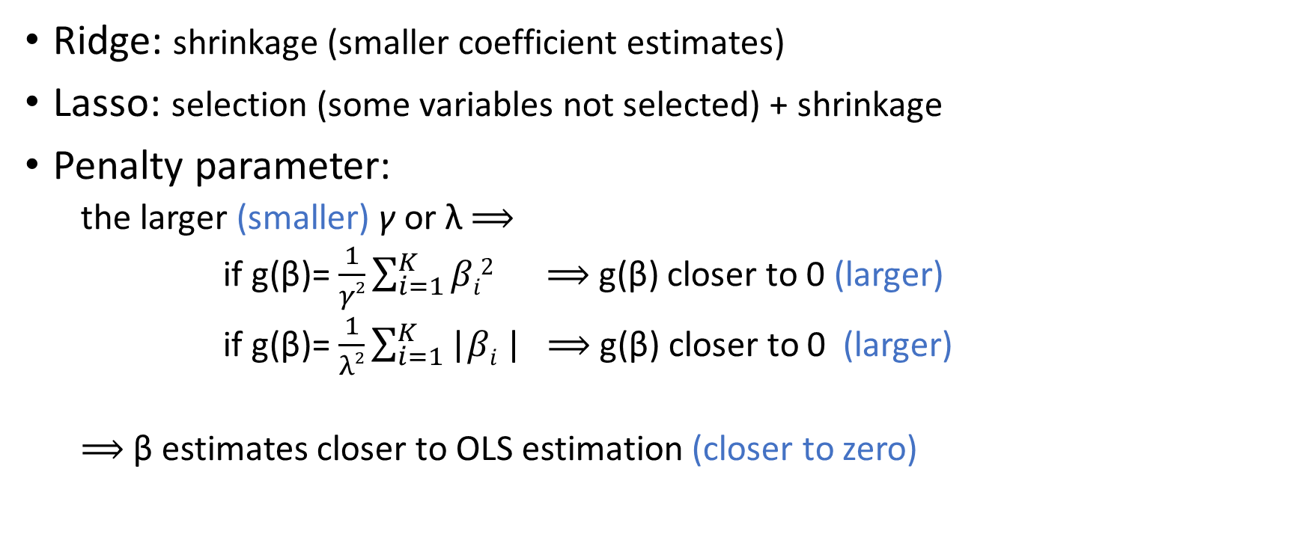
Ridge vs Lasso
Ridge: shrinkage (smaller coefficient estimates)
Lasso: selection (some variables not selected) + shrinkage
Penalty parameter:
the larger (smaller) γ or λ $⟹$
if g(β)= $\frac{1}{γ2}\sum_{i=1}^{K}{βi2} ⟹$ g(β) closer to 0 (larger)
if g(β)= $\frac{1}{λ2}\sum_{i=1}^{K}{\text{|}βi}\text{|}$ $⟹$ g(β) closer to 0 (larger)
$⟹$β estimates closer to OLS estimation (closer to zero)

Slide 7
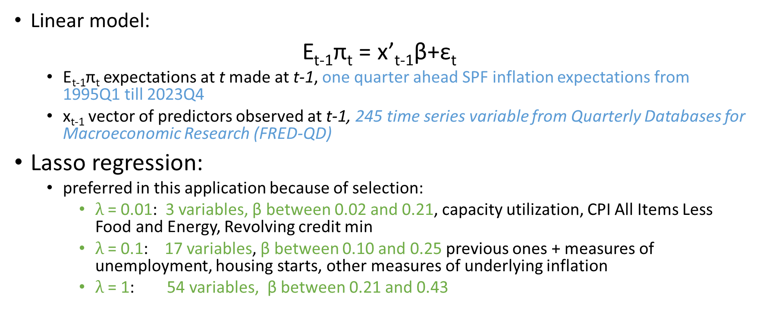
Example: On which variables are forecasts based?
Linear model:
E_{t-1}π_{t} = x’_{t-1}β+ε_{t}
E_{t-1}π_{t} expectations at t made at t-1, one quarter ahead SPF inflation expectations from 1995Q1 till 2023Q4
x_{t-1} vector of predictors observed at t-1, 245 time series variable from Quarterly Databases for Macroeconomic Research (FRED-QD)
Lasso regression:
preferred in this application because of selection:
$λ$= 0.01: 3 variables, β between 0.02 and 0.21, capacity utilization, CPI All Items Less Food and Energy, Revolving credit min
$λ$= 0.1: 17 variables, β between 0.10 and 0.25 previous ones + measures of unemployment, housing starts, other measures of underlying inflation
$λ$= 1: 54 variables, β between 0.21 and 0.43

Slide 8
Implementation
Gather data and transform them to make them covariance-stationary
Why? Because you need to standardize the data
Standardize data before penalized regression
Why? the penalties are a function of the size of the coefficients, which depends on the scale of the data
if one explanatory variable is in millions and another one is in smaller units, the latter will be penalized more
Select the penalty parameter
fix based on your preferred criterion
K-fold cross validation

Slide 9
Inference
Issue: we cannot make use of the standard inference tools (confidence intervals, p-values) for the second stage OLS model, since we peeked at the data twice: once in running the lasso, and again in fitting the OLS model;
Solutions:
Correct post-selection OLS estimates
Tibshirani, R. J., Taylor, J., Lockhart, R., and Tibshirani, R. (2016). Exact postselection inference for sequential regression procedures. Journal of the American Statistical Association, 111(514):600–620.
Naïve procedure (may be ok if S is large)
Perform the lasso in order to obtain the set of “non-zero” dependent variables A_{S}
Use least squares to fit the sub-model containing just the variables A_{S}
Use the classical confidence intervals from that least squares model, without accounting for the fact that A_{S} was obtained by peeking at the data
In Defense of the Indefensible: A Very Naıve Approach to High-Dimensional Inference by Sen Zhao, Daniela Witten, and Ali Shojaie
Bayesian inference

Slide 10
Code: inputs
function r = LassoPointForecast(Y,X,lam2)
%%%%%%%%%%%%%%%%%%%%%%%%%%%%%%%%%%%%%%%%%%% This function estimates parameters and computes the point forecast of Y at T+1 (r.FCASTpoint)
%
% Y: Tx1 vector of dependent variable
% X: Txk matrix of predictors
% Xt1: value of predictors in T+1
% lam2: value of lambda2
%%%%%%%%%%%%%%%%%%%%%%%%%%%%%%%%%%%%%%%%%%

Slide 11
Code: standardize data
% standardize the data
[y mY sY]=zscore(Y,1);
[x mX sX]=zscore(X,1);
% note: zscore matlab procedure that returns variables with zero mean and unit standard deviations
% compute dimensions
[T,k]=size(x);

Slide 12
Code: compute LASSO estimator
[r.betahat, r.FitInfo]=lasso(x,y,'Standardize',0,'Lambda',1/(2*T*lam2));
%%%%%%%%%%%%%%%%%%%%%%%%%%%%%%%%%%%%%%%%%%%
% Matlab function
% y: Tx1 vector of dependent variable
% x: Txk matrix of predictors
% Standardize: 0 means false (no need to standardize again)
% Lambda : value of lambda2 (in slides notation)
%%%%%%%%%%%%%%%%%%%%%%%%%%%%%%%%%%%%%%%%%%

Slide 13
Codes: one step ahead forecast
% compute the point forecast ("adding" back mean and std)
r.FCASTpoint=[((Xt1-mX)./sX)*betahat]*sY+mY;
Out-of-sample forecast where Xt1 is a Kx1 vector of explanatory variables
Standardize Xt1 because betahat relates standardized x to standardizes y
Multiply forecast of standardized y and add mean to get forecast for y

Slide 14
Extensions
LASSO for mixed frequency data
Nowcasting Norwegian household consumption with debit card transaction dataKA Aastveit, TM Fastbø, E Granziera, KS Paulsen, KN Torstensen
consumption quarterly variable, several regressors available weekly (e.g. debit card categories, google trend categories, financial variables)
Multistep Ahead Forecasting
Use direct multistep ahead forecast method
y_{t} =x’_{t-h}β+ε_{t} ε_{t} i.i.d. N(0,σ²) h=1,…,H

