Slide 1
Hack Your Future - Working with data -

Slide 2

Agenda
SQL
Azure Data Studio
ADO.NET
LINQ
Combine stuff

Slide 3

Joren Vandekerckhove
IT Consultant at Axxes
1 year
UGent
25 jaar
Free time
Learning new technologies
Running
Fitness
Kickboxing

Slide 4
Working with data
SQL

Slide 5

Working with data - SQL

Slide 6
Working with data - SQL
Structured Query Language
5 categories based on functionalities
DDL (Data Definition Language)
DML (Data Manipulation language)
DQL (Data Query Language)
DCL (Data Control Language)
TCL (Transaction Control Language)
Notes:
DDL commands are used for creating and altering the database and database object in the relational database management system
DML commands are used for manipulating data in a relational database management system. DML commands are used for adding, removing, updating data in the database system
DQL command is used for fetching the data
DCL commands are used for providing and taking back the access rights on the database and database objects
TCL commands are used for handling transactions in the database. Transactions ensure data integrity in the multi-user environment. TCL commands can rollback and commit data modification in the database

Slide 7
Working with data - SQL
Relational vs Non-Relational Database
Relational | Non-Relational
Stores information in tables | Doesn’t use tables, fields, and columns structured data
Relationship between tables | Cloud in mind, great horizontal scaling
Columns ➔ define information, rows ➔ actual data
A column that must have unique values ➔ primary key
https://www.mongodb.com/compare/relational-vs-non-relational-databases

Slide 8
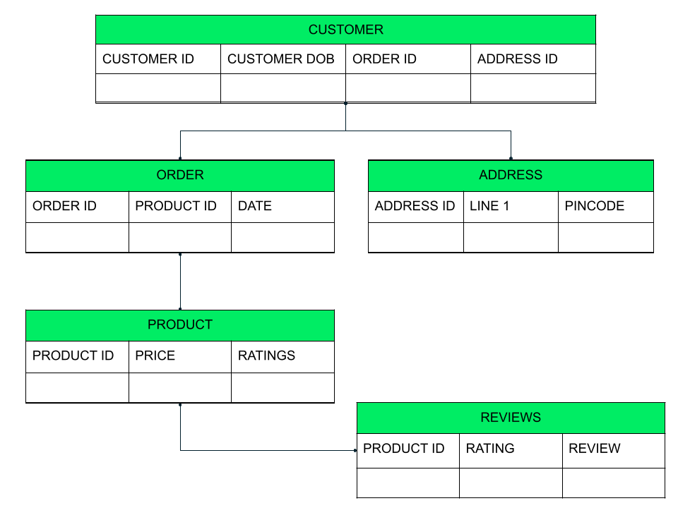
Working with data - SQL

Slide 9
Working with data – SQL DDL commands
CREATE DATABASE <DB_NAME>;
CREATE DATABASE IF NOT EXISTS <DB_NAME>;
SHOW DATABASES;
USE <DB_NAME>;
CREATE TABLE Student( student_id INT, name VARCHAR(100), age INT);
ALTER TABLE student ADD( address VARCHAR(200) );

Slide 10
Working with data – SQL DML commands
INSERT INTO table_name VALUES(data1, data2, ...)
INSERT INTO student(id, name) values(102, 'Alex’);
UPDATE table_name SET column_name = new_value WHERE some_condition;
UPDATE student SET age=18 WHERE student_id=102;
UPDATE student SET name='Abhi', age=17 where s_id=103;
DELETE FROM table_name;
DELETE FROM student WHERE s_id=103;

Slide 11
Working with data – SQL DQL commands
SELECT s_id, name, age FROM student;
SELECT * FROM student WHERE name = 'Abhi’;
SELECT * FROM Student WHERE s_name LIKE 'A%’;
SELECT * FROM Emp ORDER BY salary;

Slide 12
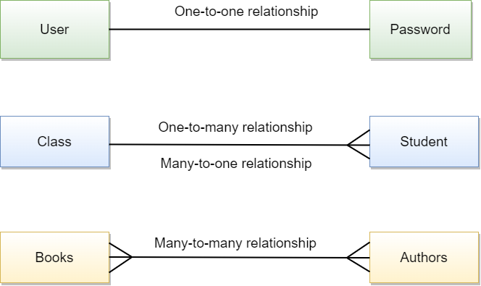
Working with data – Relationships

Slide 13
Working with data – Relationships
Usage of primary key and foreign key
Primary key:
Constraint uniquely identifies each record in a table
Contain unique values, and cannot contain null values
Foreign key:
constraint is used to prevent actions that would destroy links between tables
Field (or collection of fields) in one table, that refers to the primary key in another table.

Slide 14
Working with data
ADO.NET

Slide 15

Working with data – ADO.NET
Microsoft ActiveX Data Objects
Provides consistent access to data sources such as SQL Server
Retrieve, handle, and update the data
Separates data access from data manipulation
Notes:
ADO stands for Microsoft ActiveX Data Objects. ADO.NET is one of Microsoft’s Data Access technology using which we can communicate with different data sources.
It is a part of the .Net Framework which is used to establish a connection between the .NET Application and data sources.
The Data sources can be SQL Server, Oracle, MySQL, and XML, etc. ADO.NET consists of a set of classes that can be used to connect, retrieve, insert, update and delete data (i.e. performing CRUD operation) from data sources. ADO.NET mainly uses System.Data.dll and System.Xml.dll.

Slide 16
Working with data – ADO.NET
Components are designed for data manipulation and faster data access
Components:
Connection
Command
DataReader
DataAdapter
DataSet
DataView
Two main components for accessing and manipulating data:
Data provider
DataSet
Notes:
Components are designed for data manipulation and faster data access.
Connection, Command, DataReader, DataAdapter, DataSet, and DataView are the components of ADO.NET that are used to perform database operations.
ADO.NET has two main components that are used for accessing and manipulating data. They are as follows:
Data provider and
DataSet.

Slide 17
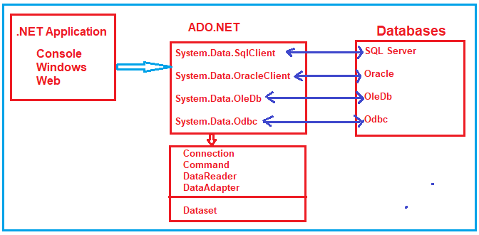
Working with data – ADO.NET
Database can’t execute our C# code
Our application needs to
Connect to the database
Prepare a SQL command
Execute the command
Retrieve the results
Notes:
The Database can not directly execute our C# code, it only understands SQL.
So, if a .NET application needs to retrieve data or to do some insert, update, and delete operations from or to a database, then the .NET application needs to
Connect to the Database
Prepare an SQL Command
Execute the Command
Retrieve the results and display them in the application
And this is possible with the help of .NET Data Providers.

Slide 18
Working with data
LINQ

Slide 19
Working with data – LINQ
Language-Integrated Query
language-level querying capabilities
Write expressive declarative code
Provides a consistent query experience to query objects
Uniform query syntax in C# and VB.NET

Slide 20
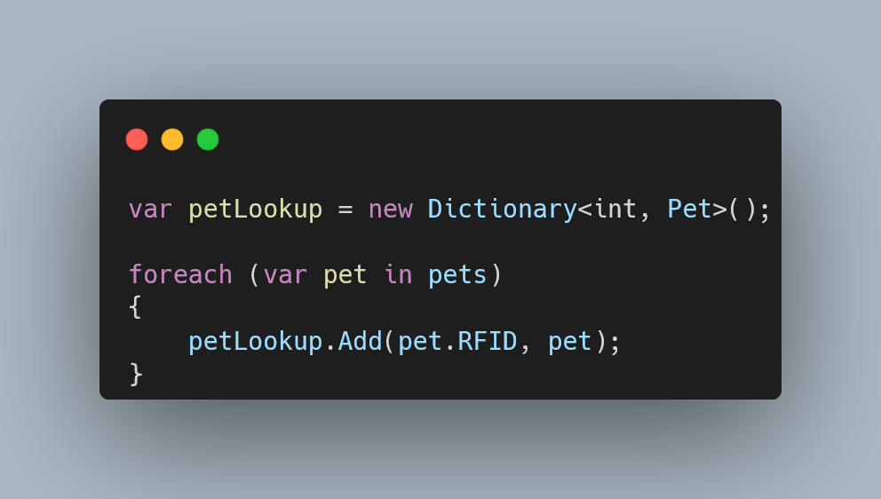
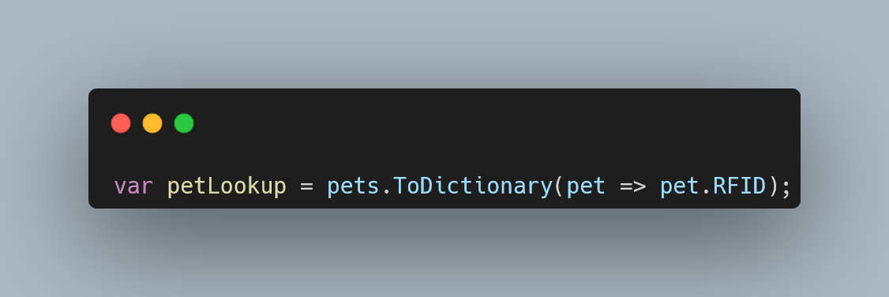
Working with data – LINQ
Example

Slide 21
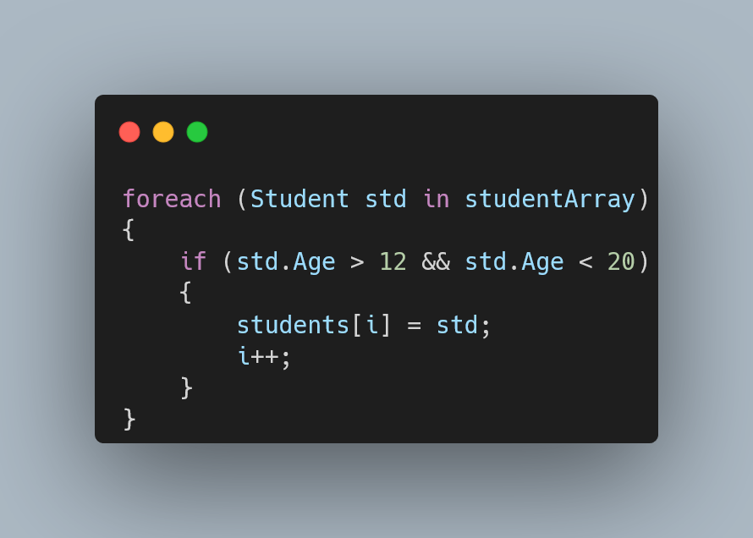
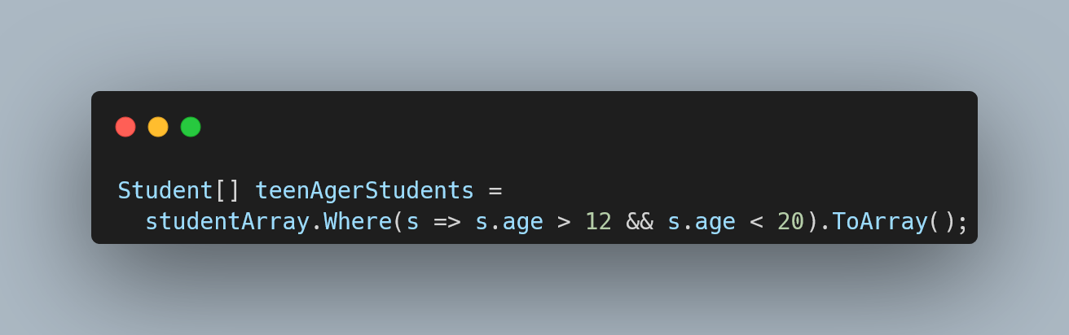
Working with data – LINQ
Example

Slide 22
Working with data – LINQ
Familiar language
Less coding
Readable code
Standardized way of querying multiple data sources
Compile time safety of queries
IntelliSense Support
Shaping data
Notes:
Familiar language: Developers don't have to learn a new query language for each type of data source or data format.
Less coding: It reduces the amount of code to be written as compared with a more traditional approach.
Readable code: LINQ makes the code more readable so other developers can easily understand and maintain it.
Standardized way of querying multiple data sources: The same LINQ syntax can be used to query multiple data sources.
Compile time safety of queries: It provides type checking of objects at compile time.
IntelliSense Support: LINQ provides IntelliSense for generic collections.
Shaping data: You can retrieve data in different shapes.

Slide 23
Bibliography
https://www.c-sharpcorner.com/article/introduction-to-sql-and-sql-commands/
https://www.mongodb.com/compare/relational-vs-non-relational-databases
https://www.studytonight.com/dbms/create-query.php
https://learn.microsoft.com/en-us/dotnet/framework/data/adonet/ado-net-overview
https://dotnettutorials.net/course/ado-net-tutorial-for-beginners-and-professionals/
https://www.tutorialsteacher.com/linq/what-is-linq
https://www.tutorialsteacher.com/linq/why-linq

