Slide 1
Christine Clayton’s RiboProf
Gowthaman Ramasamy
Bryan Jensen

Slide 2
Sample Codes
BJ033
927
PCF-DD1
Ribo
BJ045
927
PCF-DD2
Ribo
BJ047
927
PCF-DD3
Ribo
BJ035
427
cBF-FR2
Ribo
BJ049
927(?)
cBF-FR3
Ribo
BJ034
927
PCF-DD1
Frag mRNA
BJ046
927
PCF-DD2
Frag mRNA
BJ048
927
PCF-DD3
Frag mRNA
BJ036
427
cBF-FR2
Frag mRNA
BJ050
927(?)
cBF-FR3
Frag mRNA

Slide 3
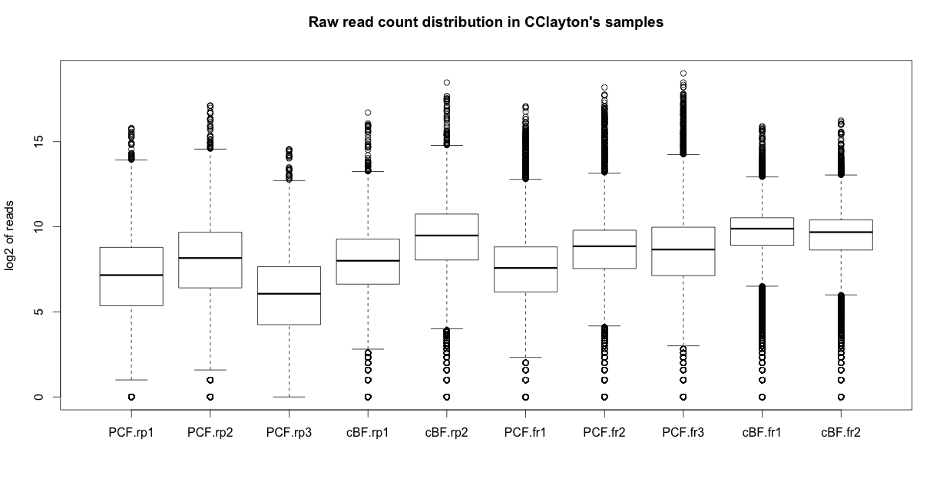
Read count distribution

Slide 4
Correlation matrix between samples (log2 of raw read counts used)
 | PCF.rp1 | PCF.rp2 | PCF.rp3 | cBF.rp1 | cBF.rp2 | PCF.fr1 | PCF.fr2 | PCF.fr3 | cBF.fr1 | cBF.fr2
PCF.rp1 | 1 | 0.981186 | 0.9894584 | 0.8570783 | 0.846374 | 0.6051104 | 0.7032286 | 0.6278228 | 0.742894 | 0.7517712
PCF.rp2 |  | 1 | 0.9696037 | 0.8581345 | 0.8630145 | 0.6750482 | 0.769822 | 0.7047331 | 0.7723967 | 0.7862816
PCF.rp3 |  |  | 1 | 0.8427779 | 0.8254515 | 0.5861103 | 0.6791177 | 0.6050417 | 0.7122926 | 0.719089
cBF.rp1 |  |  |  | 1 | 0.9853198 | 0.5601886 | 0.6520217 | 0.5837491 | 0.835528 | 0.8301282
cBF.rp2 |  |  |  |  | 1 | 0.5917461 | 0.6892893 | 0.6236861 | 0.862675 | 0.8673044
PCF.fr1 |  |  |  |  |  | 1 | 0.9659716 | 0.98811 | 0.7528391 | 0.7312912
PCF.fr2 |  |  |  |  |  |  | 1 | 0.9813768 | 0.8389101 | 0.8352587
PCF.fr3 |  |  |  |  |  |  |  | 1 | 0.7794459 | 0.771081
cBF.fr1 |  |  |  |  |  |  |  |  | 1 | 0.9832615
cBF.fr2 |  |  |  |  |  |  |  |  |  | 1
Note: There is greater correlation across PCF and cBF stages of RiboProf data than between Ribo and Frag RNA. This is okay, I guess.

Slide 5
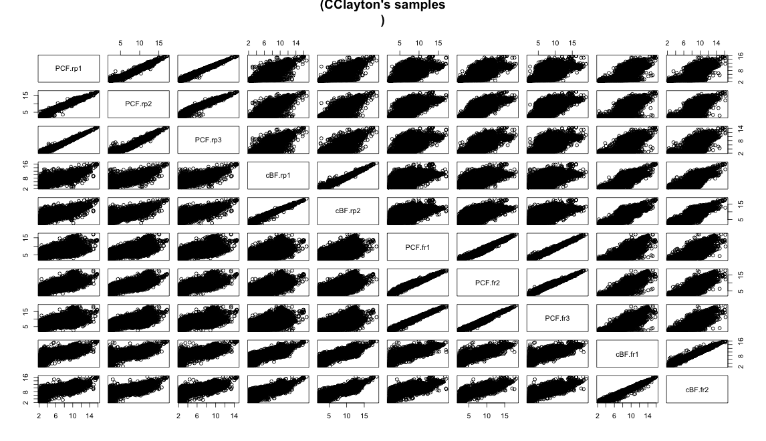
Correlation matrix between samples (log2 of raw read counts used)

Slide 6
 | PCF.rp1 | PCF.rp2 | PCF.rp3 | cBF.rp1 | cBF.rp2 | PCF.fr1 | PCF.fr2 | PCF.fr3 | cBF.fr1 | cBF.fr2
PCF.rp1 | 1 | 0.981186 | 0.9894584 | 0.8570783 | 0.846374 | 0.6051104 | 0.7032286 | 0.6278228 | 0.742894 | 0.7517712
PCF.rp2 |  | 1 | 0.9696037 | 0.8581345 | 0.8630145 | 0.6750482 | 0.769822 | 0.7047331 | 0.7723967 | 0.7862816
PCF.rp3 |  |  | 1 | 0.8427779 | 0.8254515 | 0.5861103 | 0.6791177 | 0.6050417 | 0.7122926 | 0.719089
cBF.rp1 |  |  |  | 1 | 0.9853198 | 0.5601886 | 0.6520217 | 0.5837491 | 0.835528 | 0.8301282
cBF.rp2 |  |  |  |  | 1 | 0.5917461 | 0.6892893 | 0.6236861 | 0.862675 | 0.8673044
PCF.fr1 |  |  |  |  |  | 1 | 0.9659716 | 0.98811 | 0.7528391 | 0.7312912
PCF.fr2 |  |  |  |  |  |  | 1 | 0.9813768 | 0.8389101 | 0.8352587
PCF.fr3 |  |  |  |  |  |  |  | 1 | 0.7794459 | 0.771081
cBF.fr1 |  |  |  |  |  |  |  |  | 1 | 0.9832615
cBF.fr2 |  |  |  |  |  |  |  |  |  | 1

Slide 7
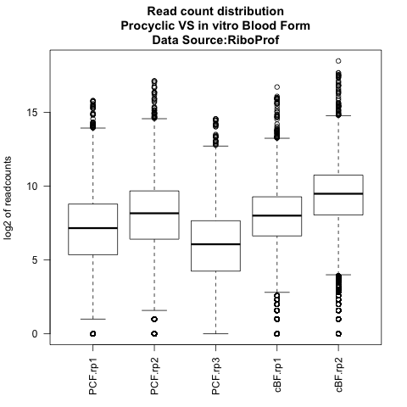
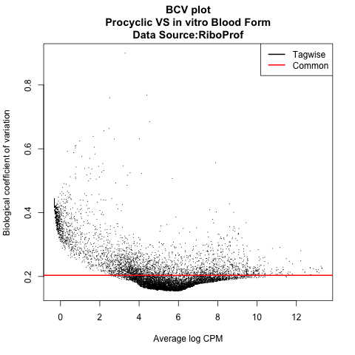
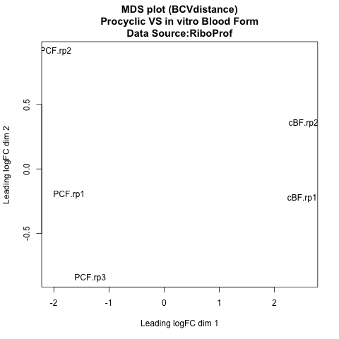
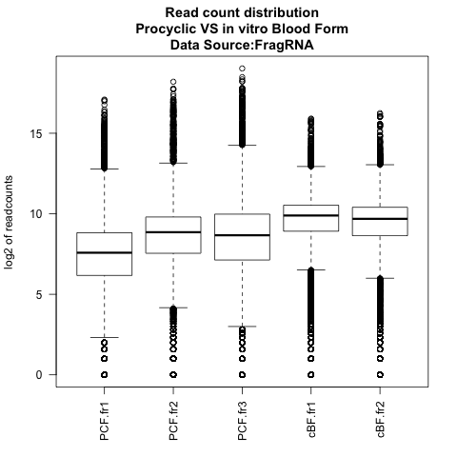
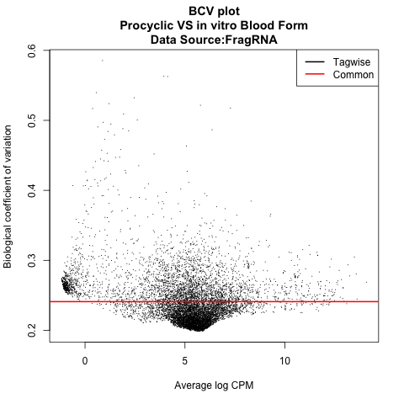
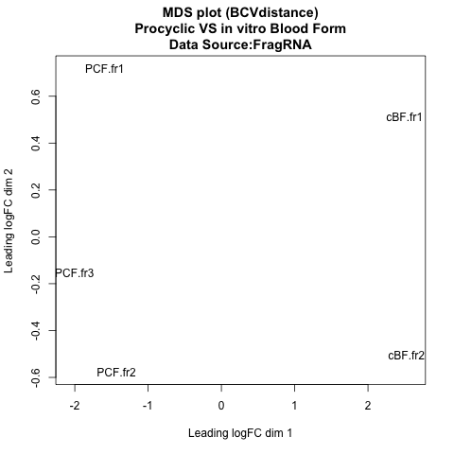
RiboProf
Frag mRNA
Box plot shows the read count distribution in each of the 8 samples.
BCV plot suggests there is a moderately low variance between replicates. This would give higher number of genes as differentially expressed during an statistical testing.
Dimention one on MDS plot clearly separates Procyclic samples from cultured Blood Form samples

Slide 8
DE comparison edgeR
 | CClayton |  | MParsons
 | Frag. mRNA | RiboProf | Frag. mRNA | RiboProf
Up in cBF | 3064 | 2457 | 953 | 1853
NOT. Reg. | 3467 | 4943 | 7641 | 5633
Up in PCF | 2635 | 1766 | 572 | 1680
A comparison of number of genes that are statistically differentially regulated between Marilyn and Christine’s samples.
Data from Christine’s sample indicates more genes have differential mRNA concentration in the cell than being regulated at translational level. Marilyn’s data suggests other way around. Potentially degraded RNAs of Cclayton.pcf data misleads the analysis.
Number of genes differentially expressed by riboprof roughly stays same between Christine and Marilyn’s samples, while, Frag.mRNA indicates ~3 times more genes being differentially regulated in Christine’s samples.

Slide 9
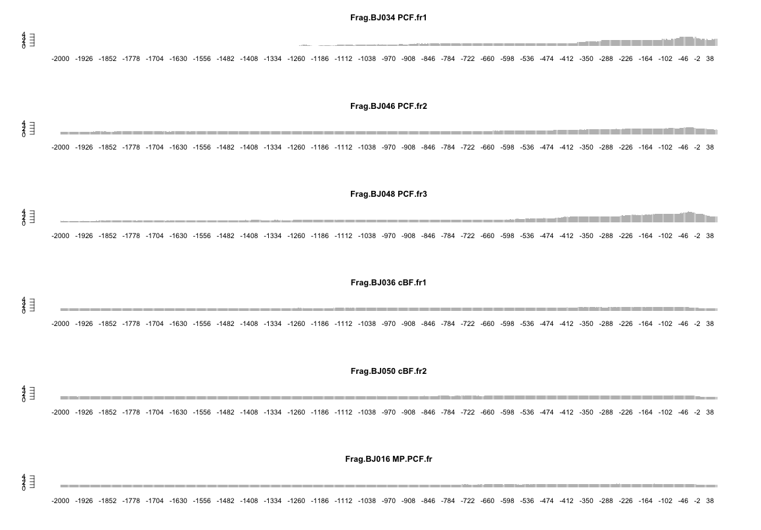
Degradation check Frag.RNA
Method: Following was done for each of the Christine’s library and one of Marilyn’s library. For each gene a median coverage was calculated. Then read coverage at each position of the gene was divided by the median read coverage of the gene. Values from all the genes longer than 2000 bases are then averaged for each position and ploted. Plot is drawn only from 2000 bases upstream stop codon (-2000; left end of plot) to 60 bases downstream of stop codon (+60; right end).
PCF Frag.RNA libraries from Marilyn and cBF Frag.RNA libs from Christine showed uniform coverage (of 1) across the gene region. However, we see enrichment around stop codon in Christine’s PCF.frag libraries. In other words, we see decreased RNA coverage in 5’ regions of the CDS compared to the 3’ region, indicating potential degradation of RNA. The libraries were constructed after selecting for polyA tail thus favoring enrichment in 3’ region.
However this pattern is not that dramatic in PCF.RiboProfiling reads (next slide). I could have ploted the coverage with respect to median coverage of 3 end. But, would essentially convey the same story.

Slide 10
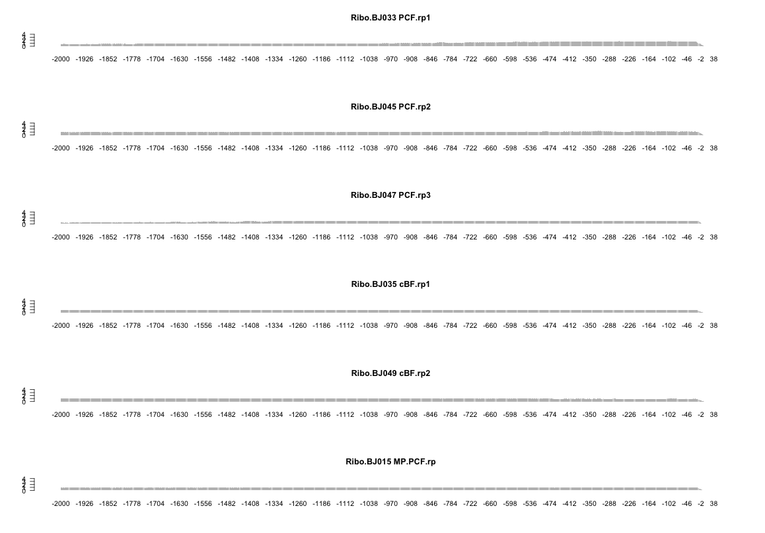
Degradation check RiboProf

