Slide 1
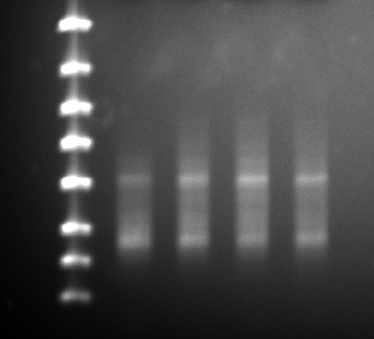
SL RNA-seq Libraries Post 9 cycles PCR amplification
Post Gene Read Size Selection Kit
Lane | Sample details | RNA Sample ID | RNA Seq Library ID | Concentration | Volume | Indexing Primer
1 | WT 25.2S: 0 uM BrdU, 48 h |  | AS001 | 2.6 ng/uL | 11 ul | RP_PCR_index1
2 | WT 25.2S: 10 uM BrdU, 48 h |  | AS002 | 7.3 ng/uL | 11 ul | RP_PCR_index2
3 | WT 25.2S: 10 M BrdU, 0 h |  | AS003 | 5.7 ng/uL | 11 ul | RP_PCR_index3
4 | WT 25.2S: 10 uM BrdU, 48 h |  | AS004 | 5.4 ng/uL | 11 ul | RP_PCR_index4
1
2
3
4
From same 2nd strand product
as library sequenced using mi-Seq
(10 uM BrdU, 48 h)
Used Gene Read Size Selection kit
(150 bp advertised cutoff – looks
more like 200-250 bp)
4000
2000
1250
800
500
300
200
100

