Slide 1
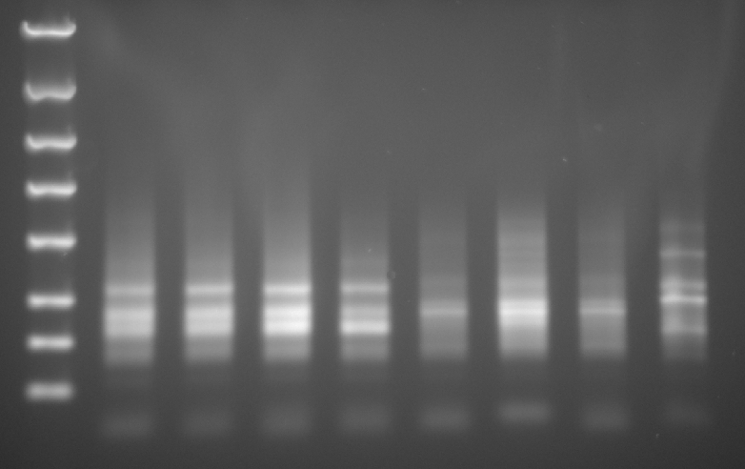
SL RNA-seq Libraries Post 15 cycles PCR amplification
Post Gene Read Size Selection Kit
4000 bp
Samples
1 2 3 4 5 6 7 8
2000 bp
[dsDNA] ng/ul via Qubit
20 19 14 15 8.5 20 10 15
1250 bp
800 bp
500 bp
300 bp
200 bp
100 bp
8 Samples:
1-4 T. brucei
5-7 C.fasciculata
8 Mouse
Lane | Sample details | RNA Sample ID | RNA-seq Library ID
1 | PCF 2-4 | MP001 | AS005
2 | PCF 3 | MP002 | AS006
3 | cBF 2-1 | MP003 | AS007
4 | slBF 4-3 | MP004 | AS008
6 | 1 Crithdia fas total RNA NSA | SB058 | AS017
5 & 7 | CF / Crithidia fasciculata (UCLA) total RNA | SB059 | AS015/AS016
8 | Mouse | - | -

Slide 2
# | Species isolated from | Sample Name | ng | ul | total ng | index seq
1 | T. brucei | PCF 2-4 | 20.0 | 11 | 220 | 3' TGCTGA 5'
2 | T. brucei | PCF3 | 19.0 | 11 | 209 | 3' TAGTCA 5'
3 | T. brucei | BF 2-1 | 14.0 | 11 | 154 | 3' GTCGTA 5'
4 | T. brucei | Sl 4-3 | 15.0 | 11 | 165 | 3' GCTGCA 5'
5 | Crithidia | fas total RNA NSA | 8.5 | 11 | 93.5 | 3' TAGTGC 5'
6 | C. fasciculata | (UCLA) total RNA | 20.0 | 11 | 220 | 3' GCTACA 5'
7 | Crithidia | fas total RNA NSA (duplicate of 5) | 10.0 | 11 | 110 | 3' AATCCG 5'
8 | Mouse |  | 15.0 | 11 | 165 | 3' ACTGGT 5'

