Slide 1
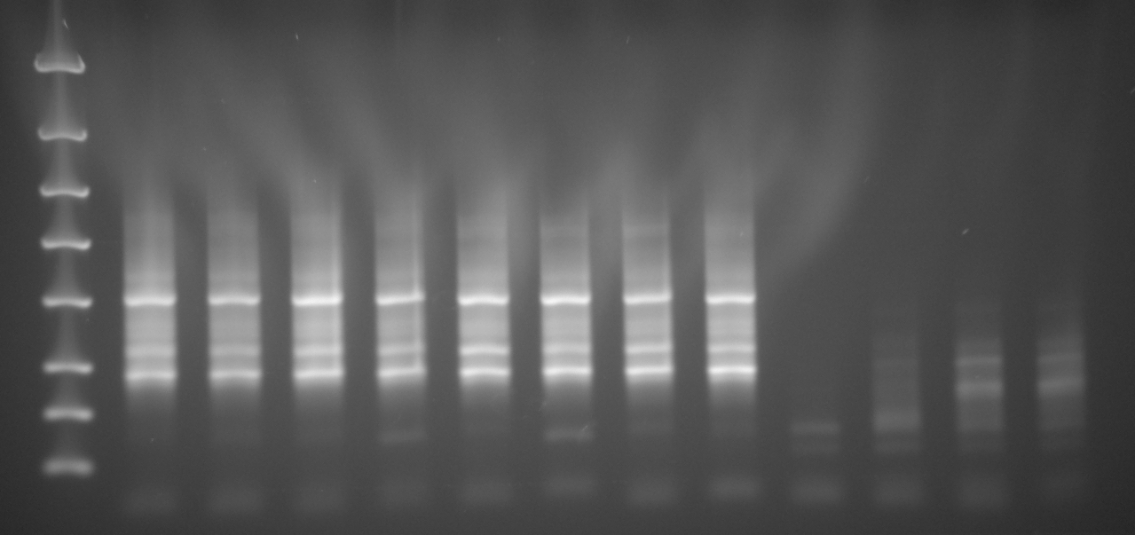
Zilberstein 8 and Beverly 4: Final products post Gene Read Size Selection purification
Samples
Z1 Z2 Z3 Z4 Z5 Z6 Z7 Z8 B1 B2 B3 B4
4000 bp
2000 bp
[DNA] ng/ul
36 28 36 27 34 33 39 34 0.37 2.7 4.3 5.5
1250 bp
800 bp
500 bp
300 bp
200 bp
100 bp
Z1-Z8 Zilberstein Libraries
B1-B4: Beverly Libraries
15 cycles
11ul of each sample remaining
Submitted to UW HTS 10/16/2013
Lane | Sample details | RNA Sample ID | Library ID
Z1 | Pro II | DZ004 | AS020/AS020Mi
Z2 | 2.5 II | DZ005 | AS021/AS021Mi
Z3 | 5.0 II | DZ006 | AS022/AS022Mi
Z4 | 7.5 II | DZ007 | AS023/AS023Mi
Z5 | 10 II | DZ008 | AS024/AS024Mi
Z6 | 15 II | DZ009 | AS025/AS025Mi
Z7 | 24 II | DZ010 | AS026/AS026Mi
Z8 | Ama II | DZ011 | AS027/AS027Mi
B1 | M2903 total lesion BR1 | SB045a | AS028
B2 | ago- quick amast | SB049a | AS029
B3 | # 1 lesion RNA ago- | SB055 | AS030
B4 | #2 lesion RNA ago- | SB057 | AS031

