Slide 1
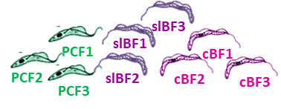
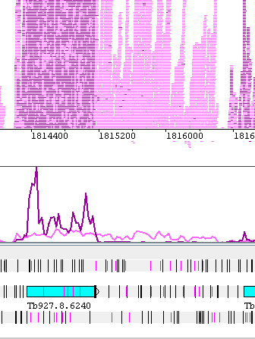
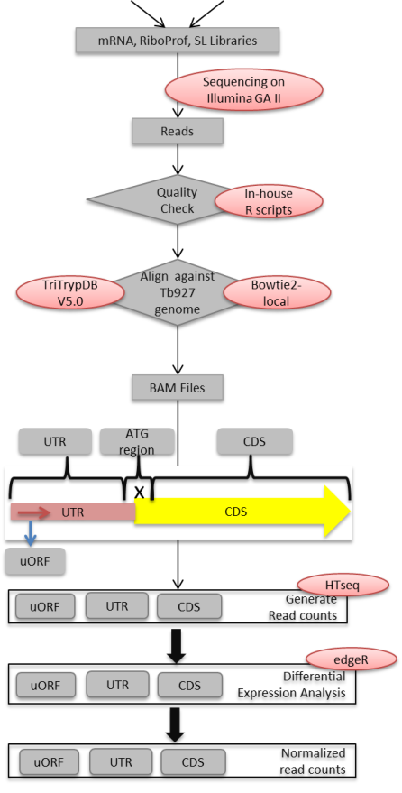
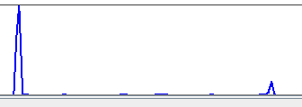
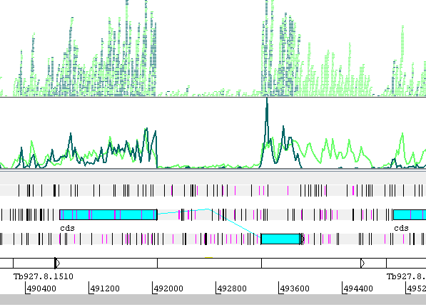
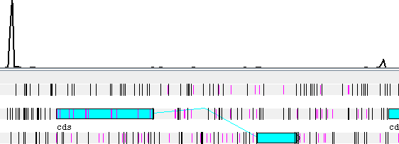
Figure 1
A
B
Top strand reads
Bottom strand reads
ORF
STOP axonemal protein: slBF
SL
Ribo
mRNA
C
5’
DESeq
DEAH box helicase with intron: PCF
SL
Ribo
mRNA

