Slide 1
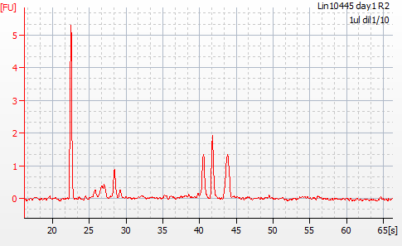
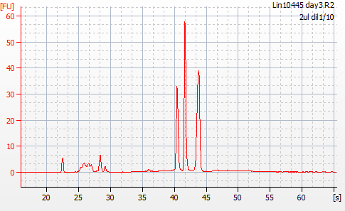
RNAseq lane 1
Total amount
105 μg
20.9 μg

Slide 2
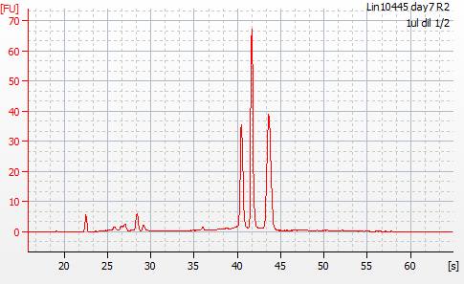
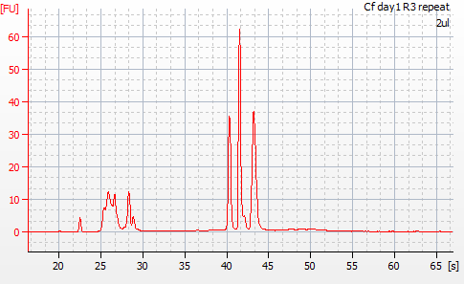
RNAseq lane 1
Total amount
6 μg
3.3 μg

Slide 3
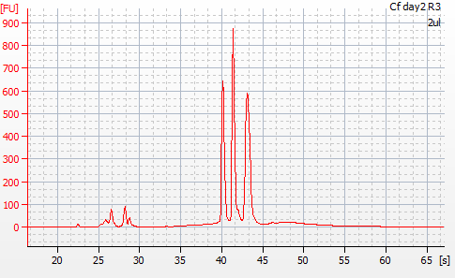
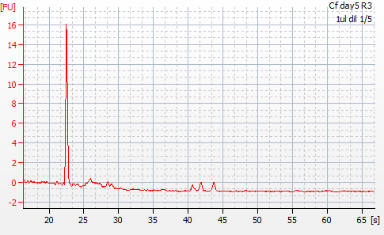
RNAseq lane 1
Total amount
3.6 μg
?
33.2 μg

Slide 4
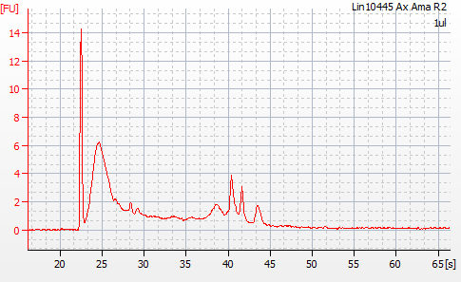
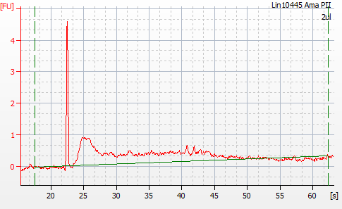
RNAseq lane 1
Total amount
2.1 μg
?
?
Non-denatured RNA aliquot
226 ng
Quality can be re-checked in a high sensitivity chip where we send samples (Bryan told us that they can detect about 10 ng)
?

Slide 5
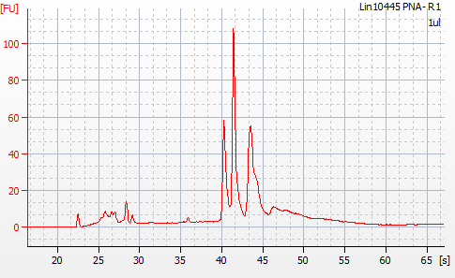
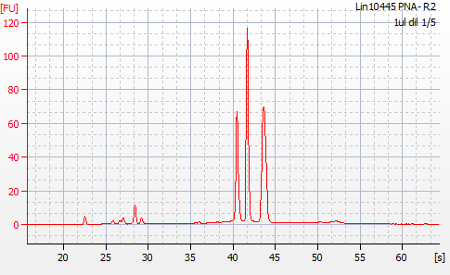
RNAseq lane 2
Total amount
8.5 μg
13.9 μg

Slide 6
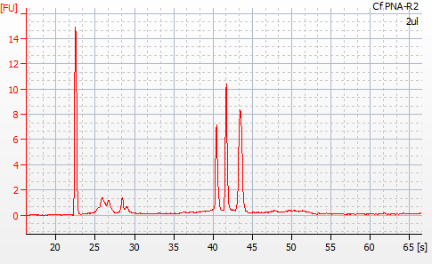
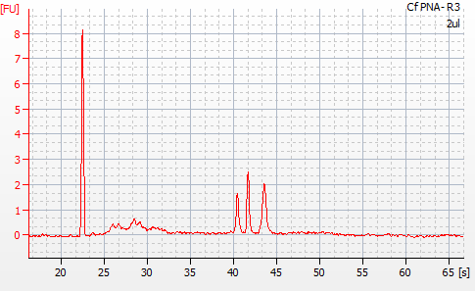
RNAseq lane 2
Total amount
416 ng
180 ng

Slide 7
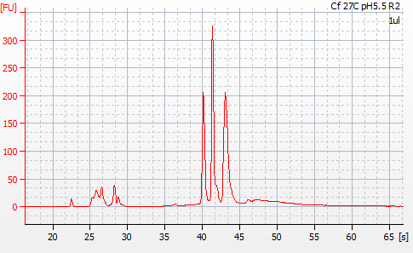
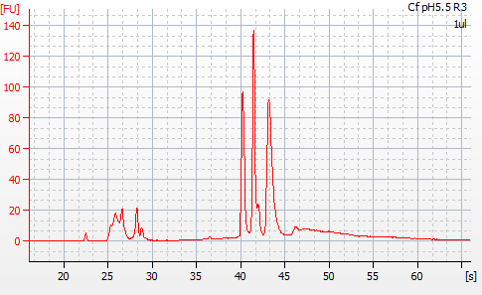
RNAseq lane 2
Total amount
11.9 μg
7.9 μg

Slide 8
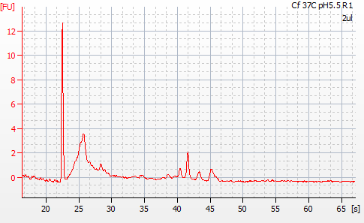
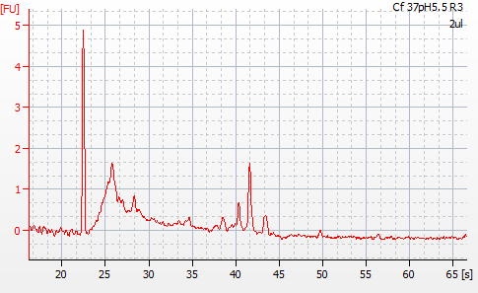
RNAseq lane 2
Total amount
490 ng
?
?
412 ng

