Slide 1
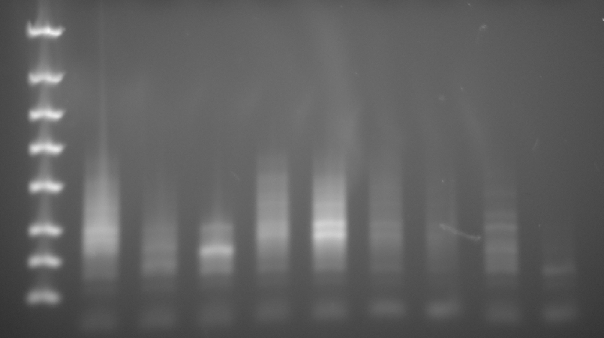
SL RNA-seq Libraries Post 15 cycles PCR amplification
Post Gene Read Size Selection Kit
4000 bp
2000 bp
Samples
1 2 3 4 5 6 7 8 9
1250 bp
[dsDNA] ng/ul via Qubit
15 4.6 5.5 5.0 13 3.9 1.9 3.2 1.0
800 bp
500 bp
dsDNA total ng
165 50 60 55 143 43 21 35 11
300 bp
200 bp
100 bp
Lane | Sample details | RNA Sample ID | RNA Seq Library ID | Concentration | Volume | Indexing Primer
1 | 4 FV1 quick | SB018 | AS009 | 15 | 11 ul | RP_PCR_index1
2 | 6 FV1 total – Index primer 2 | SB020 | AS010 | 4.6 | 11 ul | RP_PCR_index2
3 | 7 FV1 total – Index primer 3 | SB021 | AS011 | 5.5 | 11 ul | RP_PCR_index3
4 | Log 7.4 – Index primer 4 | SB011 | AS013 | 5 | 11 ul | RP_PCR_index4
5 | PNA – Index primer 5 | SB012 | AS014 | 13 | 11 ul | RP_PCR_index5
6 | II AM (Used Indexing primer #6) | SB013 | AS012 | 3.9 | 11 ul | RP_PCR_index6
7 | 87 AMAST (Used Indexing primer #6) | SB006 | Did not submit | 1.9 | 11 ul | RP_PCR_index6
8 | M2903 QUICK ama BR2 – Index primer 7 | SB053 | AS018 | 3.2 | 11 ul | RP_PCR_index7
9 | M2903 TOTAL lesion BR2 – Index primer 8 | SB047a | AS019 | 1 | 11 ul | RP_PCR_index8

Slide 2
LmjF: 1. 4 FV1 quick – Index primer 1 2. 6 FV1 total – Index primer 2 3. 7 FV1 total – Index primer 3 4. Log 7.4 – Index primer 4 5. PNA – Index primer 5 6. II AM (Used Indexing primer #6) 7. 87 AMAST (Used Indexing primer #6) L. braziliensis: 8. M2903 QUICK ama BR2 – Index primer 7 9. M2903 TOTAL lesion BR2 – Index primer 8 (started with 64ng total instead of 1ug)
Beverly Samples (libraries completed 7/16/13)

