Slide 1
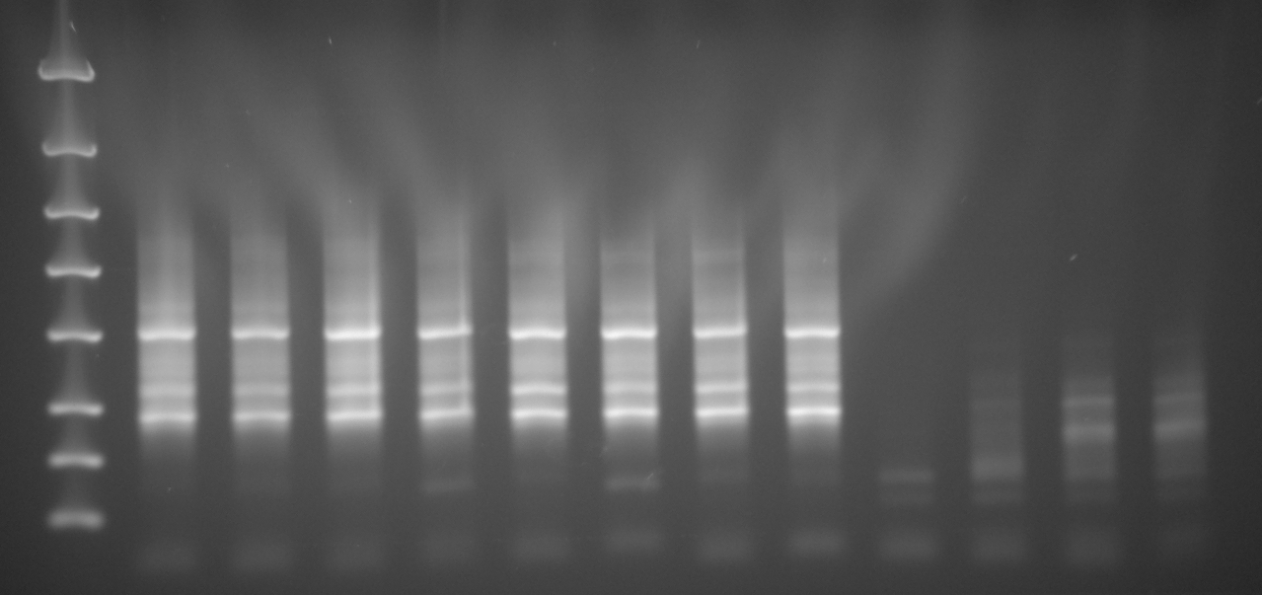
Zilberstein 8 and Beverly 4: Final products post Gene Read Size Selection purification
Samples
Z1 Z2 Z3 Z4 Z5 Z6 Z7 Z8 B1 B2 B3 B4
4000 bp
2000 bp
[DNA] ng/ul
36 28 36 27 34 33 39 34 0.37 2.7 4.3 5.5
1250 bp
800 bp
500 bp
300 bp
200 bp
100 bp
Z1-Z8 Zilberstein Libraries
B1-B4: Beverly Libraries
15 cycles
*Need to redo Qubit for sample Z7
11ul of each sample remaining
Submitted to UW HTS 10/16/2013

