Slide 2
ALGORITHMS FINAL PROJECT
IMAGE RECOGNITION SYSTEM
(IRAR)
Under Supervision of
Prof. Khaled Bugrara
Presented by
Rajat Agrawal(https://www.linkedin.com/in/ragraw26)

Slide 3
PROBLEM STATEMENT
The problem addressed by this project is to recognize the images of similar types using the best available data structure to store image feature and machine learning algorithm to produce the best result based on the input image searched.

Slide 4
SUMMARY
Section 1: Extract Features
Extract Features based on Color/ Texture/Edges
Create a Feature File
Section 2: Index the Images
Implement Indexing techniques to store Image object in Hash Map
Use Hashing techniques
Section 3: Apply Machine Learning Algorithm
Clustering using K –Means
Clustering using K- Nearest Neighbor
Based on Distance Function (Euclidean Distance)
Section 4: Search Image
Extract Features of the image to be compared
Section 5: Display Best Results

Slide 5
IMAGE DATASET
For training our model we have used a database that contains various images across different domains and widely used for the purpose of creating a machine learning model.
Total Images present in image database os around 10,000 but we have trained our model on 1,000 images.
These image database comprises of various image data set like :
Flowers
People
Building
Objects
Scenery
Food

Slide 6
FEATURE EXTRACTION:
Feature Extraction is the key concept in this project. A certain number of features for each image are extracted, describing its high level content information. Then, according to the similarity of these vectors, we can compare two specific images to each other.
There are two methods in this class which extracts the features:
extractSingleImage : which extracts the features for a single image. It is used to extract the features of the input image.
extractAll : which is used to extract the features for all of database images. It takes about half an hour for this method to complete and stores the result table in a text file named: "Features.txt"
The first step is the Color Extraction.Then the edge map of the given image is calculated. It is implemented in Canny Edge Detector class.The last step is Texture Extraction.

Slide 7
INDEXING
For faster retrieval of result, we are indexing our image object and storing the Hash key with Image object as Key value pair using the Hashing Technique named “md5”;
The MD5 algorithm is a widely used hash function producing a 128-bit hash value.
If the Hash Map is already created, we will be using the using the same Hash Map rather than creating a new one.

Slide 8
ML ALGORITHMS
We have use the following Machine Learning Algorithm to train and test our Model namely :
K – Means Clustering :
k-means clustering aims to partition n observations into k clusters in which each observation belongs to the cluster with the nearest mean, serving as a prototype of the cluster. This results in a partitioning of the data space into Voronoi cells.
K- Nearest Neighbors :
In pattern recognition, the k-nearest neighbors algorithm (k-NN) is a non-parametric method used for classification and regression. In both cases, the input consists of the k closest training examples in the feature space. The output depends on whether k-NN is used for classification or regression
Euclidean Distance :
Euclidean distance or Euclidean metric is the "ordinary" straight-line distance between two points in Euclidean space.

Slide 9
RETRIVAL
First of all, it loads the "Features.txt". Then it gets the input image number, between 0 - 1000, and computes the feature vector for this single image.
In "retrieve" method, the feature vector for this single image is compared to all other feature vectors, and they are sorted in increasing order, based on the ML method selected.
After all, the first ten images with the least distance will be given as the output.

Slide 10
WEBSITE

Slide 11


Slide 12


Slide 13
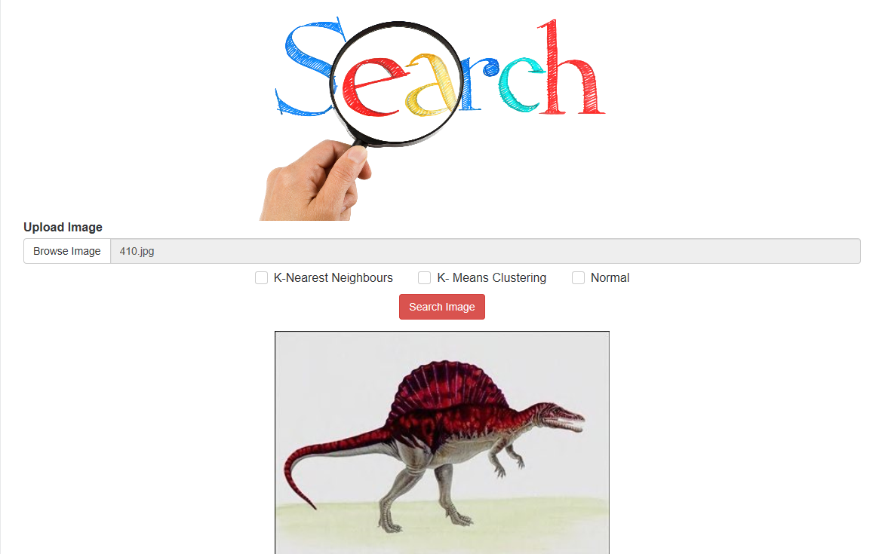

Slide 14
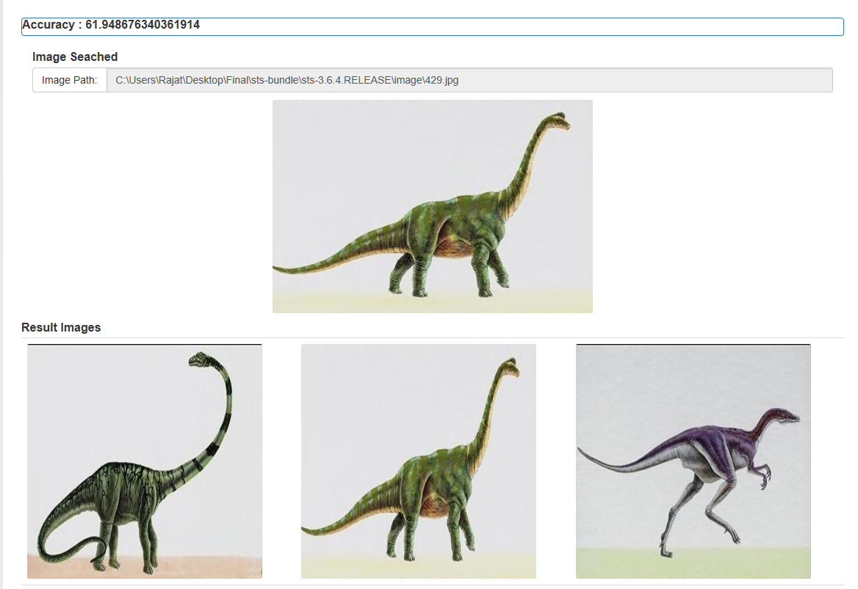

Slide 15
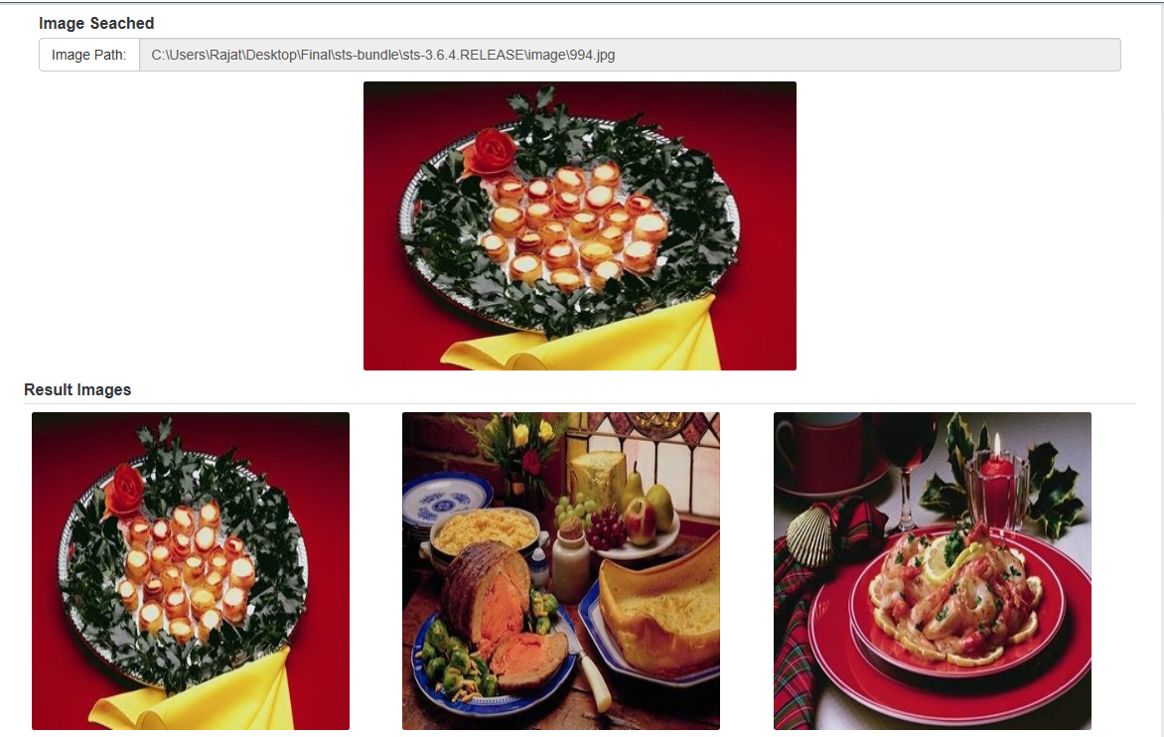

Slide 16
THANK YOU!!!!

