Slide 1
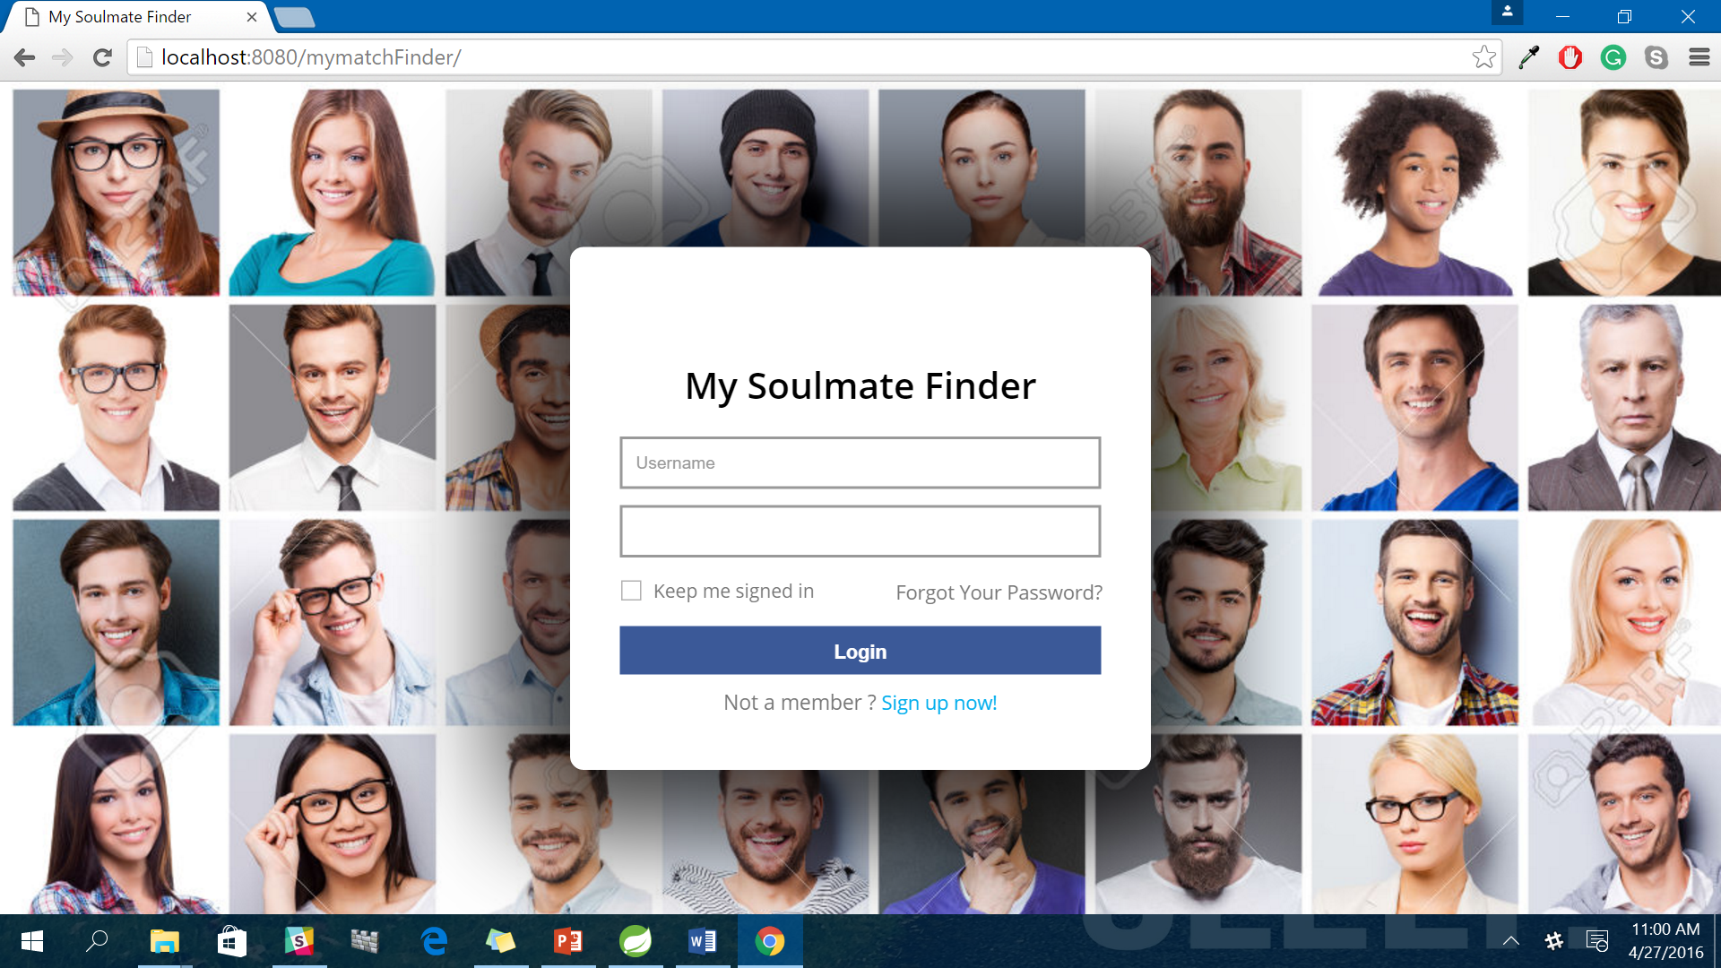

Slide 2
Overview:
MatchFinder.com is a match making site where user can register and create his/her profile. This will be based on the contact application provided by the professor.
MatchFinder.com is a web-application created using a MVC architecture. Spring MVC and Hibernate will be used to create this application with some new functionality with the existing one. It is a social networking site for searching a suitable profile which matches the user requirement.

Slide 3
Approach of Implementation:
Front – End Technology: Bootstrap/HTML5
Spring MVC
Hibernate
Ajax/JQuery/Java Script
Back End: MySQL
Application Server: Apache Tomcat

Slide 4
Silent Features of the Application:
User Registration
Login
View Match Profile
Communication with the desired profile
View/search profile
Admin Dashboard
Use of Auto wired to remove dependency Injection
Error Handling
Session Management

