Slide 2


V-CARE
Because Every One Matters
Prepared By: Rajat Agrawal
NUID : 001617745

Slide 3
Problem Targeted:
In case of medical emergency, How do you act?
Normally people become so distressed that they are unable to summon the action plan and steps need to be executed.
This may sometimes result in loss of life as every second counts!
House calls by doctors may be a thing of the past, but virtual visits are a new way for healthcare to become accessible from home.

Slide 4
Solution Proposed:
V-Care – a surveillance consultation is an application about delivering individual care plans that extend beyond the clinical and provide care planning and coordination.
It takes an ecosystem of organizations that must come together and collaborate to care for an individual.
Used by patients in need of care, V-care assess their needs, establish the appropriate care plan to support their needs, manage the care and monitor results and outcomes.
V- care offers a personalized, 360-degree view of the individual to facilitate outcome-focused care.

Slide 5
Roles:
Patient
  View the dashboard consisting of all the vital sign captured.
  Fix an appointment with doctor.
  Ask help in case of emergency.
  Repository for all health related records, lab results and medication prescribed.
Receptionist
  Confirm an appointment of patient with doctor.
  Create new patients for an enterprise.
  Generate the bill for the patient served by the doctor.

Slide 6
  Special Care Team
  Take care of Patient basic need.
  Act as an emergency team when required.
Doctor
  View the dashboard consisting of all the vital sign captured, medication prescribed and test result outcome at one place.
  Prescribe medication and request Test result for the patient.
Nurse
  Prescribe medication with proper Instructions and advice.
Laboratory
  Generate and request Test result for the patient.

Slide 7
Key Features:
Simulate as an Health App for tablets.
Capturing and displaying of Vital Sign on demand.
One Click Call for emergency.
Special Care Team : Direct Messaging
Direct chat integration between Doctor and Patient

Slide 8
Extra Features:
Patient requesting Doctor Appointment
Repository for patient data like test reports, medications and medical bills.
Proper Care and Medication prescribed.
Lab Report Generation mail directly to Patient mail box.

Slide 9
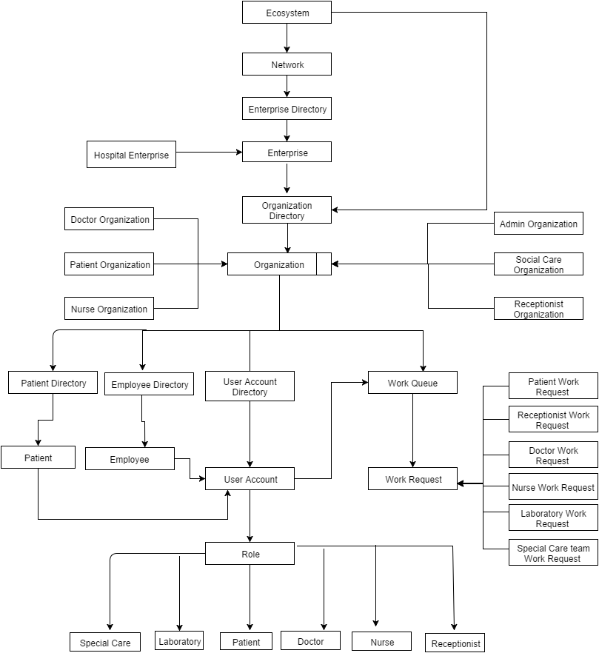
Object Model Diagram:

Slide 10
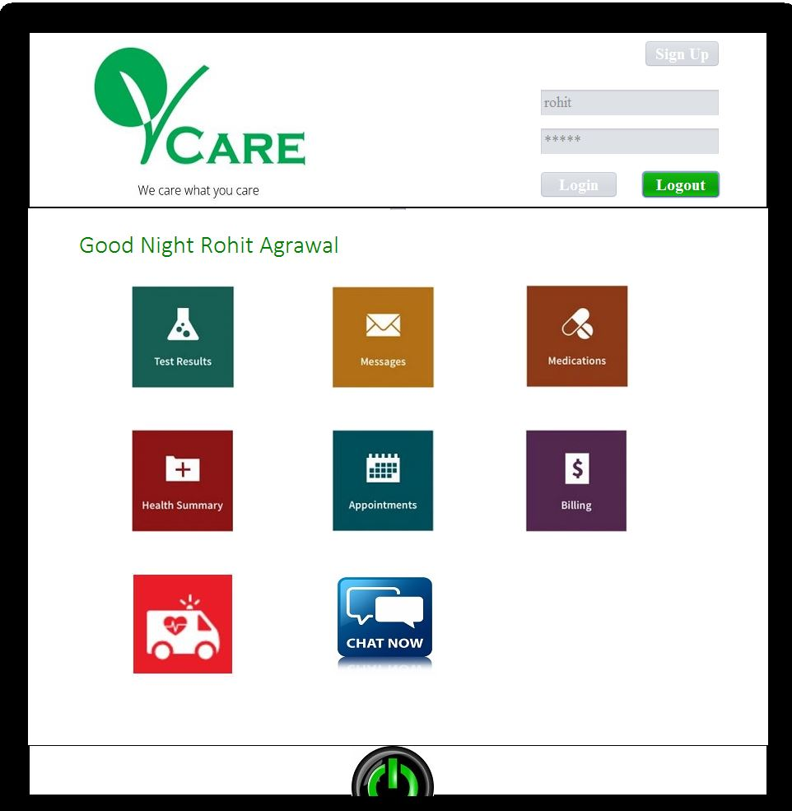
Patient Home Screen

Slide 11
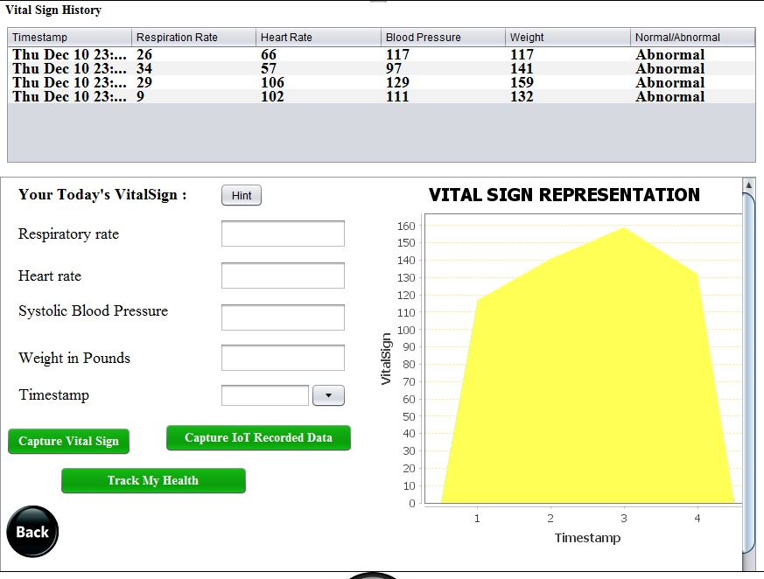
Capturing Vital Sign

Slide 12
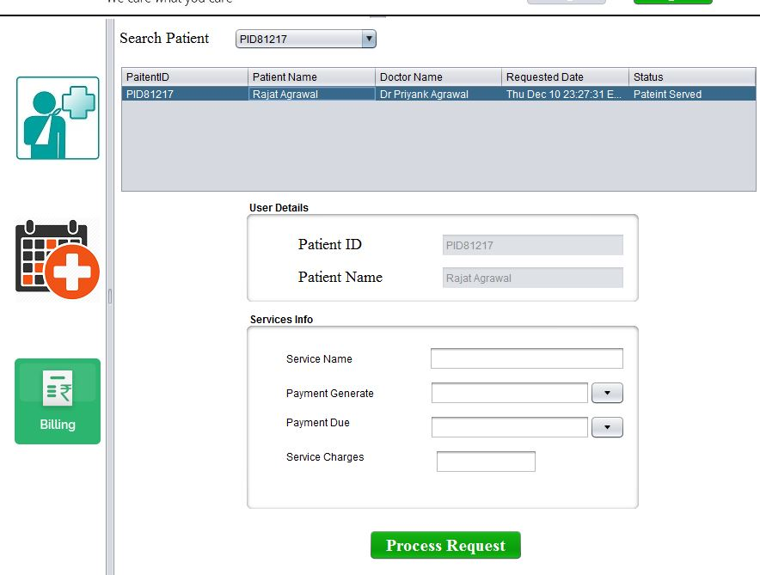
Receptionist Work Area

Slide 13
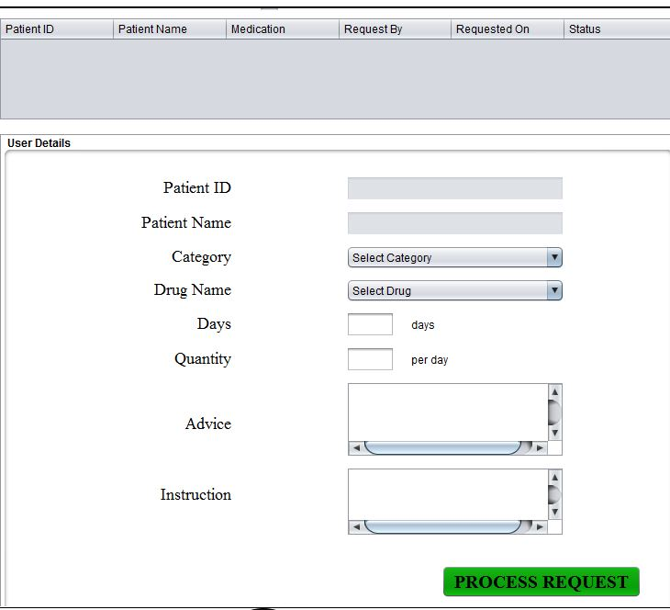
Nurse Work Area - Medication

Slide 14
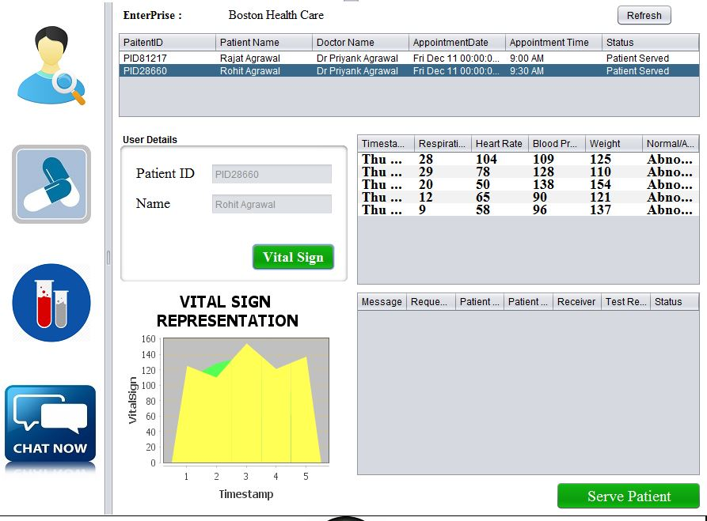
Doctor Work Area

Slide 15
THANK YOU !!!

