Slide 1
CATEGORYAI
Strategic Category Suite
The complete procurement category strategy workbench in a single HTML file —
fifteen guided steps from market scan to board-ready strategy, with AI assistance you can always audit.
Single file · no install
Works fully offline (Sandbox)
Claude · Gemini · Sandbox
v1.1.0 · frozen 2026-07-14
Product overview · feature guide · quick-start reference

Slide 2
WHY CATEGORYAI
From fragmented spreadsheets to one guided strategy
Category strategy work is usually scattered across Excel, slide templates and tribal knowledge. CategoryAI puts the whole method in one place.
The problem
What CategoryAI does
Every category manager rebuilds the same analysis from blank templates
Frameworks (Kraljic, Five Forces, chessboard) applied inconsistently — or skipped
Strategies stall waiting for perfect internal spend data
No trace of which numbers were evidence and which were assumptions
Guides the full CIPS-style method: 15 steps across six phases, in order
AI drafts every model; you review, correct and confirm each input
Builds a complete strategy from external market data alone — spend upload optional
Flags every value as User, AI-inferred or Assumed, end to end
Four design principles
External data first
Confidence transparency
Accumulate, never overwrite
Explainable by design
A strategy never waits for internal data
Every cell shows where it came from
AI appends suggestions; you keep or discard
Every AI section states its sources

Slide 3
THE WORKFLOW
Fifteen steps, six phases — the whole method, in order
The navigation rail tracks completion per phase; each step unlocks from a single category name. Use this slide as your map of the app.
1 · INTAKE
2 · ASSESSMENT
3 · STRATEGY
4 · BARGAINING
5 · EXECUTION
6 · OUTPUT
Category profile
Spend profile (optional CSV)
Market info hub + research
SWOT & PESTLE
Porter's Five Forces radar
Kraljic matrix
Suppliers, tiering & SRM
Risk heatmap 5×5 + ESG
Purchasing chessboard
Cost drivers & levers
Negotiation plan
BATNAs · issues matrix
Trading board
Gantt & RACI
Savings pipeline & funnel
Benefits · maturity
Commercial 7Ps (optional)
Strategy document
Exports & templates
Progress you can see: green/amber dots per step · per-phase completion counts in a collapsible rail · a Module Review dashboard with per-module Word export · autosave on every change.

Slide 4
AI PROVIDERS
Sandbox, Claude or Gemini — your choice of engine
Switch provider any time in the header settings. The workflow is identical in all three; only the source of the AI drafting changes.
🏖 SANDBOX
CLAUDE
GEMINI 2.5
NEEDS
NEEDS
NEEDS
Nothing — no key, no account
Nothing inside Claude.ai (in-app) · or an Anthropic API key
Google AI key (Flash or Pro)
COST
COST
COST
Zero
Included in-app / API usage
Per Google pricing / free tier
DATA LEAVES DEVICE
DATA LEAVES DEVICE
DATA LEAVES DEVICE
Never — 100% offline
Only your prompts, to Anthropic
Only your prompts, to Google
OUTPUT
OUTPUT
OUTPUT
Simulated demo data, always tagged “[Sandbox — simulated]”
Live drafting on current models (claude-sonnet-4-6)
Live drafting with automatic model fallback
BEST FOR
BEST FOR
BEST FOR
Demos, training, trying the method safely
Day-to-day strategy building
Teams standardised on Google
Honest by default: live-API errors are shown, never silently swapped for simulated content — and API keys are stored on your device only, if you choose to save them.

Slide 5
AI, MODULE BY MODULE
What the AI drafts — and the control you keep
Every AI-generated section carries a banner explaining its sources; every value carries a confidence flag you can confirm with one click.
MODULE
AI DRAFTS
YOU CONTROL
Market info hub
Market variables, briefs & cited research answers
Adjust the nine sliders; re-ask anything
SWOT · PESTLE
Buyer-perspective analysis per factor
Edit any cell; confirm to flip flag to User
Five Forces · Kraljic
Force levels & quadrant derived from market variables
Manual override of every coordinate
Suppliers & SRM
Segmentation, scorecards, preferencing (labelled subjective)
Re-score; SRM reviews accumulate as history
Risk heatmap
Risks with likelihood/impact + ESG opportunities
Move, edit or delete any risk
Chessboard
Method recommendations for your power position
Appends only — tick Keep on what stays (cap 15)
Negotiation plan
Objectives, BATNAs, issues matrix, trades
Every position editable before the room
Execution & value
Gantt, RACI, savings pipeline with complexity
Owners, statuses and values stay yours
Strategy document
Full narrative, elevator pitch, defensible FAQs
Regenerate sections; export when satisfied
USER
AI-INFERRED
ASSUMED
— the three confidence flags on every AI-touched value, one click to confirm.

Slide 6
INTAKE · MARKET INTELLIGENCE
Start from the market, not the spreadsheet
The info hub grounds the whole strategy in external evidence — so work starts on day one, with or without internal data.
Market information hub
Why external-first matters
Nine market variables (capacity tightness, entry barriers, switching cost…) set with AI-suggested defaults — these later drive Five Forces and Kraljic mathematically
AI market brief per category and region: structure, pricing dynamics, regulation to watch
Research assistant: ask specific questions (“what is driving hyperscaler price rises?”) and get structured, sourced-and-dated answers into the hub
PESTLE and SWOT drafted from the buyer’s perspective — including an Environmental/ESG read
Optional spend CSV upload refines every downstream number; an approximate annual spend unlocks indicative values without it
Most category strategies stall waiting for perfect spend data. CategoryAI inverts that: the market view is enough to position the category, pick the levers and draft the plan. Internal data then sharpens the numbers — it never blocks the thinking.
GENERIC MODE
No internal data at all? The strategy document is generated in clearly-labelled generic mode — honest about what it doesn't know, still structurally complete.

Slide 7
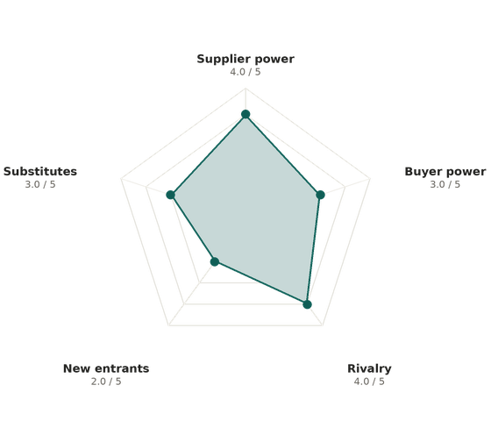
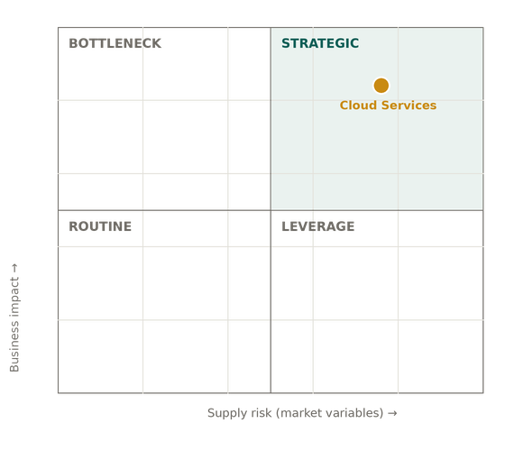
ASSESSMENT · POSITIONING
Five Forces and Kraljic — derived, not guessed
Both models compute from the nine market variables, removing assessment bias. Every coordinate stays manually adjustable.
Each force is derived from entry barriers, capacity tightness and switching costs — and explains its inputs. Manual override always available.
The amber dot is your live session position; quadrant strategy advice is written into the step.

Slide 8
STRATEGY · SUPPLIERS
Supplier strategy — before and after contract
One step covers strategic segmentation, Gold/Silver/Bronze governance tiering, mutual-attractiveness preferencing and post-contract SRM.
Strategic view
SRM post-contract reviews
NEW 1.1.0
Five-dimension scorecard per supplier: Quality, Delivery, Cost, Innovation, ESG — every score confidence-flagged
Capability/alignment segmentation with tier suggestion
Preferencing model (account attractiveness × relative value) — explicitly labelled as a subjective best-suggestion
Gold / Silver / Bronze tiers carry differentiated governance: executive sponsorship and QBRs down to standard PO terms
Date-stamped performance reviews on the same five dimensions — history accumulates, never overwrites the strategic scorecard
Radial gauge with four grades: Executive leader ≥90 · Preferred partner ≥70 · Transactional ≥50 · Improvement plan below
Drift visible over time: the review table shows every snapshot
Exports into the strategy document as an SRM history table
Executive leader
Preferred partner
Transactional
Improvement plan

Slide 9
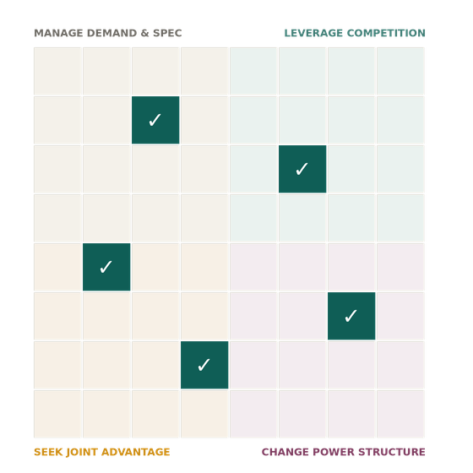
STRATEGY · METHODS
The purchasing chessboard — methods you choose to keep
Sixty-four methods across four power strategies, recommended by AI for your position — grounded in a levers library of 20+ archetypes.
CHANGE THE POWER STRUCTURE
Accumulate-and-select
Co-design specifications, aggregate global volumes
Regeneration appends new recommendations — it never wipes your shortlist
Tick “Keep” on the methods that stay (working cap of 15)
Kept methods drive the negotiation and execution steps
LEVERAGE COMPETITION
Transparent multi-round RFPs, target-price indexation
SEEK JOINT ADVANTAGE
Value partnerships, risk-sharing agreements
MANAGE DEMAND & SPEC
Standardisation, volume bundling, demand control
Cost drivers & levers library
16 cost drivers and 21 savings levers mapped across 20+ category archetypes (cloud, professional services, logistics, energy…). Pick the archetype; the relevant drivers, levers and weightings load — and feed the savings pipeline directly.
Open 64-method board · kept methods (✓) flow into negotiation and execution · licensed A.T. Kearney board pluggable via Admin.

Slide 10
STRATEGY → BARGAINING
Price the risk, then plan the room
The 5×5 heatmap keeps risk and ESG opportunity on the table; the negotiation module turns strategy into positions.
Risk heatmap & ESG
Negotiation planning (Huthwaite-style)
AI proposes category risks scored for likelihood and impact; drag, edit or delete each
ESG opportunities tracked alongside threats — value, not just exposure
Feeds mitigation actions into the execution plan
Objectives with intend / expect / must-achieve ranges
BATNAs for both sides — know your walk-away and theirs
Issues matrix scoring value vs. cost of every negotiable
Trading board pairing concessions to requests, so nothing is given away free
All of it drafted by AI from your strategy, then edited by you before the room
Impact ↑ · Likelihood →

Slide 11
EXECUTION · VALUE
From plan to delivered value — and proof of maturity
Execution tooling keeps the strategy honest after sign-off: who does what, what lands when, and what the category is actually worth.
Savings pipeline & funnel
NEW 1.1.0
Gantt & RACI
Idea
Validated
In delivery
Delivered
Three-year interactive timeline and a responsibility matrix across procurement and the business — generated from the strategy, edited in place, exported with the document.
Weighted by planned % of spend · complexity and owner per initiative · indicative £/$ view from uploaded spend or an approximate baseline (clearly flagged).
Benefits register — five types
Maturity — two honest views
NEW 1.1.0
Cash
Avoidance
Efficiency (hrs)
Self-assessment: five dimensions scored 1–5 (perception). Staged checklist: twelve practices across four CIPS/Hackett-style stages — a stage is awarded only when it and every stage below are complete. No skipping.
Carbon (tCO₂e)
Social value
Each benefit shows its exact upstream source in the plan.

Slide 12
BUILT-IN HELP
An analyst in the corner of every screen
The guide chat bubble reads the step you're on and answers from the app's own reference library — methods, levers, archetypes and your current context.
What it's for
YOU How should I govern a Gold-tier cloud supplier?
Explains any framework in plain terms while you're using it
Queries the master library: cost drivers, levers, chessboard plays, archetypes
Standardises judgement — every team member gets the same method guidance
Works in every provider mode, including Sandbox
Never edits your data — it advises, you decide
GUIDE Gold tier warrants an executive sponsor, quarterly business reviews with SLA audits, and continuity planning. Your tier calculator weights value, risk and complexity — this supplier's profile supports Gold. See step 7 for the governance detail.
Context-aware: the guide prioritises the screen you have open, and closes itself when you move on.

Slide 13
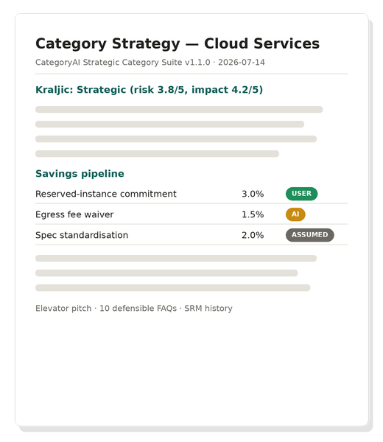
REPORTING & OUTPUTS
Board-ready in one click — and portable forever
Everything the workflow builds can leave the app as a polished document, a deck, a fillable template or a re-loadable session.
Word strategy document
PowerPoint board deck
.docx (offline .doc fallback) — full narrative: analysis, matrices, negotiation plan, RACI, pipeline, SRM history, pitch and 10 FAQs
.pptx generated from your data — native charts and matrices, ready to present
Four master templates
Per-module Word reports
Fillable Word: Category Management Plan · Sourcing Strategy · Negotiation Plan · Execution Plan
One-click briefing note for any single module, from the Module Review dashboard
Session files (.json)
Autosave
Full round-trip: export, share, re-import to continue — v1.0 files load in v1.1.0
Every change persists locally in the browser; nothing to remember to save
Confidence flags travel with the data — exported tables keep User / AI-inferred / Assumed provenance.

Slide 14
GET STARTED
Sixty seconds to your first strategy
1
2
3
Open the file
Pick a provider
Take the tour
One HTML file, any modern browser. Nothing to install, no account to create.
Header ⚙ — start in Sandbox (no key, fully offline), switch to Claude or Gemini when ready.
Sixteen guided stops on a simulated Cloud Services category — or name your own category and go.
Also in the box: Admin panel for keys, users, custom templates & archetypes · collapsible phase navigation with hover help · minimisable tour for mobile · session import from any v1.0 file.
CategoryAI Strategic Category Suite · v1.1.0 · frozen 2026-07-14
This deck doubles as the feature reference — keep it with the app.

