Slide 1
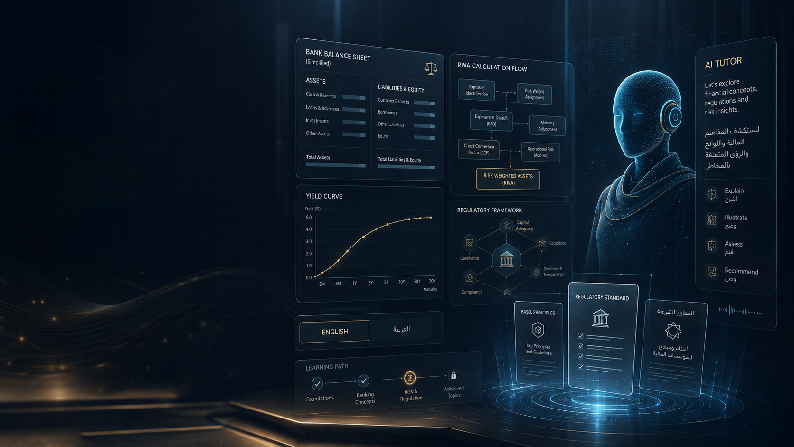
FINANCIAL
PODS
AI-Native Banking & Regulatory Learning Platform
Research synthesis • Product blueprint • Technical architecture • Commercial model • Implementation roadmap
BASEL
SAMA
UAE
US
Basel first. Then Regulatory Reporting, ALM, FTP, Profitability, Liquidity and Financial Crime.
August 2026

Slide 2
The thesis
The opportunity is not AI video. It is an AI learning operating system for regulated banking roles.
THE PRODUCT PROMISE
AI TUTOR
Learn the rule.
See the bank.
Run the numbers.
Ask the expert.
Do the job.
Explains • questions • scaffolds • personalizes
DETERMINISTIC FINANCE ENGINE
Calculates EAD • RW • RWA • capital — never delegated to the LLM
OFFICIAL-RULE GROUNDING
BCBS canonical baseline + jurisdiction overlays + source citations
PRACTITIONER REVIEW
SME sign-off before regulated learning content is published

Slide 3
What the research already proves
Demand exists for serious finance education and AI-native learning. Our differentiation must go deeper than “video + chatbot.”
VIZZ / VIZUARA
CFI
FITCH
ACAMS
Realtime voice, timeline Q&A, multilingual interaction and Active Mode validate the interaction pattern.
AI Tutor is already embedded into finance learning and uses course/progress context.
Basel remains a premium professional training topic with practical exercises.
Enterprise financial-crime learning and certification is an established category.
What is still missing
Official prudential rules connected directly to bank products, data and calculations.
A persistent Digital Bank that reappears across Basel, ALM, FTP and profitability.
Jurisdiction comparison: BCBS vs U.S. vs SAMA vs CBUAE.
Reporting labs and job-oriented simulations, not only lectures.
Adaptive mastery at the concept / misconception level.
Sources: Vizz pricing/terms; CFI AI Tutor; Fitch Basel III; ACAMS; Scientific Reports AI tutor study (2025).

Slide 4
Competitive white space
The AI layer is becoming common. The moat must live in the finance-specific system underneath it.
Finance-domain infrastructure
FINANCIAL PODS
OUR MOAT
Rule grounding
Deterministic tools
FinBank Digital Twin
Jurisdiction maps
Reporting labs
Adaptive mastery
CFI
Fitch
Vizz
Generic LLM
Generic AI
Passive content
Executable / simulated

Slide 5
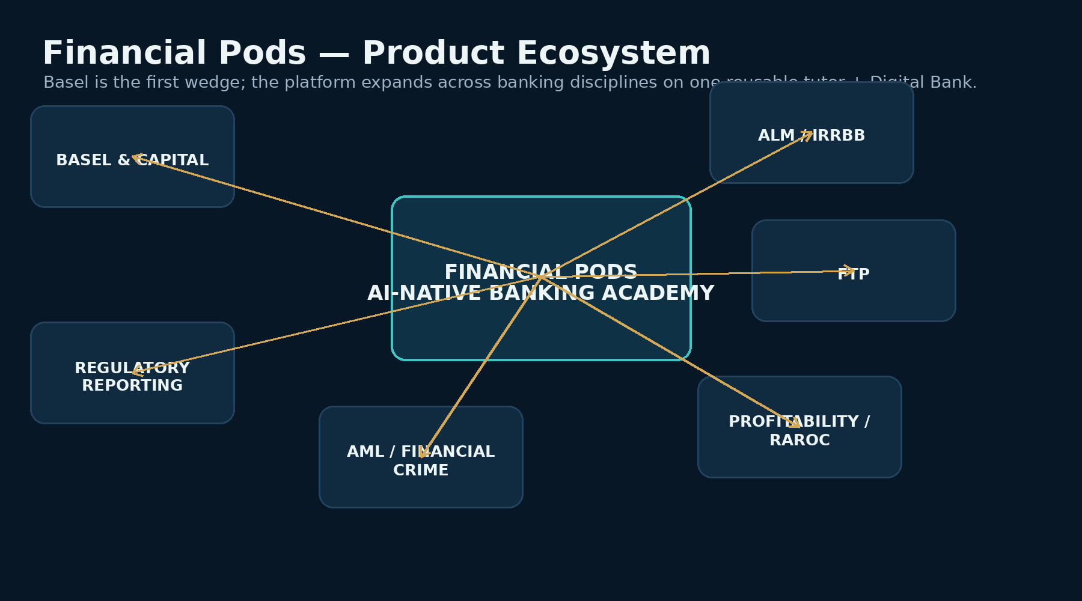
Financial Pods is the platform — Basel is the first wedge
One reusable tutor, Digital Bank and learning engine can support multiple banking disciplines.

Slide 6
Long-term Pod roadmap
Do not launch everything at once. Build the platform once, then expand domain packs deliberately.
01
Basel Regulatory Capital
LAUNCH
02
Regulatory Reporting
NEXT
03
ALM / IRRBB
THEN
04
Fund Transfer Pricing
THEN
05
Profitability / RAROC
THEN
06
Liquidity
LATER
07
Financial Crime / AML
LATER
The same synthetic products and customers should reappear across Pods so learners understand how the bank works end-to-end.

Slide 7
Basel Pod — first commercial wedge
Canonical BCBS concepts + U.S., SAMA and CBUAE implementation tracks.
FOUNDATIONS
CREDIT RISK SA
JURISDICTIONS
Bank balance sheet
Why capital exists
Basel I / II / III
Three Pillars
Exposure • EAD • RW • RWA
CET1 • AT1 • Tier 2
Sovereigns
Banks
Corporates & SMEs
Retail
Residential Real Estate
Commercial Real Estate
Defaulted exposures
Off-balance sheet
CRM basics
BCBS baseline
U.S. current + March 2026 proposals
Saudi Arabia / SAMA
UAE / CBUAE
REPORTING INTRO
Calculated exposures aggregate into capital and reporting schedules. Future labs: FFIEC, FR Y-14, SAMA Q17, UAE reporting/disclosures.
Sources: BIS CRE20; Federal Reserve March 2026 proposals; SAMA Minimum Capital Requirements for Credit Risk; CBUAE capital standards/guidance.

Slide 8
Golden Lesson 001
Corporate Exposure — From a Bank Loan to Regulatory Capital. This one lesson must prove the whole product experience.
1. Context
2. Classify
3. Source
4. Calculate
FinBank receives a $10m corporate term loan
What exposure class applies?
Open BCBS / SAMA / UAE / U.S. rule
EAD → Risk Weight → RWA → capital
5. Manipulate
6. Interrupt
7. Compare
8. Prove mastery
Change rating, revenue, collateral, jurisdiction
Pause and ask by chat or voice
Explain jurisdiction differences
Active question + practice + voice viva
Acceptance gate: do not scale Lesson 002 until English + Arabic + sources + calculator + pause/ask + realtime voice + mastery all work reliably.

Slide 9
Pause anywhere. Ask anything about the exact moment.
The tutor should know the current timestamp, rule, example, jurisdiction and on-screen calculation.
Lesson 001 • Corporate Exposures
06:42 / 10:24
AI TUTOR
“Why is this corporate rather than SME?”
Tutor context:
• timestamp 06:42
• SAMA jurisdiction
• Alpha Manufacturing example
• corporate/SME concept
• relevant SAMA rule IDs
Actions:
Explain • Show rule • Modify revenue • Recalculate • Resume lesson
Alpha Manufacturing
Loan $10,000,000
Exposure Class Corporate
Rating BBB
Risk Weight 75%
RWA $7,500,000
PAUSE

Slide 10
Adaptive tutor = evidence-based personalization
Do not label users “visual learners.” Adapt from mastery, misconceptions, language, confidence and retention.
LEARNER MODEL
TEACHING POLICY
MASTERY OUTPUT
Mastery by concept
Misconceptions
Confidence vs correctness
Preferred explanation depth
Response latency
Language
Voice/chat behavior
Retention over time
If abstract explanation fails → use worked example.
If concept remains weak → return to prerequisite.
If confident but wrong → Socratic challenge.
If retention decays → spaced review.
If voice is preferred → voice-first practice and viva.
Capital Definition 91%
Corporate Exposure 88%
Real Estate 63% ⚠
CRM 57% ⚠
SAMA 87%
UAE 74%
U.S. 65%
Next action: targeted CRM + real-estate cases
Research basis: Scientific Reports (2025) found a carefully designed AI tutor outperformed in-class active learning in the studied setting; pedagogy and scaffolding were central.

Slide 11
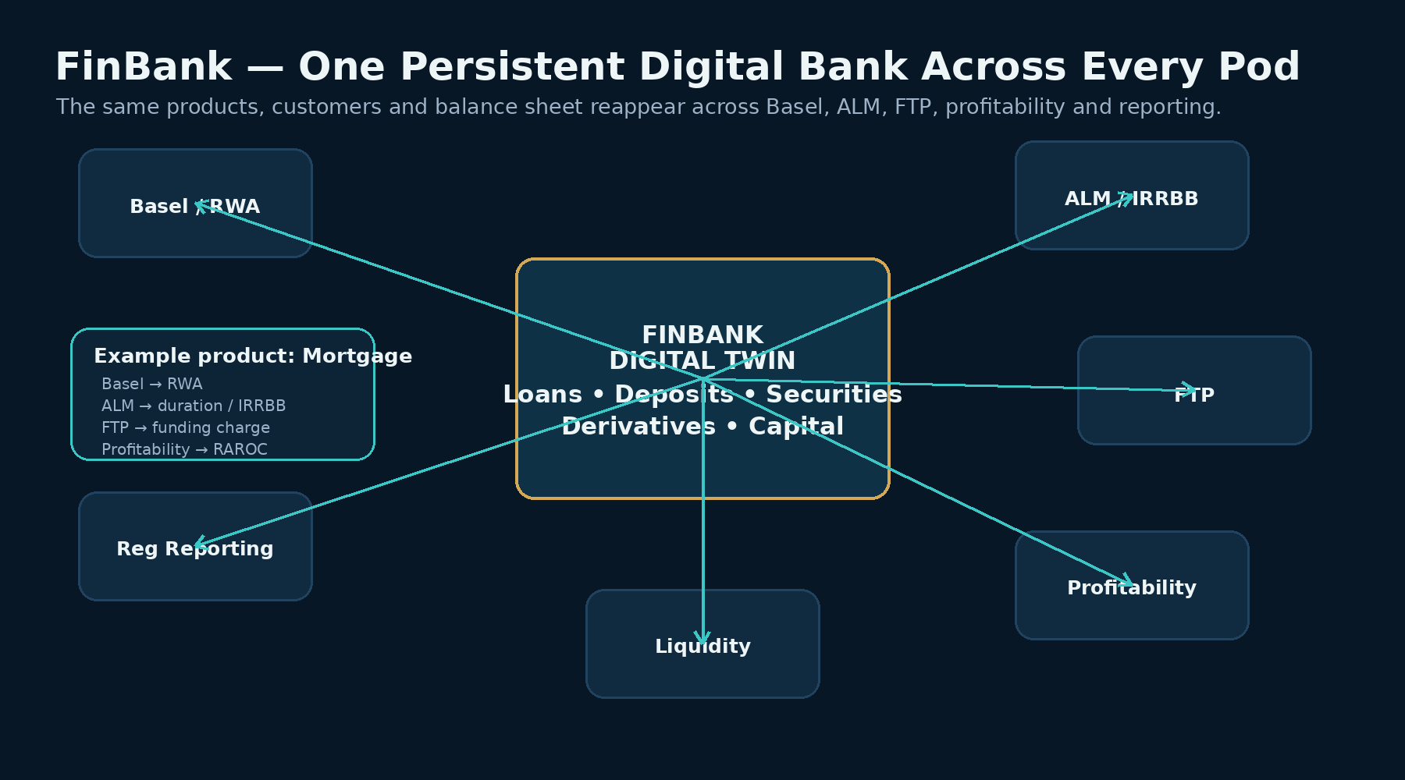
FinBank — the reusable Digital Bank
The same mortgage, corporate loan, deposit and derivative become learning assets across multiple Pods.

Slide 12
Launch multilingual: English + Arabic
Language is a presentation layer; the rule and calculation layer remains canonical and language-neutral.
ENGLISH
ARABIC
FOUNDER DIGITAL TUTOR
Global banking language
Primary master script
Founder voice prototype
Original BCBS / Fed source text
English subtitles and transcript
Modern Standard Arabic for formal teaching
Arabic + English financial terms mode
Support mixed Arabic-English questions
Native Arabic tutor voice option
Arabic subtitles and transcript
Clone your own voice for narration and interactive tutoring.
Test multilingual cloned Arabic vs a native Arabic professional voice.
Later add Hindi, French, Spanish and Portuguese based on demand — without rebuilding the calculations.
Sources: ElevenLabs voice cloning / Arabic TTS; HeyGen multilingual avatar/digital-twin workflows.

Slide 13
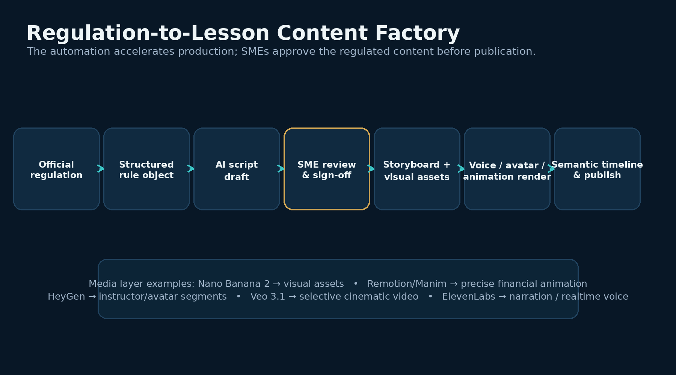
World-class lessons require a media factory
Use different generation tools for different jobs. Financial formulas and numbers must remain deterministic.
Current tooling examples: Google Nano Banana 2 (image); Google DeepMind Veo 3.1 (video); HeyGen (avatar); ElevenLabs (voice).

Slide 14
Knowledge architecture
Relationships live in the graph; rules determine applicability; finance engines calculate; the tutor teaches.
REGULATORY
GRAPH
LEARNING
GRAPH
RULE
ENGINE
FINANCE
ENGINE
AI
TUTOR
Rule • concept • source
jurisdiction • version
Prerequisite • lesson
exercise • misconception
Which rule applies
for this version?
EAD • RW • RWA
capital • later ALM/FTP
Explain • question
compare • coach
Architectural rule: the LLM does not invent capital numbers. It calls deterministic tools and returns explanations with authoritative citations.
BCBS is the canonical baseline; U.S., SAMA and CBUAE are versioned jurisdiction overlays.

Slide 15
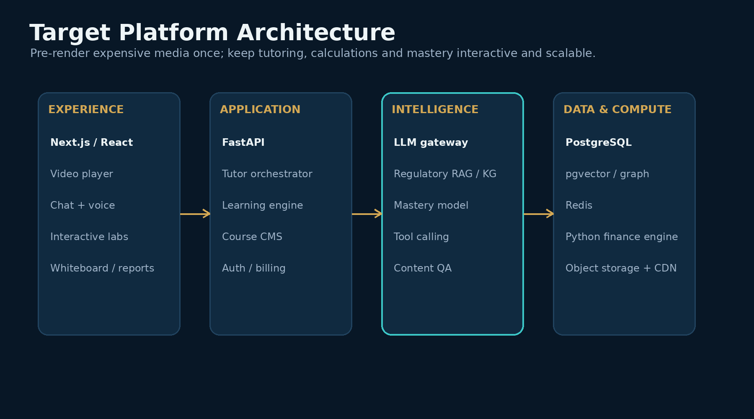
Technology stack
Keep the first version simple: Python remains the finance/control layer; scale media via object storage + CDN.

Slide 16
Infrastructure does not need to be huge at launch
Separate pre-rendered content from realtime experiences so costs scale with user value.
PRE-RENDER ONCE
REALTIME
CONTROL UNIT ECONOMICS
Lesson video
Diagrams
Captions
Localized video/audio
Thumbnails
Cinematic sequences
Store in object storage and deliver through CDN/HLS.
Chat tutor
Voice conversation
Whiteboard
Calculations
Assessments
Mastery updates
Optional live avatar
Text: generous
Voice: fair-use / premium quota
Live avatar: premium
Generative video: offline production
Python / Polars / Postgres are enough for learning portfolios. Spark only later for large enterprise simulations.

Slide 17
Yes — partner with bankers, but structure the relationship
You need practitioners for accuracy, realism and distribution — not necessarily as co-founders.
REGULATORY CONTENT COUNCIL
INDUSTRY LEARNING COUNCIL
BETA PRACTITIONER PANEL
U.S./BCBS capital SME
Saudi/SAMA SME
UAE/CBUAE SME
Validation / reporting practitioner
Validate interpretations, examples and calculations.
Capital manager / analyst
Regulatory consultant
Treasury practitioner later
Bank L&D buyer
Make the experience feel like actual bank work.
10–20 practitioners
U.S. / Saudi / UAE target audience
Test the Golden Lesson, expose confusion, challenge accuracy and validate willingness to pay.
Source of truth remains the official regulation — practitioner experience adds interpretation and workflow realism, not replacement rules.

Slide 18
Monetization: B2C first, enterprise becomes the larger prize
Pricing below is a test hypothesis — validate willingness to pay before locking tiers.
Free Foundations
$0
Acquisition
Individual
$29–49/mo
Core content + chat
Professional
$59–79/mo
Voice + labs + jurisdictions
Professional+
$99/mo
Heavy voice/viva + career
Annual
$499–799
Cross-Pod access
Bank pilot
$10K–25K
Cohort validation
Bank academy
$25K–100K+
Enterprise learning
Future enterprise dashboard: proficiency by team, assigned Pods, weak concepts, completion, voice-viva readiness and jurisdiction specialization.
Market anchors: Vizz AI pricing; CFI membership pricing; Fitch Basel training. Financial Pods prices are internal hypotheses only.

Slide 19
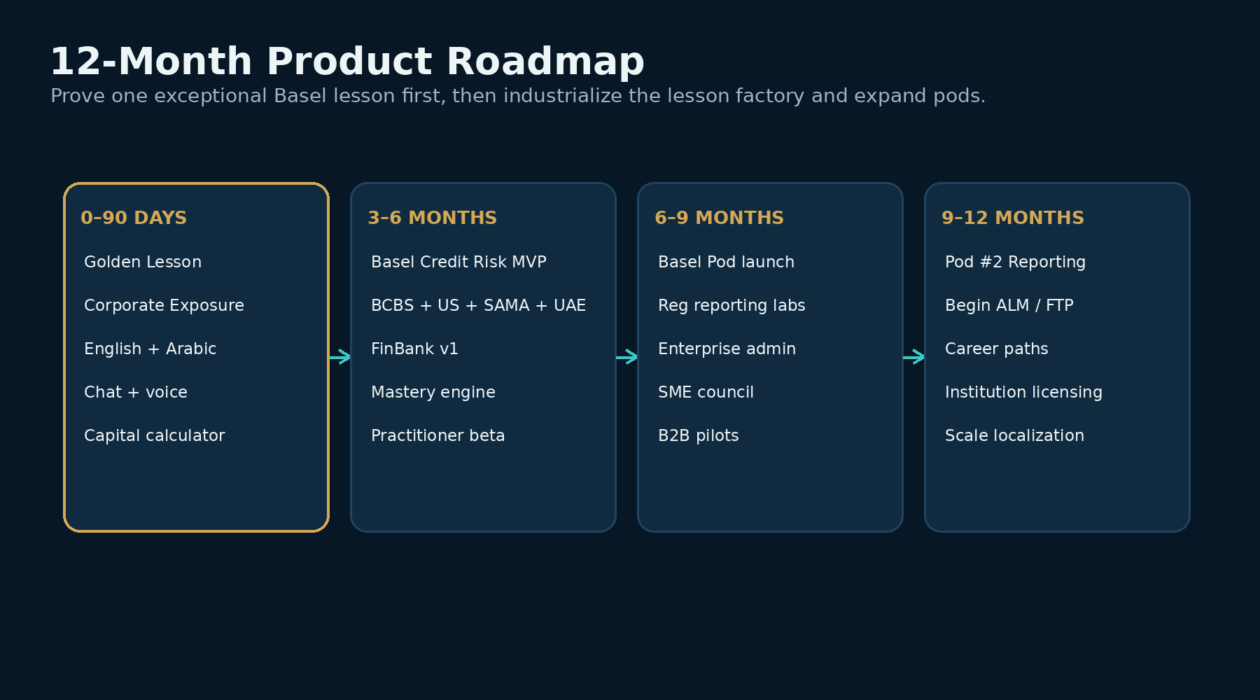
12-month roadmap
Prove one exceptional Basel lesson first. Then industrialize the content factory and expand.

Slide 20
Next 90 days
The immediate goal is commercial proof of one Golden Lesson — not a full Basel library.
DAYS 0–30
DAYS 31–60
DAYS 61–90
Freeze Golden Lesson
Rule/content schema
BCBS + U.S. + SAMA + UAE mapping
Alpha Manufacturing data
Capital calculation APIs
English script + Arabic glossary
Recruit 3 core SMEs
Next.js lesson player
Semantic timeline
Grounded chat tutor
Interactive calculator
Premium visuals
English + Arabic media
Voice clone experiment
Active Mode + basic mastery
Realtime voice interruption
Voice viva
Generated practice cases
Analytics + cost telemetry
10–20 practitioner betas
Pre/post learning test
Willingness-to-pay test
Go / Refine / Stop gate

Slide 21
Decision gates before scaling
We should earn the right to build the full Basel Pod.
Accuracy
Learning
No unresolved material regulatory or calculation errors.
Users can explain and calculate the target concept better after the lesson.
Engagement
Willingness to pay
Learners use pause/ask, labs or voice — not only video.
Individuals would pay or practitioners would recommend a bank/team pilot.
Scalability
Transferability
Lesson 002 can be produced materially faster using the same factory.
The architecture can support Reporting or ALM without a rewrite.
Immediate implementation focus: lesson-content schema + deterministic calculator API + semantic timeline + grounded tutor.

Slide 22
Research sources — regulation & learning market
Selected current sources used to ground the strategy.
BIS Basel Framework — https://www.bis.org/basel_framework/chapter/CRE/20.htm
Federal Reserve March 19, 2026 capital proposals — https://www.federalreserve.gov/newsevents/pressreleases/bcreg20260319a.htm
SAMA Minimum Capital Requirements for Credit Risk — https://rulebook.sama.gov.sa/en/minimum-capital-requirements-credit-risk
CBUAE Capital Adequacy Standards — https://rulebook.centralbank.ae/en/rulebook/standards-capital-adequacy-banks-uae
Vizz AI pricing/features — https://vizz.vizuara.ai/pricing
CFI AI Tutor — https://corporatefinanceinstitute.com/news/ai-tutor/
CFI membership pricing — https://corporatefinanceinstitute.com/pricing/
Fitch Basel III training — https://fitchlearning.com/course/risk-and-regulatory/bank-capital-adequacy-under-basel-iii/
Scientific Reports AI tutor study — https://www.nature.com/articles/s41598-025-97652-6
ACAMS CAMS Certification — https://www.acams.org/en/certifications/cams-certification
Re-verify product features and pricing before commercial commitments; these can change.

Slide 23
Build one lesson that proves the company.
Media / voice source references:
ElevenLabs voice cloning — https://elevenlabs.io/voice-cloning
HeyGen LiveAvatar — https://www.heygen.com/blog/how-to-activate-your-audience-with-personalization-and-interactivity
Google Nano Banana 2 — https://blog.google/innovation-and-ai/technology/ai/nano-banana-2/
Google DeepMind Veo 3.1 — https://deepmind.google/models/veo/
Golden Lesson 001: Corporate Exposure → English + Arabic → official sources → deterministic RWA calculation → pause & ask → realtime voice → jurisdiction comparison → practice → voice viva → mastery.
Then scale the factory — not before.
FINANCIAL PODS

