Slide 1
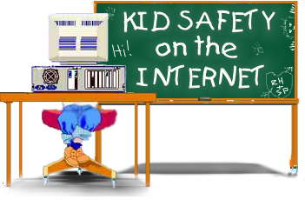

Slide 2
INTERNET SAFETY
What is the Internet
&
Why is it important to be safe?
Notes:
Why does internet safety matter? Children today can go online from so many different sources, including video games, smart phones, ipads, etc.. You are living your lives more than ever online, This new playground needs to be a safe place! Your teachers and your parents are responsible for teaching you how to be safe online just like we have taught you to eat, walk, read, write, recognize the dangers in the real world.

Slide 3
What are some of the names for THE INTERNET
CYBERSPACE
THE WEB
THE NET
THE INFORMATION HIGHWAY
THE WORLD WIDE WEB
W3
Notes:
The internet is a great big “spiderweb” collection of cables and computers that anyone can connect to with a device that can be connected. Like a computer, a smart phone, an ipad, GPS systems, your music player…an even some dog collars. It’s a great big mishmash of cables, mainframes, servers, and satellites with no standards or rules. Millions of people use it every day and nobody “governs” or is in control of it. Personal computers, business computers, government computers, school computers are all driving down these “highways”. Suppose the roads we drive on had no rules either. Some people would be driving 100mpr on any side of the road, not stopping at crossroads, even driving on other people’s property.!

Slide 4

How Do You Receive/Send Information?
By using a Browser (shortened form for Web Browser)
It is a program installed on your computer that understands special “internet language”
There are MANY Browsers. We use Safari and Firefox.
Notes:
Firefox and Safari are two of the four most popular Browsers. We use Safari and Firefox here in the lab. Safari is very popular with users of Apple computers.

Slide 5
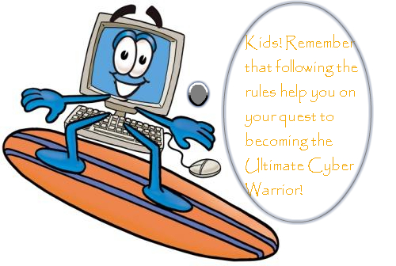
Looking for Something?
Looking up information on the internet is called browsing because you use a browser.
Some people call it “surfing”
If you know the address, you can just type it in.
Notes:
Kind of like when you go shopping with Mom and she doesn’t have an idea of what she wants to buy, she is just “looking around” or browsing. That is why a web browser is also called a “Search Engine.”
Before there was the internet, people would “channel surf” on th TV going from channel to channel. It is sort of normal that a librarian used the phrase in 1992 as a title for an article she was writing.

Slide 6
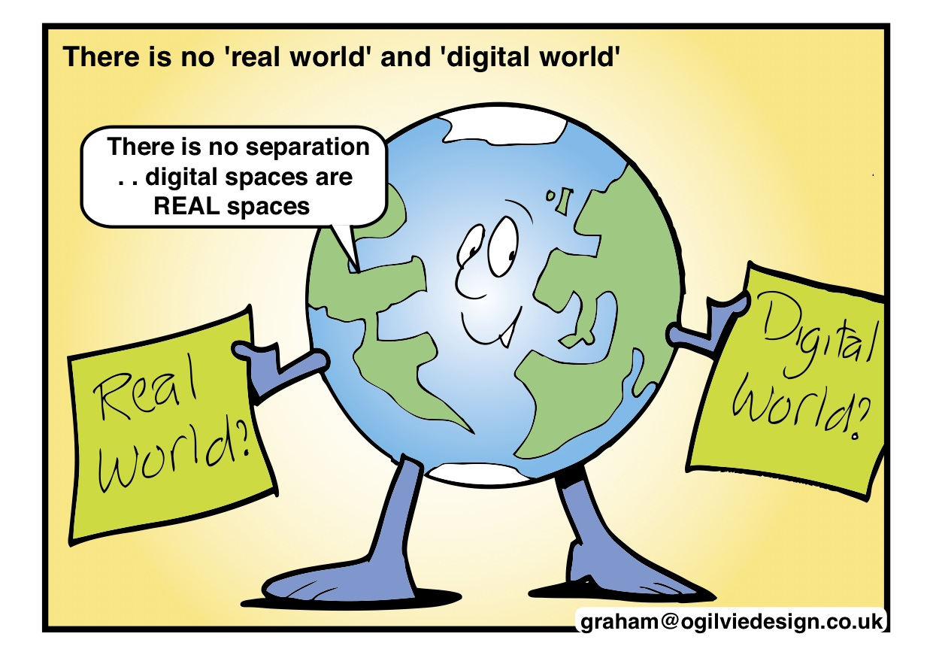
Notes:
You need to give the same consideration to safety rules whether you are in the real world or the digital world.

Slide 7
Rules for the Real World vs. the Net
Stranger Danger
Say you’re sorry when you hurt someone
Go to bed on time
Share your toys and take turns playing a game.
Brush your teeth
Don’t answer the door when Mom’s in the shower
Never meet someone in person you’ve met in the cyber world.
Limit time on the computer. Have a social life.
Never give out personal information
Don’t respond to messages that are threatening or obscene.
Notes:
Never Meet with a Stranger in the real World. Never agree to meet with a stranger you met in the cyperworld
Mom and Dad set down“rules” for a purpose: To promote safety, To promote social skills, To promote morality. To develop Good Habits.
Rules that will prepare you for the real world when you are adults. There are rules for the cyberworld for the same reasons.

Slide 8
MORE BASIC RULES TO KEEP SAFE
Never share your name, age, phone number, address, or even your school
Never send any pictures to a stranger
Keep passwords private - Don’t share even with your school buddies.
Never open an email from someone you don’t recognize. It may contain a virus that will totally shut down your computer OR let someone use your computer without your knowing it.
Visit age appropriate sites.
Tell an adult you trust if you see something that makes you feel uncomfortable.

Slide 9
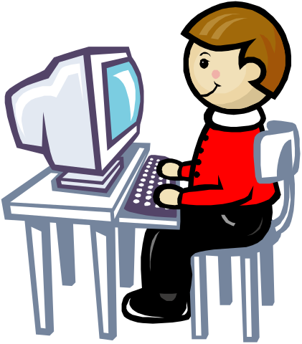
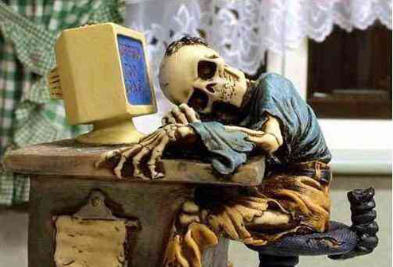
ARE YOU REALLY YOU?
Some of your online “friends may not be who they say they are.
Someone who tells you “she” is a teenager could be a 40-year old man posing as a teenager.
Gee, you sound really cute and we have the same birthday! We must be destined to meet!
Well, I don’t mind admitting I was homecoming queen and maybe we could celebrate our birthdays together.
Notes:
Never share personal information!
I have seen some of you on games after school where you can chat with strangers AND have even used your real names. That is so dangerous!

Slide 10
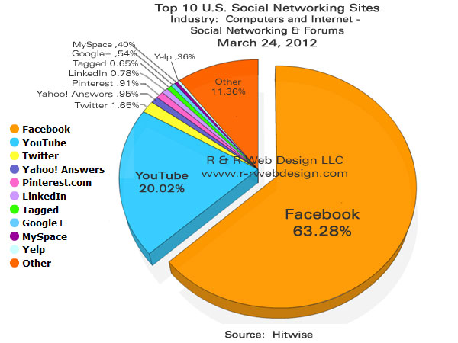

Have You Given Out This Kind of Information?
http://www.troopers.ny.gov/Schools_and_Communities/Internet_Safety/Internet_Story/
Notes:
Sometimes you may be giving out personal information without even realizing it. This girl did!

Slide 11

THINK BEFORE YOU POST
To post or not to post, that is the question. Think before you post. DO NOT post something that you would not want your grandmother to read. Everything that an individual posts no matter how old or young you are stays online.
The places you visit and things you say, leave a trail on the internet that never goes away.
All of this digital communication is called your “digital footprint”.
Notes:
To post or not to post, that is the question. Do NOT post something that you would not want your grandmother to read. EVERY individual NO MATTER THEIR AGE, should THINK before sharing information. Everything that an individual does online stays online. The places you visit and things you say, leave a trail on the internet that never goes away.

Slide 12
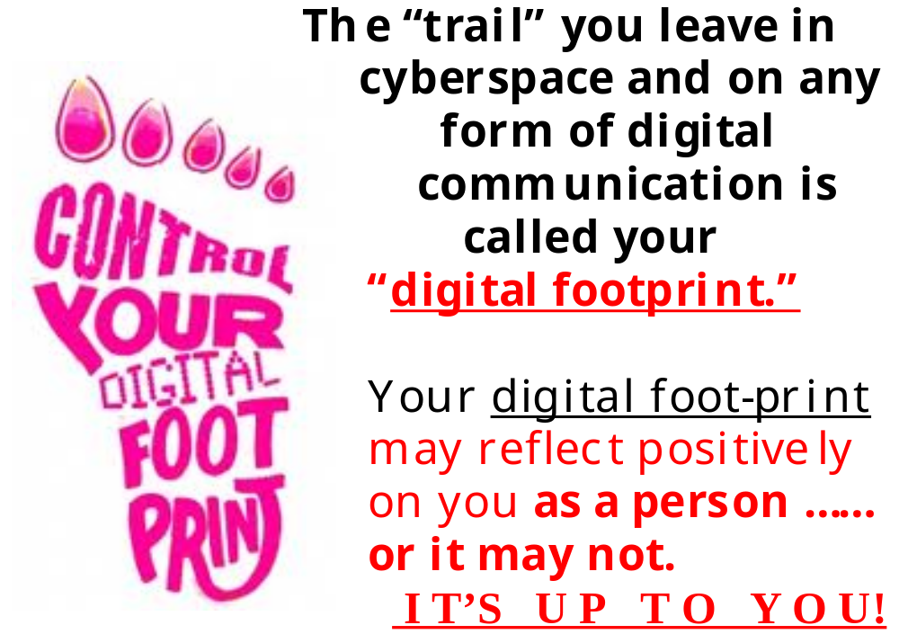

Slide 13


The words we say, the pictures we post, the places we visit make up our digital “reputations.” They cannot be washed away like footprints in the sand.

Slide 14

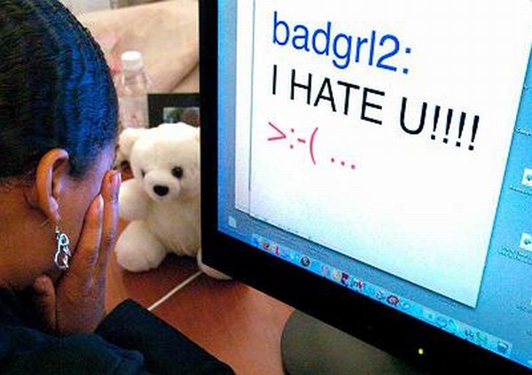
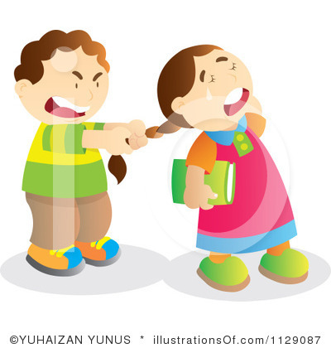
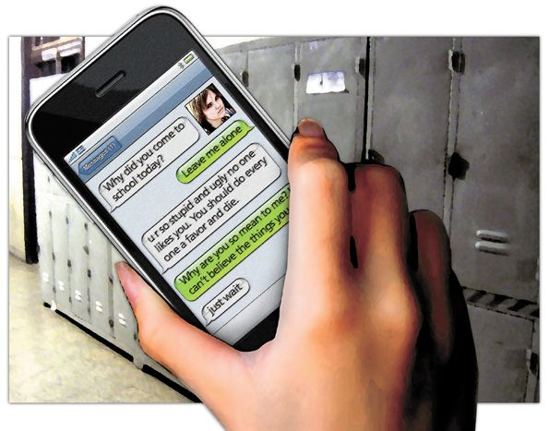
Don’t be a Cyber Bully
Just like there are bullies in the real world, there are bullies in the cyber world. The words you say online can hurt just as bad as being physically hurt.
In the Real world vs the Cyber world a Bully uses Intimidation as their favorite tool.
Notes:
To intimidate: name-calling, profanity, rumors, threats, and abusive criticism
To frighten someone especially in order to make them do what one wants
Cyber Bullying is bullying through email, instant messaging, chat rooms, web and gaming sites, through digital messages or images sent on a cell phone

Slide 15
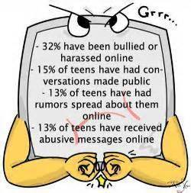
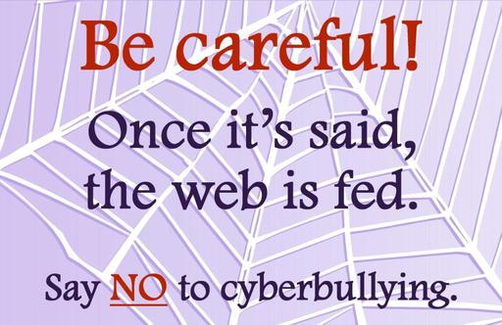
YOU ARE NOT ALONE!

Slide 16
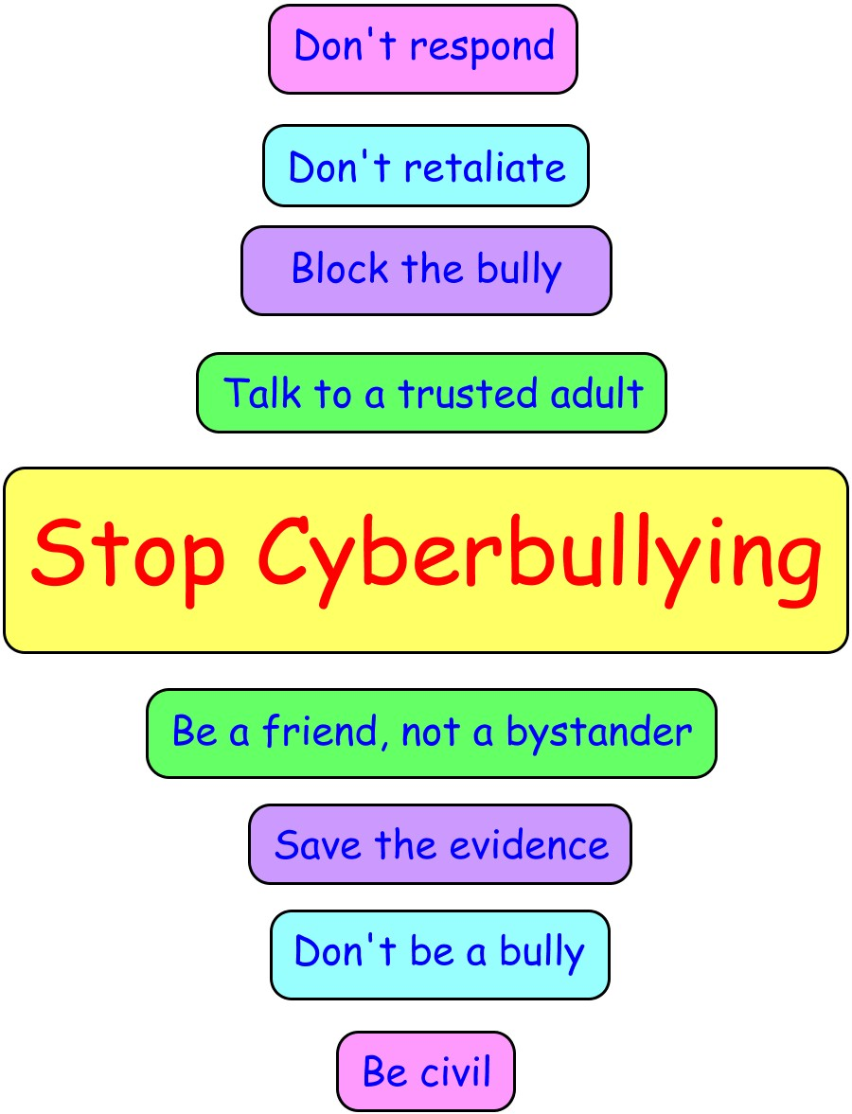
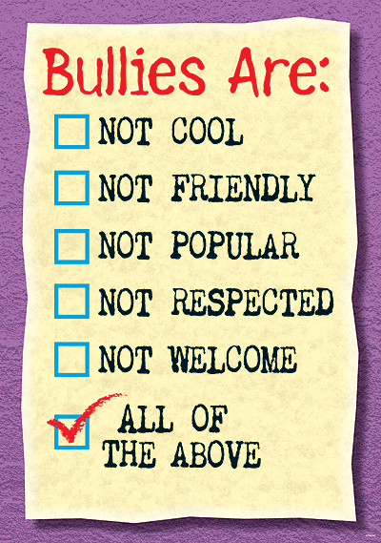
How Do You Stop a Cyber Bully?

Slide 17
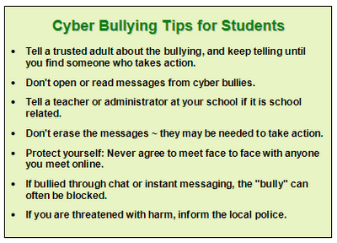
MORE TIPS

Slide 18

THE INTERNET CAN OPEN ALL KINDS OF NEW WORLDS,
BUT REMEMBER TO BE A “WEB WISE KID” AND BE SAFE!

