Slide 1
First Aid Info

Slide 2
Providing First Aid info during Natural Calamities
There will be many people who needs first aid for following cases: 1. Injury which is causing bleeding. Can we stop bleeding, avoid infection by applying some medicines. (can be minor one because this can be handled most of the times by lay man) 2. Person in shock is screaming/went mute, needs to calm down. He/She needs quick Psychological analysis. 3. Person who has abnormal heart beats needs quick first aid. 4. First aid in case epidemic disease break. For e.g. guide to have high amount of water/fluids, fruits, glucose, etc.
Based on epidemic disease identification, NGOs can plan for collecting relevant medicines.
5. In case we have knowledge guide what are the best medicine to these diseases. (Building knowledge may be one time activity.)
Legal issue: We need authentication from right authority to specify/distribute medicine for a particular treatment?

Slide 3
Technology Stack
Watson Discovery: Ingest Documents which has info preparedness.
Apache Nutch Crawler : Use Crawler to get insights from website to get Do’s and Don’ts during Natural Calamities.
HTML: Embed first aid info clips in html pages

Slide 4
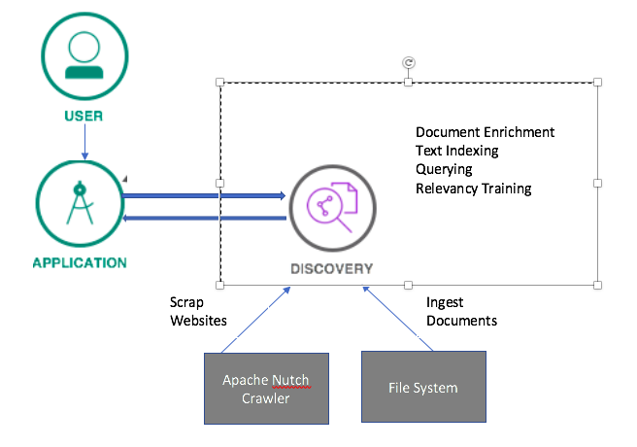
Technical Architecture

Slide 5
