Slide 1

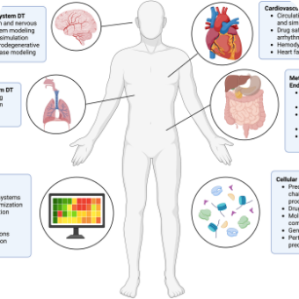
DIGITAL TWIN CHALLENGE 2026
Synthetic Research Prototype
Cardio Twin
Personalized Cardiovascular Digital Twin for Proactive Healthcare
“Understand the present. Anticipate the next. Explore what could change.”
FORECAST HORIZON
STATE RESOLUTION
VALIDATION MODE
60 Minutes Pre-Onset
5-Minute Discrete Replay
Held-Out Patient Partition
Synthetic data demonstration only. Not approved or validated for clinical diagnostics or therapy management.

Slide 2
PROBLEM FORMULATION
From Static Snapshots to Evolving State
CURRENT LIMITATION
THE CARDIO TWIN APPROACH
Generic Population Thresholds
Personalized Multimodal Fusion
Rigid cutoff criteria overlook individual baseline offsets, daily circadian rhythms, prior chronic histories, and recent trajectory shifts.
Dynamic continuous wearables linked with longitudinal EHR history, personalized baseline references, and calibrated warning horizons.
CORE SCIENTIFIC HYPOTHESIS
“Does combining static EHR, dynamic wearable features, and personal-baseline features improve a simulator-defined deterioration forecast on held-out synthetic patients?”
Cardio Twin • Clinical Background
02 / 13

Slide 3
SYSTEM TOPOLOGY
More Than a Classifier: The Digital Twin
1. Profile
2. Replay Clock
3. Current State
4. Forecast
5. Scenario
Longitudinal EHR, demographics, comorbidities.
Discrete 5-min steps. Prevents data leakage.
Rolling telemetry, baselines, and quality metrics.
Calibrated 60-min risk + SHAP explanation.
Isolated sandbox copy for counterfactual queries.
The deterministic replay engine strictly seals future timesteps: future events never leak to the current observation frame.
Cardio Twin • Stateful Core
03 / 13

Slide 4
TELEMETRY GENERATOR
Reproducible Synthetic Data Engine
60
34,560
90
48 hrs
SYNTHETIC PATIENTS
5-MIN OBSERVATIONS
RULE-DERIVED EVENTS
SIMULATED / PATIENT
Generated Signal Modalities:
Explicit Simulation Assumption
• Continuous Heart Rate (HR)
• Heart Rate Variability (HRV)
5-minute BP is an explicit modeling setup to stress-test multimodal telemetry fusion algorithms, not a clinical capability claim for consumer watches.
• Systolic / Diastolic BP
• Step cadence & activity sleep
• Sensor quality & missingness
• Circadian rhythm drift
Cardio Twin • Cohort Synthesis
04 / 13

Slide 5
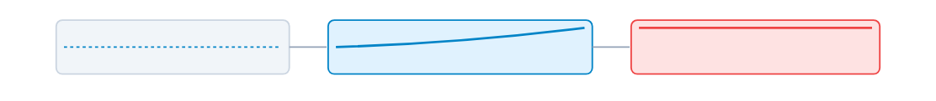
TARGET FORMULATION
A Narrow Simulator-Defined Event
First 12h: Median Reference Baseline
60 Min Prior to Onset (Target = 1)
Deterioration: ≥ 20 Min Sustained Run
EVENT THRESHOLD CRITERIA
LEAKAGE SAFEGUARD
• HR: ≥ Personal Baseline + 22 bpm
• Systolic BP: ≥ Personal Baseline + 17 mmHg
Event logs and simulator state flags are excluded from input feature layers. The target is an experimental rule, not a clinical endpoint.
Cardio Twin • Event Definition
05 / 13

Slide 6
SYSTEM ARCHITECTURE
Integrated End-to-End Pipeline
Synthetic EHR + Telemetry
Leakage-Safe Features
Calibrated GBDT
FastAPI + Replay
React Dashboard
Event generator module
Rolling statistics & baselines
Platt scaling on validation
SQLite audit log store
Recharts & SHAP view
SHAP TreeExplainer Runtime Integration
Active Inspection
Extracts exact additive feature contributions on the calibrated model for each discrete forecast without degrading inference latency.
Cardio Twin • End-to-End Architecture
06 / 13

Slide 7
MODEL GOVERNANCE
Leakage-Safe ML Pipeline
1
Patient-Level Split
2
Strict Causal Features
70 / 15 / 15 partition grouped strictly by patient ID.
Constructed only from current and historical timesteps.
3
GBDT Ablations
4
Validation Calibration
Systematic evaluation against standard logistic baselines.
Platt scaling and alert threshold chosen on validation F1.
Guardrails: Zero backward-filling, zero event-log features, and zero test-patient tuning during calibration.
Cardio Twin • Training Rigor
07 / 13

Slide 8
ABLATION RESULTS
Personalization Adds the Clearest Signal
Configuration | F1 Score | ROC-AUC | PR-AUC | Assessment
EHR Only | 0.000 | 0.521 | 0.036 | Near chance level
Wearable Only | 0.232 | 0.802 | 0.153 | Dynamic sensitivity
EHR + Wearable Fusion | 0.198 | 0.799 | 0.153 | Marginal interaction
Fusion + Personal Baseline | 0.362 | 0.833 | 0.339 | +121% PR-AUC gain
The core hypothesis is validated in synthetic configuration: baseline deviations drive the strongest early deterioration signal.
Cardio Twin • Model Ablations
08 / 13

Slide 9
TEST PERFORMANCE
Genuine Held-Out Synthetic Metrics
0.833
0.339
0.587
0.262
0.026
ROC-AUC
PR-AUC
PRECISION
RECALL
BRIER SCORE
Event Replay Dynamics (14 Events)
Noise & Missingness Robustness
100%
26.1 min
1.72
• ROC-AUC remains 0.822 under additive sensor noise.
• ROC-AUC remains 0.833 under simulated 15% packet dropout.
Detection Rate
Mean Lead Time
False Alerts / Day
Cardio Twin • Benchmark Evaluation
09 / 13

Slide 10

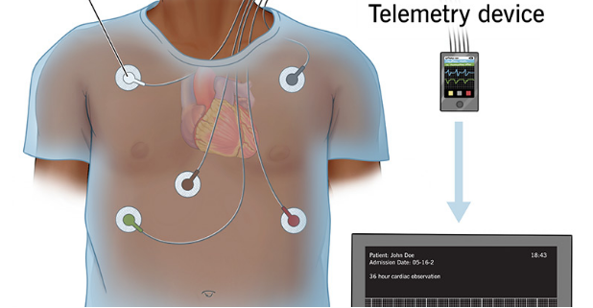
INTERACTIVE INTERFACE
Dashboard: Real-Time API State
Active Research Console
Live updates directly over asynchronous FastAPI backends with zero faked calls.
Live Telemetry Modules
Multi-channel vital trajectories, calibrated 60-min risk, and +5-min step controls.
SHAP Local Explanations
Real-time feature attributions identifying physiological drivers of risk shift.
Cardio Twin • Clinician Console
10 / 13

Slide 11
BRANCHING SCENARIOS
What-If Simulation Without Mutating State
STEP 1
STEP 2
STEP 3
STEP 4
STEP 5
STEP 6
Copy State
Declare Rule
Recompute
Inference
Compare
Audit Log
Deep-copy current twin
Hypothetical premise
Recalculate features
Same pipeline
Base vs. hypothesis
Preserve baseline
Included Scenario Presets
Causal Disclaimers
• Return toward Baseline: Immediate rest / restorative physiological drift.
• Increased Activity: Elevated exertion and sympathetic load.
The outcome represents a machine learning response sensitivity, not a causal treatment-effect estimate. It does not recommend medication or therapy adjustments.
Cardio Twin • Sandbox Execution
11 / 13

Slide 12
SAFETY & COMPLIANCE
Responsible-Use Boundaries
Synthetic Cohort Only
Simulator-Defined Target
Evaluated purely on synthetic patients and generative models. Zero live clinical trials.
Forecasts simulator mathematical rules, not real-world cardiac arrests or diagnoses.
Prototype Risk Categories
SHAP Explanations ≠ Causality
Presentation labels only. Must never be used as clinical triage instructions.
Statistical feature importance reflects model weights, not biological causal mechanisms.
Prospective validity, clinical safety, workflow impact, demographic fairness, and regulatory compliance remain untested.
Cardio Twin • Governance
12 / 13

Slide 13
CONCLUSION & ROADMAP
Challenge Complete
Scale Carefully. Validate Honestly.
CLOSED TECHNICAL DEMONSTRATION LOOP:
Synthetic Patient
Evolving State
Calibrated GBDT
60-Min Forecast
SHAP Attributions
What-If Sandbox
1.0M Observations
Stress-Testing
Clinical Review
Scale to 500 patients × 7 days across multiple random seeds.
Probe edge cases with missingness, sensor dropouts, and baseline drift.
Formal bioethics and clinician oversight before real-world trials.
Cardio Twin • Digital Twin Challenge 2026
Synthetic Research Prototype • Not Clinically Validated

