Slide 1

Presented by
Ragul.M

Slide 2
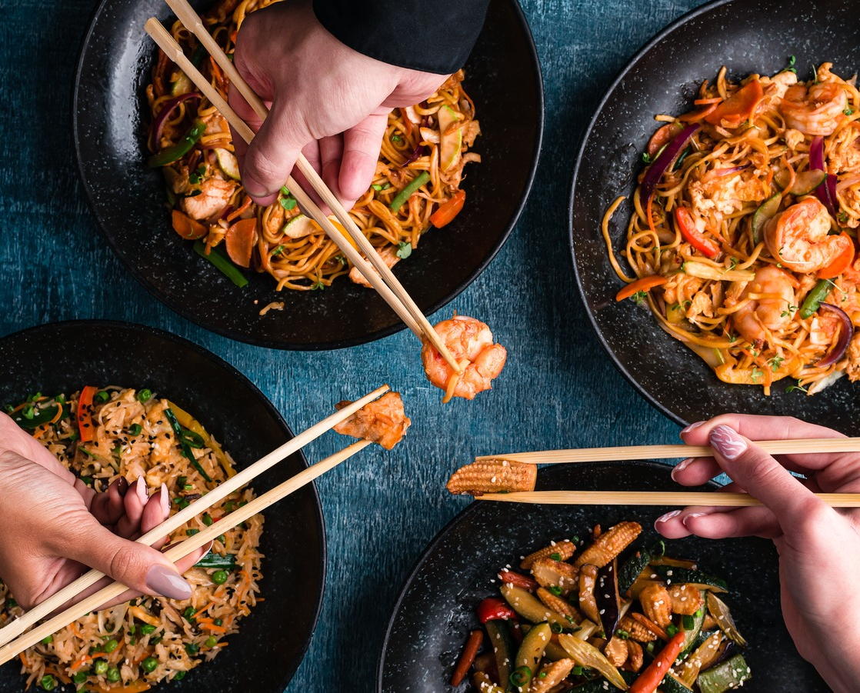
Tablesused
Sales
Menu
members

Slide 3
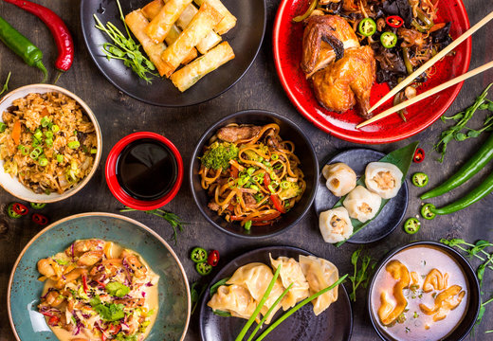
INTRODUCTION
Here challenge is to craft SQL queries to extract insights from the 92.7 BIG FM radio network database. We have multiple table in the dataset from this we have to find the solution for our quries.
Challenge link – Digits n Data
Linkedin - Ragul

Slide 4
Questions
What is the total amount each customer spent at the restaurant?
How many days has each customer visited the restaurant?
What was the first item from the menu purchased by each customer?
What is the most purchased item on the menu and how many times was it purchased by all customers?
Which item was the most popular for each customer?
Which item was purchased first by the customer after they became a member?
Which item was purchased just before the customer became a member?
What is the total items and amount spent for each member before they became a member?
If each $1 spent equates to 10 points and sushi has a 2x points multiplier - how many points would each customer have?
In the first week after a customer joins the program (including their join date) they earn 2x points on all items, not just sushi - how many points do customer A and B have at the end of January?

Slide 5

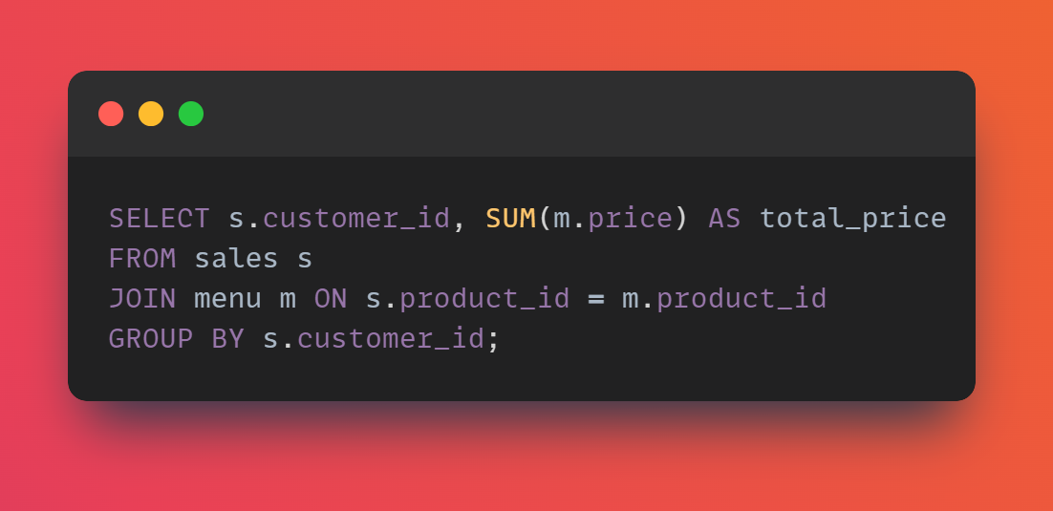

1) What is the total amount each customer spent at the restaurant?

Slide 6
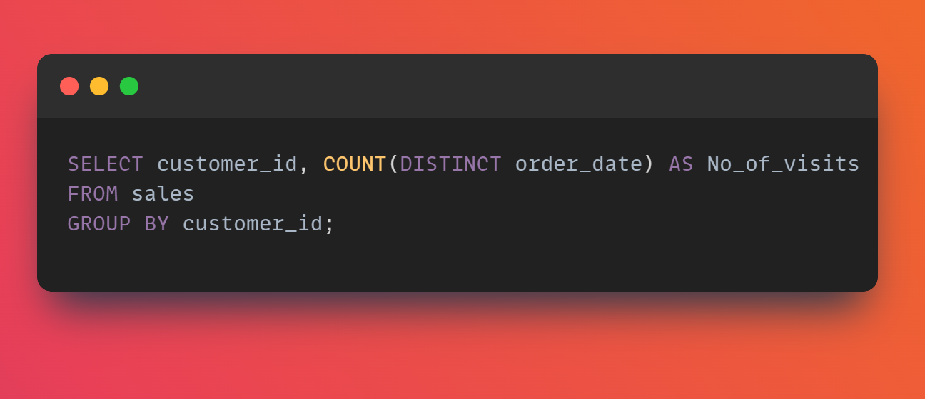

2) How many days has each customer visited the restaurant?

Slide 7
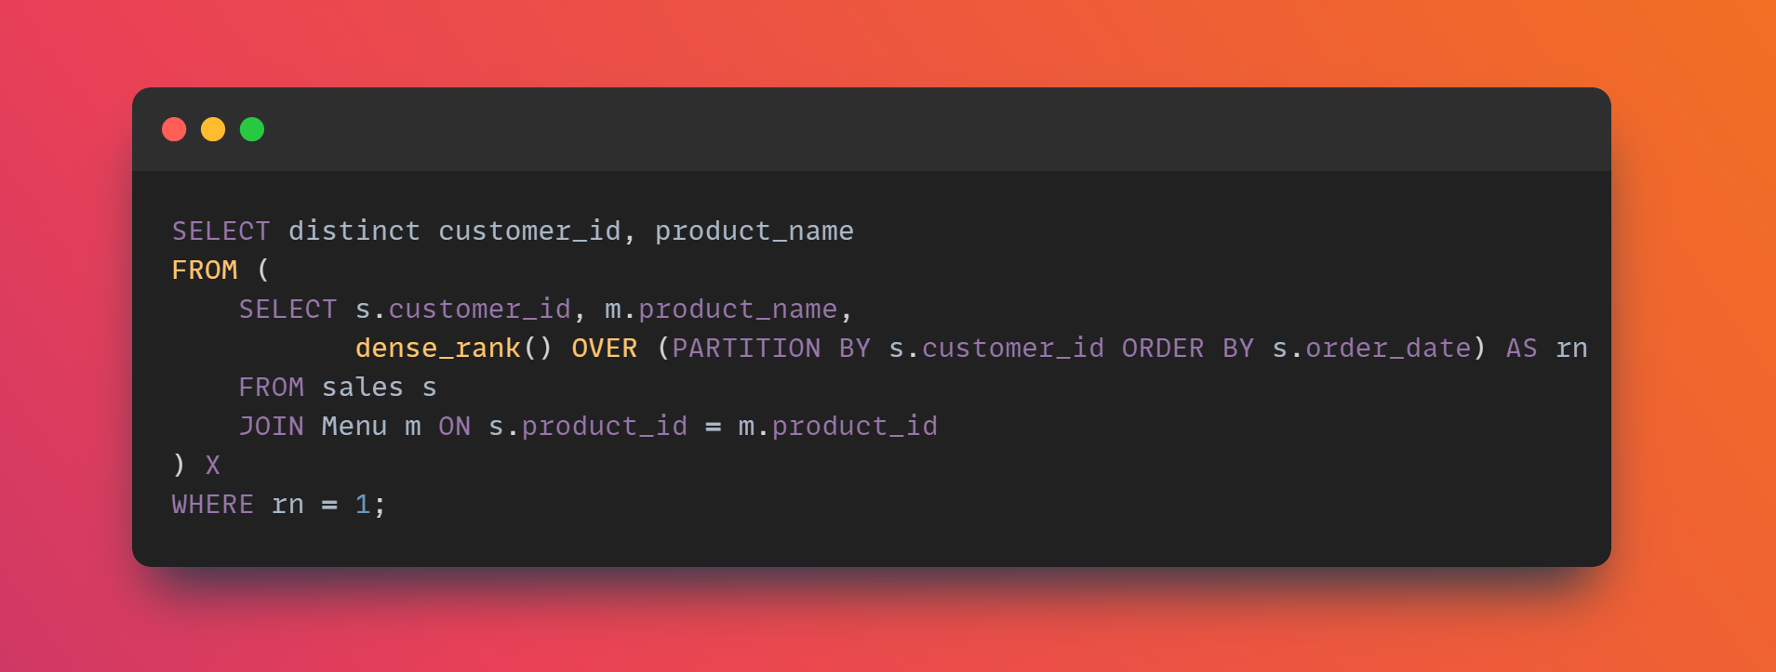

3) What was the first item from the menu purchased by each customer?

Slide 8
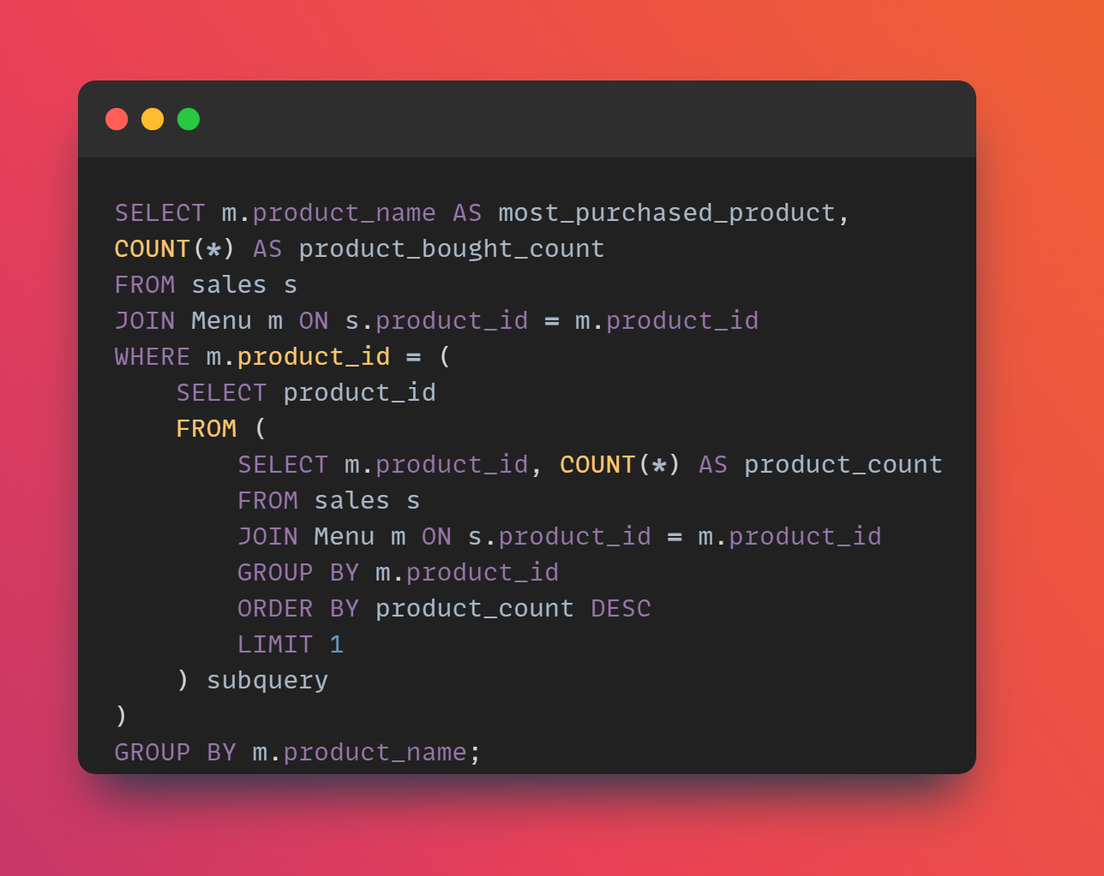

4) What is the most purchased item on the menu and how many times was purchased by all customers?

Slide 9
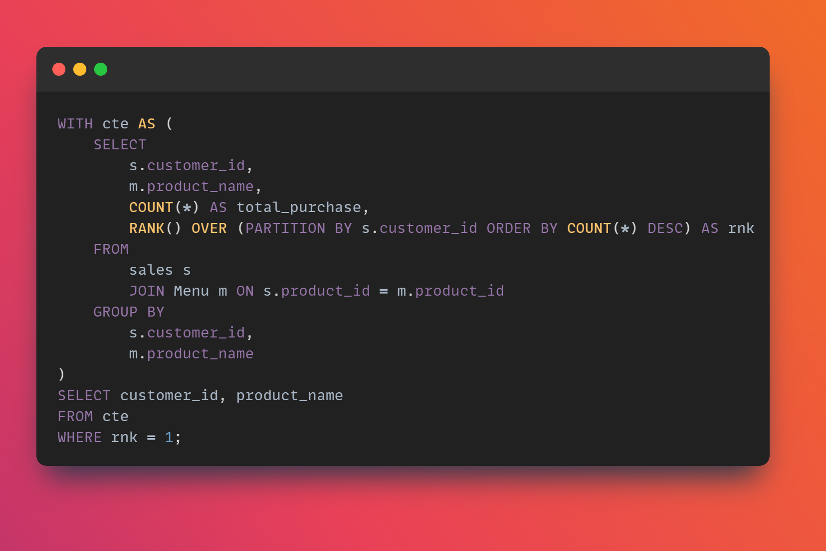
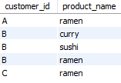
5) Which item was the most popular for each customer?

Slide 10
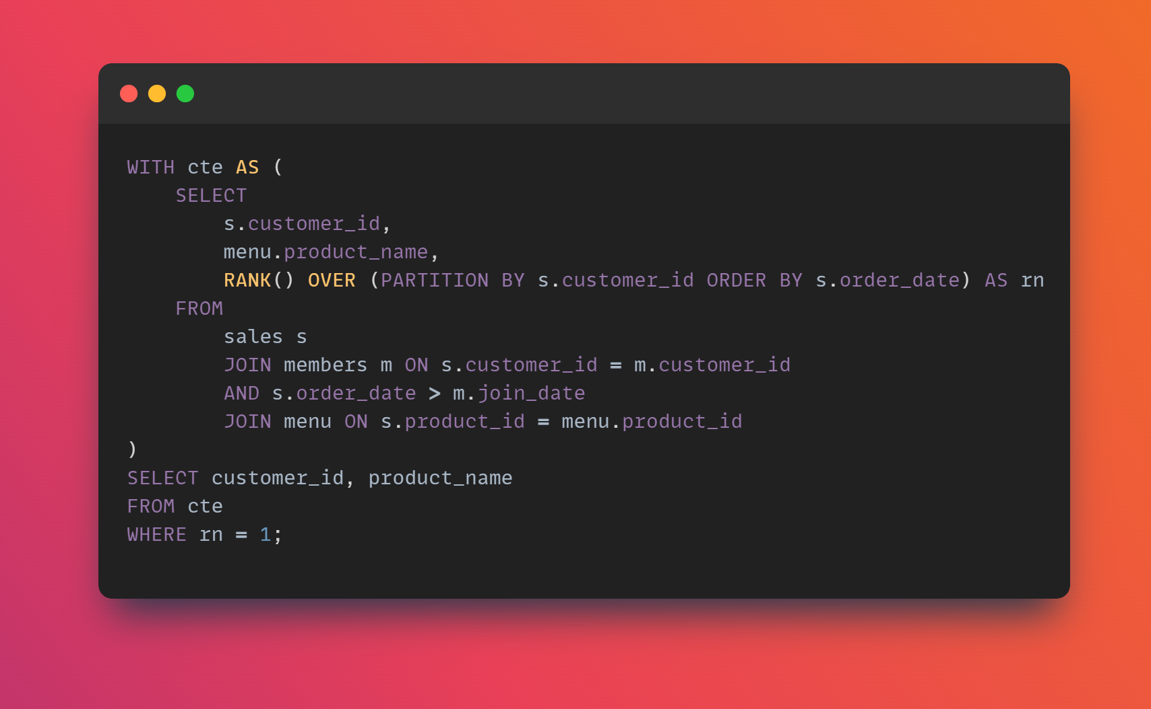

6) Which item was purchased first by the customer after they became a member?

Slide 11
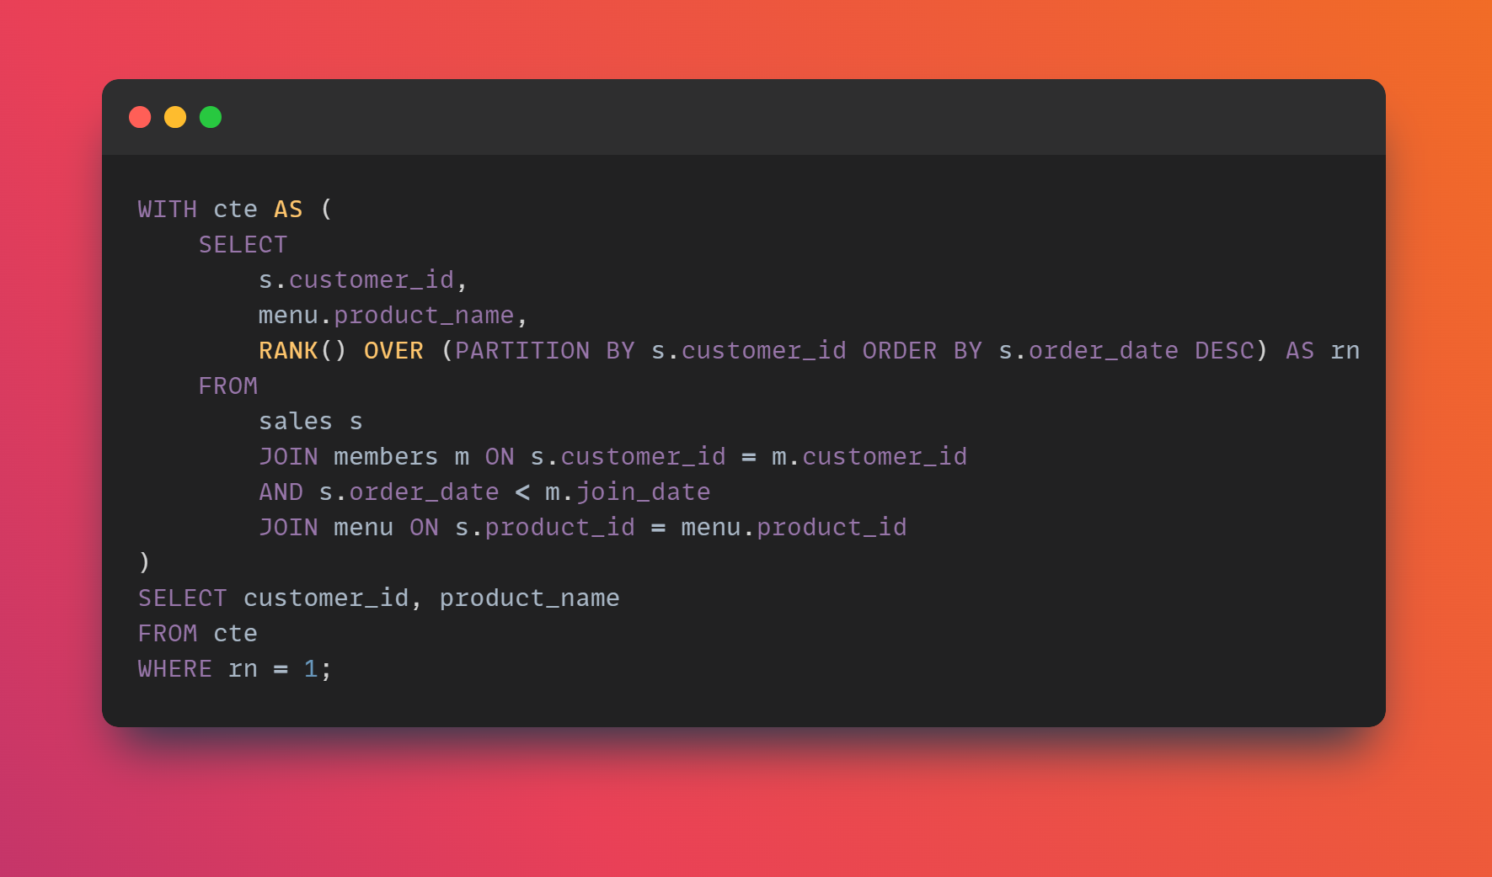

7) Which item was purchased just before the customer became a member?

Slide 12
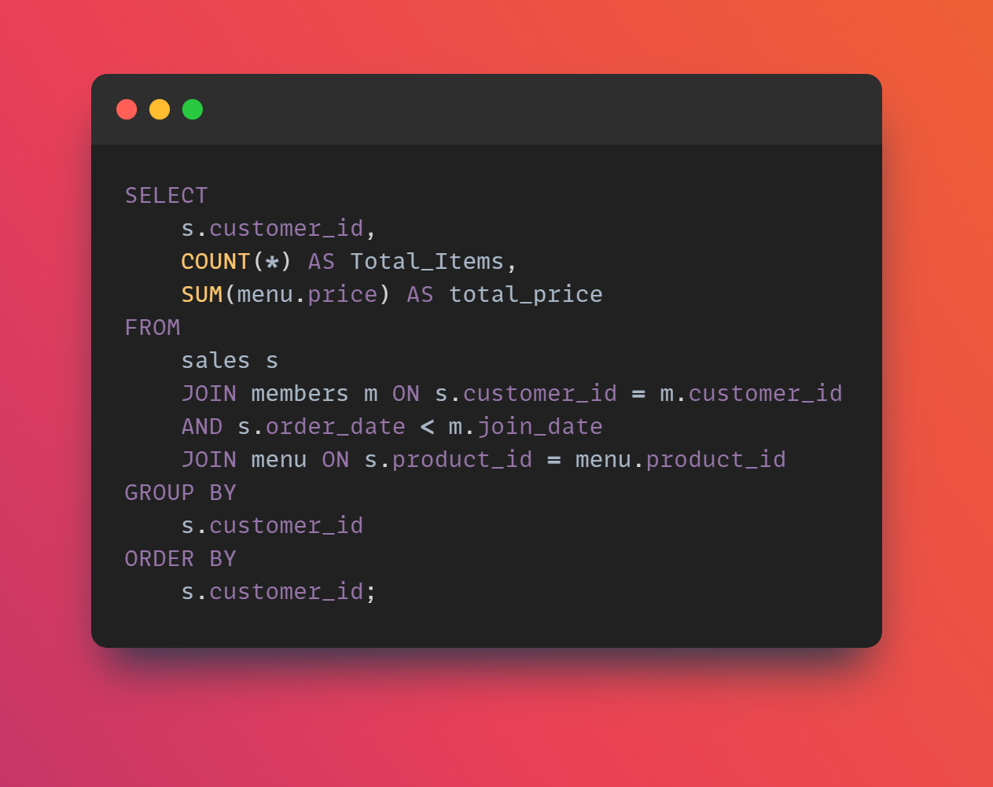

8) What is the total items and amount spent for each member before they became a member?

Slide 13
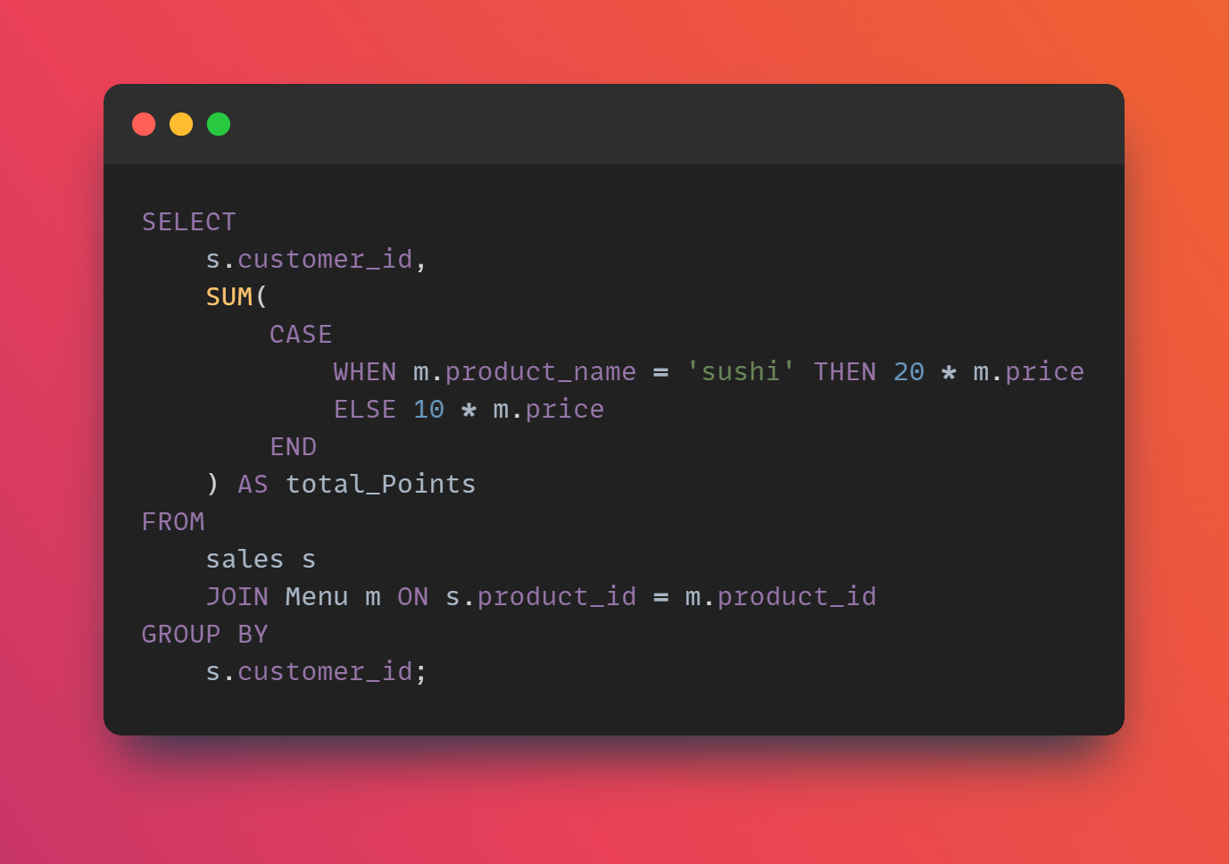

9) If each $1 spent equates to 10 points and sushi has a 2x points multiplier - how many points would each customer have?

Slide 14
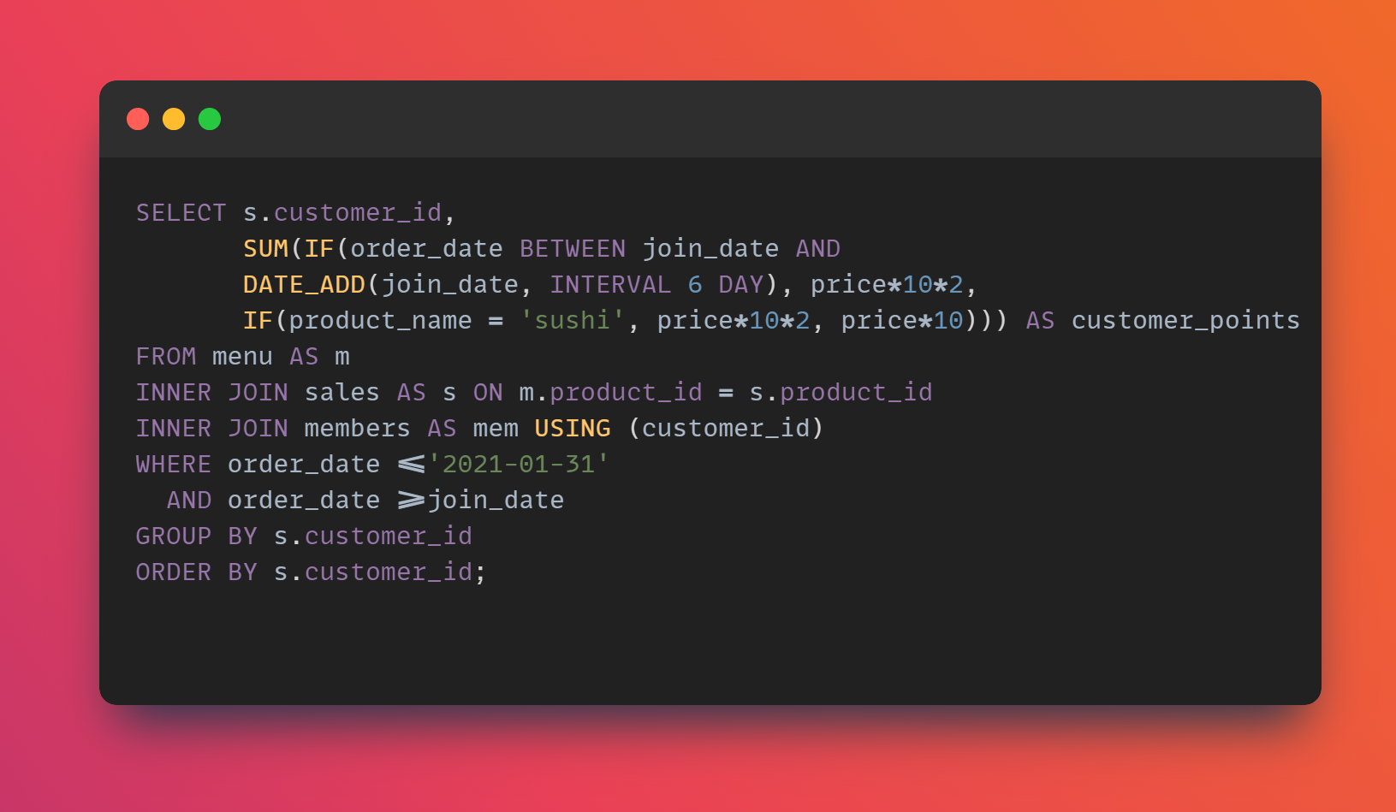

10) In the first week after a customer joins the program (including their join date) they earn 2x points on all items, not just sushi - how many points do customer A and B have at the end of January?

Slide 15
THANK YOU
Linkedin - Ragul

