Slide 1

92.7 Big FM's history
Presented by
Ragul.M

Slide 2

Tables used
Shows
Partnerships
ShowPartnerships
Awards
OnlinePresence

Slide 3

INTRODUCTION
Here challenge is to craft SQL queries to extract insights from the 92.7 BIG FM radio network database. We have multiple table in the dataset from this we have to find the solution for our quries.
Challenge link – Digits n Data
Linkedin - Ragul

Slide 4
Questions
1)Retrieve all stations in the "East" region?
2)List all shows hosted by "Vrajesh Hirjee"?
3)Count the number of awards each show has won?
4)Find shows that have partnerships with "Spotify"?
5)Retrieve hosts who joined before 2010?
6)List the shows and their launch dates in descending order of launch date?
7)Find the total count of shows for each host?
8)Show the online presence platforms with their links?
9)Retrieve the stations in the "South" region launched before 2010?
10)Rank hosts based on the number of shows they have hosted?

Slide 5

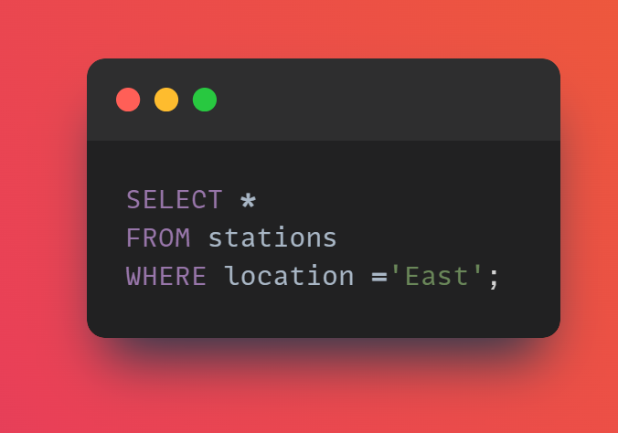
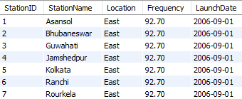
1)Retrieve all stations in the "East" region?

Slide 6
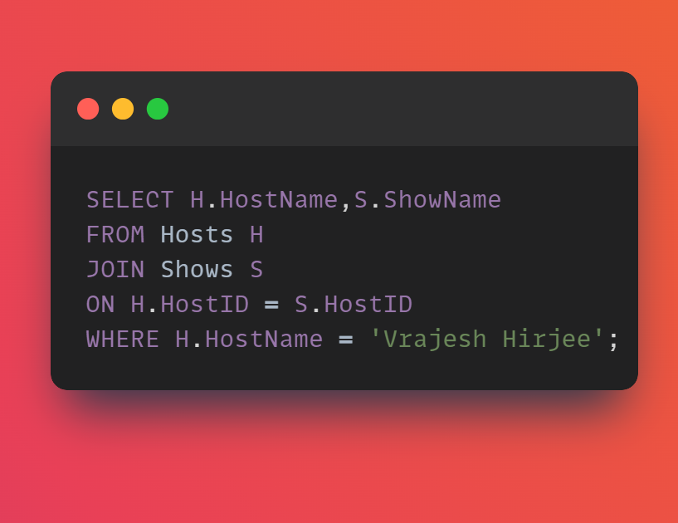

2) List all shows hosted by "Vrajesh Hirjee"?

Slide 7
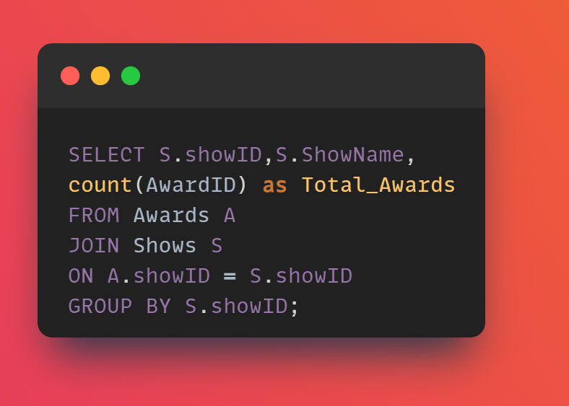
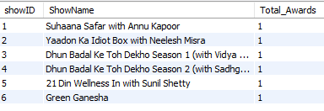
3) Count the number of awards each show has won?

Slide 8
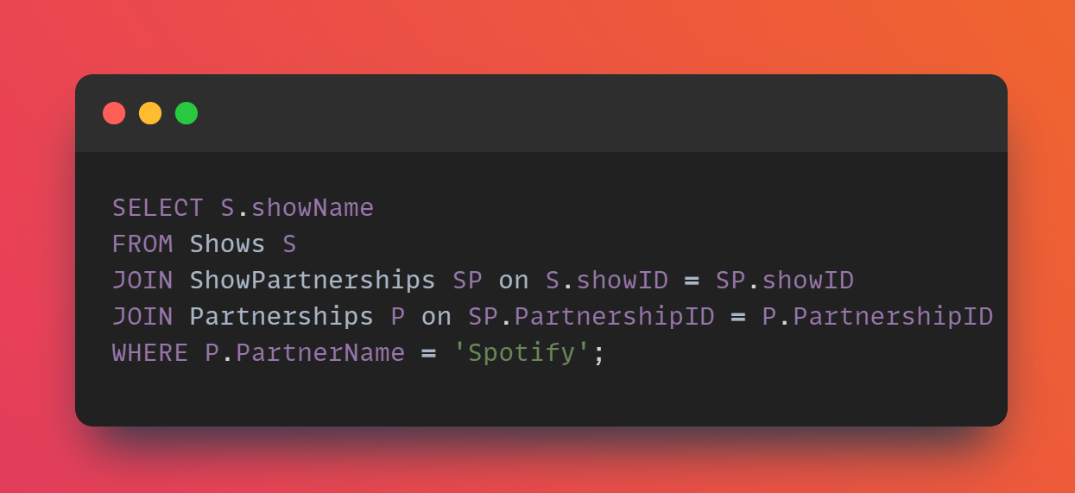

4) Find shows that have partnerships with "Spotify"?

Slide 9
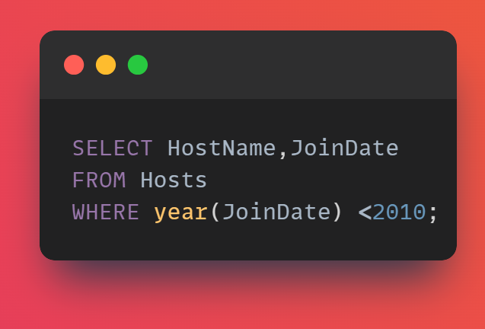
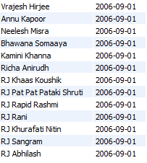
5) Retrieve hosts who joined before 2010?

Slide 10
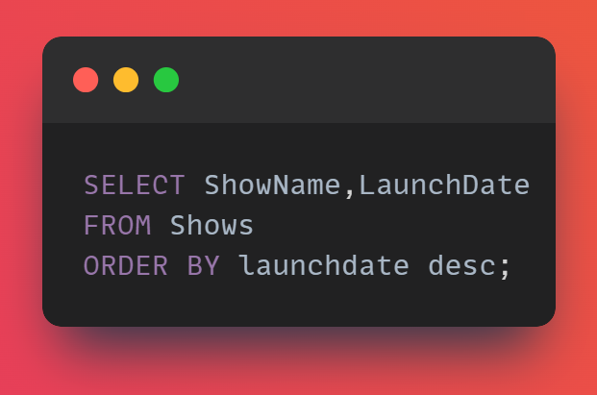
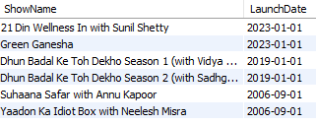
6) List the shows and their launch dates in descending order of launch date?

Slide 11
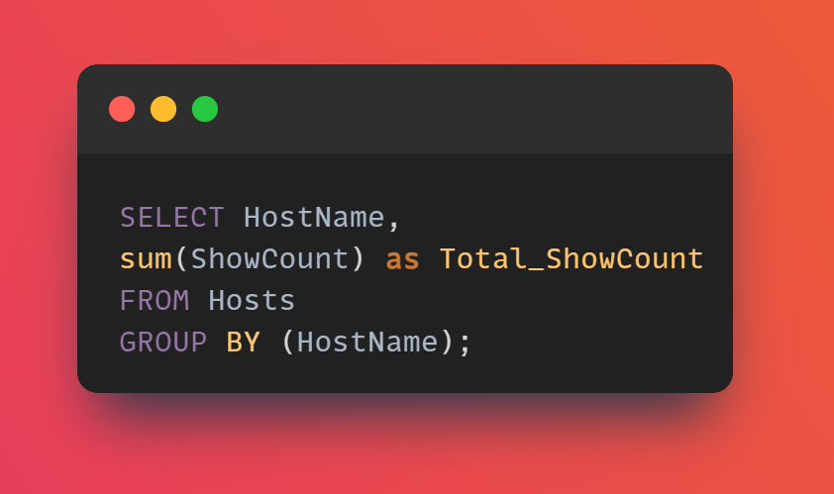
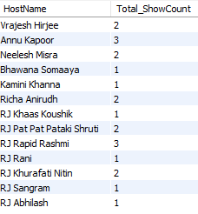
7) Find the total count of shows for each host?

Slide 12
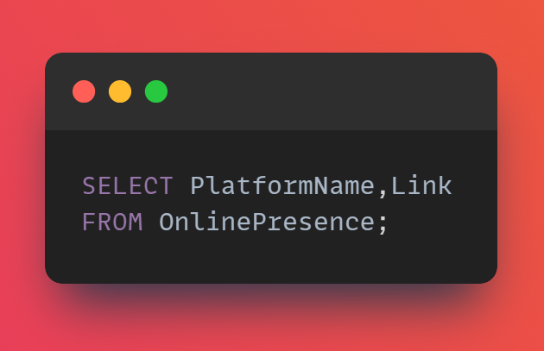
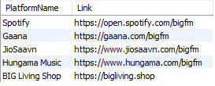
8) How the online presence platforms with their links?

Slide 13
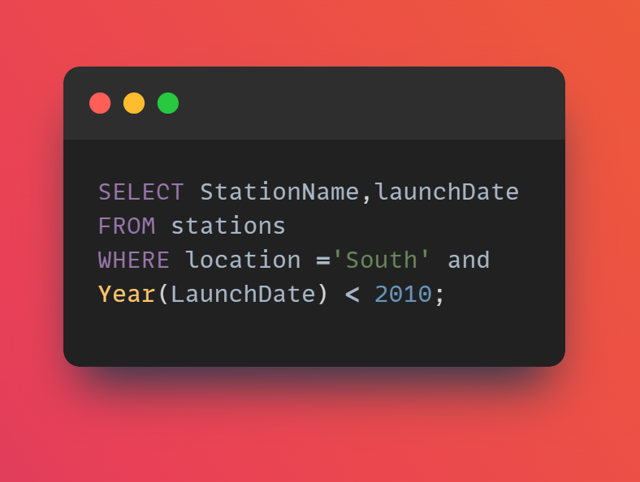
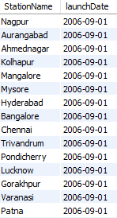
9) Retrieve the stations in the "South" region launched before 2010?

Slide 14
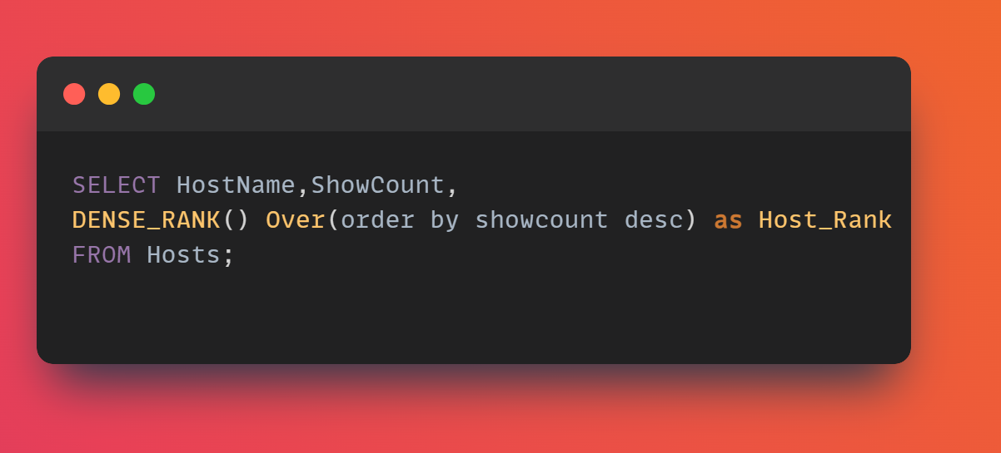
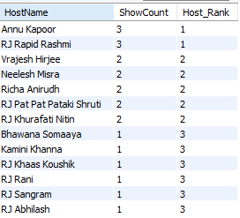
10) Rank hosts based on the number of shows they have hosted?

Slide 15
THANK YOU
Linkedin - Ragul

