Slide 1


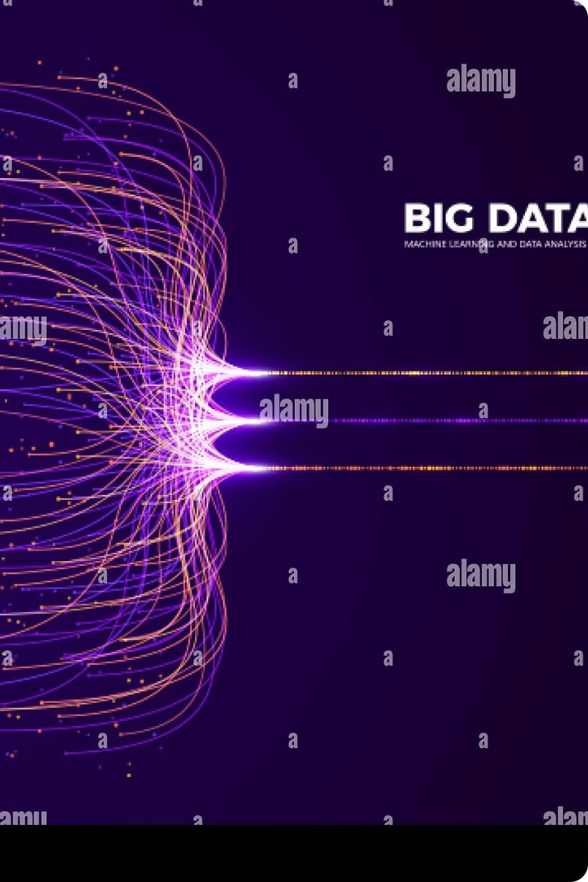
SAVEETHA SCHOOL OF ENGINEERING
SAVEETHA INSTITUTE OF MEDICAL AND TECHNICAL SCIENCES
MapReduce-based Big Data Classification Model using feature Subset selection and Hyper-parameter tuned deep belief network
BY
R. R. RAGUL
192211887

Slide 2
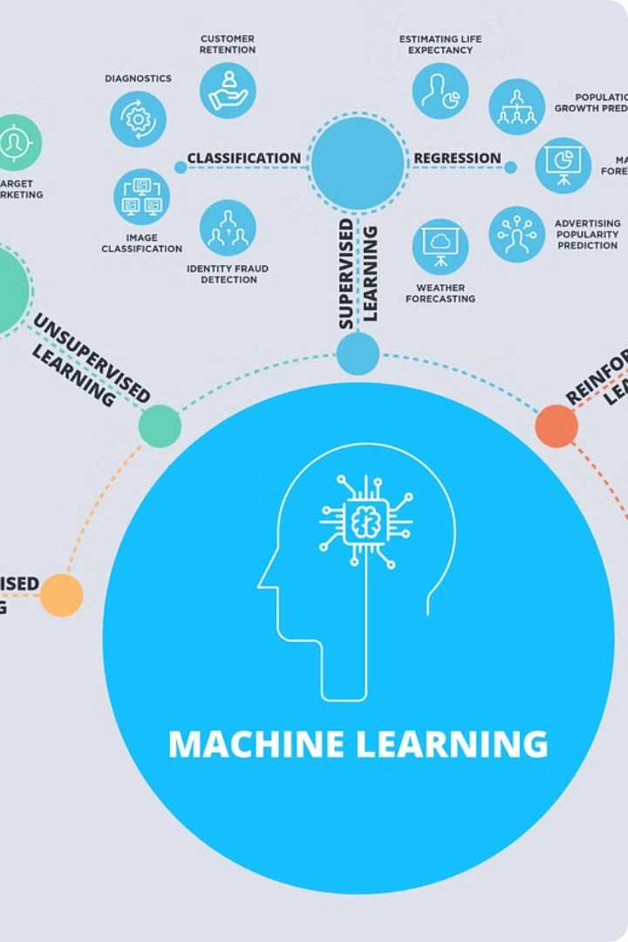
Big Data Classification: A Primer
Big data classification is the process of categorizing vast amounts of data into meaningful groups. This task is essential for extracting insights, making predictions, and informing decision-making in various domains.
Classification algorithms learn patterns from labeled data to assign new instances to predefined categories. Common techniques include decision trees, support vector machines, and neural networks. The choice of algorithm depends on the data characteristics and the desired outcome.

Slide 3




MapReduce for Scalable Data Processing
Distributed Processing
MapReduce distributes data across multiple nodes, enabling parallel processing for faster computation.
Map Phase
Data is processed in parallel by the map function, transforming it into key-value pairs.
Reduce Phase
The reduce function combines data with the same key, generating final results. This aggregation allows for complex calculations on massive datasets.
Fault Tolerance
MapReduce handles failures by replicating tasks, ensuring data integrity and continuous operation even with node failures.

Slide 4




Feature Subset Selection: Optimizing for Efficiency
Feature Ranking
1
Evaluating the importance of each feature.
2
Filter Methods
Using statistical criteria to select features.
3
Wrapper Methods
Testing different subsets of features.
4
Embedded Methods
Selecting features during model training.
Feature subset selection plays a crucial role in optimizing the performance and efficiency of big data classification models. By carefully selecting a subset of features that are most relevant to the task at hand, we can reduce the dimensionality of the data, improve model accuracy, and enhance computational speed. This process involves various techniques that can be categorized into four main approaches: feature ranking, filter methods, wrapper methods, and embedded methods.

Slide 5
Deep Belief Networks: A Powerful Classification Tool
Deep belief networks (DBNs) are powerful generative models capable of learning complex data distributions.
DBNs consist of multiple layers of latent variables, with each layer representing a different level of abstraction of the input data.
1
Unsupervised pre-training
Learns hidden representations of the data
2
Fine-tuning
Supervised learning to classify data
3
Hierarchical feature extraction
Captures complex relationships between features
High accuracy
4
Outperforms traditional methods for large datasets
DBNs offer several advantages, including unsupervised pre-training, hierarchical feature extraction, and high classification accuracy.

Slide 6

Hyperparameter Tuning: Finding the Optimal Configuration
1
Grid Search
This systematic method explores a predefined range of values for each hyperparameter, evaluating the model's performance at each combination.
2
Random Search
Randomly sampling hyperparameter values from their respective distributions provides a more efficient exploration of the search space, especially for high-dimensional problems.
3
Bayesian Optimization
This intelligent approach utilizes a probabilistic model to guide the search, focusing on promising areas of the hyperparameter space, leading to faster convergence.

Slide 7
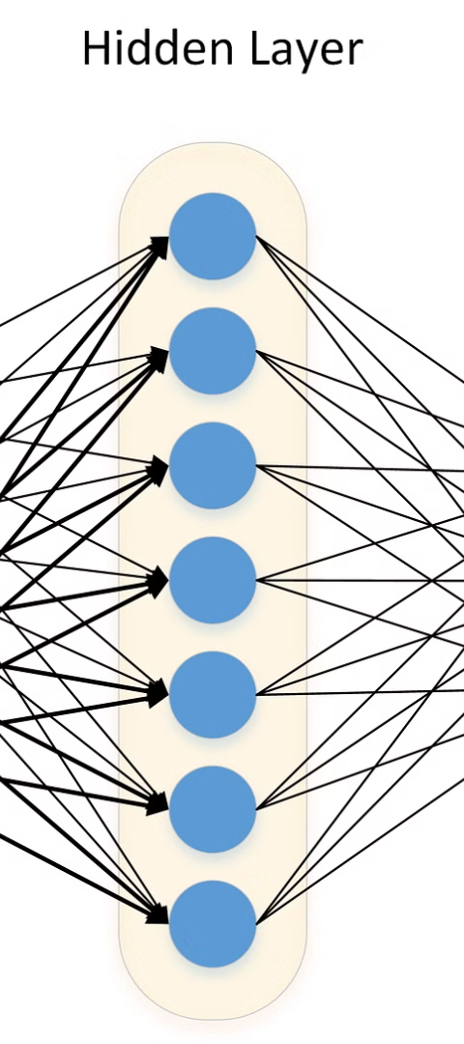
Our Proposed Model: Combining the Best of Both Worlds
1
MapReduce
This framework enables distributed processing of large datasets across multiple nodes, leveraging parallelism for increased efficiency.
2
Feature Subset Selection
By identifying the most relevant features for classification, we optimize the model for efficiency and accuracy.
3
Hyperparameter Tuned Deep Belief Network
This powerful tool allows us to learn complex patterns from the data and achieve high accuracy in classification tasks.

Slide 8
Implementation and Evaluation: Demonstrating Model Performance
1
1. Data Preparation
Preprocess raw data for training and testing.
2
2. Model Training
Train the MapReduce-based model on prepared data.
3
3. Performance Evaluation
Evaluate the model's accuracy, precision, and recall.
4. Hyperparameter Optimization
4
Fine-tune model parameters for improved performance.
We meticulously implement the proposed model, leveraging a robust data preparation process. This involves cleansing and transforming raw data, ensuring optimal model training. We train the model using real-world big data, evaluating its performance on various metrics, such as accuracy, precision, and recall. A rigorous hyperparameter tuning process ensures the model operates at peak efficiency, effectively classifying big data with high accuracy.

Slide 9

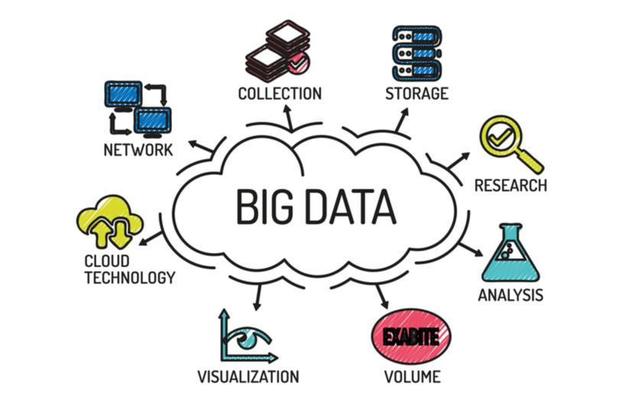
Conclusion: The Future of Big Data Classification
The future of big data classification promises greater efficiency, accuracy, and scalability. Advancements in artificial intelligence, cloud computing, and distributed systems will further enhance our ability to process vast datasets.

