Slide 1


Case Study
Client: A Global Marine Group Ship Management Company
BUSINESS CHALLENGE
APP REQ & SPECS
MAHAT PERFORMANCE
The client’s rapid expansion through acquisition doubled their number of managed ships to 550.
Requirement:
A Multi-Tenant SaaS Application to manage Port Service Agencies across the world.
Application Specs:
5 Large Modules
18 Complex Workflows
85 Diverse Business Objects
359 Unique Business Actions.
Team Size: 4 people
MVP: 7 Days
First Module: 4 Weeks
Final Release: 9 Months
Cost: 70% less
“Mahat allowed us to launch efficiently, saving significant costs, time, and reputation. The ROI from this app has been the best we’ve seen in years.” - CIO, Client
They needed an application ASAP to efficiently manage hundreds of port services for their ships.
Vendor estimated $1M - $2M and 1.5 to 2 years of development - time they simply didn't have.

Slide 2
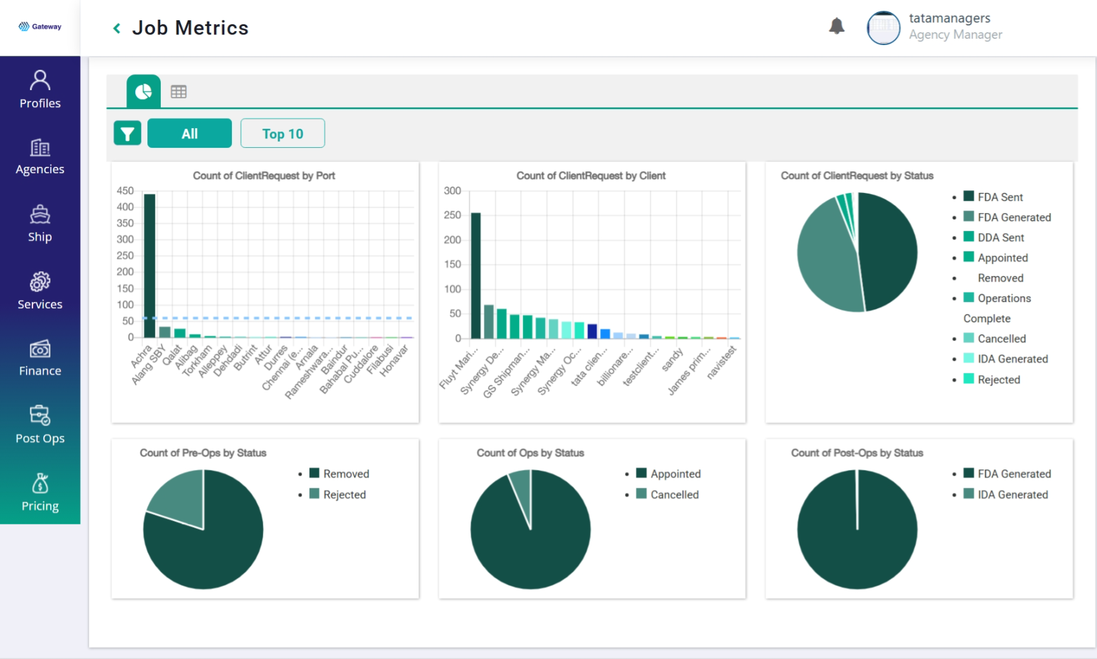
Detailed metrics of port services jobs.

Slide 3

Case Study
Client: DeepWorks Fleet Focus: Mining Solutions
BUSINESS CHALLENGE
APP REQ & SPECS
MAHAT PERFORMANCE
Client’s heavy vehicles in large mines incur huge costs and delays significantly cutting ROI.
Requirement:
Complex IOT Devices and a Multi-Tenant SaaS Application to efficiently monitor, signal and improve dozens of vehicle and driver parameters.
Application Specs:
9 Large Modules
28 Complex Workflows
130 Diverse Business Objects
563 Unique Business Actions.
Team Size: 4 people
MVP: 10 Days
First Module: 6 Weeks
Alpha Release: 3 Months
Cost: 75% less
Mahat was able to show an MVP, finalize the full scope and start delivering in a few weeks. No one matched their speed, quality, cost, and delivery." - Mahesh, CEO, DeepWorks
They needed IOT devices and an application to efficiently manage hundreds of heavy vehicles and their drivers.
Off-the-shelf devices and apps just don’t meet custom needs but are already costing a lot.

Slide 4
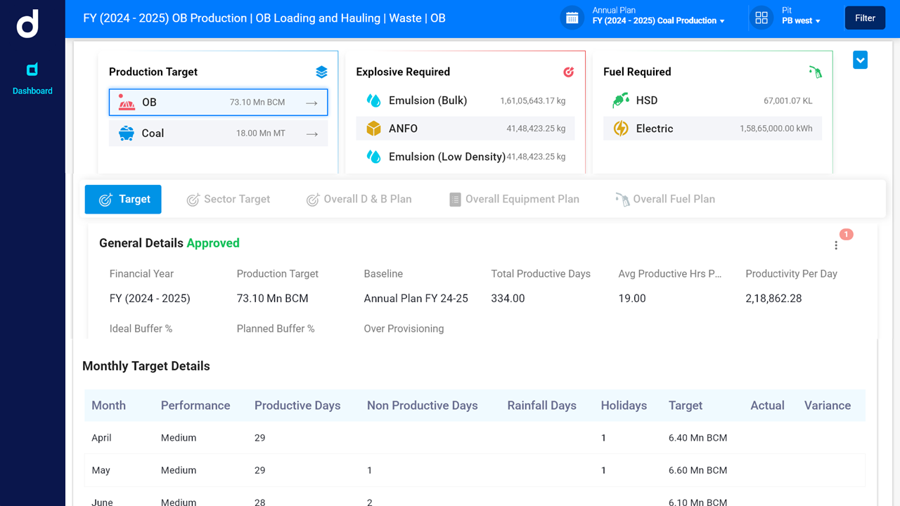
Loading and Hauling Waste

Slide 5

Case Study
Client: ShootingSimplified Media Solutions
BUSINESS CHALLENGE
APP REQ & SPECS
MAHAT PERFORMANCE
Client’s film pre-production work was in complete disarray with multiple delays and confusions.
Requirement:
A Multi Tenant SaaS Application that super-efficiently manages the complexity of pre-production work often involving continuous reworks and approvals.
Application Specs:
5 Large Modules
16 Complex Workflows
73 Diverse Business Objects
310 Unique Business Actions.
Team Size: 3 people
MVP: 4 Days
First Module: 2 Weeks
Full Release: 8 Weeks
Cost: 60% less
Following an MVP, the full application came alive like a movie - scene by scene, surprisingly in the same time frame it takes to release a short movie.“ - CEO, ShootingSimplified
They needed an application that streamlines multiple departments, roles and processes.
Ready made apps were large with feature-bloat, less custom options & costly in the long run.

Slide 6
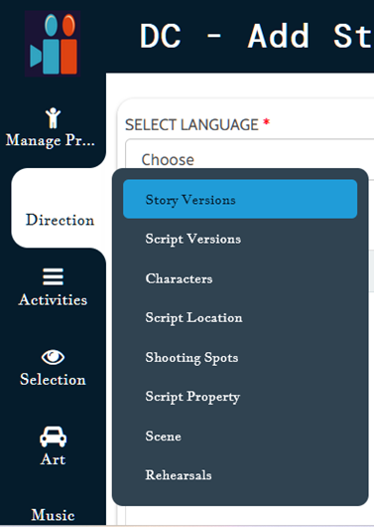
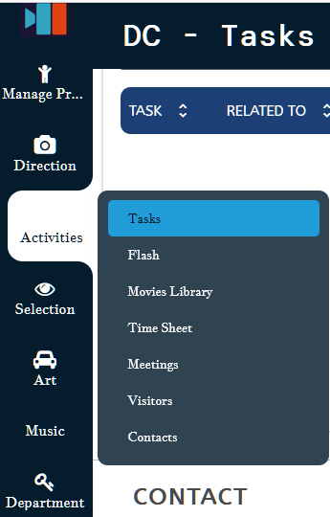
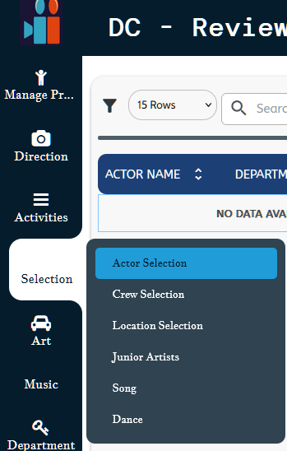
Complete Pre-Production Roles, Master Data and Activities.

Slide 7

Case Study
Client: aKarma.life Health Community
HEALTH CHALLENGE
APP REQ & SPECS
MAHAT PERFORMANCE
Community members had strong intention for a healthy lifestyle but struggled with practice.
Requirement: A custom app to manage educational content and events, manage membership, assign individualized health plan, track daily practices and give reminders and recommendations.
Application Specs:
3 Modules
9 Workflows
34 Diverse Business Objects
140 Unique Business Actions.
Team Size: 2 people
MVP: 3 Days
Full Release: 3 Weeks
Cost: 65% less
“It initially appeared that we needed three applications. Mahat was able to combine them into one very fast with fully tailored features.” - Founder, aKama.life
They needed an application to onboard, educate, track and support a healthy life style for their health community members.
Assembling opensource apps or subscribing to multiple SaaS apps was not practical.

Slide 8
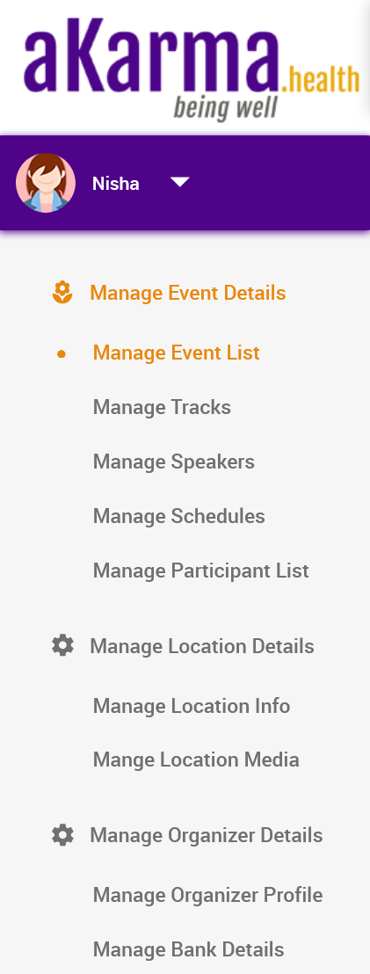
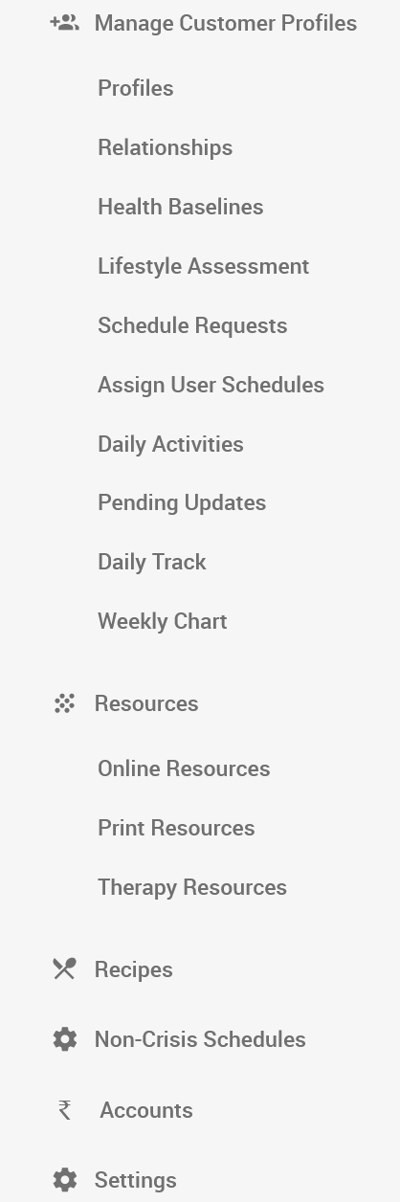
9 Workflows that manage
multiple aspects
of onboarding customers,
managing health events,
complete customer
health support and more.

Slide 9
