Slide 1
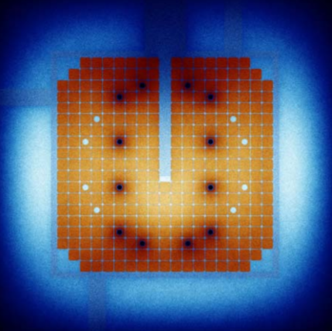
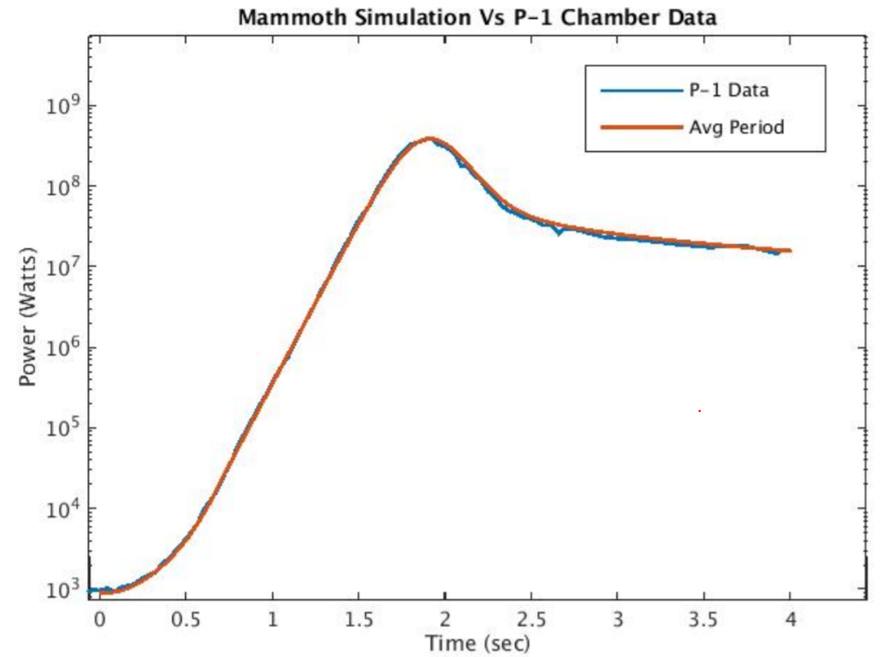
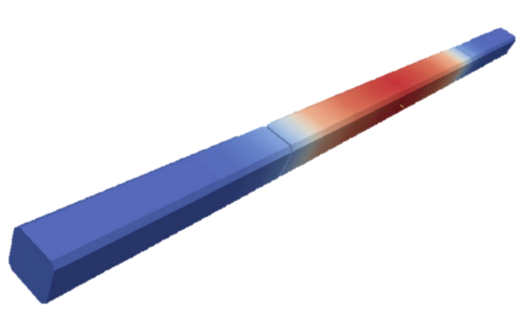
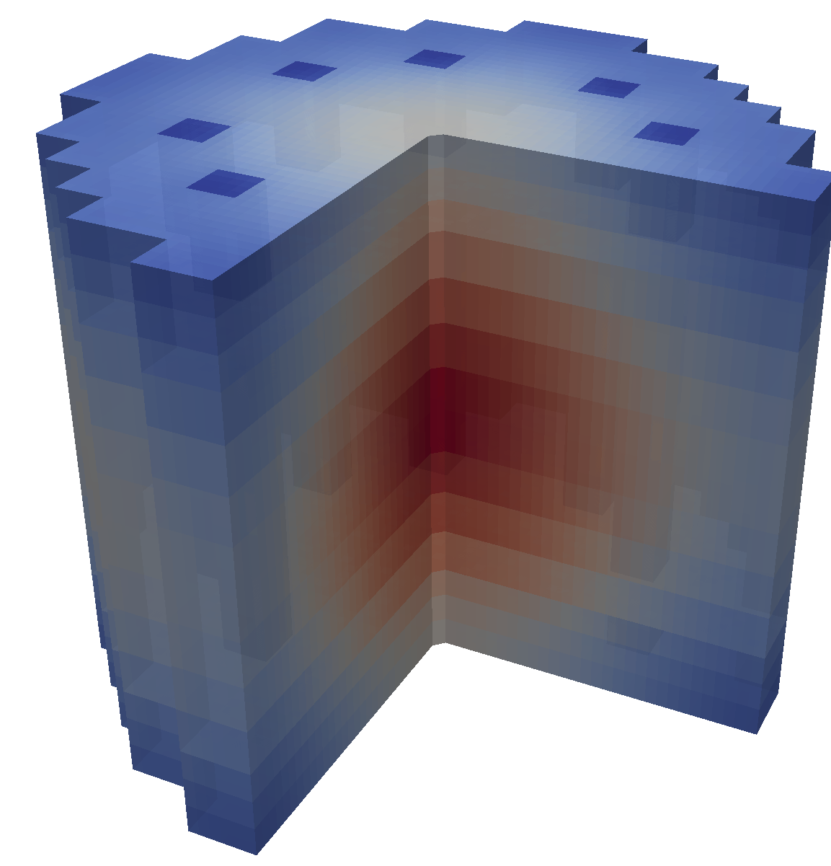
Validation
Experiments
Modelling &
Simulation
Prediction

Slide 2
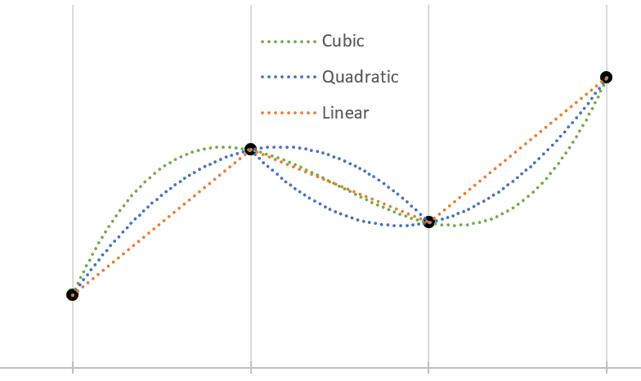








$$ρ_{n+1}$$
$$ρ_{n−1}$$
$$ρ_{n}$$
$$ρ_{n−2}$$
Macro
$$t_{n−2}$$
$$t_{n−1}$$
$$t_{n}$$
$$t_{n+1}$$

Slide 3













$$ρ_{n+1}^{k}\left(φ_{n+1}^{k}\right)$$
$$φ_{n+1}^{k+1}\left(p_{n+1}^{k} \right)$$
$$ρ^{k}\left(t\right)$$
$$ρ_{n}\left(φ_{n}\right)$$
$$ρ_{n+1}^{0}\left(φ_{n+1}^{0}\right)$$
$$ρ^{0}\left(t\right)$$
$$φ_{n}\left(p_{n} \right)$$
$$φ_{n+1}^{0}=φ_{n}$$
$$t$$
$$t_{n }$$
$$t_{n+1 }$$
$$p\left(t\right)$$
$$φ\left(t\right)$$

Slide 4
MOOSE
Rattlesnake
Particle Transport
Cross-sections
Flux Profile
BISON
Fuel Performance
MAMMOTH
Reactor Physics
Heat Source
Temperature Profile
RELAP-7
Safety Analysis
(Thermal Hydraulics)
Heat Source
Fluid Convection

Slide 5
Executioner
Steady-state
Eigenvalue
Transient
Action System
CFEM-Diffusion
SAAF-Sn
LS-Pn
Residual Evaluation
Auxkernels
Precursors
Solver
Libmesh
Petsc
User Objects
Kernels
Streaming
Scattering
Fission
Postprocessors
Materials
Cross-sections

Slide 6
Thank You & Gig Em

