Slide 1
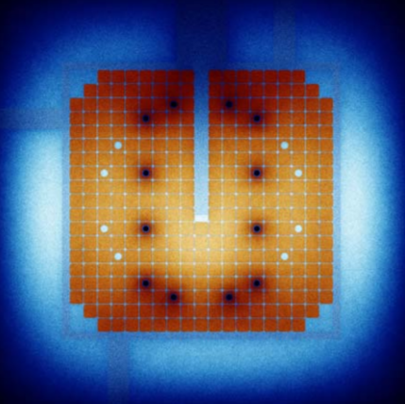
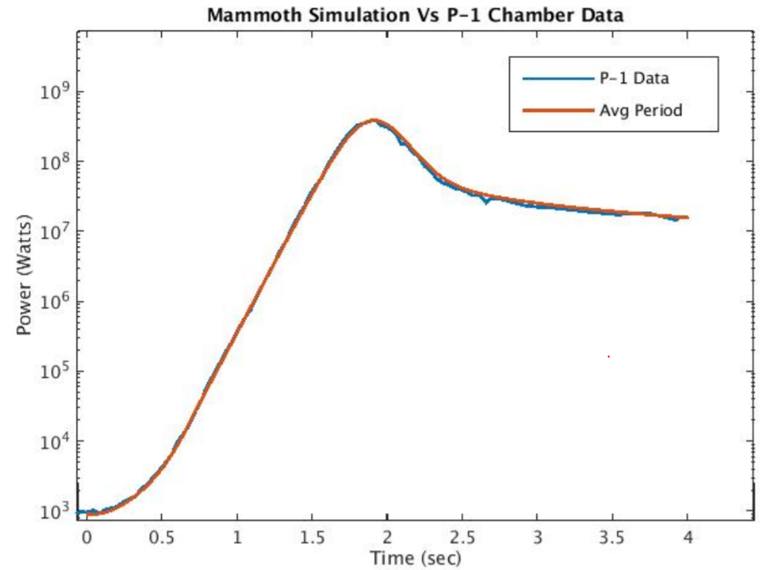
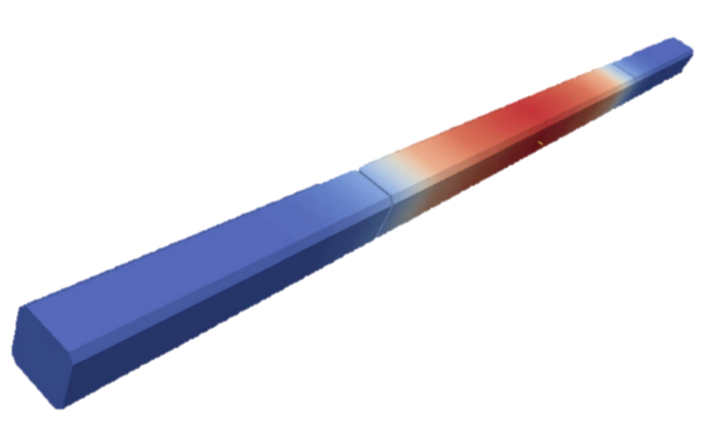
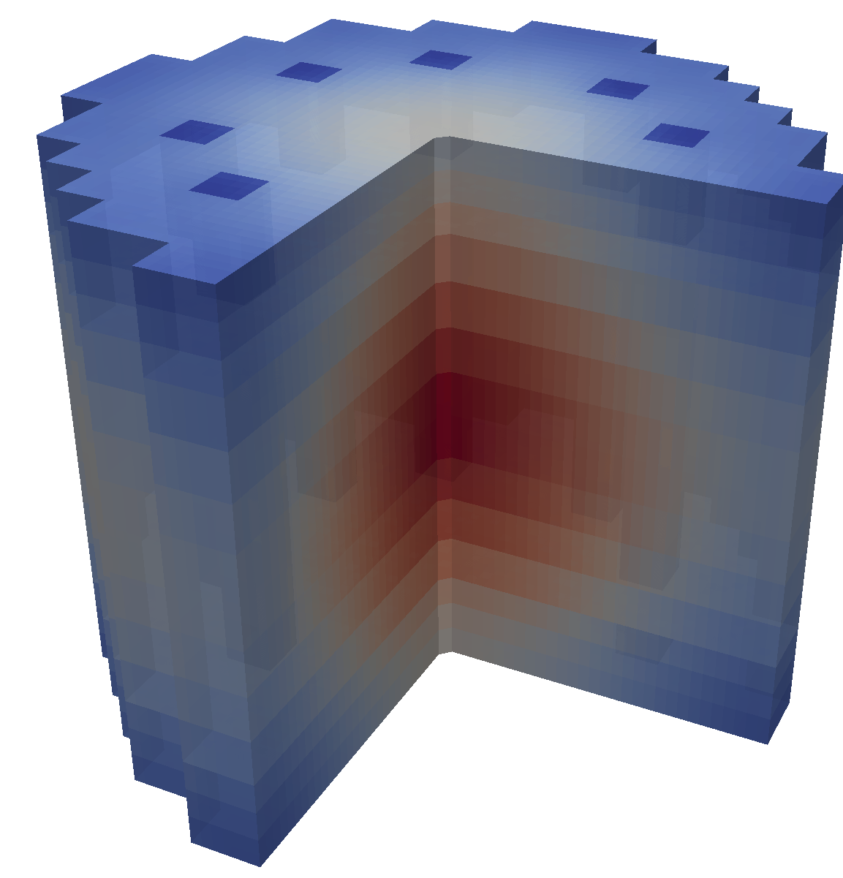
Validation
Experiments
Modelling &
Simulation
Prediction

Slide 2
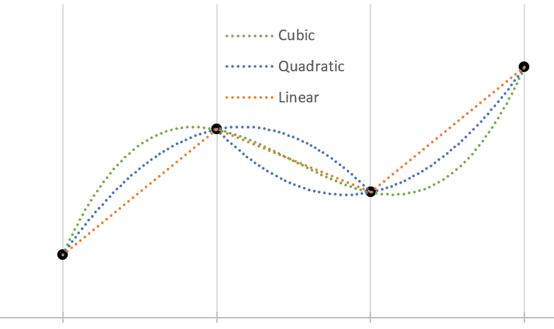








$$ρ_{n+1}$$
$$ρ_{n−1}$$
$$ρ_{n}$$
$$ρ_{n−2}$$
Macro
$$t_{n−2}$$
$$t_{n−1}$$
$$t_{n}$$
$$t_{n+1}$$

Slide 3
MOOSE
Rattlesnake
Particle Transport
Cross-sections
Flux Profile
BISON
Fuel Performance
MAMMOTH
Reactor Physics
Heat Source
Temperature Profile
RELAP-7
Safety Analysis
(Thermal Hydraulics)
Heat Source
Fluid Convection

Slide 4
Executioner
Steady-state
Eigenvalue
Transient
Action System
CFEM-Diffusion
SAAF-Sn
LS-Pn
Residual Evaluation
Auxkernels
Precursors
Solver
Libmesh
Petsc
User Objects
Kernels
Streaming
Scattering
Fission
Postprocessors
Materials
Cross-sections

Slide 5
Thank You & Gig Em

