Slide 1

CPTS 421
AgWeatherNet
AI Chatbot
Presented by Team 15
Notes:
Gavin

Slide 2
CONTENT
01
Introduction
02
Sprint Objectives
03
Requirements Gathering Process
Documentation of US, UC and UML Diagrams
Installation and Evaluation of Existing Solution
Kanban Overview & Team Contribution
04
05
06
07
Feature Demonstration
08
Skills Identification and Learning Process
09
Sprint Achievements and Challenges
10
Responsible Use of AI
11
Next Steps and Sprint Retrospective
12
Conclusion
Notes:
Gavin

Slide 3
01. Introduction
Project Overview:
Our project focuses on designing and developing an AI chatbot that enables users to access AgWeatherNet data through natural language queries
The goal is to simplify how agricultural stakeholders retrieve weather information by replacing complex data navigation with an intuitive conversational interface
Problem:
A previous implementation of the AI chatbot failed
The AgWeatherNet platform is not user-friendly for farmers or non-technical users
Solution:
Develop the AI chatbot using Retrieval-Augmented Generation (RAG) to provide accurate, real-time, and contextual weather insights
Notes:
Danbi

Slide 4
01. Introduction
Team Introduction:
Sairaghav Gubba: Senior student majoring in Computer Science at Washington State University
Zuriel Hernandez: Senior student majoring in Computer Science at Washington State University, interested in AI/ML and building sports analytics pipelines
Danbi Kim: Senior student majoring in Computer Science at Washington State University, interested in web development
Gavin Travis: Computer Science Senior, interested in systems programming, parallel computing, and data engineering
Notes:
All of us

Slide 5
01. Introduction
Sprint 1 Objectives:
Establish a strong foundation for the project before development begins
Gather and refine Functional Requirements (FRs) and Non-Functional Requirements (NFRs) from stakeholders
Create core documentation, including user stories, use cases, and UML diagrams
Define the initial system structure and project scope
Identify the tech stack (React, Python, MySQL, AWS, RAG)
Begin prototype planning
Notes:
Danbi

Slide 6
01. Introduction
Technology Exploration:
Front-end: React for building a responsive and interactive user interface
Back-end: Python for server-side logic and API development
Database: MySQL for storing weather data and system information
Deployment: AWS EC2 instance for hosting and running the application
AI Implementation: Retrieval-Augmented Generation (RAG) to enable the chatbot to retrieve and generate accurate weather data responses
Notes:
Danbi

Slide 7
02. Sprint Objectives
Sprint 1 Goals:
Collect and clarify client requirements to understand the system’s expected functionality and constraints
Develop core design documentation, including user stories, use cases, and UML diagrams
Evaluate any existing systems related to the project to understand previous approaches and limitations
Identify and begin learning the full-stack technologies required for implementation
Begin initial development and setup for key system components
Notes:
Zuriel

Slide 8
03. Requirements Gathering Process
Client Meetings:
Conducted weekly meetings via Microsoft Teams every Wednesday at 1:30 PM
Held brief internal team discussions before each meeting to prepare questions and align on goals
Followed up with short team meetings after each session to review feedback and refine requirements
Methods Used:
Direct client discussions to understand system needs and expectations
Iterative clarification through follow-up questions and feedback
Collaborative team analysis to translate client input into structured
Notes:
Zuriel

Slide 9
03. Requirements Gathering Process
Meeting Overview:
4 client meetings were conducted throughout Sprint 1
Key portions of these meetings highlight requirement clarification and system expectations
Key Requirements Identified:
Enable natural language querying of AgWeatherNet data through an AI chatbot
Ensure accurate and relevant data retrieval for users
Design a scalable and maintainable system architecture
Provide a user-friendly interface for efficient interaction with the system
Notes:
Gavin

Slide 10
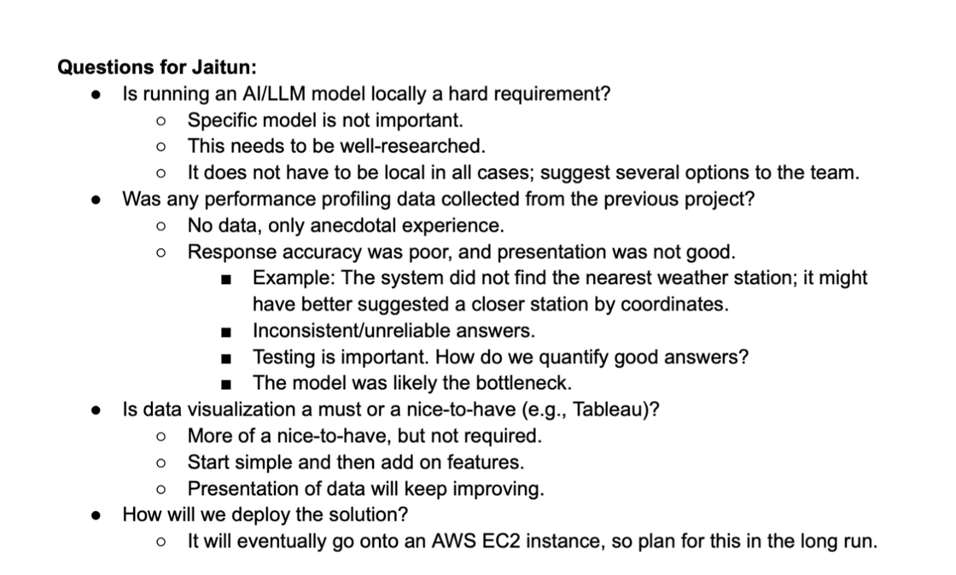
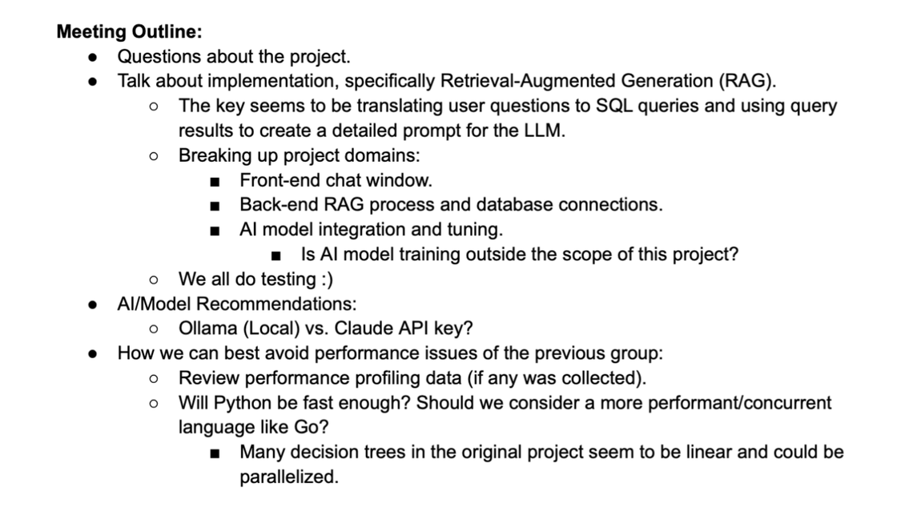
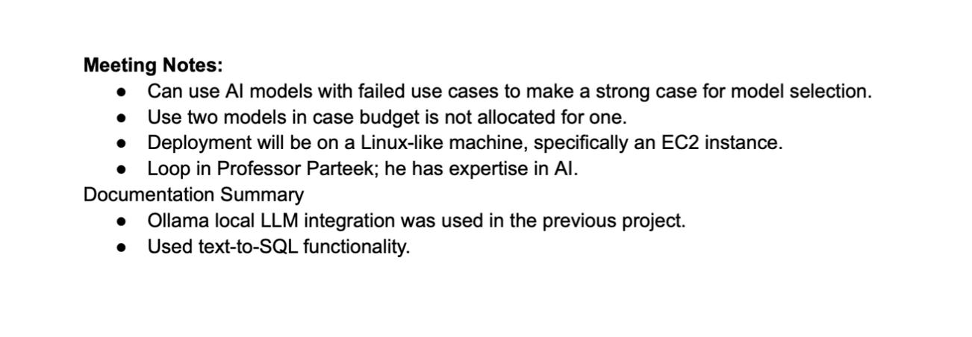
03. Requirements Gathering Process
Notes:
Gavin

Slide 11
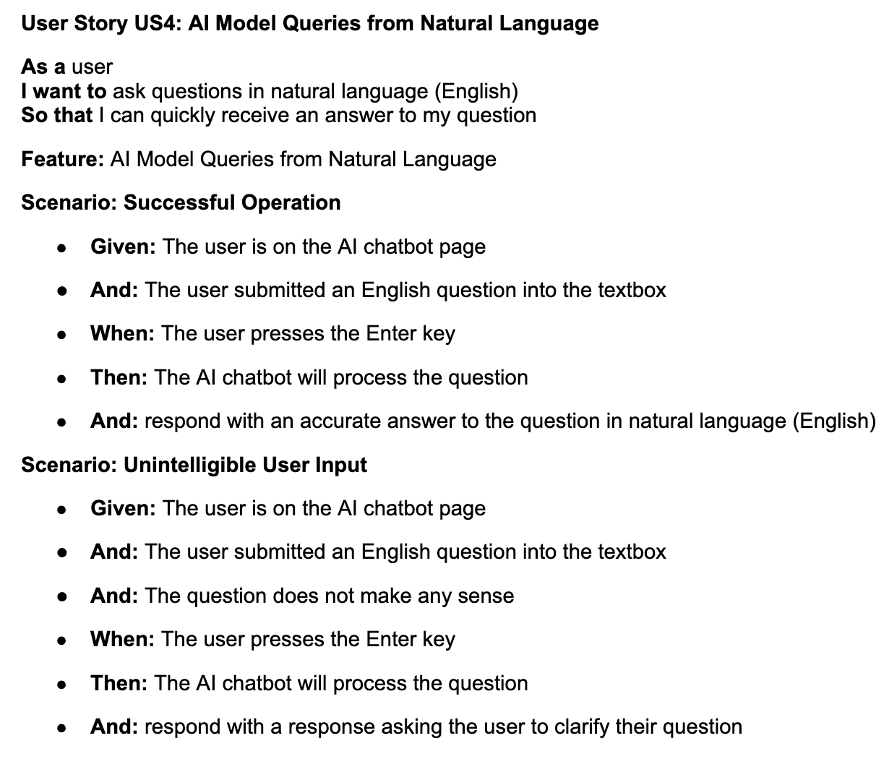
04. Documentation of User Stories
Notes:
Gavin

Slide 12
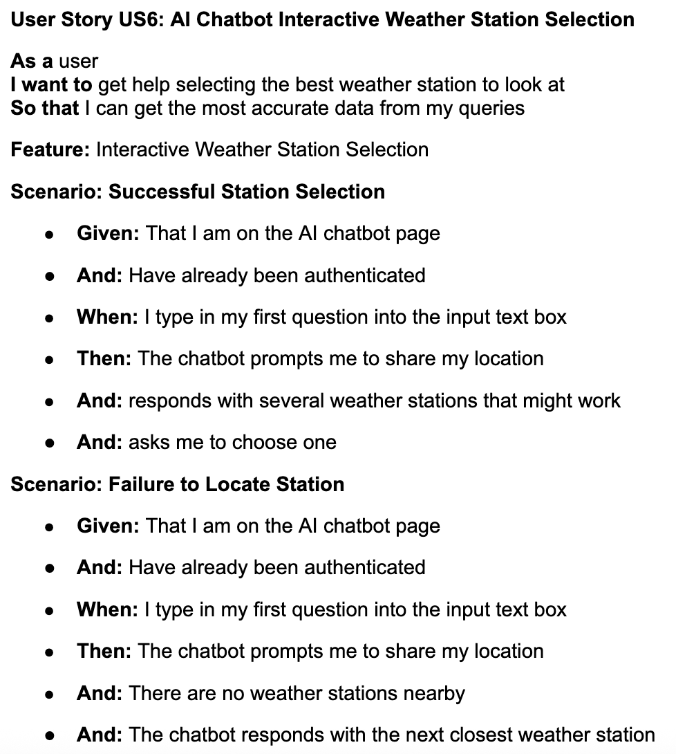
04. Documentation of User Stories
Notes:
Gavin

Slide 13
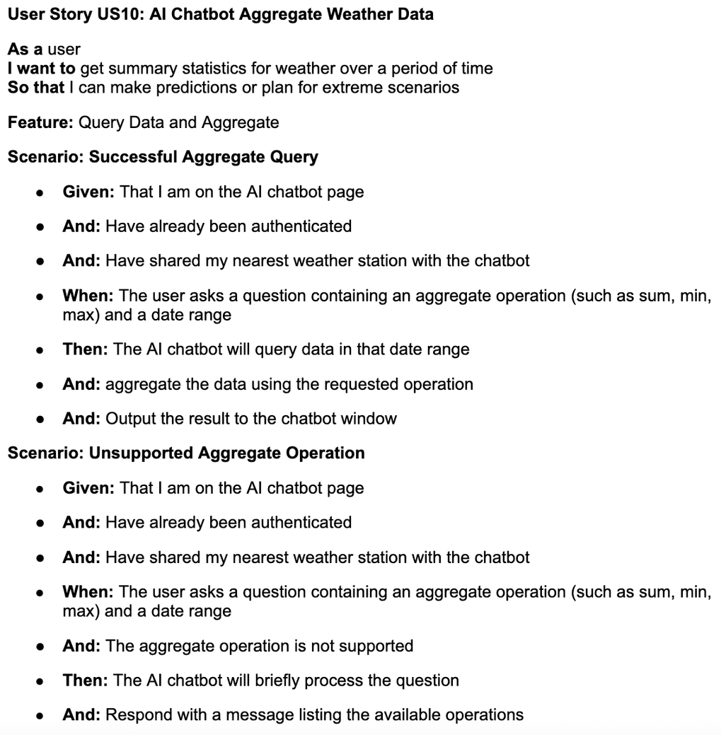
04. Documentation of User Stories
Notes:
Gavin

Slide 14
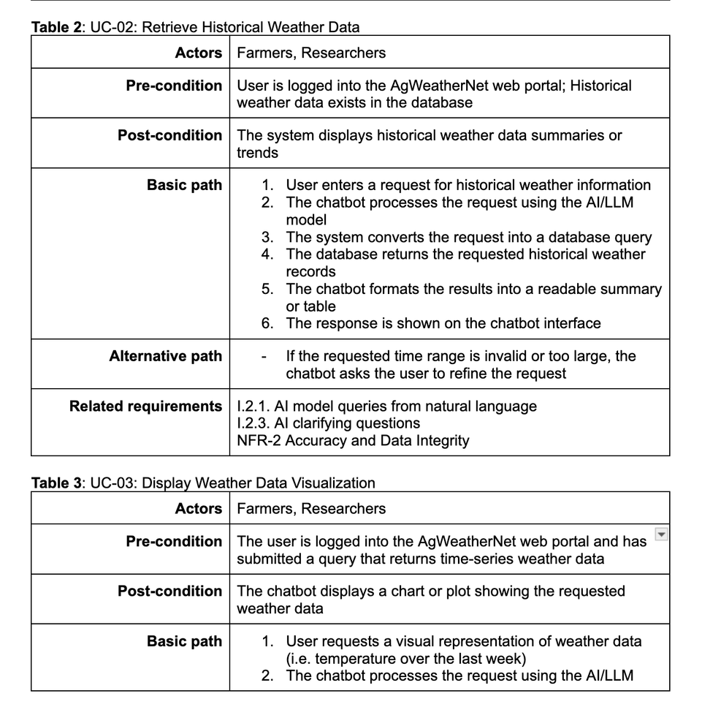
04. Documentation of Use Cases
Main actors:
Farmers, Researchers, Administrators, Developers
Core user goal:
Ask weather questions in natural language and receive accurate answers
Use cases help define system behaviour, alternative flows, and related requirements
Notes:
Sai

Slide 15
04. Documentation of UML Diagrams
Actors: Farmers, Researchers, System Administrators
Precondition: User is logged into AgWeatherNet and chatbot is open
Basic flow:
User asks a weather question
AI interprets the question
System generates a database query
Data is retrieved
Chatbot returns a readable response
Alternative flow:
If query is ambiguous, chatbot asks clarifying questions
If query cannot be answered, chatbot returns an error message
Notes:
Zuriel

Slide 16
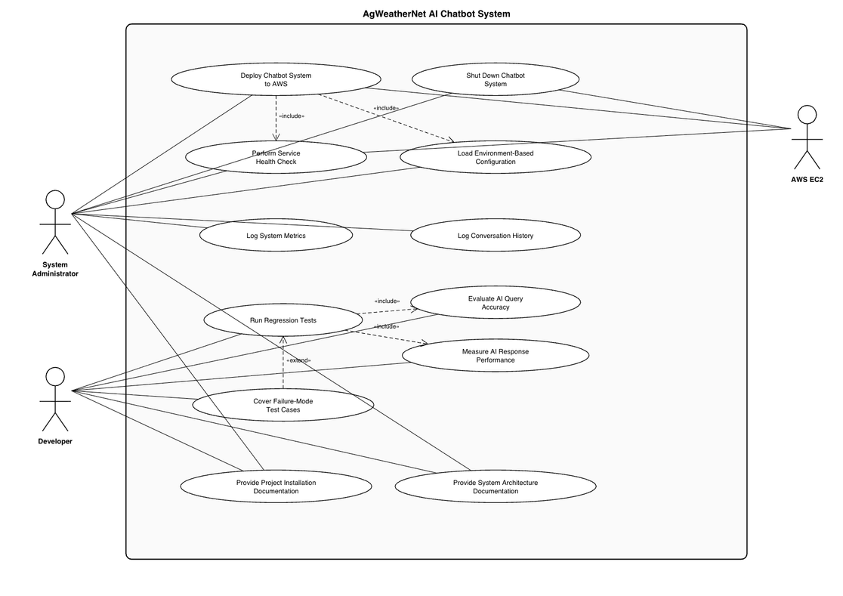
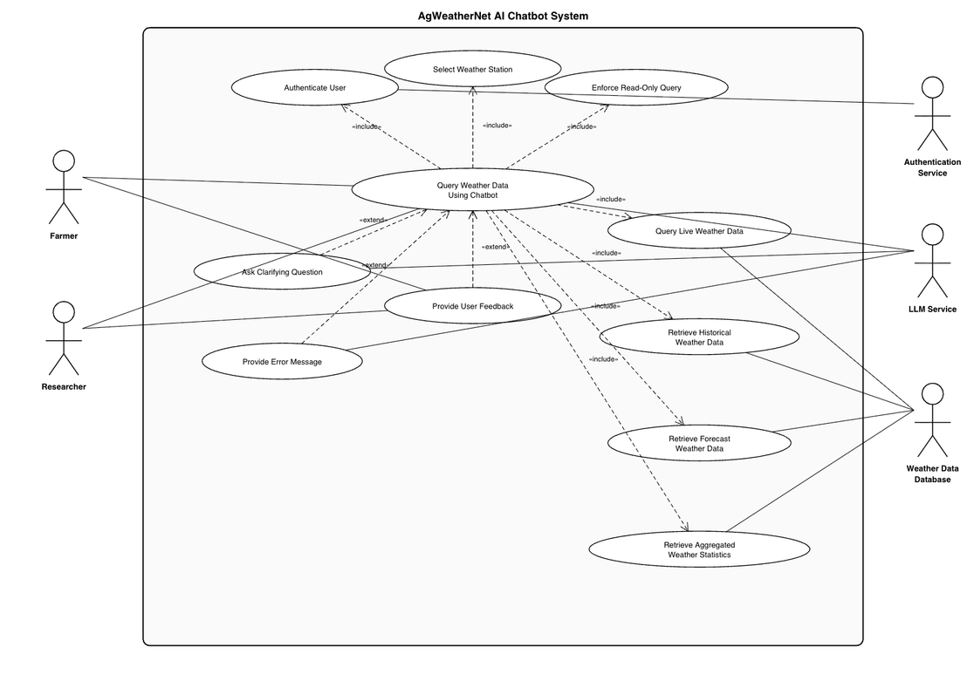
04. Documentation of UML Diagrams
Notes:
Zuriel

Slide 17
05. Installation and Evaluation of Existing Solution
Previous Solution & Identified limitations:
A prior version of the system existed but did not meet expectations in terms of performance, scalability, and overall usability
Due to these limitations, the decision was made to rebuild the system from scratch rather than extend the existing codebase
Client Context:
The client currently relies on existing platforms that require more manual or less intuitive interaction with weather data
The new project aims to streamline this process through a more user-friendly and intelligent solution
Notes:
Zuriel

Slide 18
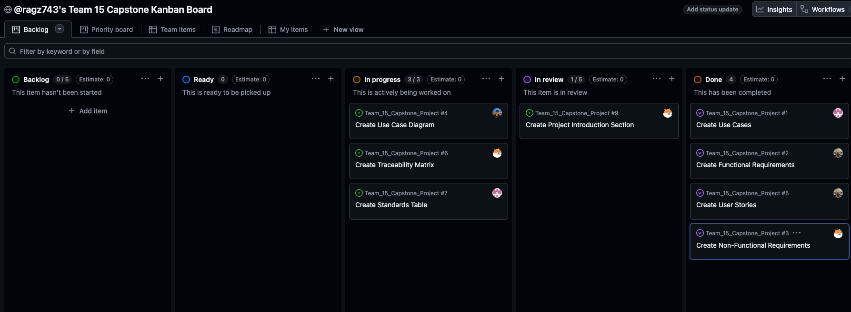
06. Kanban Overview & Team Contributions
Notes:
Zuriel

Slide 19
07. Feature Demonstration
Notes:
Zuriel

Slide 20
08. Skills Identification and Learning Process
Sairaghav Gubba:
Skill sets identified:
Retrieval Augmented Generation (RAG) Techniques
Front End Development with Typescript, React, and HTML/CSS
Python for AI Development
Learning Resources:
Chat With Your Data Course from DeepLearning AI
Typescript, React, HTML/CSS, and Python Documentation
What I Learned:
RAG Pipeline Components from Chat With Your Data
Basics of Typescript and RAG
Notes:
Sai

Slide 21
08. Skills Identification and Learning Process
Zuriel Hernandez:
Skill sets identified:
Retrieval Augmented Generation (RAG) Techniques
React, Python, FastAPI, Typescript
Full Stack Development + Deployment (AWS, Azure, GCP)
Learning Resources:
FastAPI Documentation
Project Experiences
What I Learned:
Basic RAG Architecture
Team Collaboration and Communication
Notes:
Zuriel

Slide 22
08. Skills Identification and Learning Process
Danbi Kim:
Skill Sets Identified:
Retrieval-Augmented Generation (RAG) system design and implementation
Frontend development using TypeScript, React, and Tailwind CSS
Python fundamentals for AI-related development
Learning Resources:
“Chat with Your Data” course from DeepLearning.AI
Official documentation for TypeScript, React, Tailwind CSS, and Python
What I Learned:
Core architecture of RAG systems
Refreshed Python basics relevant to AI
Notes:
Danbi

Slide 23
08. Skills Identification and Learning Process
Gavin Travis:
Skill Sets Identified:
Retrieval Augmented Generation (RAG) Techniques
Database Management
Front End Development with Typescript and React
Learning Resources:
Chat With Your Data Course from DeepLearning AI
Typescript and React Documentation
What I Learned:
RAG Pipeline Components from Chat With Your Data
Basics of Typescript
Notes:
Gavin

Slide 24
09. Sprint Achievements and Challenges
Achievements:
Defined system scope and objectives for the redesign of the AI Chatbot
Completed detailed use case documentation for both user and admin workflows
Evaluated previous implementation and its limitations
Identified tech stack (React, Python, MySQL, AWS, RAG)
Established team workflow using Kanban board
Notes:
Sai

Slide 25
09. Sprint Achievements and Challenges
Challenges:
Large scope and complexity: Many use cases (30+) made it harder to keep everything consistent
Maintaining traceability: Linking user stories, use cases, and requirements took time
UML diagram clarity: Balancing readability vs including all system interactions
Limited or lack of experience: Team members having limited or no prior experience with AI-based systems
Notes:
Zuriel

Slide 26
10. Responsible Use of AI
Disclosure:
GenAI tools such as ChatGPT were used during this sprint to assist with certain documentation tasks
Notes:
Sai

Slide 27
10. Responsible Use of AI
Application & Improvements:
AI tools were used to help draft and refine documentation and support brainstorming of system design ideas
This improved efficiency, helped clarify documentation, and reduced time spent on initial drafting
Limitations & Checks:
Some AI-generated outputs required refinement or correction, particularly for technical details and system-specific requirements
The team reviewed all AI-assisted content to ensure accuracy, relevance, and alignment with project goals
Notes:
Sai

Slide 28
10. Responsible Use of AI
Accountability:
All final documentation, design decisions, and deliverables were reviewed and approved by the team
The team maintains full responsibility for the accuracy and quality of the final project work
Notes:
Sai

Slide 29
11. Sprint Retrospective
What Went Well
Capturing all functional and non-functional requirements
Learning fundamentals of new technology (RAG)
Establishing good communication with client
Areas to Improve
Improving background knowledge of AI/Large-Language-Models
Deep dive client data
Research RAG System Testing Strategies
Notes:
Gavin

Slide 30
11. Next Steps
Determine System Architecture
RAG Pipeline Components
Indexing Strategy
Database Selection
Data Retrieval Strategy (Balancing Query Speed vs Validation)
Prototype RAG Pipeline
Mock Chatbot User Interface with Figma
Notes:
Gavin

Slide 31
12. Conclusion
Sprint 1 successfully established the foundation of our AI chatbot system. With clear system requirements and design in place, we are ready to begin development in Sprint 2.
Notes:
Gavin

