Slide 1
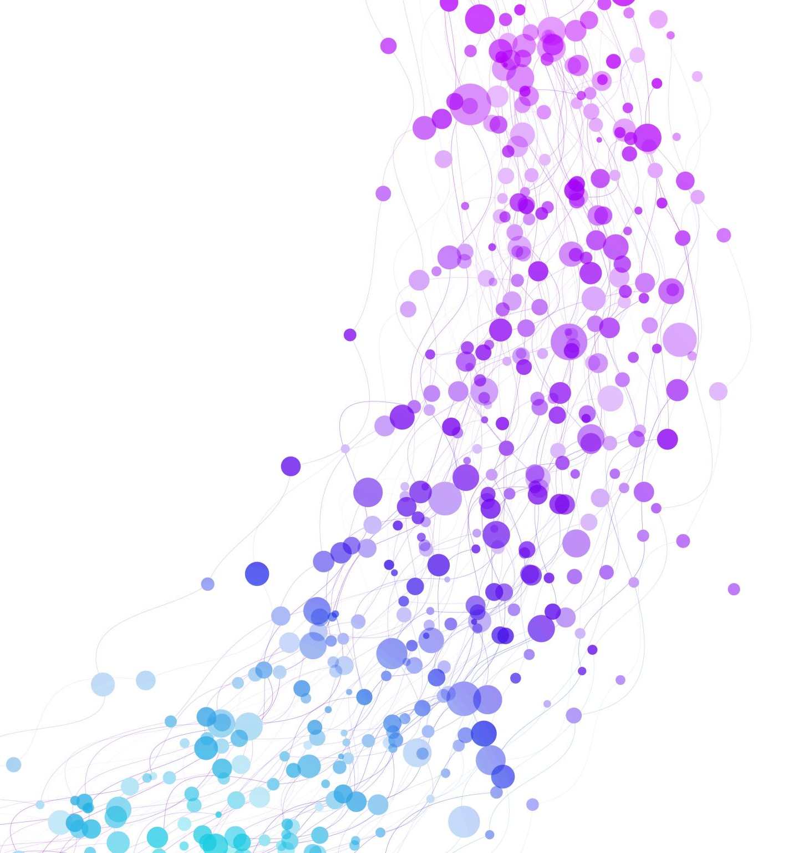
Understanding movie industry trends using IMDB
By Ryan Healy

Slide 2
Objective
After a series of recent Box Office Flops its time for our Studio to better our understanding of our industry
Using our Database of containing 5,000 movies (about a 1% sample of the total IMDB database) we explore Industry Trends and where to go from here.

Slide 3
Notes on the Data
IMDB also contains TV shows which for this analysis are left out

Slide 4
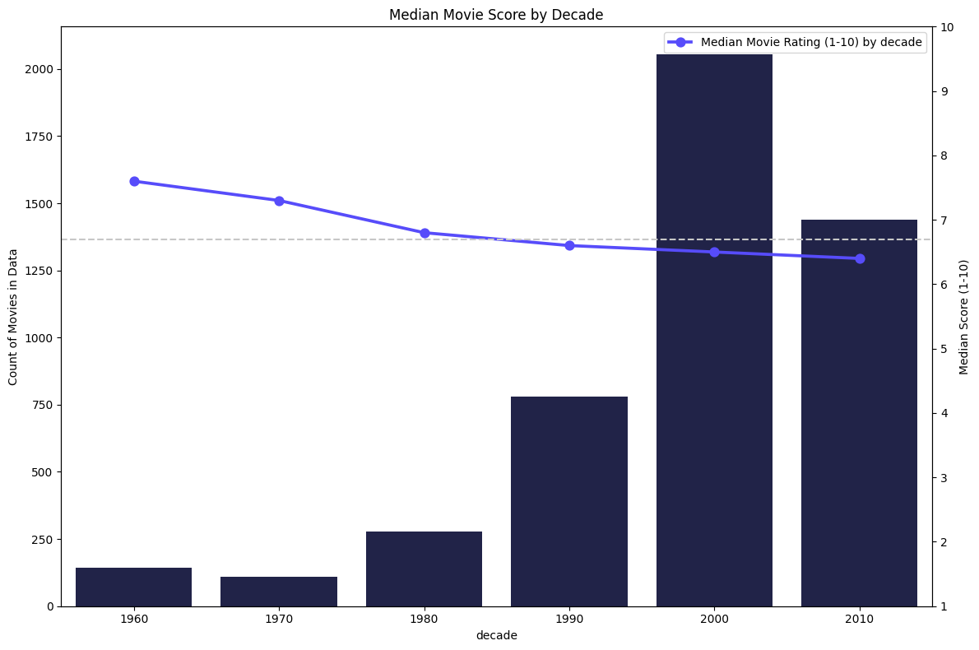
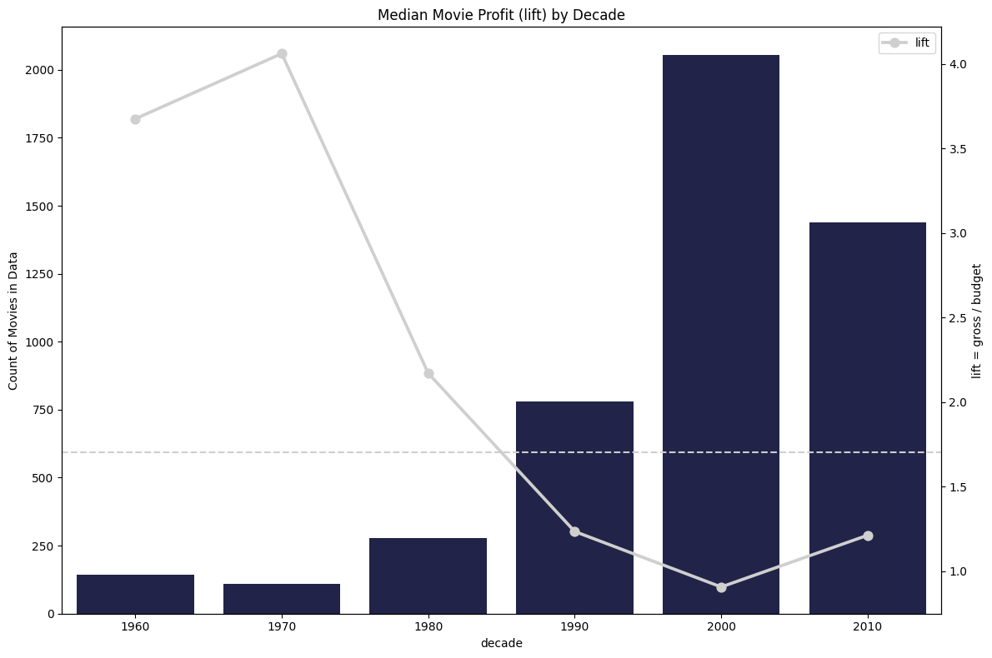
Scale of the Problem

Slide 5
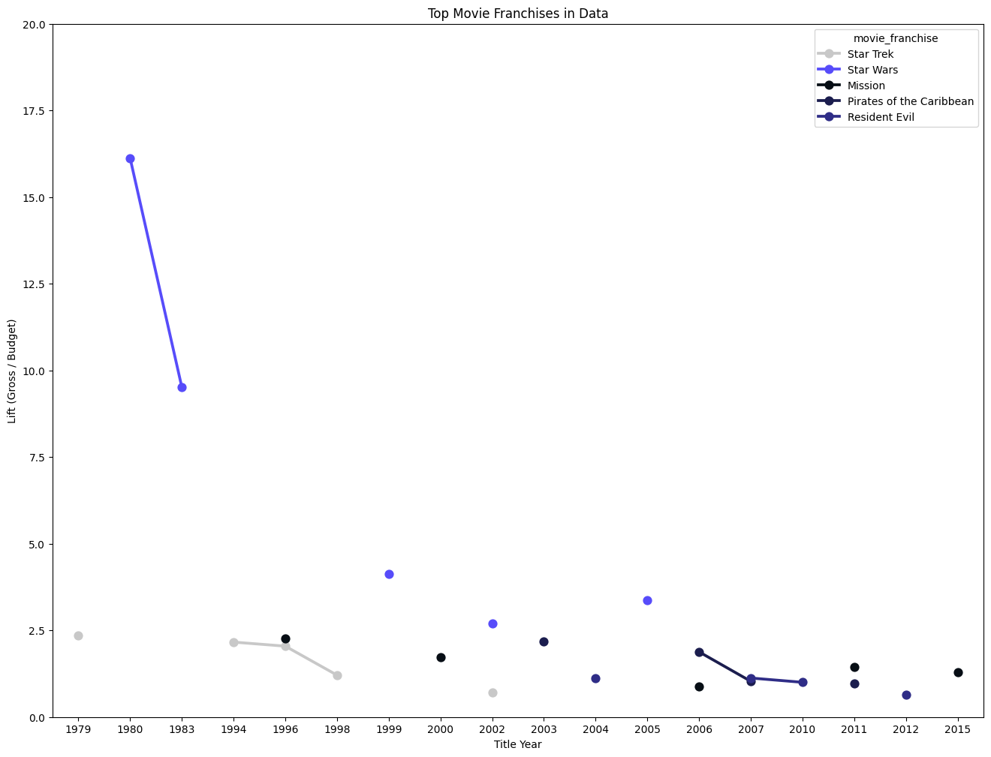
Franchises can’t save us

Slide 6
What goes into a Breakout Hit

