Slide 1
ODSC - 2009
Drools Advisor
(shortly to be renamed)

Slide 2
Agenda
Agenda
Who's involved
What does it do
What are the pieces
What is the model
The entry point
The rules
The java script engine
The execution server
questions

Slide 3



Who's involved
Collaboration between:
  Solnet New Zealand
  JBoss Drools
  Suncorp

Slide 4
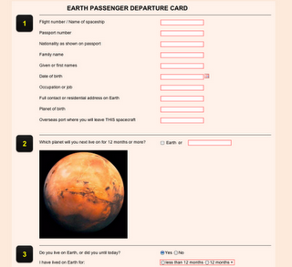
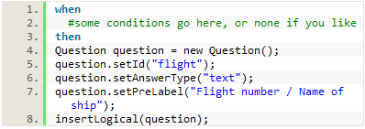
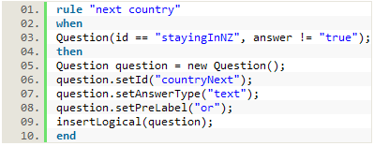
What does it do?
What does it do?
Designed to support question and answer style interactions where the set of questions are dynamic and potentially dependent on the answers received
Initial version targeted at interactive web applications, however technology independent and could be used in B2B scenarios, mobile devices, etc
Not a UI framework and designed to complement and work within existing frameworks such as Seam/JSF/Spring MV

Slide 5
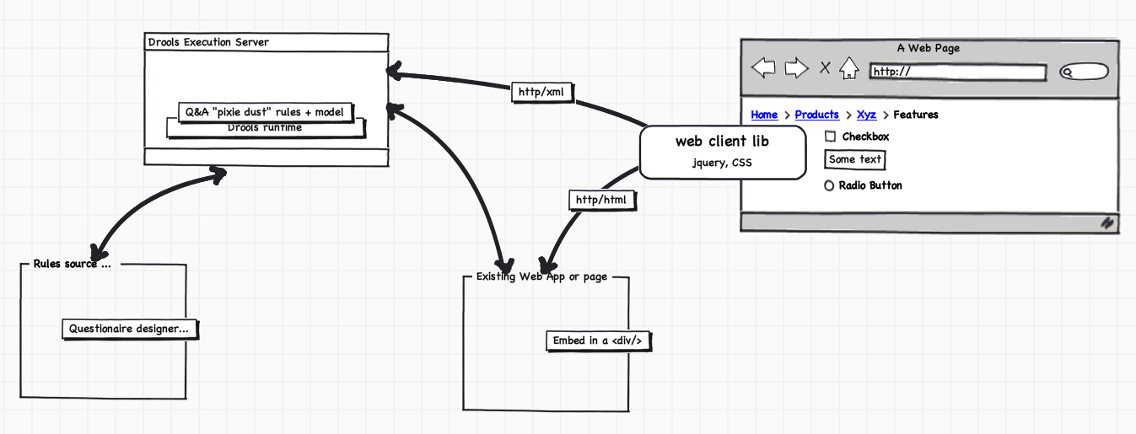
What are the pieces?
What are the pieces

Slide 6
What is the model?
Key domain entities are:
  Questionnaire
  Question
  Multi-Choice Question
  Notes
  Answers
  Invalid Answers
  Note: Insert domain model diagram

Slide 7
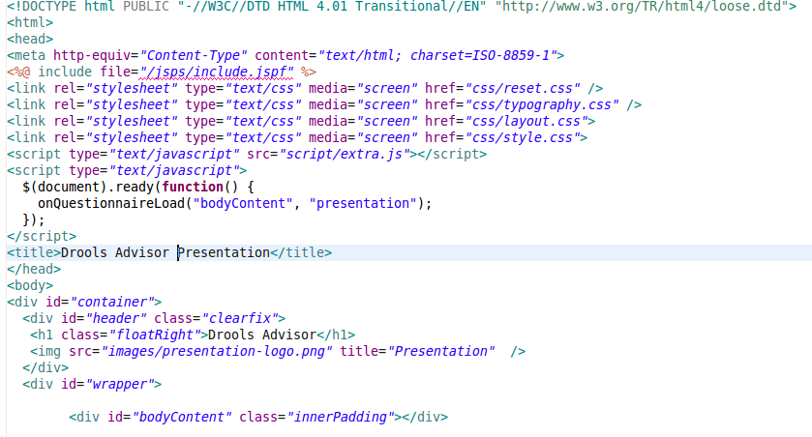
The Entry Point

Slide 8
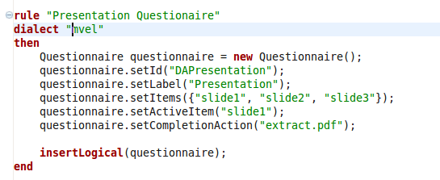
The Rules - Questionnaire

Slide 9
The Java Script
Explain how the java script calls the execution server and builds the internal dom and html elements.
Explain how the CSS styles interact with this and demonstrate changing of the styles – include the raw view

Slide 10
The Execution Server
Interface
Scala server
Rule Agents
Knowledge Bases

Slide 11
Questions?
Provide an initial set of questions ...

