Slide 1
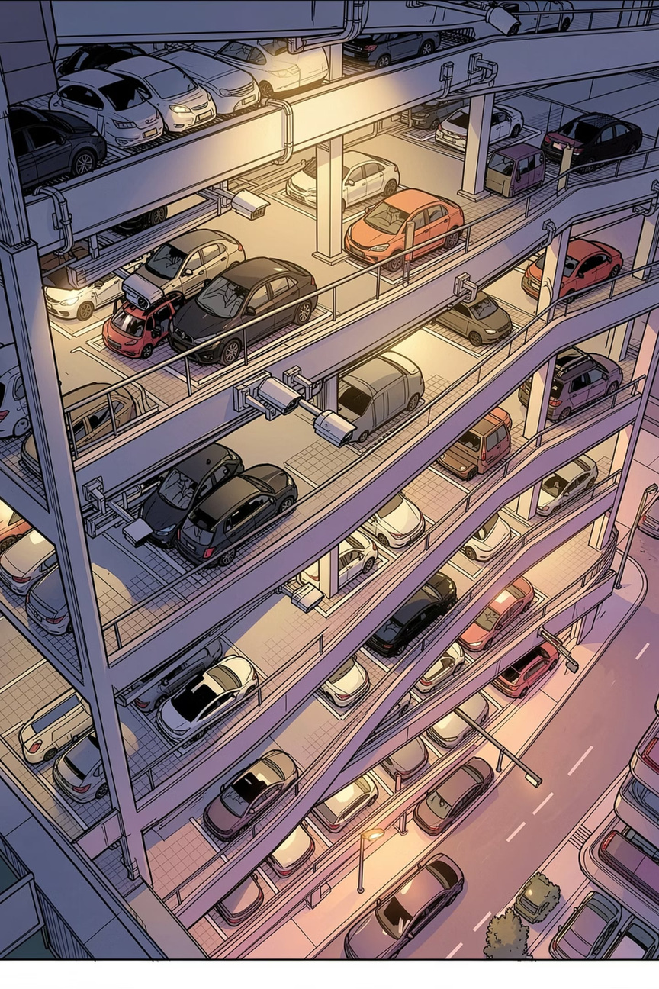
Real-Time Parking Space Occupancy Detection
A deep learning approach for decentralized, real-time parking occupancy detection using standard CCTV cameras — deployable on low-powered embedded devices.
IEMTRONICS 2022 · IEEE
NORTH SOUTH UNIVERSITY, DHAKA
Notes:
1

Slide 2
LITERATURE REVIEW
Evolution of Parking Occupancy Detection
Research has progressed from classical classifiers to deep CNN architectures, each addressing limitations in accuracy, scalability, and environmental robustness.
Classical ML
Texture-Based SVM
SVM, Bayesian classifiers with hand-crafted features — limited under shadows and lighting changes
LBP variants on ~700K images — better aggregation but still feature-engineering dependent
Temporal & 3D Methods
Deep CNN (This Work)
Background subtraction, 3D Bayesian frameworks — improved accuracy but high complexity
Mini-AlexNet / Mini-LeNet — generic, robust, deployable on Raspberry Pi
Notes:
2

Slide 3
LITERATURE REVIEW
Classical Machine Learning Approaches
Key Limitations
SVM + visual features [6]: Low accuracy under shadows and varying weather
SVM + neighbor correlation [3]: Color histograms of adjacent spots; light changes unaddressed
Bayesian classifier [7]: Corners, edges, wavelet features; partial improvement on lighting
3D Bayesian framework [8]: Models spots in 3D space; better accuracy but computationally heavy
Notes:
3

Slide 4

LITERATURE REVIEW
Temporal Analysis & Hybrid Methods
Background Subtraction [4]
Inter-Space Occlusion Handling [10]
Sensor-Fusion Approaches [11][12]
Gaussian-based frame differencing detects entering/leaving vehicles. Suffers from transient occlusions and cannot handle static obstacles.
Tracks entry/exit events to resolve spots hidden by neighboring vehicles. Requires temporal continuity and event modeling.
Vehicle navigation systems and smartphone sensors supplement vision. Adds hardware cost and integration complexity.
Notes:
4

Slide 5
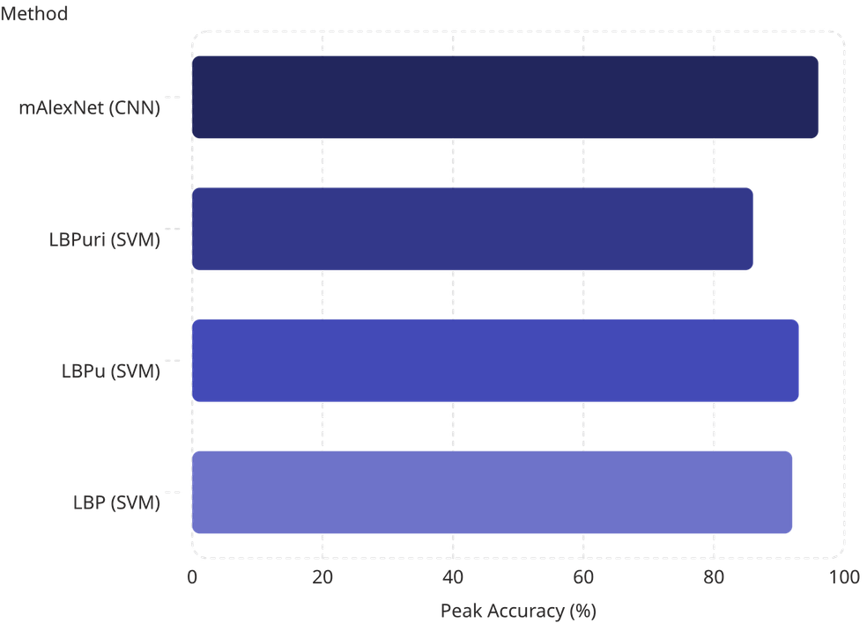
LITERATURE REVIEW
Texture-Based SVM: The LBP Family
Approach Overview [5][17][18][19]
Trains SVM classifiers on Local Binary Pattern texture features extracted from ~700,000 images across three cameras. Confidence aggregation via max/min functions improves detection.
LBP — Classical 256-dim texture descriptor
LBPu — Uniform patterns, 59-dim
LBPuri — Uniform + rotation invariant, 10-dim
Best among SVM variants but still outperformed by CNN on cross-dataset generalization.
Notes:
5

Slide 6
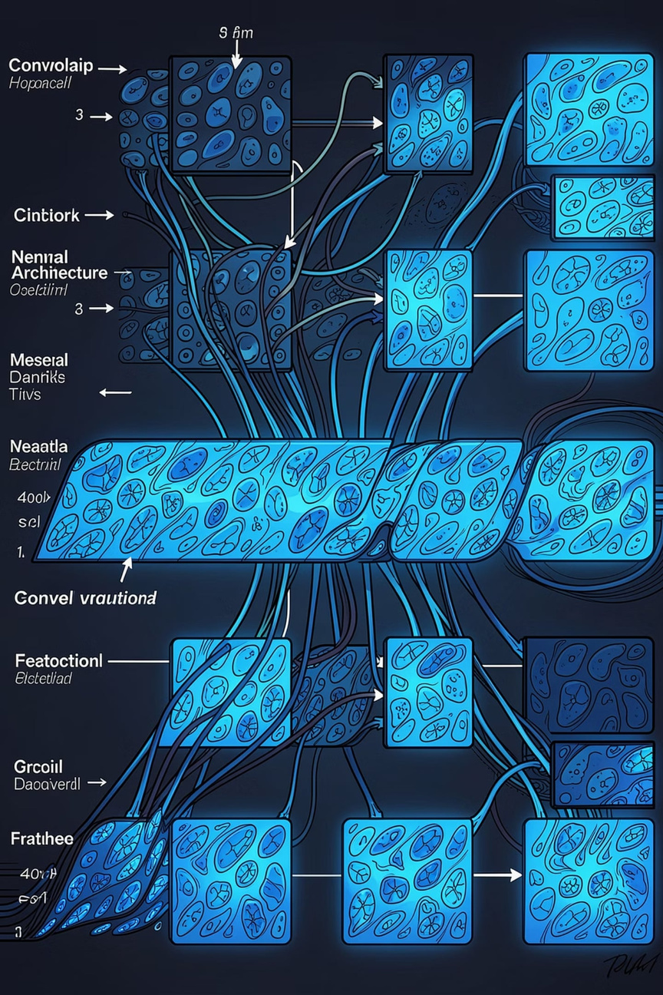

LITERATURE REVIEW
Deep Learning: The Turning Point
AlexNet [15]
LeNet [16]
Landmark CNN for ImageNet (1,000 classes). Inspiration for lightweight variants. High accuracy but computationally expensive.
Early CNN for digit recognition. Gaussian RBF output layer. Compact architecture suitable for binary tasks.
CNRPark Deep Learning [14]
Prior work using deep CNN for outdoor parking detection. This paper extends it to indoor environments with higher obstacle density.
Notes:
6

Slide 7


LITERATURE REVIEW
Research Gap & Motivation
What Prior Work Misses
This Paper's Positioning
Limited generalization — Most models trained on a single parking space; fail to transfer
Proposes a decentralized, camera-only solution using lightweight CNNs (mini-AlexNet, mini-LeNet) validated across three independent datasets (PKLot, CNRPark-Ext, custom indoor/outdoor) under diverse lighting and obstacle conditions.
Indoor environments — Low light, shadows, and artificial lighting poorly addressed
Centralized compute — Server-based pipelines create bottlenecks and increase cost
Goal: Binary occupancy classification runnable on Raspberry Pi with ≥80% accuracy across unseen environments.
Hardware dependency — Sensor-per-spot approaches scale poorly with cost
Notes:
7

Slide 8

LITERATURE REVIEW
Comparative Summary of Key Approaches
Approach
Core Method
Features Used
Key Limitation
Generalization
SVM [6]
Binary classifier
Visual regions
Shadows, light
Low
SVM + Neighbor [3]
SVM + correlation
Color histogram
Light changes
Low
Bayesian [7][8]
Probabilistic
Corners, edges, 3D
Complexity
Medium
LBP-SVM [5][17]
SVM + texture
LBP variants
Feature engineering
Medium
Temporal [4][10]
Background subtraction
Frame differencing
Occlusions
Medium
mini-AlexNet (Ours)
Deep CNN
Learned features
Embedded compute
High
Notes:
8

Slide 9
LITERATURE REVIEW
Positioning Within the Research Landscape
This work builds on prior deep CNN efforts [14] but extends them to indoor environments with higher obstacle density, multi-dataset cross-validation (PKLot, CNRPark-Ext, custom), and embedded deployment on Raspberry Pi — addressing gaps in generalization, lighting robustness, and cost-effective scalability left by classical ML and centralized vision systems.
✅ Decentralized
✅ Camera-only
✅ Embedded-ready
No central server
No per-spot sensors
Raspberry Pi viable
Notes:
9

Slide 10

LITERATURE REVIEW
Key Takeaways
1
Classical ML falls short on real-world variability
SVM and Bayesian methods struggle with shadows, lighting changes, and occlusions without extensive feature engineering.
2
Texture-based SVM improves but lacks transferability
LBP variants on large datasets achieve ~92% accuracy but remain dataset-specific and feature-dependent.
3
Deep CNN enables generic, embedded-ready detection
Mini-AlexNet achieves up to 96% accuracy across unseen datasets — validating CNN generalization and edge deployability.
Notes:
10

Slide 11
[1] A. N. Belbachir, *Smart Cameras*, vol. 2. Springer, 2010.
[2] Y. Bengio, "Learning Deep Architectures for AI," *Foundations and Trends® in Machine Learning*, vol. 2, no. 1, pp. 1–127, 2009.
[3] Q. Wu, H. Chen, W. Su, S. Y. Chen, W. C. Wang, and T. Chen, "Robust Parking Space Detection Considering Inter-Space Correlation," in *Proceedings of the IEEE International Conference on Multimedia and Expo (ICME)*, 2007.
[4] C. G. del Postigo, T. J. Torres, and M. J. Menéndez, "Vacant Parking Area Estimation Through Background Subtraction and Transience Map Analysis," *IET Intelligent Transport Systems*, vol. 9, pp. 835–841.
[5] P. R. de Almeida, L. S. Oliveira, A. S. Britto Jr., E. J. Silva, and A. L. Koerich, "PKLot: A Robust Dataset for Parking Lot Classification," *Expert Systems with Applications*, vol. 42, no. 11, pp. 4937–4949.
[6] N. Dan, "Parking Management System and Method," U.S. Patent 10/066,215.

